Slide 1




MODULE 7 · TRAINER PRESENTATION
Time Management
Notice where your time goes, protect rest, family and learning, and plan your week in small, flexible steps.
About 3 hours
3 units
Ages 18-30
B1-B2 English
SMILE
Support Young Migrants Integration in the Labour market in Europe
Erasmus+ KA220-YOU · 2024-1-TR01-KA220-YOU-000256357
Empowerment Through Skills · Inclusion Through Opportunity
Notes:
Module 7 of the SMILE soft-skills curriculum. Duration in the curriculum: about 3 hours (1.5 h theoretical input and guided discussion, 1.5 h hands-on learning). It can run as one 3-hour session or as two shorter sessions.
Welcome participants, introduce yourself and the SMILE project in one sentence: an Erasmus+ project of seven partners in Türkiye, Greece, Italy, Germany and the Netherlands that helps young migrants enter the labour market.
Say the core message of the module from the start: "This is not about working harder or faster. It is about getting back some control of your time, and protecting your well-being." The curriculum is explicit that time management is not "productivity pressure" but a supportive competence linked to well-being, stress regulation, decision-making and sustainable integration.

Slide 2




HOW WE WORK TOGETHER
Our agreement for this module
Any English is good English
Your story belongs to you
Listen to understand
“Pass” is always OK
We listen to ideas, not grammar. Nobody corrects your language here. Mix words from other languages if it helps.
You never have to share your migration story. Our examples use invented characters.
One voice at a time. Every question is a good question.
You can skip any activity or question. Take a break when you need one.
Module 7 · Time Management
2
Notes:
Co-create or confirm the agreement before content starts. Write it on a flipchart and keep it visible for the whole module.
Why: many young refugees carry heavy stress. A review of 26 studies (5,143 adult refugees and asylum seekers) found PTSD and depression in about 31.5% each (Blackmore et al., 2020, PLOS Medicine). Never ask participants to tell their migration story; use the constructed characters on the slides.
Language: do not correct grammar or pronunciation during sharing. Model the phrases instead (the "useful phrases" slides).
For this module, add two rules: we never judge anyone's schedule, and we never ask what happens at appointments with authorities (court dates, asylum interviews, therapy). In the timeline activity, everyone may draw a persona's day instead of their own.
Watch your own language: avoid "lazy", "waste", "efficient", "maximise". Use "control", "energy", "protect", "small step" (research note, trauma-informed tips, based on SAMHSA principles as summarised by Fiolet et al., 2026).

Slide 3
MODULE MAP
Three units, from awareness to practice
01
Unit 1: Understanding time management
02
Unit 2: Time management in the reality of young migrants
03
Unit 3: Practical strategies and good practices
Taking control of time: definition, a life skill not pressure, plan, prioritise, focus, balance, myths. Time awareness activity.
Stress and waiting, procrastination, the phone, cultural time norms, well-being. Case study.
Time to put it into practice: awareness, priorities, flexible plans, focus, micro-actions, habits, reflection. Try one strategy.
≈ 50 min
≈ 60 min
≈ 55 min
Module 7 · Time Management
3
Notes:
The curriculum fixes only the total (about 3 hours: 1.5 h input, 1.5 h practice) and gives no time per unit. The minutes on this slide are a suggestion from the SMILE research note: 10 min opening + Unit 1 (20 input + 30 practice) + Unit 2 (30 + 30) + Unit 3 (25 + 30) + 5 min closing = 180 min. Input and discussion then add up to about 1.5 h and practice to 1.5 h, as the curriculum requires.
Two-session option: Session A (≈ 2 h) = opening + Units 1 and 2; at the end, each participant picks one small strategy to try for 5-7 days. Session B (≈ 1 h) = Unit 3 + reflection on how the strategy worked. This fits the Unit 3 activity "try one small strategy and reflect on its effects" particularly well.
Add a 10-minute break in the single-session format. Rest is part of the plan in this module, so model it.

Slide 4
LEARNING OUTCOMES
By the end of this module, you will be able to
1
Explain what time management means and why it is important for daily life, education and employment.
4
Apply simple and realistic tools for prioritisation, planning and attention management.
2
Identify the factors that affect your personal use of time, including stress, emotions and digital environments.
5
Develop small, sustainable routines that support balance and well-being.
3
Recognise common time management challenges such as procrastination, overload and distraction.
6
Reflect on your own progress (carry out a self-assessment) and adapt your time management strategies over time.
Module 7 · Time Management
4
Notes:
These are the six learning outcomes of the SMILE curriculum (English edition; only "their" was changed to "your" for participants).
Assessment is formative and reflective: no grades, no comparison between participants. The curriculum names observation of participation, reflection questions, the self-diagnosis questionnaire (end of this deck) and feedback during exercises.

Slide 5
WHY THIS MATTERS
It helps how you feel more than how much you do
Bigger bar = stronger link. Time management goes together with feeling good more than with doing more.
Less stress too: r = -.29 with stress and -.36 with psychological distress.
Be careful: most studies measure once, so these are links, not proof of cause.
Source: Aeon, Faber & Panaccio (2021), PLOS ONE, Tables 4-7: meta-analysis of 158 studies, 53,957 participants (students and employees)
Module 7 · Time Management
5
Notes:
This is the key message of the module. The largest meta-analysis so far (158 studies, 490 effect sizes, 53,957 people) found that time management is linked more strongly to life satisfaction (r = .43) and overall well-being (r = .31) than to job performance (r = .26) or academic achievement (r = .26).
The authors write that this "challenges the common perception that time management first and foremost enhances work performance" (Aeon et al., 2021, abstract). They also report that the link with job performance has grown over the years: today's workplaces reward it more than in the 1990s.
How to explain r without statistics: "The longer the bar, the more two things go together. Look which bars are longest: life satisfaction and well-being." Ask: "Why could this be?" Collect 2-3 answers.
Honest caveat for curious participants: most studies are cross-sectional, so we see associations, not proof of cause and effect.

Slide 6



WHY THIS MATTERS
Many young workers do not choose their hours
7 in 10
1 in 5
1 in 3
young employees (15-34) say their employer mainly decides their working time (69.6%). Only 7.7% decide fully.
young employees (15-29) work shifts (20.6%). In Greece it is 37.2%.
young employees (15-34) were contacted about work in their free time: 12.4% several times, 21.4% occasionally.
For many of us, time management means managing the time around a schedule that others set, and knowing its legal limits.
Source: Eurostat lfso_19fxwt01 and lfso_19fxwt14 (2019, EU-27) · Eurostat lfsa_ewpshi (2025, EU-27). All young employees, not only migrants.
Module 7 · Time Management
6
Notes:
Say clearly: "If you have little control over your hours, that is not a personal failure." Even time-management research admits it: "Time management assumes that the workplace is suitable for planning one's workday and being able to say 'no' to more work, whereas in practice, this is often not the case" (Claessens, 2004, p. 26).
More context (Eurostat 2025, employees 15-29, EU-27): one in three works evenings (33.8%), one in four works Sundays (25.4%). Among low-educated young employees, 81.3% say the employer decides their working time (2019). Eurostat does not break these tables down by citizenship, so they describe all young employees.
The schedule of many participants is fragmented: language course, part-time or shift job, appointments with authorities, care duties and calls with family. Non-EU employees are also twice as likely to have a temporary contract (22.1% vs 10.7%, Eurostat lfsa_etpgan, 2025), so routines change with every new job.
Ask for a show of hands: "Who has a schedule that someone else decides: a rota, a course timetable, an appointment?" Most hands go up. That is the starting point of the module.

Slide 7


01
UNIT 1 · ≈ 50 min
Understanding time management
Taking control of time: what time management is, what it is not, and how to balance a full week.
Definition
Not pressure
Plan, prioritise, focus
Balance and myths
Module 7 · Time Management
7
Notes:
Unit 1 introduces the core concept in a non-judgemental and accessible way (curriculum wording). Suggested timing: 20 min input and discussion + 25-30 min time awareness activity. The times are a suggestion; the curriculum does not split the 3 hours by unit.

Slide 8
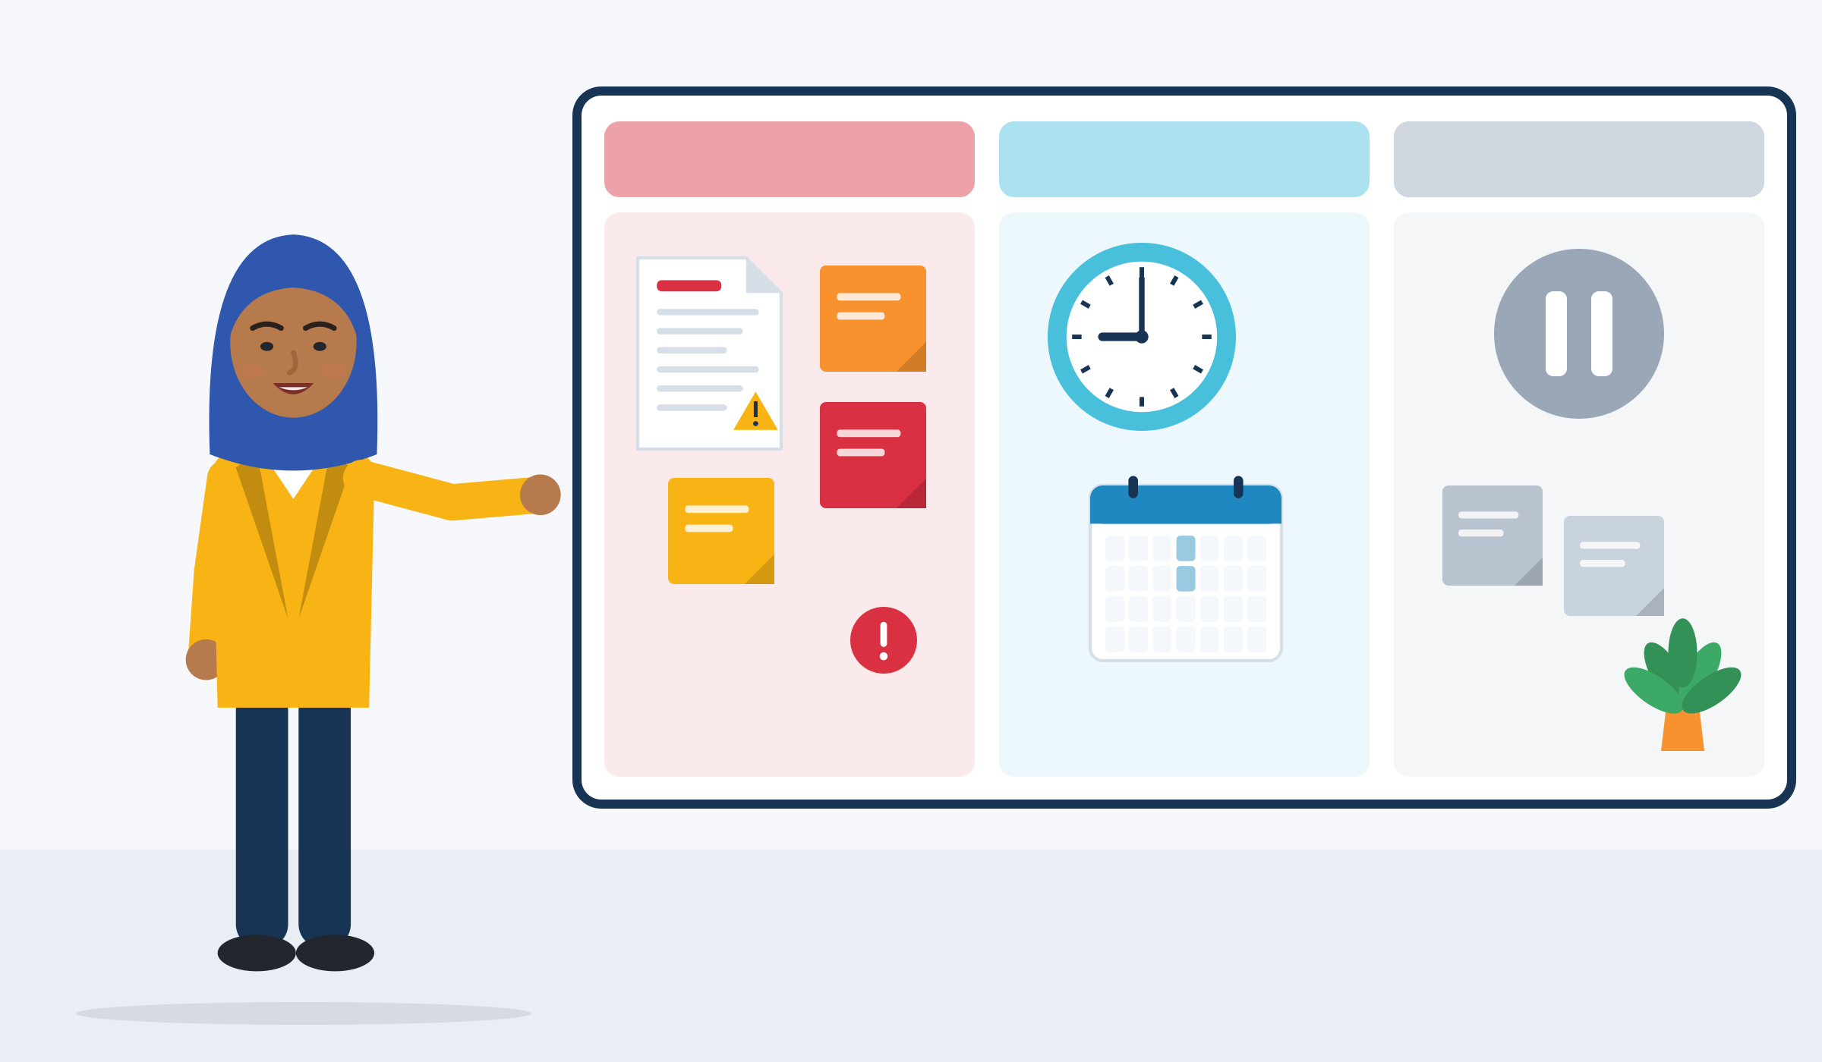
DEFINITION OF TIME MANAGEMENT
What is time management?
In short
What to do
When
What can wait
Time management: small daily decisions. What to do, when, and what can wait.
Control, not speed: you decide how to use the time you have.
EU key competence: "effectively manage time and information".
CV skill (ESCO): "manage time", "prioritise tasks", "plan deadlines".
Research definition: decisions that “structure, protect, and adapt” your time.
Source: Aeon & Aguinis (2017), p. 311, as quoted in Aeon et al. (2021) · Council Recommendation on key competences (2018), in Sala et al. (2020), LifeComp, p. 11 · ESCO skill "manage time"
Module 7 · Time Management
8
Notes:
Research definition (Aeon & Aguinis, 2017, p. 311): "A form of decision making used by individuals to structure, protect, and adapt their time to changing conditions." Control, not speed: you decide how to use the time you have, even when others decide part of your day. The key competence wording belongs to "learning to learn"; ESCO lists "manage time" plus "prioritise tasks" and "plan deadlines".
Start with a question before the slide: "What does time management mean to you? One word." Write the words on the flipchart. Typical answers: "discipline", "calendar", "stress". Keep them for the next slides.
The definition has three verbs: structure, protect, adapt. They are the backbone of this module (next slide).
Employability link: ESCO lists "manage time" as a transversal skill ("Plan the time sequence of events, programmes and activities, as well as the work of others"). Participants can use the exact ESCO wording in Europass CVs. Cedefop's second skills survey (2021, 46,213 employees aged 25-64) found that 75% are often or always able to plan their work activities, and for 63% reacting to situations that could not be anticipated is usual: work needs planning AND flexibility.

Slide 9
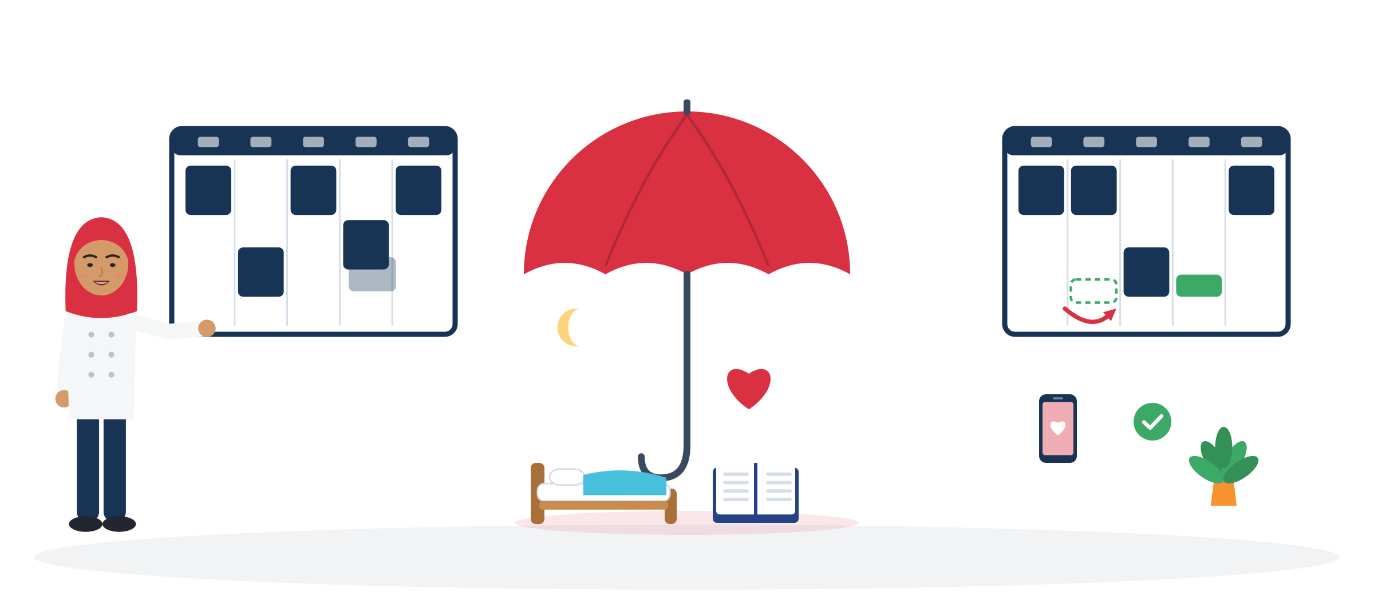
TAKING CONTROL OF TIME
Three verbs: structure, protect, adapt
Control of time
Structure
Protect
Adapt
Structure: fixed blocks first: shifts, course, appointments.
Protect: sleep, family and learning, like appointments.
Adapt: life changes, the plan changes. No guilt, just a new version.
Source: Aeon & Aguinis (2017) via Aeon et al. (2021) · Macan (1994) process model, via Claessens (2004) and Claessens et al. (2007)
Module 7 · Time Management
9
Notes:
The mechanism behind time management is the feeling of control. In Macan's (1994) model, planning gives "a sense of mastery over how one allocates one's time", and this perceived control of time lowers job tension and raises satisfaction. A review of 32 studies (Claessens et al., 2007) found that time-management behaviours relate positively to perceived control of time, job satisfaction and health, and negatively to stress; the link with performance "is not clear".
Example (constructed): Amira cannot choose her cleaning shifts. She can prepare her bag the night before (structure), use the 40-minute tram ride for vocabulary and protect one evening a week for calling her mother (protect), and move that call when the rota changes (adapt).
Ask: "Which verb is easiest for you? Which one is hardest?" Pairs, 2 minutes. No one has to share their answer with the group.

Slide 10
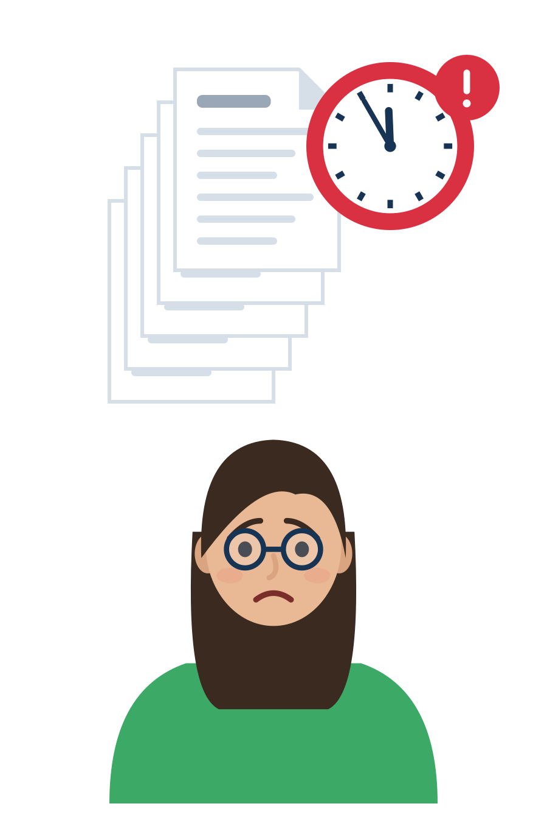
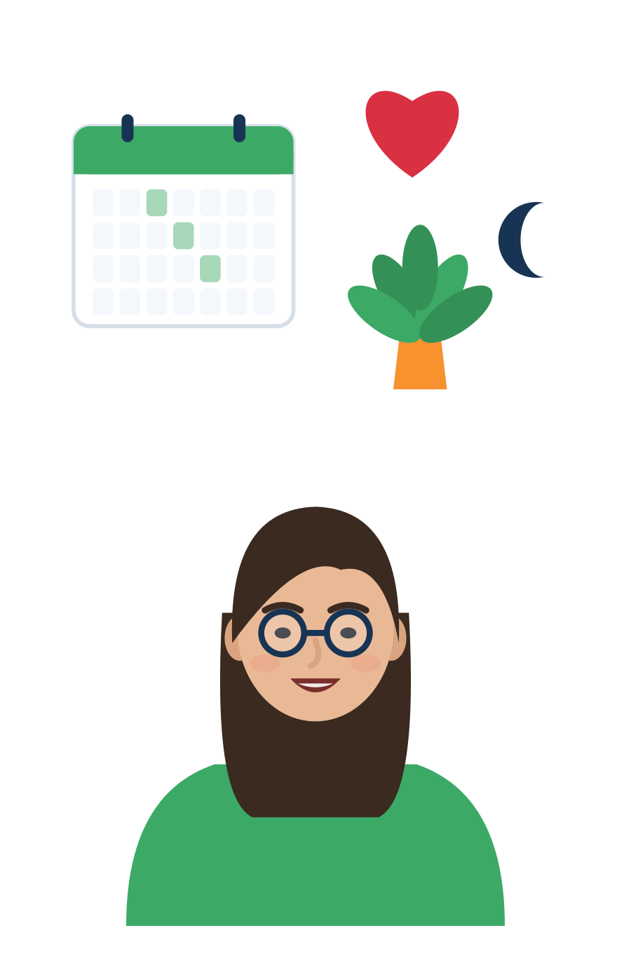
NOT PRODUCTIVITY PRESSURE, BUT A SKILL THAT SUPPORTS LIFE
Time management is not a race
Productivity pressure
A skill that supports life
Do more, faster, every day.
Rest is wasted time.
A bad day means you failed.
One perfect system for everyone.
Feel more in control and less stressed.
Rest, family and learning are part of the plan.
Plans change: you adapt and try again.
Small tools that fit your situation.
In a German trial, training raised the feeling of control and lowered stress. Performance did not change.
Source: Häfner & Stock (2010), The Journal of Psychology: randomised trial with 71 employees (training n = 35, waiting list n = 36)
Module 7 · Time Management
10
Notes:
This is the curriculum's central stance: time management is "a supportive competence linked to well-being, stress regulation, decision-making and sustainable integration", with flexibility and self-compassion.
Evidence: in a German randomised trial, time-management training increased perceived control of time and decreased perceived stress, but had no effect on performance indicators. Participants found the techniques useful, but "there were large differences concerning the actual use of the various techniques" (Häfner & Stock, 2010). Lesson for this module: let people choose the tools that fit them.
Go back to the flipchart words from the definition slide. Ask: "Which of our words belong to the left side, which to the right?" Move "discipline" or "stress" to the left and invite new words for the right.

Slide 11
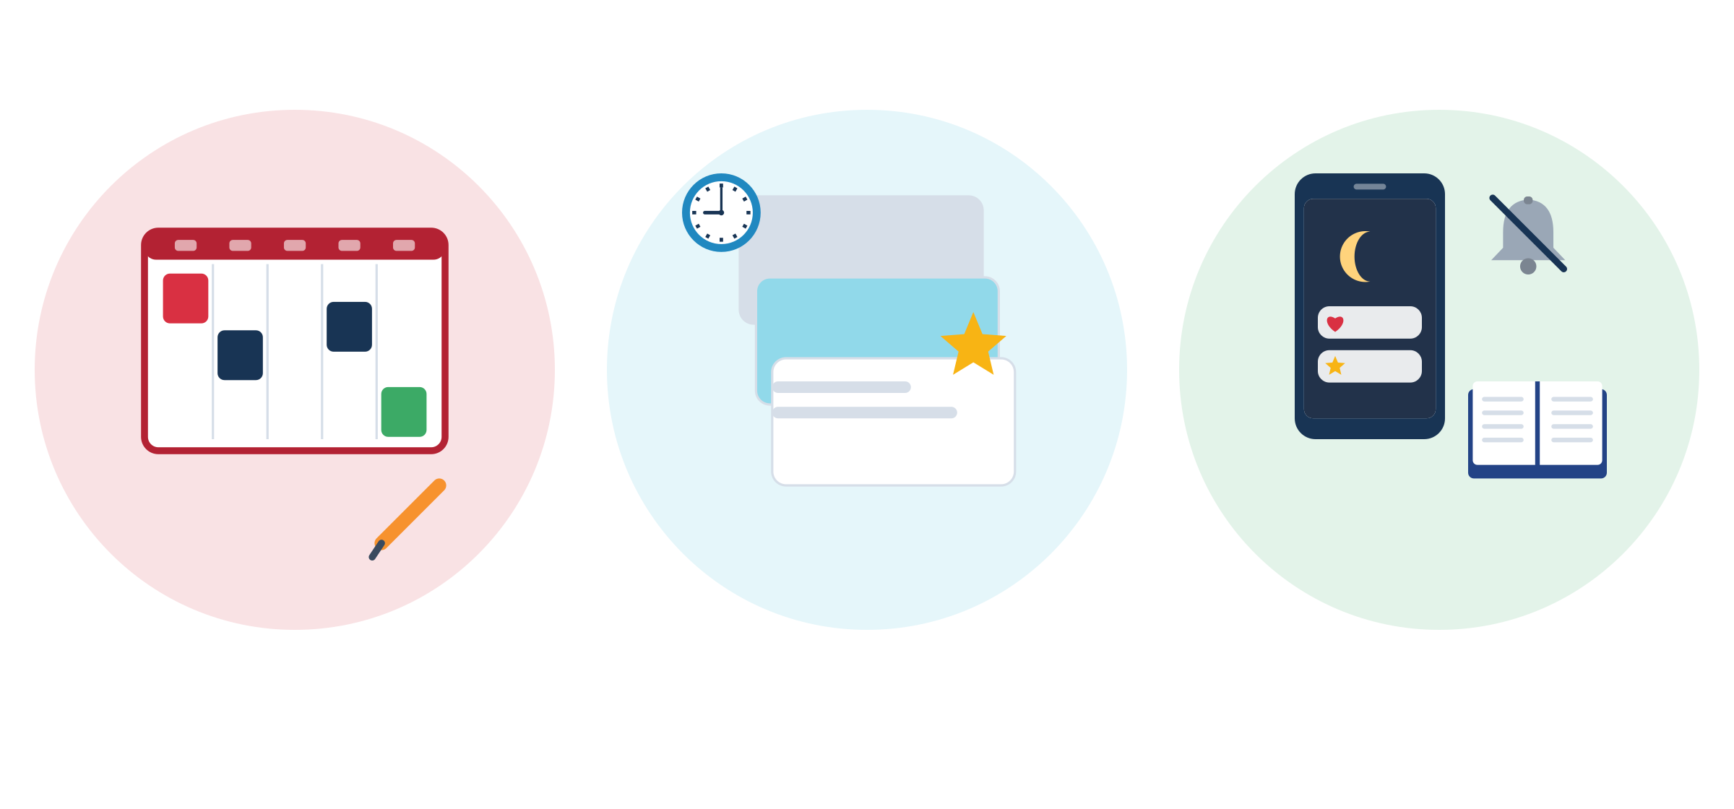
PLANNING, PRIORITISATION AND ATTENTION MANAGEMENT
Three everyday skills: plan, prioritise, focus
Plan: decide when, and write it down so your head does not have to hold it.
Prioritise: what matters most? Important tasks often feel less urgent, so give them a time.
Focus: alerts pull attention away, even when you do not answer them.
All three: a feeling of control. That feeling lowers stress.
Plan
Prioritise
Focus
Source: Claessens (2004); Claessens et al. (2007) · Stothart, Mitchum & Yehnert (2015), notifications and attention
Module 7 · Time Management
11
Notes:
These are the three skills the curriculum names for Unit 1. Keep this slide short (3 min): it is a map, and Unit 3 practises each skill with a tool.
Coming in Unit 3: urgent or important? A week in three layers. If-then plans. A 5-minute check of your phone notifications.
Evidence for "even when you do not answer": phone notifications alone "significantly disrupted performance on an attention-demanding task", without any interaction with the phone (Stothart et al., 2015).
Quick check: "Raise one finger if planning is easiest for you, two for prioritising, three for focusing." Notice the variety: people start from different places, and that is fine.

Slide 12



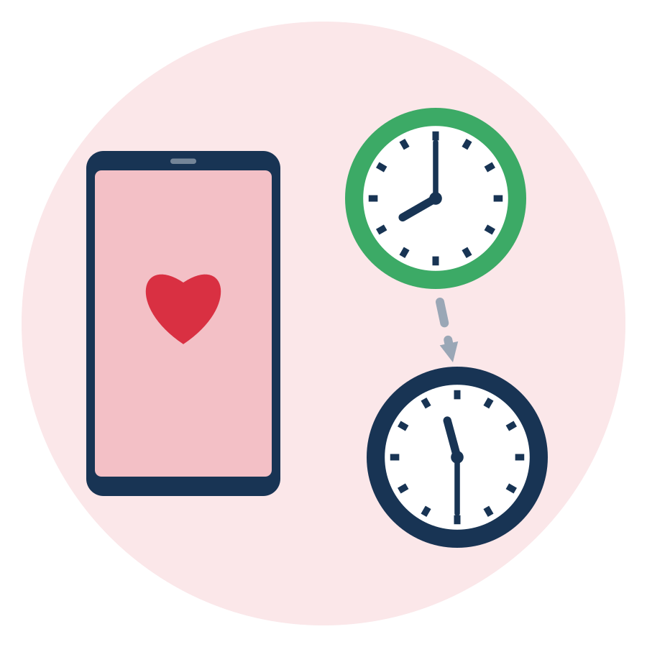
BALANCING WORK, LEARNING, REST AND PERSONAL NEEDS
Work, learning, rest and personal needs
Work
Learning
Rest
Personal needs
Shifts, commute, overtime. Often set by others: plan around them, know the limits.
Language course, homework, exams. Finishing language courses goes with higher employment.
Adults (18-60) need 7 or more hours of sleep. Rest is part of the plan, not a reward.
Family, friends, faith, care duties. 20:00 in Berlin is 23:30 in Kabul in winter.
Source: CDC, About Sleep (citing Watson et al., 2015) · Brücker et al. (2024), IAB-Kurzbericht 10/2024 · time zones from the IANA time-zone database
Module 7 · Time Management
12
Notes:
Balance does not mean equal parts. It means no part is always the one that gets cut. Ask: "In your week, which of the four is cut first when time is short?" Most people answer "rest" or "personal needs".
Evidence: short-term sleep loss hits simple attention hardest (lapses, g = -0.78; Lim & Dinges, 2010). In Germany, completing BAMF language programmes is positively associated with refugees' employment (Brücker et al., 2024), so learning time is an investment, not a luxury.
Family across time zones: when it is 20:00 in Berlin in winter, it is 22:00 in Damascus, Mogadishu and Istanbul, 23:30 in Kabul and 00:00 in Karachi (one hour earlier in summer time). Calls home often fall late at night, close to an early shift. Treat family time as a protected block, not as "leisure that can be cut".
Commuting is time too: in 2019, young workers (15-34) in the EU spent on average 25 minutes on their commute, and about 8% needed 60 minutes or more (Eurostat lfso_19plwk28).

Slide 13

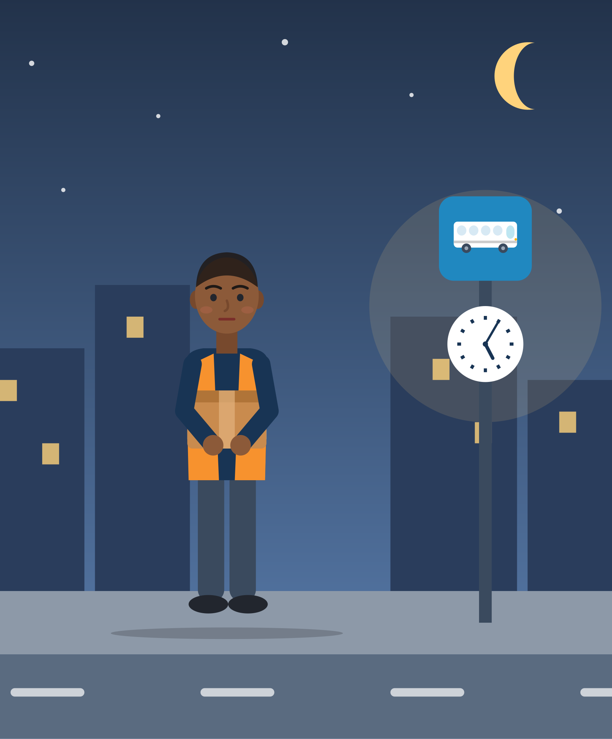
ILLUSTRATIVE SCENARIO
The 06:00 start and the long bus ride
Darius, 22
First job in a distribution centre near Rotterdam
DISCUSS
Is Darius lazy? What does his situation ask of him?
What could he prepare the evening before?
Which part is his responsibility, and which part is the employer's (rota, transport)?
Logistics
Netherlands
Early shift
Darius's shift starts at 06:00. The night bus takes 55 minutes, so he wakes up at 04:40. In the evening he often talks to friends and family until late. In week one he is late twice. He thinks: “I am lazy. Other people can do this.”
Grounded in: 20.6% of young EU employees work shifts, 22.0% in the Netherlands (Eurostat lfsa_ewpshi, 2025); about 8% of young workers commute 60+ minutes (Eurostat, 2019); adults need 7+ hours of sleep (CDC).
Module 7 · Time Management
13
Notes:
Illustrative scenario (constructed). Use it for the topic "balancing work, learning, rest and personal needs". Groups of 3, 6 minutes, then 3 minutes of plenary.
Good answers: an evening "launch routine" (bag, clothes and lunch ready; phone on Bedtime mode at 21:30) and an if-then plan for the bus ("If the 05:05 bus is late, then I text my team leader at once"). Unit 3 comes back to both.
Important: also name what is NOT his job. He can ask whether a later start or a different shift pattern is possible, or whether colleagues share rides. The point is not to blame him for a rota and a bus timetable he did not choose.

Slide 14


MYTH OR FACT?
Common misconceptions about time management
“Time management means working more and faster.”
It is linked more to life satisfaction (r = .43) and well-being (r = .31) than to job performance (r = .26).
“A good plan always works.”
People usually underestimate how long their own tasks take. Good plans include buffer time.
“If you delay things, you are lazy.”
Delay is often about bad feelings: unpleasant tasks and low confidence are strong predictors of procrastination.
“Be hard on yourself and you will stop delaying.”
Students who forgave themselves for procrastinating procrastinated less before the next exam.
“My willpower is used up by the evening.”
A 23-lab replication found this effect close to zero. Tiredness from shifts and short sleep is real, though.
Source: Aeon et al. (2021) · Buehler, Griffin & Ross (1994) · Steel (2007); Sirois & Pychyl (2013) · Wohl, Pychyl & Bennett (2010) · Hagger et al. (2016), d = 0.04
Module 7 · Time Management
14
Notes:
Run it as a quick vote: read each myth aloud; participants stand up (or raise a card) if they think it is true. Then reveal the fact. 8-10 minutes.
Background: procrastination is strongly predicted by task aversiveness, low self-efficacy and impulsiveness (Steel, 2007), and often serves short-term mood repair (Sirois & Pychyl, 2013). Ego depletion: a preregistered replication in 23 labs found d = 0.04 (95% CI -0.07 to 0.15) (Hagger et al., 2016). The self-forgiveness study is Wohl et al. (2010); the sample size is reported differently in secondary sources, so we do not quote it.
One more myth for later: "A new habit takes 21 days." Keep it for Unit 3 (the real median was 66 days).
Facilitation tip: when someone believed a myth, say "Many people think so, the research surprised me too." No one should feel caught out.

Slide 15
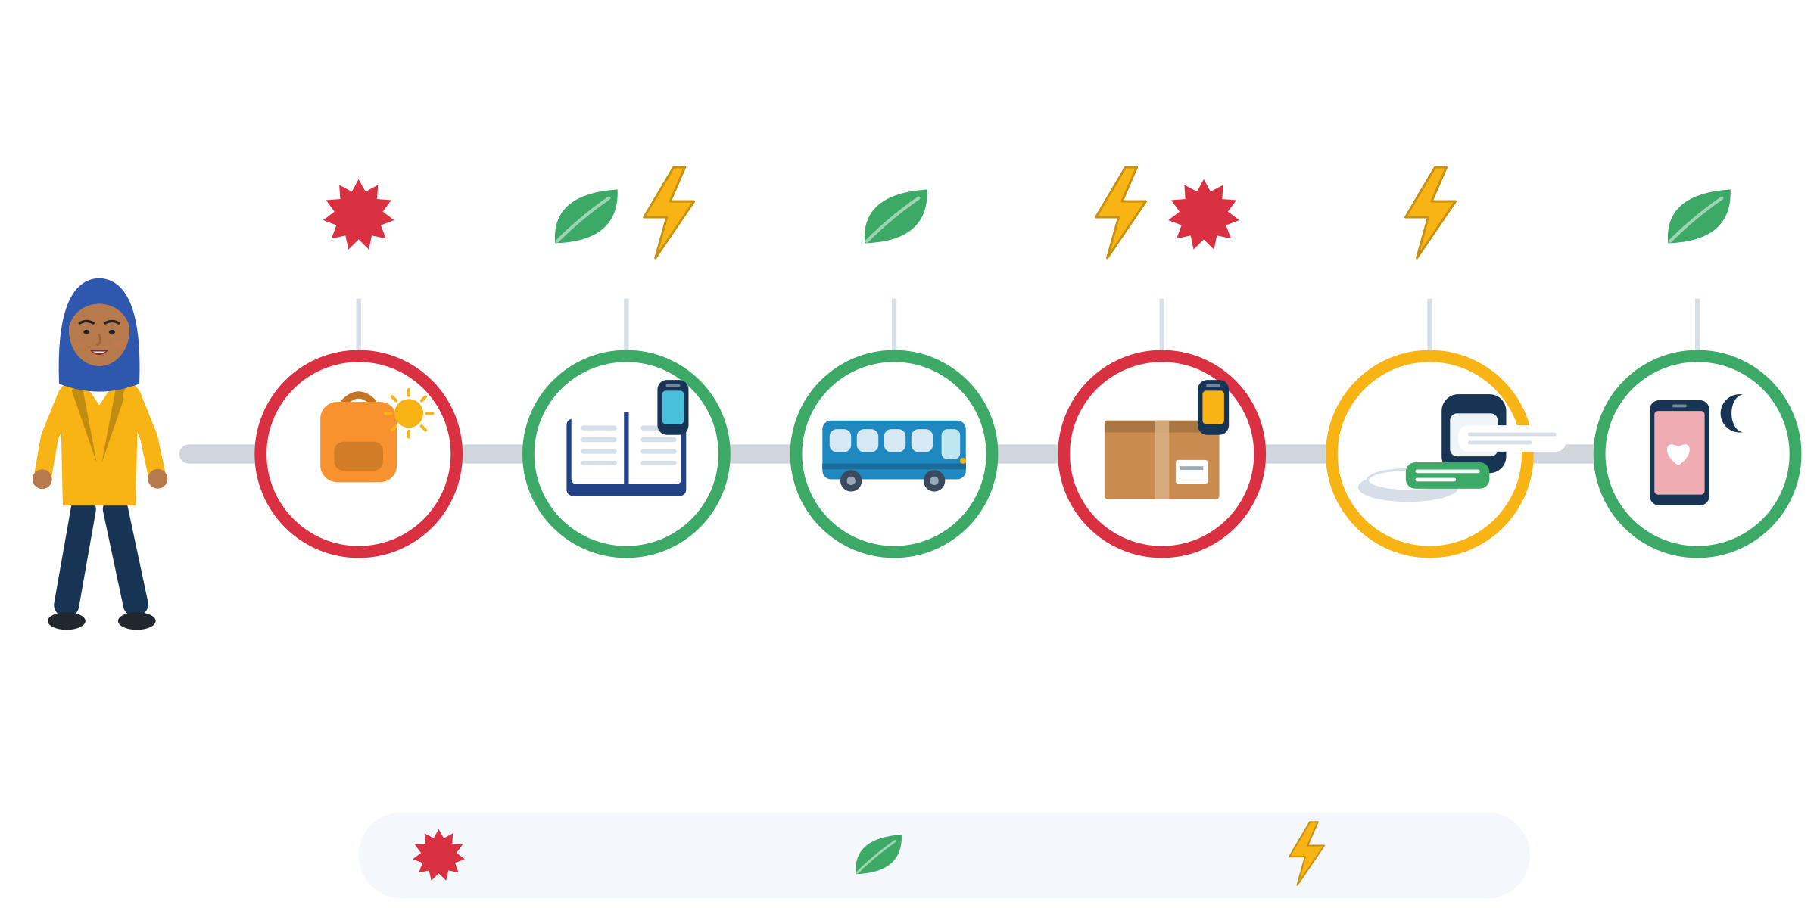
MINI ACTIVITY: TIME AWARENESS
Example: Nour's day on a time awareness chart
07:00
09:00
13:00
14:00
20:00
22:30
Who decides?
07:00 stress: rushing, no breakfast. The school.
09:00 calm, but the phone buzzes 12 times. Mixed.
13:00 calm: 30 minutes of music. Nour.
14:00 stress: the rota changes by message. The employer.
20:00 interrupted by group chats. Mixed.
22:30 calm and important, but late. The time zone.
Brother to school
Integration course
Bus to the delivery hub
Delivery shift
Dinner and homework
Call with family
Stress
Calm
Interruption
Source: Persona constructed for SMILE (research note, scenario S11). Time awareness: Claessens (2004), p. 19
Module 7 · Time Management
15
Notes:
Illustrative persona (constructed): Nour, 21, lives in the Netherlands. She has a civic-integration course three mornings a week, a 20-hour delivery job with changing shifts, a monthly appointment with the municipality and care duties for her younger brother.
Use this slide to model the activity before participants draw their own chart. Point out the three markers: stress, calm and interruption. On the real worksheet they use colours (red = stress, green = calm, a lightning symbol = interruption).
Ask: "Where does Nour feel calm? What interrupts her? Which parts does she decide, and which parts do others decide?" This prepares the sorting step of the activity.
Why it matters: the first component of time management is time assessment, being aware of your own use of time (Claessens, 2004, p. 19). You cannot change what you cannot see. Observation, not judgement.

Slide 16





ACTIVITY
Time awareness: my day on one line
TIME
25-30 min
STEPS
Choose what to draw: yesterday, a typical day, or a persona card. You decide what you show.
Draw blocks on the 00:00-24:00 line with words or icons: bed, bus, work, course, phone, family.
Colour it: red = stress, green = calm, lightning = interruption.
Pairs: share one calm moment and one interruption, only if you want to.
Group: what creates calm? What interrupts us? Sort the answers into “others decide”, “I decide” and “mixed”.
GROUP
Individual, then pairs, then whole group
MATERIALS
Time awareness chart (24-hour line), coloured pens, persona cards
DEBRIEF
GOAL
Notice stress, calm and interruptions in a day, without judging
Where in your day do you feel most in control?
Which interruption could you reduce a little?
Which part of your day is not your responsibility?
Module 7 · Time Management
16
Notes:
Curriculum mini activity (Unit 1): a "time awareness" exercise that uses daily timelines to explore stress, calm moments and interruptions. Timing: 3 min set-up, 10 min drawing, 7 min pairs, 7 min plenary.
Trauma-informed: some days include court dates, therapy, irregular work or very painful moments. The persona option protects privacy; announce it clearly and without explanation needed. Never compare timelines between participants. Say: "A messy day is normal for people in transition."
Language: allow drawing instead of writing, and any language on the chart. Read the instructions aloud.
Keep the "others decide / I decide / mixed" flipchart visible: Unit 2 and the rights slide come back to it. Extra debrief question if time allows: "What is one calm moment you want to protect?"

Slide 17
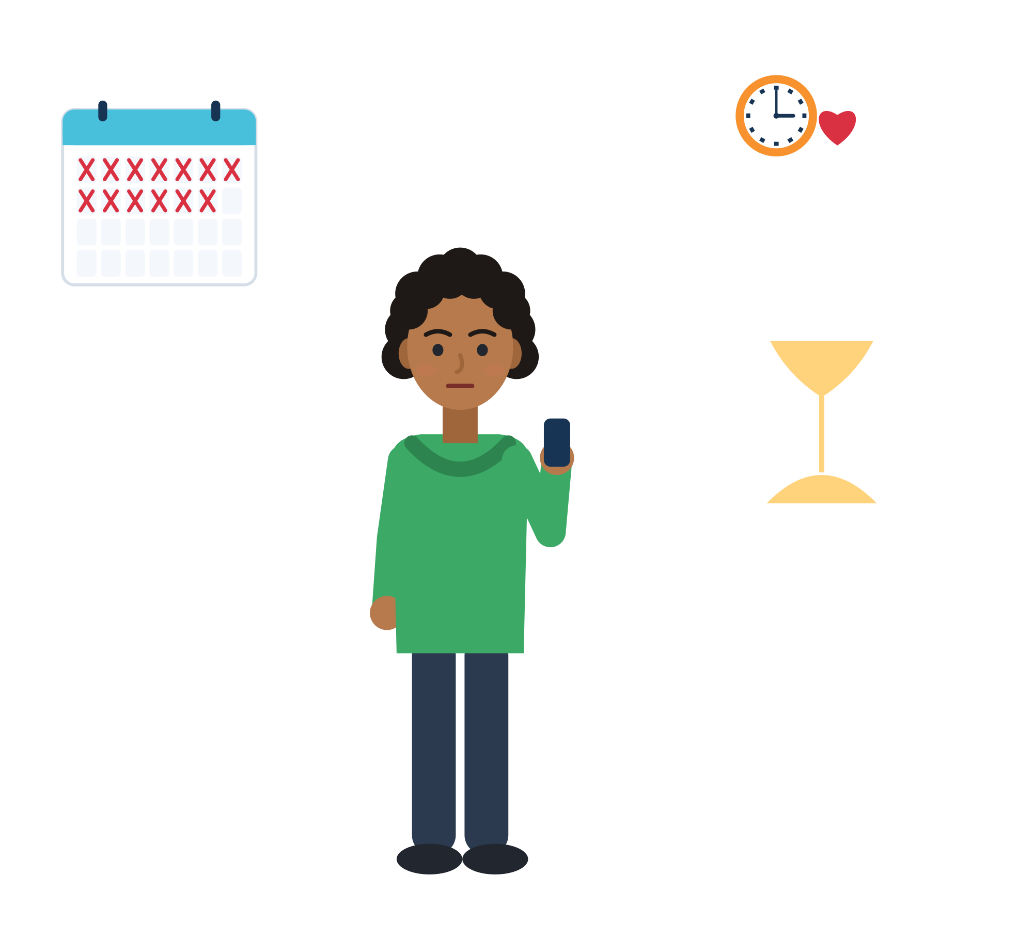
02
UNIT 2 · ≈ 60 min
Time management in the reality of young migrants
How migration, stress and uncertainty shape the way time feels and how days are organised.
Stress and waiting
Procrastination
The phone
Culture and well-being
Module 7 · Time Management
17
Notes:
Unit 2 explores how migration-related factors shape the perception of time and daily routines (curriculum wording). Suggested timing: 30 min input and discussion + 30 min case study. Heavy themes (waiting, trauma) stay with invented characters and documented studies, never with participants' own stories.

Slide 18

PERCEPTION OF TIME UNDER STRESS AND UNCERTAINTY
Waiting time is real time
614,295
4-5 points
21 months
people aged 18-34 were waiting for an asylum decision in the EU at the end of 2025, about half of all 1.22 million.
lower later employment for each extra year of waiting in the asylum process (refugees in Switzerland).
Long asylum waiting harmed emotional health, still 21 months after settlement (UK data).
Much "lost time" is structural. Waiting is not your fault, and small routines can still protect you.
Source: Eurostat migr_asypenctzm (end of December 2025, EU-27) · Hainmueller, Hangartner & Lawrence (2016), Science Advances · Phillimore & Cheung (2021), Social Science & Medicine
Module 7 · Time Management
18
Notes:
Pending asylum applications in the EU-27 at the end of December 2025: 1,220,920 people, of whom 614,295 were aged 18-34 (DE 306,650; IT 234,165, low reliability; NL 63,295; EL 31,945; Eurostat).
Hainmueller et al. (2016): each additional year of waiting reduced refugees' later employment rate by 4-5 percentage points (a 16-23% drop; refugees who applied in Switzerland 1994-2004). The authors interpret this as "psychological discouragement, rather than a skill atrophy mechanism". Phillimore & Cheung (2021): "longer asylum waiting time is associated with poor health", and the effect on emotional health "persists 21 months post settlement".
Teaching message: much "lost time" is structural, not personal (research note, documented cases). Do not ask who in the room is waiting. Speak about "many young people" and let participants decide whether to connect it to themselves.

Slide 19
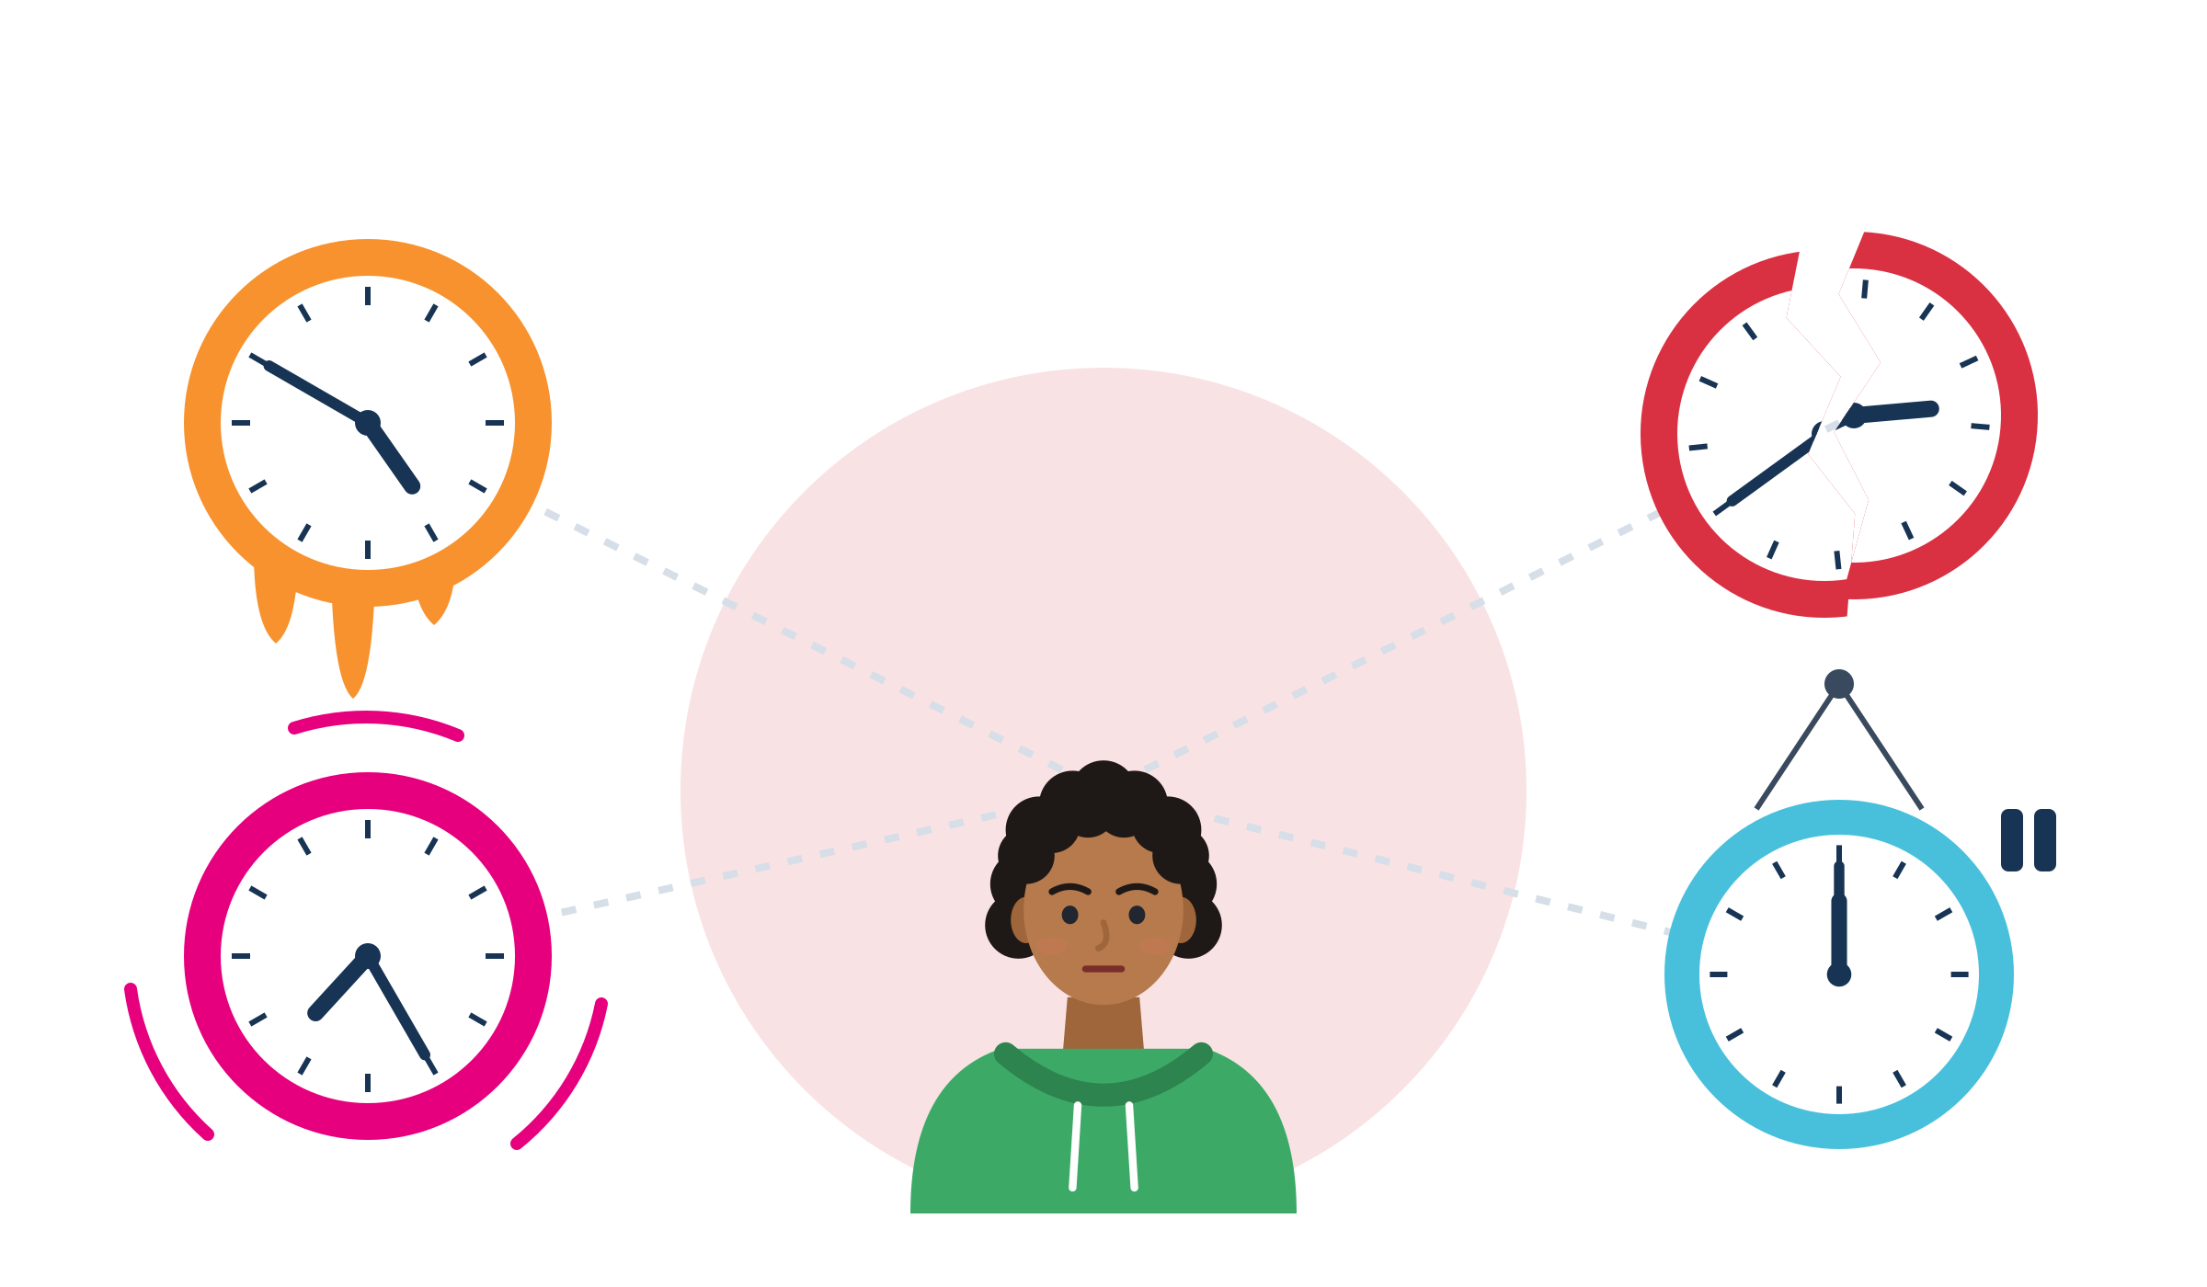
PERCEPTION OF TIME UNDER STRESS AND UNCERTAINTY
Stress changes how time feels
Sticky
Ruptured
Time can feel strange: people waiting for asylum decisions called it “sticky, suspended, frenzied and ruptured”.
Feelings change time: it flies when we have fun, drags when we worry.
A full mind: worries take up space. Planning feels harder. This is normal.
Short horizons help: plan today and this week, not five years.
Frenzied
Suspended
Source: Griffiths (2014), JEMS · Droit-Volet & Meck (2007) · Mani et al. (2013), "scarcity"; mixed replications: Carvalho et al. (2016), O'Donnell et al. (2021)
Module 7 · Time Management
19
Notes:
For trainers: time tools are not therapy. If someone is distressed: pause, ground (feet on the floor, slow breathing), offer a quiet talk and your local referral list.
Griffiths (2014) worked with refused asylum seekers and detainees in the UK and identified four experiences of time: "sticky, suspended, frenzied and ruptured". In trauma research, "temporal disintegration", where "the present moment becomes isolated from the continuity of past and future time", predicted later distress (Holman & Silver, 1998). A "foreshortened future" was listed as a PTSD symptom in DSM-IV. Expect some participants to find long-term planning meaningless: a normal response to an abnormal situation, not a character flaw.
Scarcity, with care: Mani et al. (2013) found that "poverty-related concerns consume mental resources, leaving less for other tasks". But a US payday study found no difference (Carvalho et al., 2016), and replications of 20 scarcity studies showed "some strong successes and other undeniable failures" (O'Donnell et al., 2021). Teach it as an image ("worries take up space"), never as "poverty lowers IQ".
Practical tip from this slide: write tasks down so your head does not have to hold them, and do the hardest task when your mind is freshest.
Limits: time management "can do considerably less in the way of tackling neuroticism and dampening the emotional impact of tragic life events" (Aeon et al., 2021). Know your local referral options (e.g. PM+ or Self-Help Plus providers, psychosocial services).

Slide 20

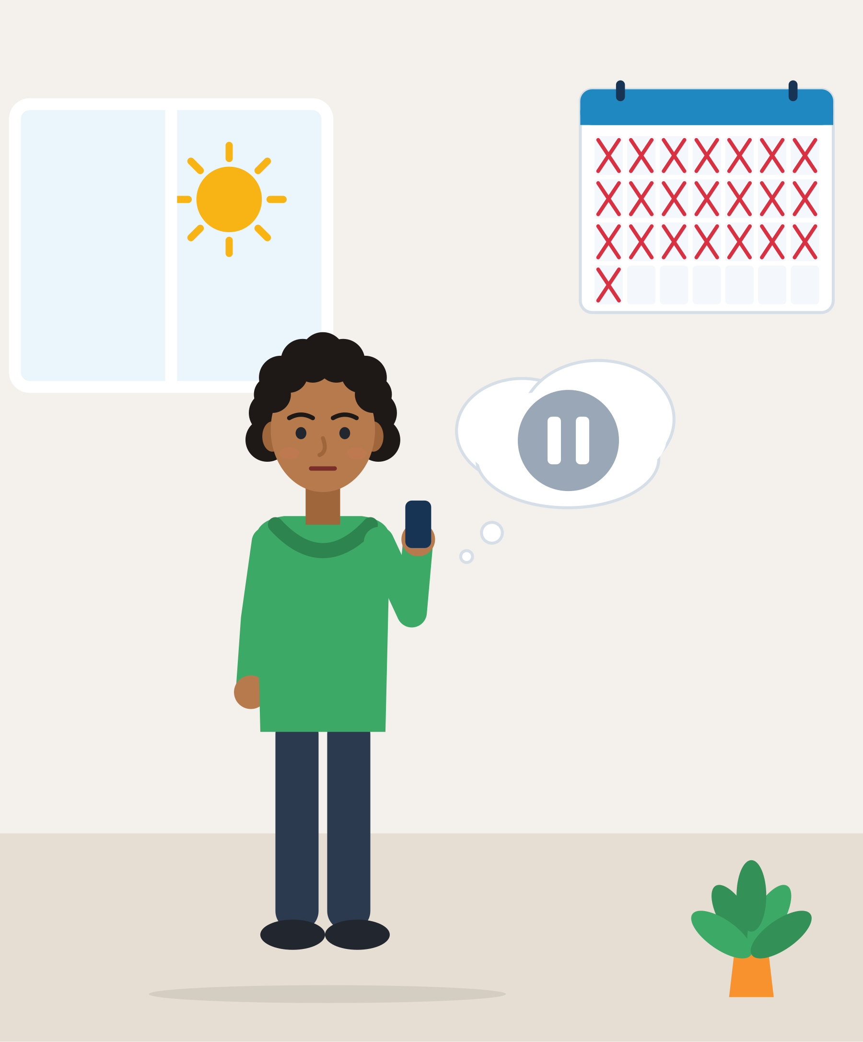
ILLUSTRATIVE SCENARIO
My life is on pause
Samir, 25
Waiting for an asylum decision in Greece, month 22
DISCUSS
What would Samir NOT need to hear?
Which parts of his situation are not in his control?
What could be three small “anchors” in his day?
Waiting
Greece
Daily structure
Samir has waited 22 months for a decision on his asylum application. “My life is on pause. Why plan anything?” He sleeps until noon and spends most evenings on his phone. Some weeks he misses the free Greek class. Friends tell him to “just be more disciplined”.
Grounded in: each extra year of asylum waiting cut later employment by 4-5 points (Hainmueller et al., 2016); people waiting in Glasgow filled time with routines (Rotter, 2016).
Module 7 · Time Management
20
Notes:
Illustrative scenario (constructed). Groups of 3, 6 minutes. Validate first: the waiting is not his fault, and his tiredness is understandable.
Anchors: three small fixed points a day, with free space around them, e.g. a morning walk, one hour of Greek, volunteering on Tuesdays. This is "behavioural activation", a part of the WHO Problem Management Plus programme (re-engaging with pleasant and task-oriented activities; de Graaff et al., 2023), and Rotter's "active waiting" in practice.
Make clear: a plan for THIS week still makes sense, even if the next year is unclear. Do not suggest "5-year goals" to people with an uncertain status.

Slide 21
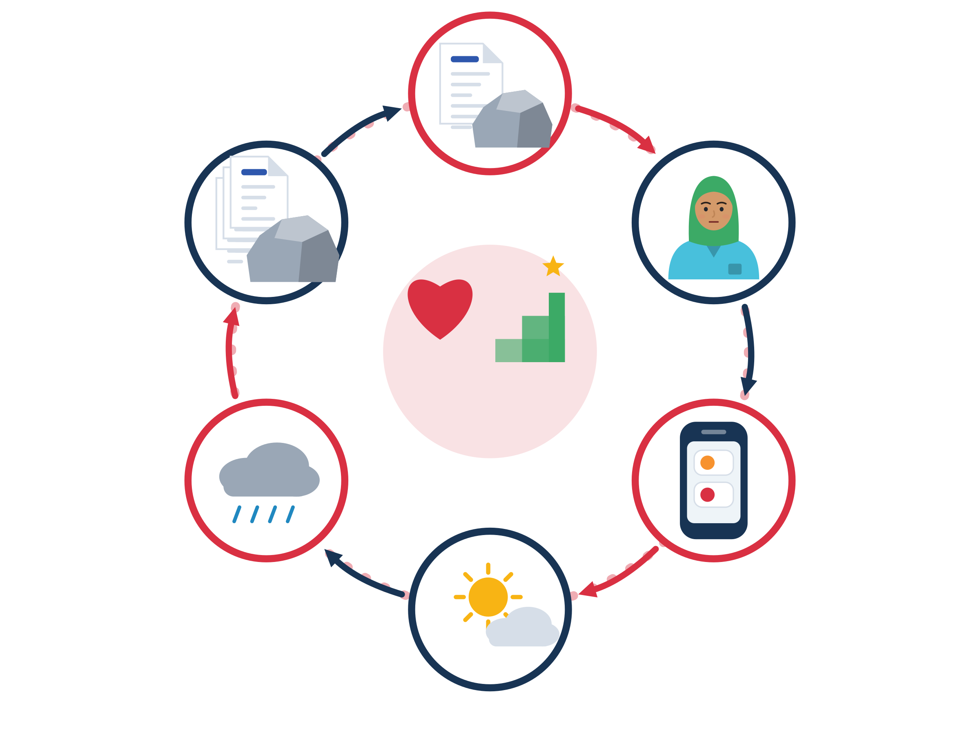
EMOTIONAL BARRIERS AND THE HABIT OF PROCRASTINATION
Procrastination is a mood problem, not laziness
Around the loop
Heavy task: a form in a second language, an official letter.
Bad feeling: fear, shame or confusion, right now.
Escape: scroll, clean, sleep. Quick relief for a moment.
Guilt: “What is wrong with me?” Self-criticism adds stress.
Heavier task: next time it feels even worse.
Break it: be kind to yourself, then one tiny step.
Heavy task
Heavier task
Bad feeling
Be kind + one tiny step
Guilt
Escape
Quick relief
Source: Sirois & Pychyl (2013) · Steel (2007) · Sirois (2014); Wohl, Pychyl & Bennett (2010)
Module 7 · Time Management
21
Notes:
Procrastination means "to voluntarily delay an intended course of action despite expecting to be worse off for the delay" (Steel, 2007). It is very common: an estimated 80-95% of college students procrastinate, and 15-20% of adults are chronic procrastinators (Steel, 2007, mostly North American studies).
Sirois & Pychyl (2013) describe it as giving priority to short-term mood repair: we delay because the task makes us feel bad now, and "the consequences are typically borne by the future self". For young migrants, the heaviest tasks are often bureaucratic: forms in a second language, document deadlines, recognition applications.
The antidote is self-compassion: self-kindness, common humanity ("many people struggle with this") and mindfulness (Neff, 2003). Across four samples, self-compassion helped explain the link between procrastination and stress (Sirois, 2014). Students who forgave themselves for procrastinating procrastinated less before the next exam (Wohl et al., 2010).
Ask: "Where would YOU break the circle?" Let people point to a node. Most will choose "bad feeling" or "guilt": exactly where kindness and a tiny step help.

Slide 22

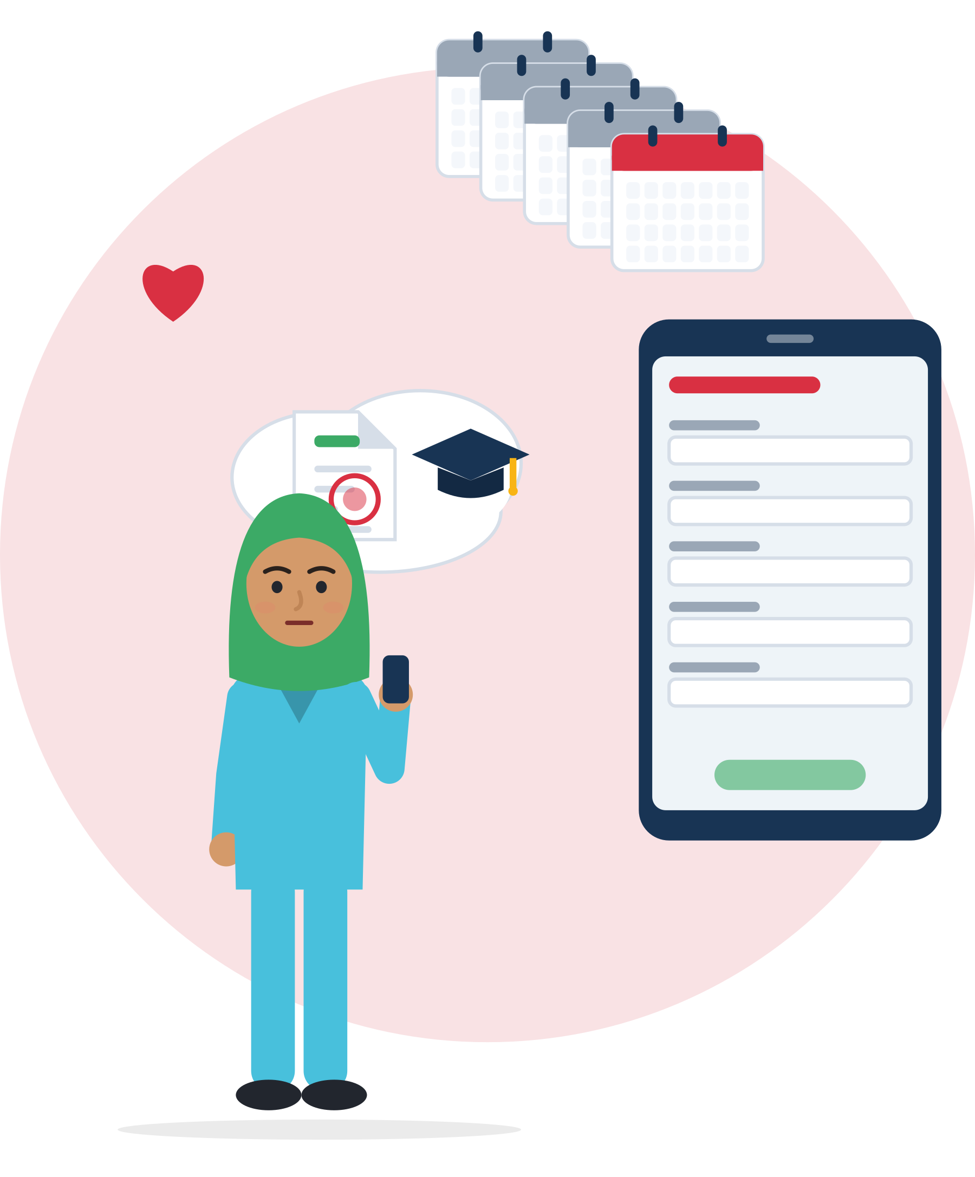
ILLUSTRATIVE SCENARIO
The form that waits for months
Rania, 27
Nurse trained in Syria, now living in Germany
DISCUSS
What feeling is Rania avoiding?
What would a harsh inner voice say? What would a kind friend say?
What could she do in 10 minutes today?
Recognition
Germany
Procrastination
Rania has a nursing degree from Syria. For five months the recognition application has been saved on her phone. When she opens it, she feels shame and closes it again. She will do it “when things are calmer”. Meanwhile she works in a warehouse.
Grounded in: only 22.5% of young people (15-29) with a non-EU qualification had applied for recognition (Eurostat lfso_21educ02, 2021); task aversiveness strongly predicts procrastination (Steel, 2007).
Module 7 · Time Management
22
Notes:
Illustrative scenario (constructed) for "emotional barriers and procrastination". Pairs, 5 minutes. Unit 3 comes back to Rania with a micro-action.
A kind sentence: "This form is hard for many people. I can ask for help." A 10-minute first step: open the Anerkennung in Deutschland portal (government site with a Recognition Finder, document lists and pages in Arabic, Turkish, Ukrainian and other languages), type "nurse" and take a screenshot of the document list.
Context: across the EU, 3 in 4 people with a non-EU diploma never applied for recognition (75.1%, Eurostat 2021). Procrastination is not the only reason: cost, missing documents and unclear procedures matter too. Name these structural reasons as well.

Slide 23
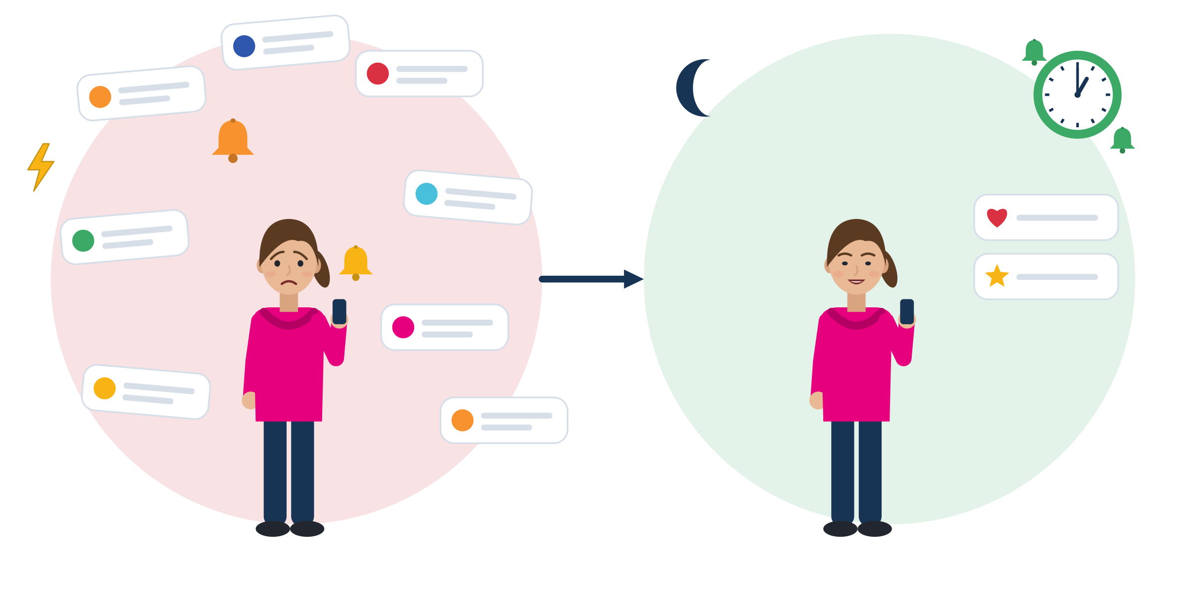
DIGITAL DISTRACTION AND DIVIDED ATTENTION
The phone: lifeline and distraction
A lifeline: family, offices, shift changes. Design it, do not ban it.
Alerts pull attention even when people do not touch the phone (experiment).
Batching helps: alerts 3 times a day gave better attention, mood and control. No alerts at all: more anxiety (n = 237).
Phone on the desk? the "brain drain" finding did not replicate. Pooled effect: small (g = -0.14).
Alerts all day
Batches and VIP contacts
Source: Stothart, Mitchum & Yehnert (2015) · Fitz et al. (2019), randomised field experiment · Böttger, Poschik & Zierer (2023), meta-analysis of 22 studies
Module 7 · Time Management
23
Notes:
For young migrants the phone is the lifeline to family, to authorities' messages and to shift changes. Teaching message: design your notifications. Do not teach "phones are bad".
More evidence: in a two-week experiment (N = 221), people reported more inattention and hyperactivity in the week with alerts on (Kushlev et al., 2016). A one-week "notifications off" trial (N = 205) did not reduce checking or screen time and raised fear of missing out (Dekker et al., 2025). Blocking mobile internet (calls and texts still allowed) for two weeks improved sustained attention and well-being in a randomised trial (Castelo et al., 2025).
Honest science: the "mere presence" idea (Ward et al., 2017) failed a preregistered direct replication (Ruiz Pardo & Minda, 2022), and the meta-analysis found no significant effect on attention (Böttger et al., 2023).
Ask: "Which apps interrupt you most? Which messages can never wait?" Collect answers without judging. Unit 3 turns them into a 5-minute notification check.

Slide 24
CULTURAL DIFFERENCES IN THE PERCEPTION OF TIME
Time norms belong to places, not to peoples
One thing at a time, fixed times
Many things at once, people first
Clock first
The handover starts at 06:00 sharp. You are dressed and at your station before. One task, then the next.
Ask, observe, adapt
Every workplace has written rules (clocking in) and unwritten ones (arrive 5 minutes early). Ask: “How do people usually do this here?”
People first
A meeting starts when everyone has arrived. Many tasks at once. Relationships come before the schedule.
Source: Hall's monochronic and polychronic time, as described by Sedlmeier et al. (2020) · Korabik et al. (2017) · Levine & Norenzayan (1999) · BAMF (2016), integration-course curriculum
Module 7 · Time Management
24
Notes:
Edward T. Hall distinguished monochronic time ("concentrating on only one thing at a time") from polychronic time ("being involved with many things at once"). These are generalisations from decades ago. Researchers today measure polychronicity as an individual preference that differs from person to person (Korabik et al., 2017). Never rank cultures and never say "people from country X are always late".
Pace of life differs between countries, but in Levine & Norenzayan's 31-country study it was linked to economy, climate and individualism, not to "character". Germany's own integration-course curriculum teaches learners to ask trusted people whether a behaviour "e.g. regarding punctuality" is appropriate, and to question stereotypes about punctuality they have heard about the country (BAMF, 2016, levels A1-B1).
Example (constructed): Yaren, 20, from Türkiye, starts an apprenticeship in a car workshop in Germany. She arrives at 08:00 sharp; colleagues are already in work clothes at 07:55, and the supervisor frowns. Useful question: "What time should I be ready to start: dressed and at my station?"
Activity (3 min): participants place a sticky note for "my last workplace or school" on the line. Then invite them to name time skills they bring, such as managing many things at once or staying flexible under uncertainty.

Slide 25
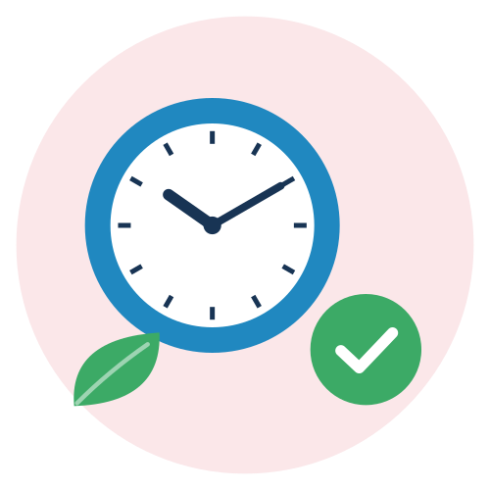
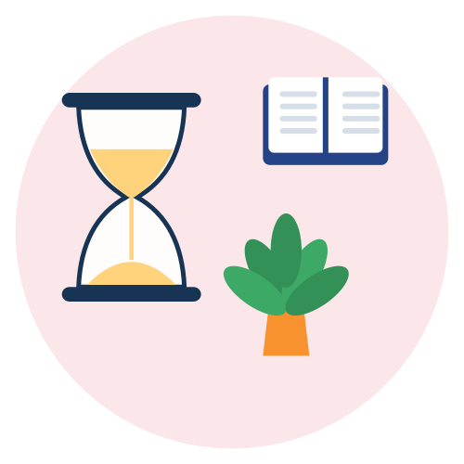


LINKS BETWEEN TIME MANAGEMENT, PROBLEM SOLVING AND WELL-BEING
Small structure, more control, better well-being
RCT · Time-management training, Germany
Field study · Active waiting, Glasgow
71 employees in a randomised trial. Training raised the feeling of control and lowered stress. Performance did not change.
Asylum seekers who waited 2-9 years filled their time with routines, activities and projects. Waiting was “not an empty interlude”.
RCT · Problem Management Plus, Netherlands
RCT · Self-Help Plus, Türkiye
Syrian peer helpers taught stress management, problem solving and planning small activities. Depression and anxiety fell more (d = 0.41).
A 5-session stress course for Syrian refugees. After 6 months, 21.69% had a mental disorder, against 40.73% without it.
Source: Häfner & Stock (2010) · Rotter (2016), Time & Society · de Graaff et al. (2023), BMJ Mental Health (206 adults) · Acarturk et al. (2022), World Psychiatry (642 adults)
Module 7 · Time Management
25
Notes:
Honest statement from the research note: there is no published, outcome-evaluated programme that teaches time management specifically to young migrants in Europe or Türkiye. These are the closest documented building blocks. Present them as such, not as proof that this module works.
PM+ (Netherlands, 2019-2021): five weekly 90-minute sessions with Arabic-speaking peer helpers; stress management, problem solving, behavioural activation (scheduling pleasant and task-oriented activities) and social support. Effects at 3 months: depression and anxiety d = 0.41, PTSD symptoms d = 0.39, self-identified problems d = 0.26; no significant effect on impairment. Time, problem solving and well-being are partners: see also Module 5.
Self-Help Plus in Western Europe (5 countries, n = 459) halved disorder frequency right after the course, but not at 6 months (Purgato et al., 2021). A self-guided app for Syrian refugees in Germany and Sweden had dropout of 86.3% and 82.1% (Burchert et al., 2026). Lesson: effects fade without follow-up, and apps alone rarely change routines. Plan a peer check-in after the module.
Know where PM+ or Self-Help Plus is offered locally, for referrals.

Slide 26

ACTIVITY
Case study: what makes time hard, what helps?
TIME
30 min
STEPS
Each group takes one case: Mariam (course vs shift), Hamid (scrolling before an exam), Rania (the form that waits) or the real “active waiting” study.
Answer: what feelings or thoughts make time hard here?
Which parts are structural, beyond the person's control?
What one small change could give back a bit of control? Who could help?
Present in 2 minutes. The trainer links each case to a model from today.
GROUP
Groups of 3-4
MATERIALS
Case study texts with a short glossary, flipchart, sticky notes
DEBRIEF
GOAL
See how stress, mental load and phone habits affect time, and find one small change
What did the person NOT need to hear?
What would a kind friend say?
Module 7 · Time Management
26
Notes:
Curriculum case study (Unit 2): real-life scenarios show how stress, cognitive load and digital habits affect time management, and how small changes can restore a sense of control. The curriculum says "real-life scenarios"; the research note found no documented time-management case of young migrants, so we use constructed scenarios grounded in facts plus one documented real study (Rotter, 2016). Say this openly to the group.
Case Mariam (constructed): Mariam, 24, Germany, B1 integration course Monday to Friday 08:30-12:45. Her new supermarket job puts her on early shifts two days a week. She is afraid to tell her manager and starts skipping class. Link: WOOP and if-then plans (Unit 3); right to reasonable advance information about working times (Directive 2019/1152).
Case Hamid (constructed): Hamid, 19, Italy, forklift licence theory exam at 09:00. At midnight he "just checks" social media and stops at 02:10. No shaming: ask what the scrolling gave him (calm? contact with home?). Link: sleep loss hits attention hardest (Lim & Dinges, 2010); Bedtime mode.
Language support: cases in short B1 sentences with a glossary (shift, deadline, appointment, rota, overtime, notification). Trainer links: Mariam and Rania to the procrastination cycle, Hamid to the phone slide, active waiting to Samir.

Slide 27
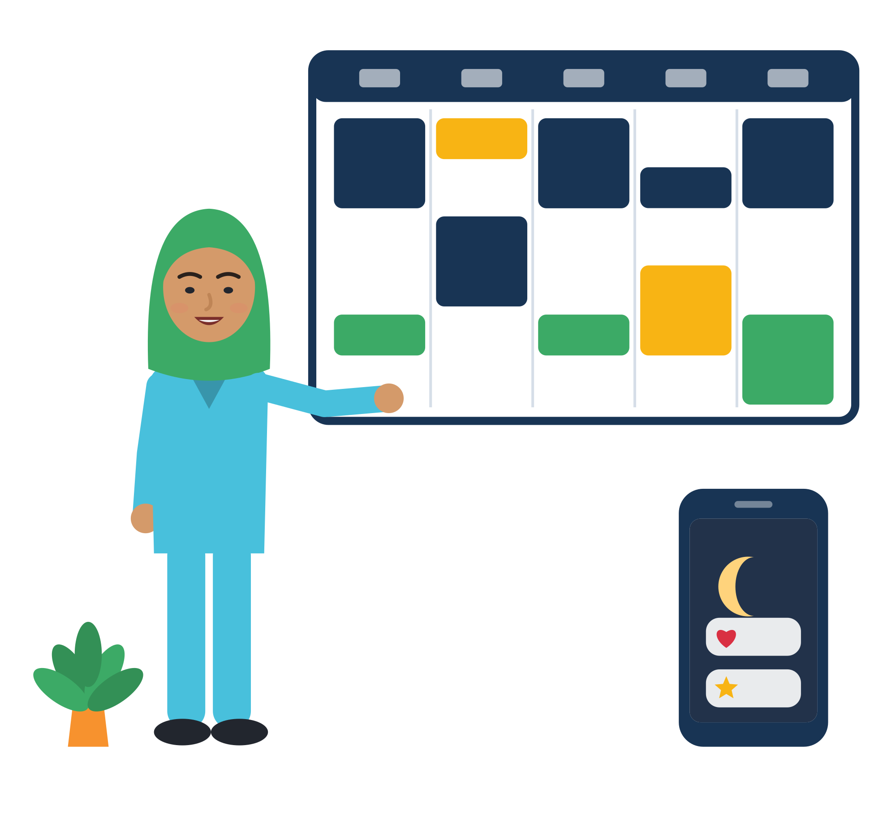
03
UNIT 3 · ≈ 55 min
Practical strategies and good practices
Time to put it into practice: small tools that fit real lives, tried today and adapted over time.
Priorities
Flexible plans
Focus and micro-actions
Habits and reflection
Module 7 · Time Management
27
Notes:
Unit 3 focuses on hands-on strategies that support sustainable time management habits (curriculum wording). Suggested timing: 25 min tools + 30 min "try one small strategy". Present the tools as a menu: nobody needs all of them. In the two-session format, this unit is Session B.

Slide 28
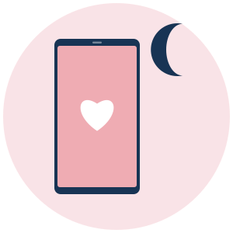



DEVELOPING AWARENESS OF TIME USE
From timeline to pattern to one small change
 | What I noticed | What it may tell me | One small change to try
 | I lose two hours after late calls with family. | Late calls cost sleep before early shifts. | Two protected call slots a week: my day off and before a late shift.
 | My calmest time is the morning. | My head is freshest early. | Do the hardest task (a form, homework) before 10:00.
 | The 30 minutes after messages from the office are hard. | Worry takes my attention. | Read official messages once a day, with a friend if needed.
 | The bus ride is 40 minutes of scrolling. | This is time I can choose how to use. | Vocabulary app for 10 minutes, then music.
You cannot change what you cannot see. Observe first, without judging.
Source: Time assessment as the first part of time management: Claessens (2004), p. 19 · examples constructed for SMILE
Module 7 · Time Management
28
Notes:
Bring back the timelines from Unit 1 (or the persona). Each participant writes ONE pattern in the first column and ONE small change in the last. 5 minutes, individual.
The first example uses Farid (constructed): early shifts in Hamburg, mother in Kabul who can only call after her evening chores. When it is 20:00 in Berlin, it is 23:30 in Kabul in winter. Negotiating two protected call slots plus short voice messages on other days keeps the family time and protects sleep.
Another awareness tool, for working time, is the personal hours log at the end of this unit: it shows where work time goes and whether it is paid.
Facilitation tip: if someone says "I noticed I waste time", reframe: "You noticed where your energy goes. That is information, not a verdict."

Slide 29
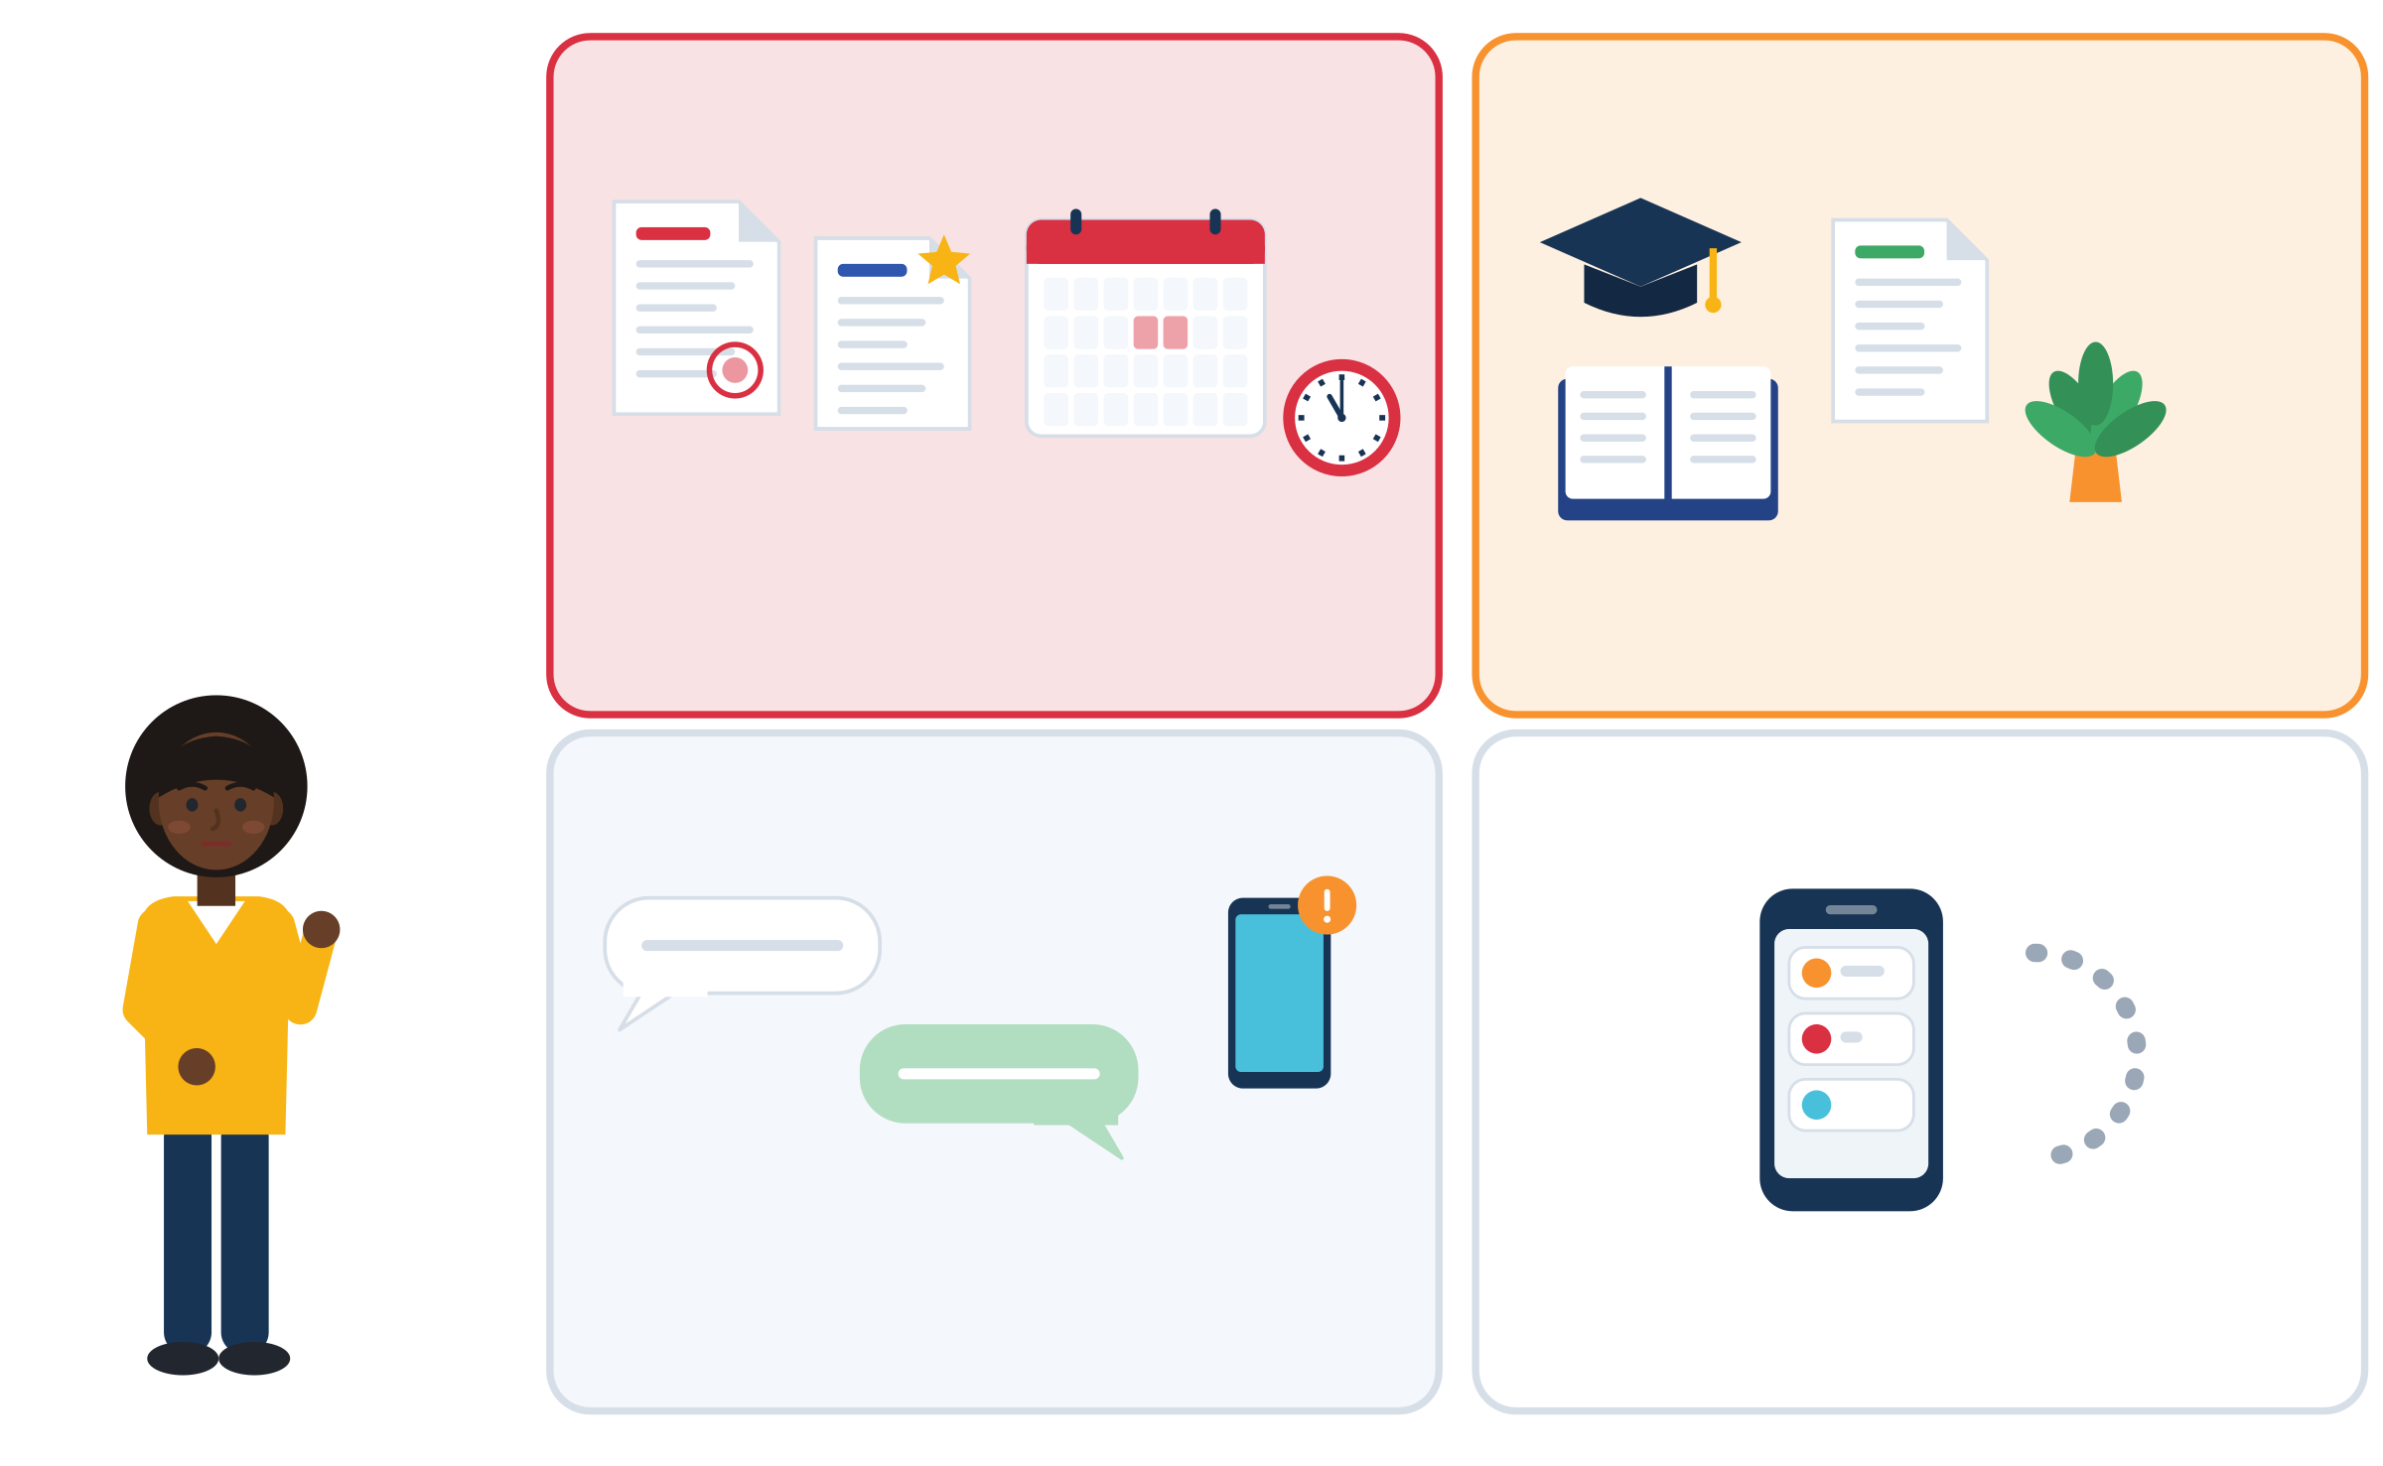
PRIORITISING UNDER COGNITIVE AND EMOTIONAL LOAD
Urgent or important? Sort before you start
1 · Urgent and important
2 · Important, not urgent
Examples: 1 permit papers due Friday · 2 diploma recognition, B1 practice, a CV · 3 most group-chat messages · 4 endless scrolling.
Kofi, 26 (constructed): permit papers due Friday, a job ad closes Thursday. He freezes and does neither.
Both are box 1: small steps, buffer time, ask a support organisation about the permit.
A thinking aid, not a law: people often choose what feels urgent over what matters.
Do it today.
Give it a time and a place.
3 · Urgent, not important
4 · Neither
Keep it short, batch it or ask.
Drop it or leave it for later.
Source: Eisenhower (1954), Evanston address, quoting "a former college president" · Zhu, Yang & Hsee (2018), the mere urgency effect · Claessens (2004), p. 165
Module 7 · Time Management
29
Notes:
Origin: Eisenhower quoted a former college president: "I have two kinds of problems, the urgent and the important. The urgent are not important, and the important are never urgent." The 2x2 grid was later popularised in self-help books. It is a heuristic, not a validated tool, and real urgency (a residence-permit deadline) can be truly important.
Why it helps: in a diary study, workers "tended to perform the highest priority tasks, but also the urgent, yet unimportant tasks" (Claessens, 2004, p. 165). Five experiments show a "mere urgency effect": people pick tasks with spurious urgency over tasks with better payoffs (Zhu et al., 2018).
Under load: first write everything down (a full head forgets), then sort. Activity (5 min): each participant writes this week's tasks on sticky notes and places them in the four boxes. Arrow to box 2: "Give this a time and a place."
Kofi is an illustrative scenario (constructed, Italy). Grounding: in the EU-27 at the end of 2025, about half of the 1.22 million people with a pending asylum application were aged 18-34 (Eurostat); uncertainty about status harms health (Phillimore & Cheung, 2021).

Slide 30




FLEXIBLE AND REALISTIC PLANNING TOOLS
A week in three layers, with buffers
 | Layer | Monday | Tuesday | Wednesday | Thursday | Friday
 | Fixed: others decide | Course 9-12, shift 14-18 | Shift 7-13 | Course 9-12 | Municipality 10:00 | Course 9-12, shift 15-19
 | Protected: I guard it | Sleep from 23:00 | Brother from school 15:30 | Call home 21:00 | Rest in the afternoon | Call home 21:00
 | Flexible: I choose | Homework, 30 min | Shopping, homework | Friends, sport | Homework, 30 min | Free evening
 | Buffer: space for delays | Lunch and travel 12-14 | Rota changes | Spare afternoon | Leave 08:50, nothing else before lunch | Weekly check, 10 min
Plan less than the full day. People usually underestimate how long their own tasks take.
Source: Buehler, Griffin & Ross (1994), the planning fallacy · three-layer plan: constructed SMILE tool · example week invented (persona Nour)
Module 7 · Time Management
30
Notes:
This is the "simple planning template" named in the curriculum materials. Fill in the first row first: fixed blocks decided by others. Then protect sleep, family and learning. Only then add flexible blocks, and keep grey buffer bands around appointments.
The planning fallacy: people underestimate how long their own tasks will take (Buehler et al., 1994). Plans with no space break at the first late bus, long queue at the office or phone call home. Buffer time is not laziness; it lets a plan survive real life.
Evidence that work needs flexibility too: for 63% of EU employees, reacting to situations that could not be anticipated is usual (Cedefop, 2022). Young workers often cannot choose the fixed row at all (69.6% say the employer mainly decides; Eurostat 2019).
Hand out a blank template. 7 minutes: participants fill in next week. Offer the persona option again.

Slide 31
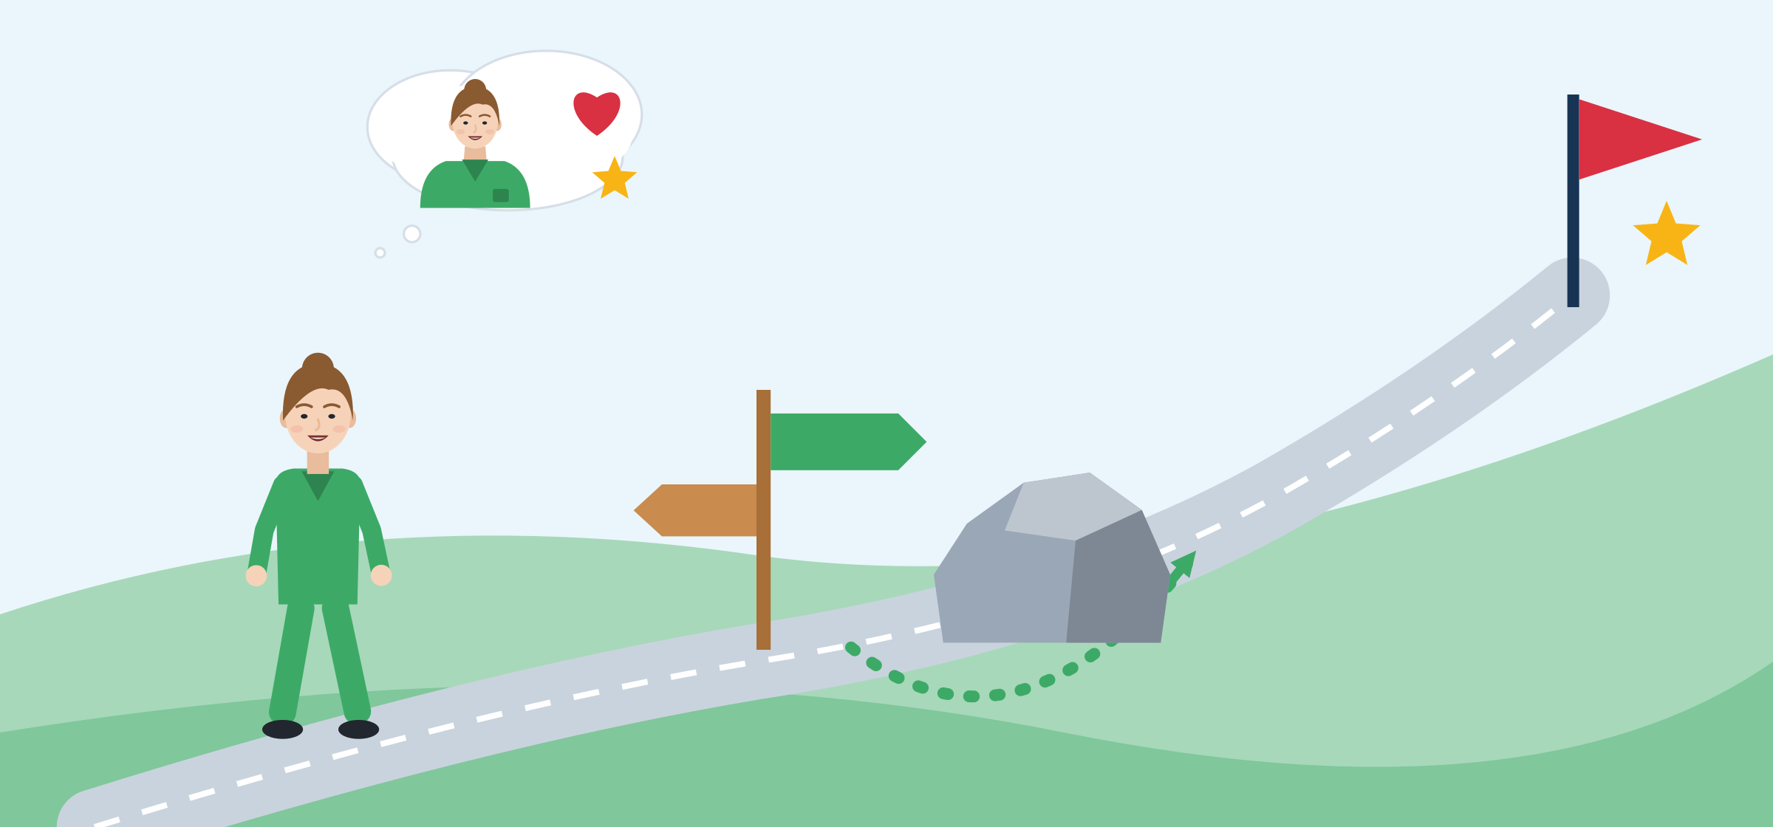
PLANNING TOOL: WOOP AND IF-THEN PLANS
WOOP: from a wish to an if-then plan
W · Wish
Wish: pass the B1 exam this year.
Outcome: I can apply for nurse training. I feel proud.
Obstacle: after late shifts I am exhausted and skip class.
Plan: if I had a late shift, then I sleep until 10:00 and do 20 minutes of homework on my phone before class.
O · Outcome
P · Plan
O · Obstacle
Your turn: “If ___, then I will ___.” Across 94 tests, if-then plans helped people reach their goals (d = .65).
Source: Gollwitzer & Sheeran (2006), meta-analysis · Oettingen, Kappes, Guttenberg & Gollwitzer (2015) · woopmylife.org (free materials)
Module 7 · Time Management
31
Notes:
A goal ("I will study more") is not enough. An if-then plan (implementation intention) links a specific situation to a specific action. Across 94 independent tests, such plans had a medium-to-large effect on reaching goals (d = .65; Gollwitzer & Sheeran, 2006).
WOOP (Wish, Outcome, Obstacle, Plan) adds an honest look at the inner obstacle first. In Oettingen et al. (2015) this improved self-reported time management in students and helped working mothers in a vocational business programme attend classes more regularly: the closest documented analogue to "language course plus job plus family".
Run it in pairs (6 min): each person writes one WOOP for a real wish. The obstacle must be inside the person ("I am tired", "I feel ashamed"), the plan must start with "If".

Slide 32
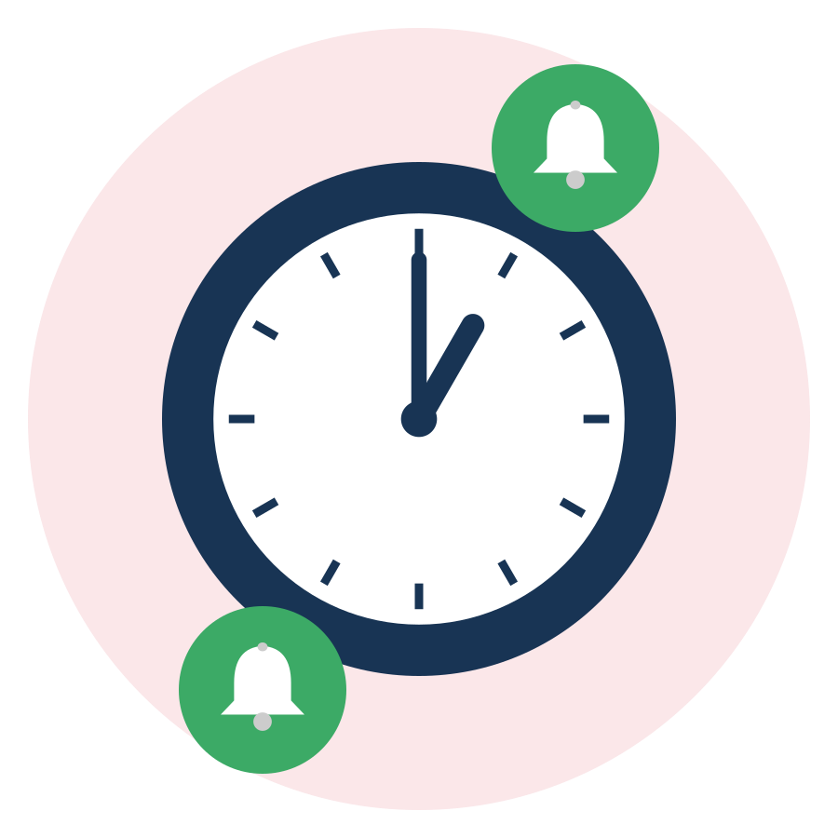

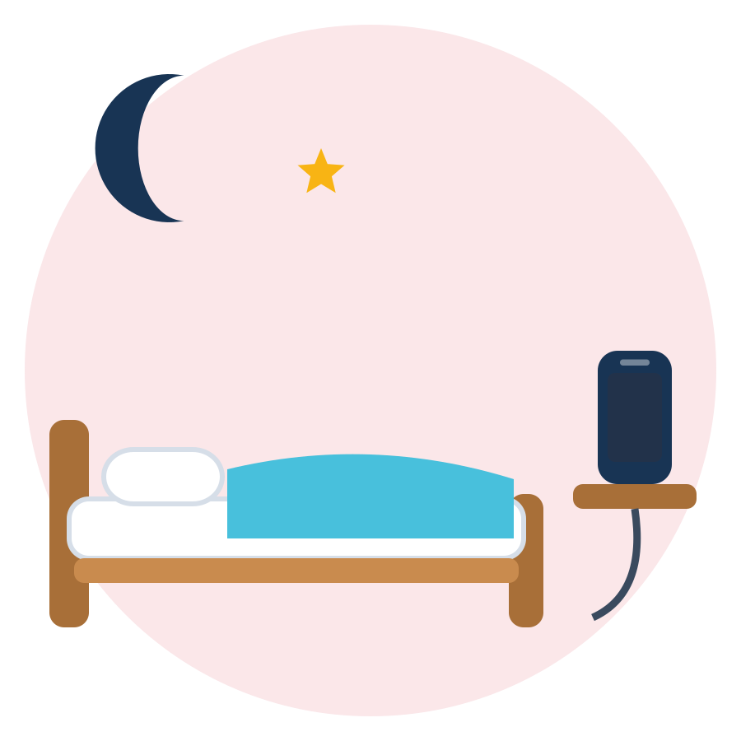

MANAGING ATTENTION AND DIGITAL DISTRACTIONS
Design your phone, do not ban it
tested
try it
Batch your alerts
VIP exceptions
Bedtime mode
Focus block
Check messages at set times, for example 13:00 and 19:00. Mute busy groups.
Let your supervisor and your family through. Everything else can wait.
Phone quiet from 23:00. Charge it away from your bed.
Work about 25 minutes, then a short break. Evidence: one day, 87 students.
Source: Fitz et al. (2019) · Biwer et al. (2023), Pomodoro-style breaks · Google Android Help (Digital Wellbeing: Focus mode, Bedtime mode) · Apple iPhone User Guide (Focus)
Module 7 · Time Management
32
Notes:
Optional material named in the curriculum: digital well-being tools (focus modes, notification settings guides). Do a 5-minute notification check live: list the 5 apps that interrupt you most; for each choose keep / batch / off / VIP only. Android: Settings, Digital Wellbeing, Focus mode or Bedtime mode. iPhone: Focus, with allowed people and apps.
Evidence: batching notifications three times a day improved attention, mood and sense of control, while no notifications at all raised anxiety and fear of missing out (Fitz et al., 2019, n = 237). Pomodoro (created by Francesco Cirillo): in a one-day study with 87 Dutch university students, set breaks (24/6 or 12/3 minutes) gave less fatigue and similar task completion compared with self-chosen breaks (Biwer et al., 2023). Limited evidence: present it as "try it and see".
EU link: DigComp 2.2 (competence 4.3) includes "digital usage monitoring and limitation strategies (e.g. rules and agreements on screen-free times)". This is digital competence, not phone policing.
Example (constructed, Eleni, 18, Greece): six family and friends' groups send about 300 messages a day. She mutes them, checks at 13:00 and 19:00, and lets her parents through as VIP contacts.

Slide 33
OVERCOMING PROCRASTINATION THROUGH MICRO-ACTIONS
Make the first step tiny
BIG AND HEAVY
TINY FIRST STEP
“Do my diploma recognition.”
Open the Recognition Finder, type “nurse”, screenshot the document list. 10 minutes.
“Study German more.”
If I sit down on the bus after my shift, then I open the vocabulary app for 10 minutes.
“Sort out all my papers.”
Tonight: put every letter in one folder. Nothing else.
“Find a better job.”
Read one job ad, save it and write one question about it.
“I am lazy, I never finish anything.”
“This is hard for many people. Today I do the first small step.”
Source: Steel (2007), temporal motivation theory · Gollwitzer & Sheeran (2006) · Anerkennung in Deutschland portal (Recognition Finder)
Module 7 · Time Management
33
Notes:
Back to Rania: the first row is her micro-action. A micro-action is so small that the bad feeling of starting is tiny. Then an if-then plan for the next step.
Steel's temporal motivation theory gives four levers against delay: raise "I can do it" (a small first step), raise "it matters to me" (link the task to a personal goal), lower distraction (move the phone away) and shorten the wait for a reward (a coffee after sending the email, a friend as "body double").
The "two-minute rule" comes from popular books (David Allen; James Clear): a practical heuristic that has not been tested as such. The habit research supports the "same cue, small action, repeat" logic.
Pairs (5 min): each person writes one "big and heavy" task and turns it into a step of 10 minutes or less. Recognition offices for other countries: CIMEA (IT, free for protection holders), DOATAP (EL), IDW (NL), YÖK / MEB e-Denklik (TR).

Slide 34
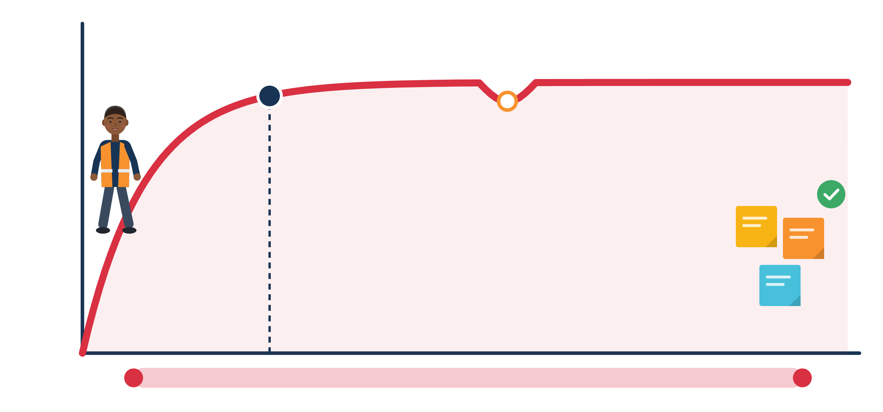
BUILDING SMALL ROUTINES AND HABITS
New habits take time, and a missed day is OK
1 missed day did not materially affect the habit. Just continue.
66 days: the median time until a new habit felt automatic
Same cue, small action, repeat
18-254 days: the range. Weeks or many months, both are normal.
Example: “After I brush my teeth, I write tomorrow's 3 tasks on a sticky note.”
Source: Lally, van Jaarsveld, Potts & Wardle (2010), European Journal of Social Psychology, p. 1002 (39 of 96 UK volunteers with good model fit)
Module 7 · Time Management
34
Notes:
Myth check: "A new habit takes 21 days." In the real-world study by Lally et al. (2010), the median time to reach 95% of maximum automaticity was 66 days, with a range of 18-254 days, and missing one day did not materially affect the process.
Habits form through repetition in the same situation. Link a new small action to something you already do every day (brushing teeth, sitting down on the bus, the end of a shift).
Example routine (constructed, Darius from Unit 1): an evening "launch routine": bag, clothes and lunch ready, phone on Bedtime mode at 21:30. If he misses a day: "No problem. One missed day does not break it."
Ask each participant to name one existing daily cue they could attach a new small action to. One sentence each, or pass.

Slide 35




REFLECTION AND ADAPTING TO THE SITUATION
Try it, notice it, keep it or change it
Try
Notice
Decide
Adapt
Use one strategy for 5-7 days. Small and real.
How did it feel? What got easier? What did not fit?
Keep it, change it or drop it. All three are fine.
New shift, new course, new letter? Change the plan, not your worth.
Effects of stress skills can fade without follow-up. Check in with a peer after one week.
Source: Purgato et al. (2021), Self-Help Plus in 5 Western European countries: effect at the end of the course, not at 6 months · Häfner & Stock (2010)
Module 7 · Time Management
35
Notes:
The curriculum ends Unit 3 with reflection and adaptation "over time". A tool that does not fit is not a failure: dropping it is a valid decision. Participants in the German training trial used the techniques very differently (Häfner & Stock, 2010).
Why follow-up matters: Self-Help Plus halved the frequency of mental disorders right after the course in Western Europe, but the effect was gone at 6 months (Purgato et al., 2021). Plan a check-in: LMS forum, WhatsApp group or the second session.
Link to EU frameworks: EntreComp 3.2 "Planning and management" includes "Adapt to unforeseen changes"; LifeComp L3 covers "the planning, organising, monitoring and reviewing of one's own learning". The reflection can be used as Youthpass evidence (SMILE is an Erasmus+ Youth project).

Slide 36
ACTIVITY
Try one small strategy and reflect
TIME
30 min (+ check after 7 days)
STEPS
Look at the menu: urgent/important sort, if-then plan, WOOP, 2-minute starter, focus block, notification check, evening routine, week with buffers, hours log.
Choose ONE. Write when and where you will use it: “If ___, then I will ___.”
Try it now for 10 minutes: set up Focus mode, start the delayed task or draft your week.
Rate it with a partner: how did it feel? What got easier? What did not fit?
After 7 days: keep it, change it or drop it?
GROUP
Individual, then pairs
MATERIALS
Strategy cards, planning and prioritising templates, optional focus-mode guides
DEBRIEF
GOAL
Choose, try and reflect on one strategy that fits your life
What surprised you when you tried it?
What could make it easier next week?
One missed day: what will you say to yourself?
Module 7 · Time Management
36
Notes:
Curriculum hands-on activity (Unit 3): participants try out a small time management strategy and reflect on its effects. Timing: 5 min menu, 10 min choose and personalise, 10 min try, 5 min reflect.
Strategy menu from the research note: (a) urgent/important sort of today's list; (b) 3 "most important tasks" for tomorrow (popular source: Babauta, Zen Habits); (c) one if-then plan; (d) WOOP; (e) a 2-minute starter for a delayed task; (f) a focus block; (g) a notification redesign; (h) an evening "launch" routine; (i) a weekly plan with buffers; (j) a personal hours log.
Follow-up: in the two-session format, start Session B with "keep / change / drop?". Otherwise use the LMS forum or a WhatsApp check-in after 7 days. Normalise misses: one missed day does not break a habit (Lally et al., 2010).

Slide 37

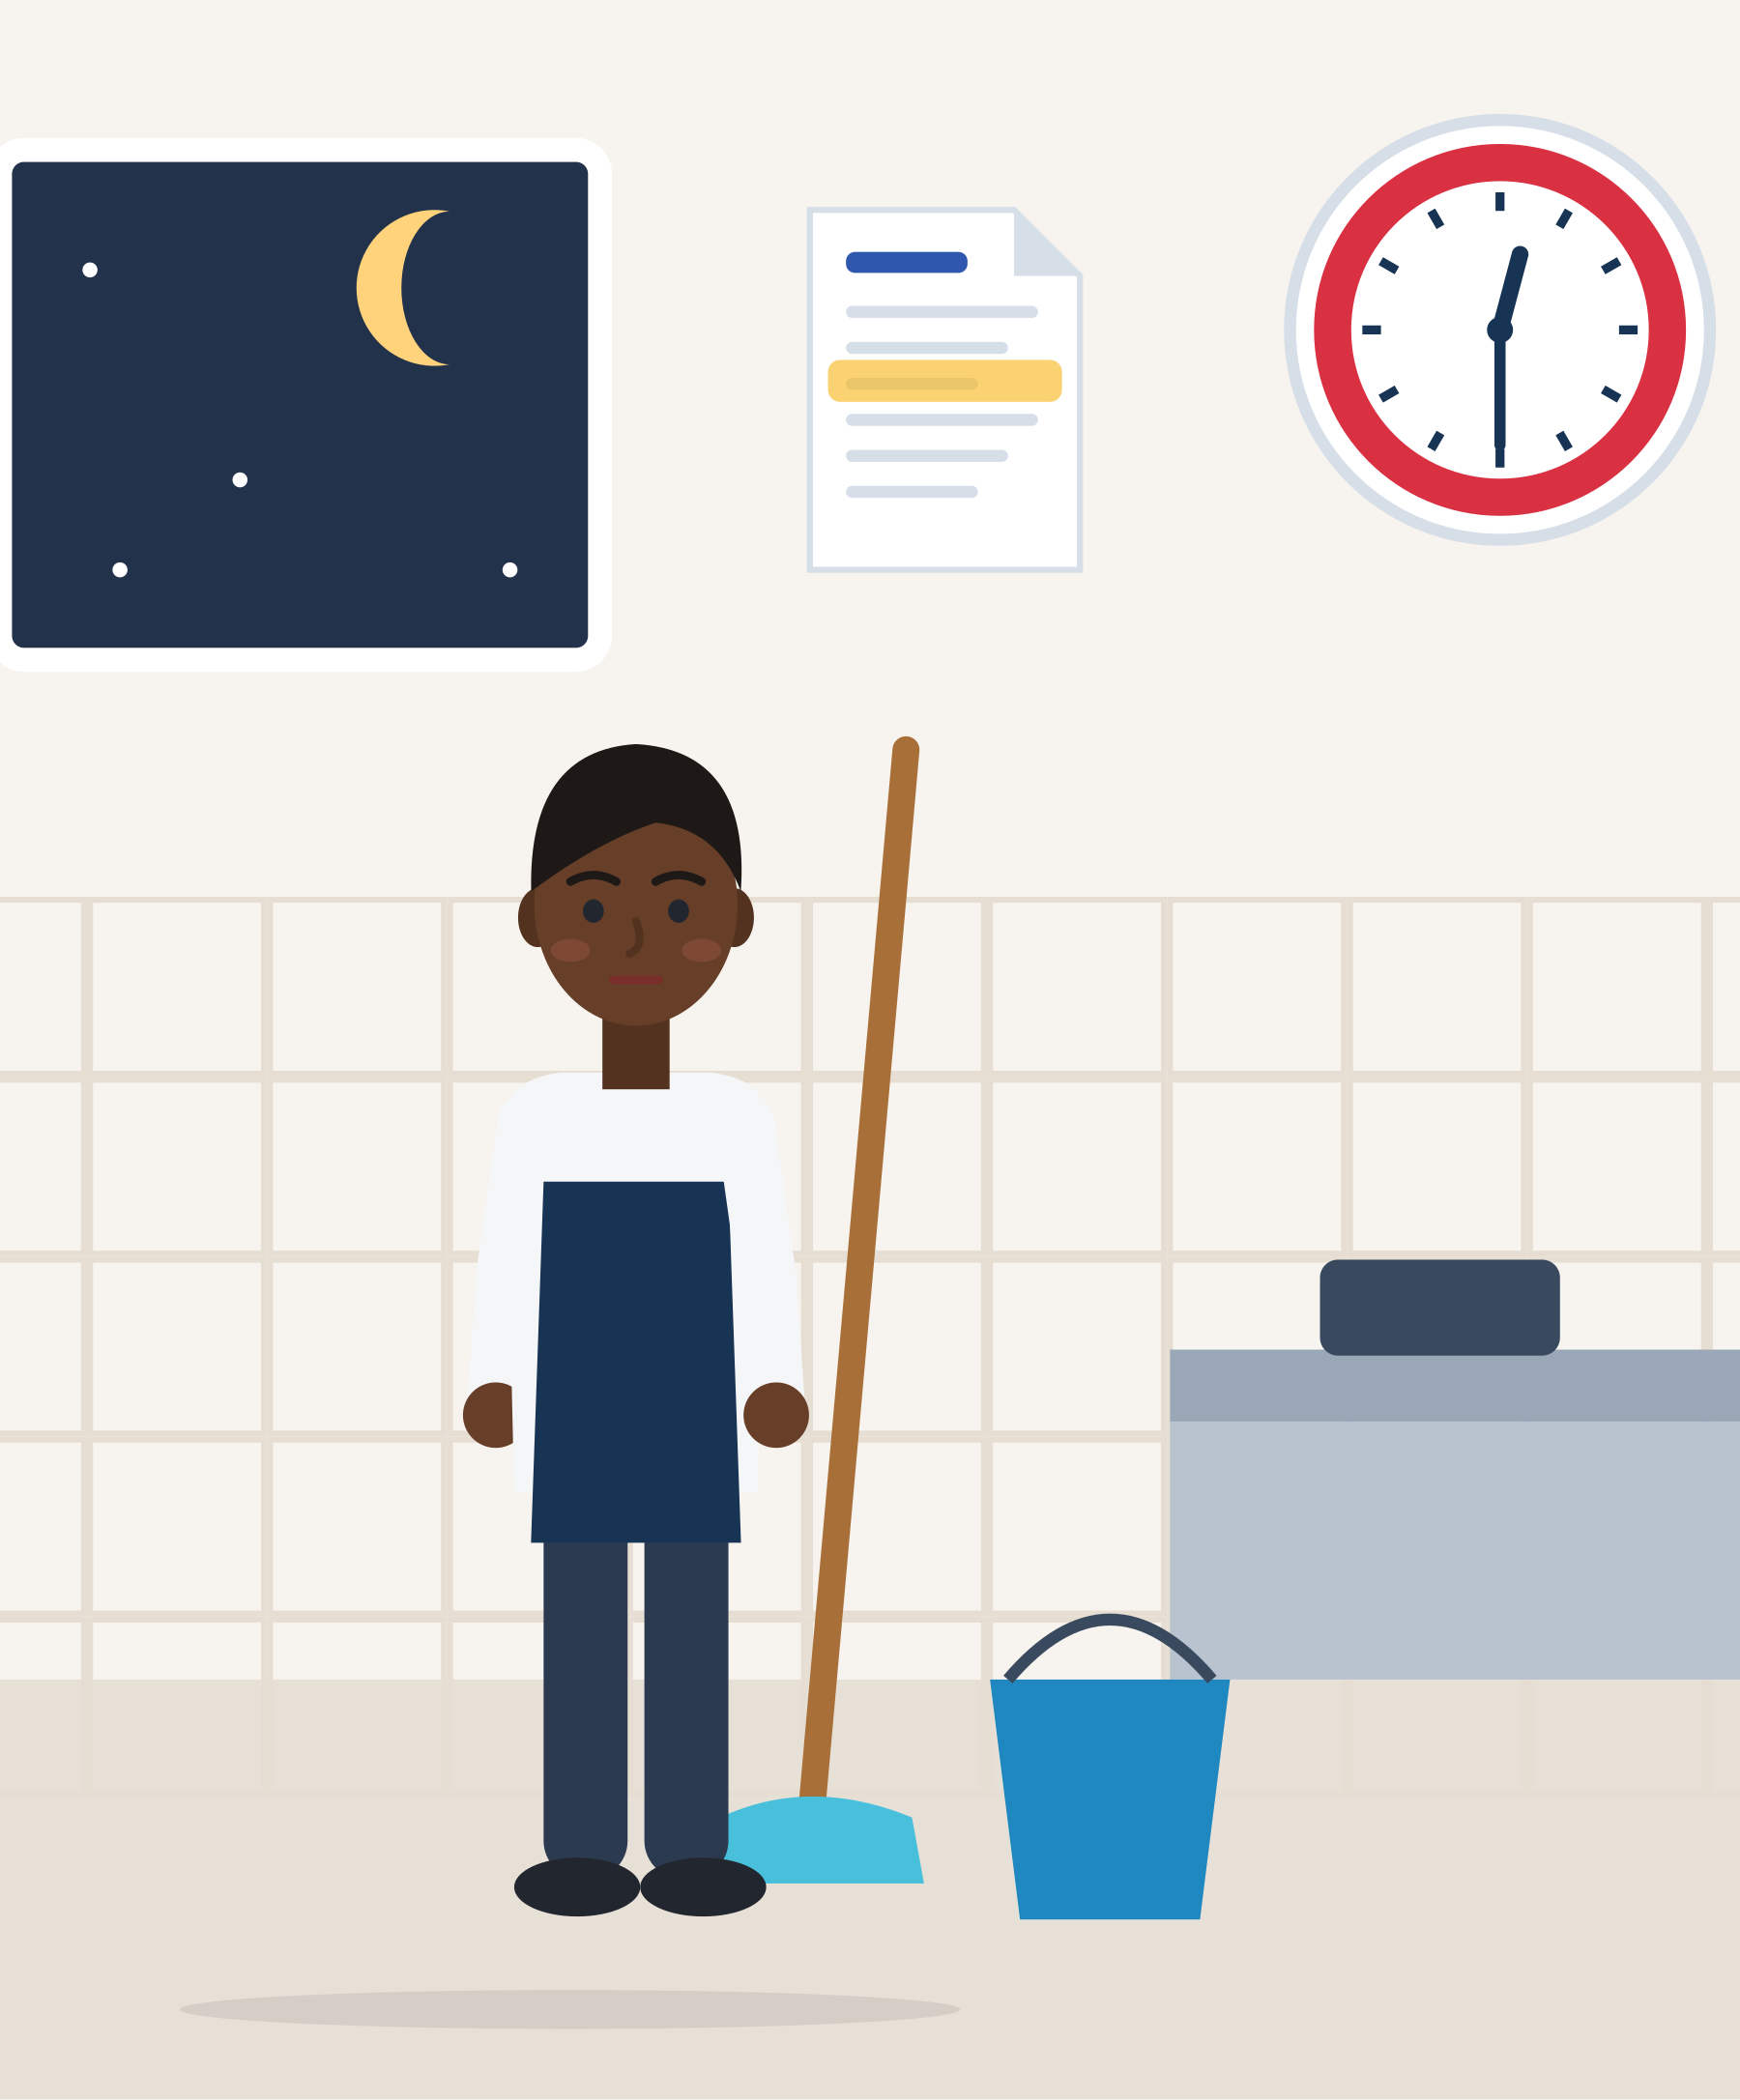
ILLUSTRATIVE SCENARIO
Six hours on paper, seven and a half in reality
Ali, 20
Kitchen assistant in a restaurant, Germany
DISCUSS
Is this a time-management problem, or something else?
What could Ali write down every day?
What could he say, and who could he ask for advice?
Hospitality
Germany
Unpaid hours
The rota says Ali works 17:00-23:00. Most nights he stays until 00:30 to clean the kitchen. His payslip shows six hours a day. He does not want problems with the chef, so he says nothing. He is tired at his language course and thinks his time management is the problem.
Grounded in: 80% of 237 exploited migrant workers reported excessive, irregular hours (FRA, 2019, p. 45); German hospitality employers must record daily working time (§ 17 MiLoG).
Module 7 · Time Management
37
Notes:
Illustrative scenario (constructed). Key learning: some "time problems" are not personal planning problems but rights problems. Unpaid overtime is a real constraint, not a personal failure.
FRA (2019): one worker said, "I finished my work [after midnight] and then I started my work at 9.00 in the morning. I had time to sleep for five hours; of course I was feeling exhausted." FRA also reports that paying in cash is used by some employers "to avoid any evidence that could be used against them in court proceedings".
Germany: under § 17 MiLoG, employers in sectors listed in § 2a SchwarzArbG (construction, hospitality, passenger transport, logistics including platform delivery, building cleaning, meat industry, security) must record start, end and duration of daily working time within 7 days and keep the records for 2 years.
Answer to question 1: both. Ali can plan his sleep better, but the main problem is unpaid work. The next slides give him a tool (hours log) and his rights.

Slide 38



TOOL: PERSONAL HOURS LOG
Write down your real hours, every shift
 | Day | Rota says | Real start and end | Breaks | Place and supervisor | Notes and proof
 | Tue | 17:00-23:00 | 17:00-00:30 | 15 min | Kitchen, chef on duty | Cleaning after closing. Photo of the rota.
 | Wed | 17:00-23:00 | 16:45-00:15 | none | Kitchen, chef on duty | Asked by message to come early. Screenshot.
 | Fri | 17:00-23:00 | 17:00-01:00 | 20 min | Kitchen, chef on duty | Busy night. Payslip later shows 6 hours.
Keep it private and safe. If hours or pay do not match, ask a counselling service or a union.
Source: Constructed tool (SMILE research note) · CJEU C-55/18, CCOO v Deutsche Bank (2019) · Directive 2003/88/EC, Art. 4 (break if the day is longer than 6 hours)
Module 7 · Time Management
38
Notes:
The personal hours log is a time-management tool AND a rights tool: it shows where your time goes and whether it is paid. Columns: date, planned start and end, real start and end, breaks, place, supervisor, notes, plus photos of the rota and screenshots of messages.
The EU Court of Justice ruled that employers must have "a system enabling the duration of time worked each day by each worker to be measured"; without one it is "excessively difficult, if not impossible in practice, for workers to ensure that their rights are complied with" (C-55/18, 2019). A personal log is a backup, not a replacement.
Ask: "What do you notice in Ali's log?" (He worked about 7.5 hours each night, not 6; on Wednesday he had no break although the day was longer than 6 hours.)
Give out a blank log on the worksheet. Remind participants: keep it on their own phone or paper, not on a shared work device.

Slide 39






KNOW YOUR BASICS
Six things every worker in the EU should know
Job information in writing
Probation has a limit
Required training is free
Your employer must give you the main information about your job in writing within 7 days: place, pay, hours, notice.
A probation period can last at most 6 months in general.
Training the employer requires is free for you and counts as working time.
Working time has limits
Unpaid wages can be claimed
Keep your own record
On average no more than 48 hours a week, 11 hours rest every day, at least 4 weeks paid holiday a year.
Even without papers, workers can claim unpaid wages, also through a union or another organisation.
Write down your hours, breaks and payments every day. Photos of rotas and messages help too.
Source: Directive (EU) 2019/1152 Art. 5, 8, 13 · Directive 2003/88/EC Art. 3, 6, 7 · Directive 2009/52/EC Art. 6, 13
Module 7 · Time Management
39
Notes:
Rules are EU minimum standards; national law can give more. Rules for Türkiye differ: point Turkish participants to İŞKUR and the Ministry of Labour (ÇSGB) pages on the help points slide.
Keep the tone practical: the aim is confidence, not fear. Link to the activity on reading a contract or payslip if time allows.
Working time in detail (Directive 2003/88/EC): average maximum 48 hours a week including overtime (reference period up to 4 months); 11 consecutive hours of daily rest; a break if the working day is longer than 6 hours; 24 hours uninterrupted weekly rest plus the 11 hours; at least 4 weeks paid leave; night workers on average no more than 8 hours per 24 hours.
Predictable schedules (Directive 2019/1152): workers with unpredictable schedules have the right to be informed within a reasonable period in advance when work will have to be done. This supports Mariam asking for her shifts in advance. Late-night messages about tomorrow's rota eat into the 11 hours of daily rest.
Germany (ArbZG): 8 hours per working day, up to 10 if the average stays at 8; breaks of 30/45 minutes; 11 hours rest. Türkiye (Labour Law 4857): maximum 45 hours a week (Art. 63); overtime paid at +50%, only with the worker's consent, capped at 270 hours a year (Art. 41); night work maximum 7.5 hours (Art. 69).

Slide 40


USEFUL PHRASES
Phrases for shifts, deadlines, rest and hours
Shifts and clashes
Priorities and deadlines
“Could you tell me my shifts for next week, please?”
“I attend a language course from Monday to Friday until 12:45. Could I work afternoon shifts?”
“I have three tasks. Which one should I do first?”
“I can finish this by Friday. Is that OK, or is it urgent?”
“Could I have one more day for this? I want to do it properly.”
Rest and boundaries
Hours and pay
“Could you send changes to the rota before 20:00?”
“I need my break now; I've been working for six hours.”
“In the evening I usually don't check work messages.”
“I'd like to check my hours for last week.”
“I worked until 00:30 on Tuesday, but the payslip shows six hours. Could we look at it together?”
Module 7 · Time Management
40
Notes:
Practise in pairs: one says the phrase, the other answers as a manager (friendly, then busy). 8 minutes. Use the Mariam case for "shifts and clashes" and the Ali case for "hours and pay".
More phrases from the research note: "Is it possible to swap my shift with a colleague on Thursday?", "When will the rota be ready?", "I have an appointment at the immigration office on the 14th at 10:00. I can come in after 13:00.", "I'm sorry, my bus is delayed. I'll be there in about 15 minutes.", "What time should I be ready to start: dressed and at my station?", "How do people usually do this here?"
Example (constructed): Lena, 21, waitress in Athens, gets WhatsApp messages from her manager late at night about tomorrow's shifts and cannot sleep afterwards. Phrase: "Could you send the next day's rota by 20:00?" Discuss the difference between legal rights (11 hours daily rest) and workplace culture.
Trainers can translate the phrases and the time words into participants' strongest languages: Schicht, Termin, Frist / turno, scadenza / dienst, rooster / βάρδια, προθεσμία / vardiya, son tarih.

Slide 41

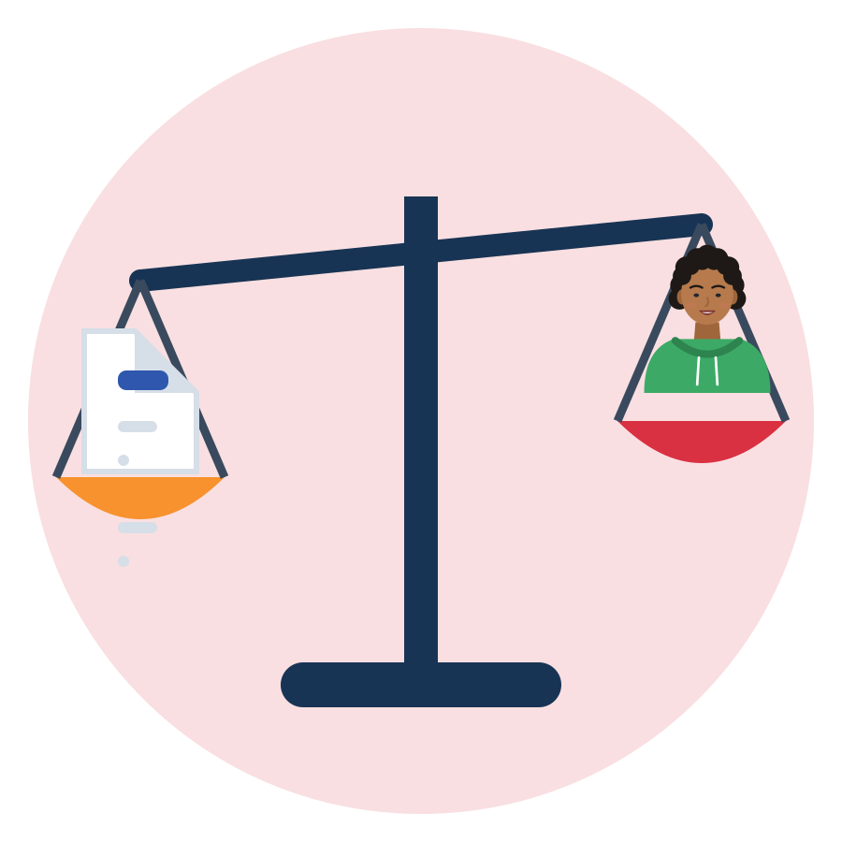
BE FAIR TO YOURSELF
Skills open doors, but they are not the whole story
What this skill can change
What it cannot fix alone
Notice where your time goes, without judging yourself.
Protect sleep, family and learning in your week.
Plan with buffers, and adapt when life changes.
Keep a record of your hours and ask about them.
Identical CV, different name: 55 of 100 got a positive answer with a Dutch name, 40 of 100 with a Turkish name.
Asylum waiting times, permits and rotas are decided by offices and employers, not by your planning.
Illegal hours and unpaid overtime are not a time-management problem. Report them to a labour inspectorate, a union or an NGO.
Plan your time AND know your rights. Both protect your well-being.
Source: Thijssen et al., 2021, JEMS (correspondence test, NL, applicants aged 23-25)
Module 7 · Time Management
41
Notes:
This slide protects participants from a "deficit" message: soft-skills training must not suggest that unemployment or discrimination is their fault.
Field experiments send identical CVs that differ only by name; the call-back gap therefore measures discrimination, not skills (Quillian et al., 2019, meta-analysis of 97 experiments).
Only 6% of Muslim respondents who felt discriminated against reported it (FRA, Being Muslim in the EU, 2024). Point to the help points slide.
For this module the limit is especially important: much "lost time" is structural. Each extra year of asylum waiting lowered refugees' later employment by 4-5 points, interpreted as discouragement, not lost skills (Hainmueller et al., 2016). In Germany, faster asylum procedures, shorter employment bans and completed language courses went with higher refugee employment, and residence obligations hampered starting work (Brücker et al., 2024).
Close with the time-management researchers' own honesty: time management "assumes that the workplace is suitable for planning one's workday and being able to say 'no' to more work, whereas in practice, this is often not the case" (Claessens, 2004, p. 26).

Slide 42





WHERE TO GET HELP
Official help points in the SMILE countries
 | Country | Jobs and training | Diplomas and recognition | Unfair or unsafe work
 | Türkiye | İŞKUR (iskur.gov.tr), Public Education Centres | YÖK denklik, MEB e-Denklik | Ministry of Labour (csgb.gov.tr), YİMER 157 helpline
 | Greece | DYPA (dypa.gov.gr) | DOATAP (doatap.gr) | Labour Inspectorate, phone 1555
 | Italy | Centri per l'Impiego, SIISL | CIMEA (free for protection holders) | Ispettorato Nazionale del Lavoro
 | Germany | Agentur für Arbeit, Jobcenter, Jugendmigrationsdienste (12-27) | Anerkennung in Deutschland, IQ Netzwerk | Faire Integration (free, multilingual)
 | Netherlands | UWV, werk.nl, your municipality | IDW (idw.nl) | Nederlandse Arbeidsinspectie, Juridisch Loket
Save the number or website of one help point in your phone today, next to your hours log.
Source: Official websites, checked 1 October 2026 (SMILE research note, labour market)
Module 7 · Time Management
42
Notes:
Ask participants which country they live in and open the matching website live if internet is available.
For questions about working hours and pay: Labour Inspectorate (Greece, phone 1555), Ispettorato Nazionale del Lavoro (Italy), Faire Integration (Germany: free, anonymous, multilingual advice on labour and social law), Nederlandse Arbeidsinspectie and Juridisch Loket (Netherlands), Ministry of Labour (Türkiye).
For young people under 30 who are unemployed or have left education: the Reinforced Youth Guarantee aims at a good quality offer of a job, education, apprenticeship or traineeship within four months. Registering with the public employment service is a good micro-action (check national rules for non-EU citizens).

Slide 43
SELF-CHECK
Self-diagnosis: my time compass (1/2)
Not like me
A bit like me
Quite like me
Very like me
I know where my time goes on a normal day.
I notice when I am too tired to plan.
I write down my most important tasks.
I plan time for rest and family, not only for duties.
I add extra time around appointments.
When a plan fails, I change it instead of giving up.
Module 7 · Time Management
43
Notes:
Curriculum tool: time management self-diagnosis tool (named in the materials and in the assessment section; the curriculum does not place it in a unit, so we use it at the end). This version, "My time compass", was constructed for SMILE, based on the components time assessment, planning, monitoring and sense of control (Claessens, 2004; Burrus, 2019, via QIC-WD, 2021). It is NOT a validated scale.
Participants rate each statement from 1 ("not like me") to 4 ("very like me"). No scores are collected or compared. Four areas: awareness (items 1-2), planning (3-5), monitoring and adapting (6-7), control and feelings (8-12).

Slide 44
SELF-CHECK
Self-diagnosis: my time compass (2/2)
Not like me
A bit like me
Quite like me
Very like me
I check my plan at least once a week.
I feel I have some control over my time.
When I delay a task, I can be kind to myself and try again.
My phone helps me more than it distracts me.
I know my rights about working hours.
I get enough sleep most nights.
Module 7 · Time Management
44
Notes:
At the end, each participant circles ONE area to work on and links it to the strategy they chose in the activity. Optional: use the compass at the start and at the end of the module, or after two weeks, to notice change.
Collect only anonymous, optional feedback on which statements the group finds hardest. That is the formative information the curriculum asks for.

Slide 45

REFLECTION
One small strategy, starting this week
Which strategy will I try?
What will I protect this week: sleep, family or learning?
When and where exactly? “If ___, then I will ___.”
How will I know in two weeks if it helps?
Write it on a card. Missed a day? Just continue.
Module 7 · Time Management
45
Notes:
Closing round (5 min): each participant says only their strategy and their if-then sentence, or passes. Keep it short and positive.
More reflection questions from the research note for later sessions: "What does taking control of time mean for you now?", "Which factor affects your time most: stress, emotions, phone, other people's schedules?", "What will you change if it does not help?"

Slide 46




KEY MESSAGES
Your time, your control: small steps, kind restarts.
Time management is not about doing more. It helps you feel more in control, protect rest, family and learning, and adapt when life changes. Where others set your time, records and rights protect you.
Module 7 · Time Management
46
Notes:
Summarise with the group: ask three volunteers to name one tool they will keep (timeline, urgent/important sort, three-layer week, WOOP, notification check, micro-action, hours log). Repeat the key evidence in one sentence: time management is linked more to well-being than to performance (Aeon et al., 2021).

Slide 47
REFERENCES
Sources used in this presentation (1/2)
Acarturk, C., et al. (2022). Effectiveness of a WHO self-help psychological intervention for preventing mental disorders among Syrian refugees in Turkey: An RCT. World Psychiatry, 21(1), 88-95.
Aeon, B., Faber, A., & Panaccio, A. (2021). Does time management work? A meta-analysis. PLOS ONE, 16(1), e0245066.
Biwer, F., et al. (2023). Understanding effort regulation: Comparing "Pomodoro" breaks and self-regulated breaks. British Journal of Educational Psychology, 93(S2), 353-367.
Böttger, T., Poschik, M., & Zierer, K. (2023). Does the brain drain effect really exist? A meta-analysis. Behavioral Sciences, 13(9), 751.
Buehler, R., Griffin, D., & Ross, M. (1994). Exploring the "planning fallacy". Journal of Personality and Social Psychology, 67(3), 366-381.
Centers for Disease Control and Prevention (n.d.). About sleep. Retrieved 1 October 2026.
Claessens, B. J. C. (2004). Perceived control of time: Time management and personal effectiveness at work [Doctoral dissertation]. TU Eindhoven.
Court of Justice of the EU (2019). Case C-55/18, CCOO v Deutsche Bank SAE (Press release No 61/19).
de Graaff, A. M., et al. (2023). Peer-provided psychological intervention for Syrian refugees: RCT of Problem Management Plus. BMJ Mental Health, 26(1), e300637.
Directive 2003/88/EC on the organisation of working time; Directive (EU) 2019/1152 on transparent and predictable working conditions.
Droit-Volet, S., & Meck, W. H. (2007). How emotions colour our perception of time. Trends in Cognitive Sciences, 11(12), 504-513.
Eurostat (2026). Datasets lfsa_ewpshi, lfso_19fxwt01, lfso_19fxwt14, lfso_21educ02, migr_asypenctzm. Extracted 1 October 2026.
Fitz, N., et al. (2019). Batching smartphone notifications can improve well-being. Computers in Human Behavior, 101, 84-94.
FRA (2019). Protecting migrant workers from exploitation in the EU: Workers' perspectives. Publications Office of the EU.
Gollwitzer, P. M., & Sheeran, P. (2006). Implementation intentions and goal achievement: A meta-analysis. Advances in Experimental Social Psychology, 38, 69-119.
Module 7 · Time Management
47
Notes:
Full verified references with URLs and page numbers (including Zhu et al., 2018; Eisenhower, 1954; BAMF, 2016; Levine & Norenzayan, 1999; Korabik et al., 2017; Brücker et al., 2024; Purgato et al., 2021; Kushlev et al., 2016; Dekker et al., 2025; Lim & Dinges, 2010; § 17 MiLoG): SMILE research note "Time Management" (arastirma/time-management-icerik.md) and the shared labour-market note.

Slide 48
REFERENCES
Sources used in this presentation (2/2)
Griffiths, M. B. (2014). Out of time: The temporal uncertainties of refused asylum seekers and immigration detainees. Journal of Ethnic and Migration Studies, 40(12), 1991-2009.
Häfner, A., & Stock, A. (2010). Time management training and perceived control of time at work. The Journal of Psychology, 144(5), 429-447.
Hagger, M. S., et al. (2016). A multilab preregistered replication of the ego-depletion effect. Perspectives on Psychological Science, 11(4), 546-573.
Hainmueller, J., Hangartner, D., & Lawrence, D. (2016). When lives are put on hold: Lengthy asylum processes decrease employment among refugees. Science Advances, 2(8), e1600432.
Lally, P., van Jaarsveld, C. H. M., Potts, H. W. W., & Wardle, J. (2010). How are habits formed. European Journal of Social Psychology, 40(6), 998-1009.
Mani, A., Mullainathan, S., Shafir, E., & Zhao, J. (2013). Poverty impedes cognitive function. Science, 341(6149), 976-980.
O'Donnell, M., et al. (2021). Empirical audit and review and an assessment of evidentiary value in research on the psychological consequences of scarcity. PNAS, 118(44), e2103313118.
Oettingen, G., Kappes, H. B., Guttenberg, K. B., & Gollwitzer, P. M. (2015). Self-regulation of time management: Mental contrasting with implementation intentions. EJSP, 45(2), 218-229.
Phillimore, J., & Cheung, S. Y. (2021). The violence of uncertainty: How asylum waiting time undermines refugee health. Social Science & Medicine, 282, 114154.
Rotter, R. (2016). Waiting in the asylum determination process: Just an empty interlude? Time & Society, 25(1), 80-101.
Sirois, F., & Pychyl, T. (2013). Procrastination and the priority of short-term mood regulation. Social and Personality Psychology Compass, 7(2), 115-127.
Steel, P. (2007). The nature of procrastination: A meta-analytic and theoretical review. Psychological Bulletin, 133(1), 65-94.
Stothart, C., Mitchum, A., & Yehnert, C. (2015). The attentional cost of receiving a cell phone notification. JEP: Human Perception and Performance, 41(4), 893-897.
Thijssen, L., Lancee, B., Veit, S., & Yemane, R. (2021). Discrimination against Turkish minorities in Germany and the Netherlands. Journal of Ethnic and Migration Studies, 47(6), 1222-1239.
Wohl, M. J. A., Pychyl, T. A., & Bennett, S. H. (2010). I forgive myself, now I can study. Personality and Individual Differences, 48(7), 803-808.
Module 7 · Time Management
48

Slide 49


Thank you
THE SMILE PARTNERSHIP
Göç Sanat ve Spor Derneği (MIGARTS) (Türkiye, coordinator)
KYTTARO ENALLAKTIKON ANAZITISEON NEON (KEAN) (Greece)
Work in Progress APS (WiP) (Italy)
Smart Leap Education Research Consultancy GmbH (Germany)
Association of Entrepreneurship School (AES) (Türkiye)
BİR-İZ (Türkiye)
Stichting Unity Sphere Europe (SUSE) (Netherlands)
Questions, ideas, stories: the floor is yours.
KEEP LEARNING
smile-lms.smartleap.eu
MODULE
7 · Time Management
PROJECT
SMILE · Erasmus+ KA220-YOU
PROJECT NO.
2024-1-TR01-KA220-YOU-000256357
Scan to join the SMILE learning platform
Free online course: lessons, activities, quiz and certificate.
Co-funded by the European Union. Views and opinions expressed are however those of the author(s) only and do not necessarily reflect those of the European Union or the Turkish National Agency. Neither the European Union nor the granting authority can be held responsible for them.
SKILLS = Opportunity
Empowerment Through Skills · Inclusion Through Opportunity
Module 7 · Time Management
49
Notes:
Invite participants to continue on the SMILE learning platform (QR code). Remind them of the 7-day check-in: keep, change or drop their strategy. Collect the anonymous feedback on the hardest self-diagnosis statements.

