Slide 1
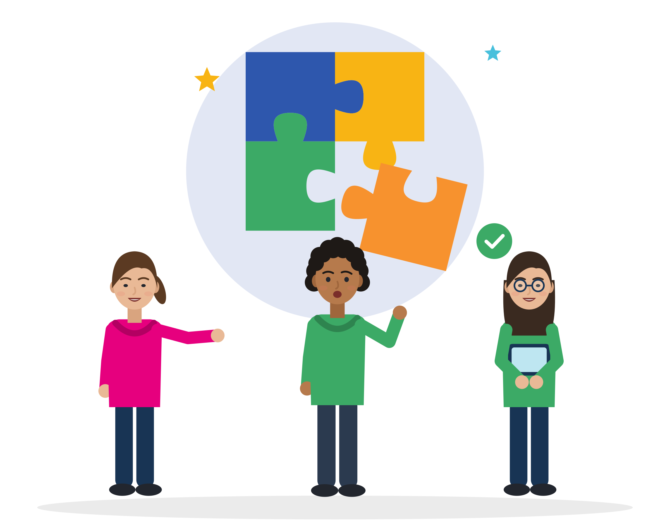



MODULE 6 · TRAINER PRESENTATION
Teamwork
Work well in mixed teams: check that you understood, share tasks fairly, disagree with respect and make sure nobody is left out.
About 3 hours
3 units
Ages 18-30
B1-B2 English
SMILE
Support Young Migrants Integration in the Labour market in Europe
Erasmus+ KA220-YOU · 2024-1-TR01-KA220-YOU-000256357
Empowerment Through Skills · Inclusion Through Opportunity
Notes:
Module 6 of the SMILE soft-skills curriculum. Duration in the curriculum: about 3 hours (1.5 h theoretical input and guided discussion, 1.5 h practical learning: case studies, role-play, reflection). It can run as one 3-hour session or as two shorter sessions.
Say: "Today is about working with other people: in a kitchen, a warehouse, a training course or a football team. Teamwork is a shared responsibility, not one person's performance."
Welcome participants and introduce SMILE in one sentence: an Erasmus+ project of seven partners in Türkiye, Greece, Italy, Germany and the Netherlands that helps young migrants enter the labour market.

Slide 2




HOW WE WORK TOGETHER
Our agreement for this module
Any English is good English
Your story belongs to you
Listen to understand
“Pass” is always OK
We listen to ideas, not grammar. Nobody corrects your language here. Mix words from other languages if it helps.
You never have to share your migration story. Our examples use invented characters.
One voice at a time. Every question is a good question.
You can skip any activity or question. Take a break when you need one.
Module 6 · Teamwork
2
Notes:
Co-create or confirm the agreement before content starts. Write it on a flipchart and keep it visible for the whole module.
Why: many young refugees carry heavy stress. A review of 26 studies (5,143 adult refugees and asylum seekers) found PTSD and depression in about 31.5% each (Blackmore et al., 2020, PLOS Medicine). Never ask participants to tell their migration story; use the constructed characters on the slides.
Language: do not correct grammar or pronunciation during sharing. Model the phrases instead (the "useful phrases" slides).
For this module, add two rules from the research note: "Any language is OK in pairs" and "No stories leave the room". The curriculum asks for emotional safety, respect, fairness and participation.
Several slides deal with unfair tasks, jokes about origin and exclusion. They always use invented characters. Nobody has to act out or tell their own experience of discrimination; people may choose to share.
Role-plays: introduce a "pause" card now. Anyone can stop a scene at any time.

Slide 3
MODULE MAP
Three units, from understanding to real practice
01
Unit 1: Understanding Teamwork (Together We Are Stronger)
02
Unit 2: Teamwork in the Reality of Young Migrants
03
Unit 3: Practical Strategies and Good Practices
What teamwork is, why it can be learned, where we use it, skills, attitudes and myths. Reflection activity.
Culture, language, unwritten rules, power and fairness, emotions. Case study: inclusive and exclusionary practices.
Roles, communication, participation, cultural differences, conflict, feedback, fairness. Simulation, role-play, self-diagnosis.
≈ 35 min
≈ 60 min
≈ 75 min
Module 6 · Teamwork
3
Notes:
Say: "We start with what teamwork is, then look at real challenges in mixed teams, then practise."
The curriculum fixes only the total: about 3 hours (1.5 h input, 1.5 h practice). The minutes on this slide are a suggestion from the research note: opening 10 min; Unit 1 20 min input + 15 min reflection; Unit 2 35 min input + 25 min case study; Unit 3 25 min input + 35 min simulation and role-play + 15 min self-diagnosis and closing. Total 180 min.
One 3-hour block: add a 10-minute break after Unit 2 and shorten the Unit 2 input. Two-session option: Session A = opening + Units 1 and 2 (about 105 min); Session B = 5-minute recap + Unit 3 + self-diagnosis (about 80 min).
Note on names: the curriculum calls the Unit 3 tool both "teamwork self-diagnosis checklist" (materials) and "self-diagnosis questionnaire" (assessment). It is the same tool (slides 43-44).

Slide 4
LEARNING OUTCOMES
By the end of this module, you will be able to
1
Define teamwork and explain its importance in education/employment contexts.
4
Demonstrate effective teamwork skills (in practice) through group activities and role-play scenarios.
2
Identify the key teamwork skills and attitudes appropriate to diverse and multicultural settings.
5
Apply collaborative, respectful and fair behaviours when working in teams.
3
Recognise the common teamwork challenges faced by young migrants and describe solution strategies for them.
6
Reflect on your own roles, strengths and the areas you need to develop in team-based situations (self-assessment).
Module 6 · Teamwork
4
Notes:
These are the six learning outcomes of the SMILE curriculum (English edition). Only outcome 6 is adapted from "their" to "your" so that it speaks to participants.
Assessment is formative and reflective: observation of group participation, reflection questions and group discussion, the self-diagnosis checklist at the end and feedback during role-plays. No grades.

Slide 5



WHY THIS MATTERS
Most jobs in Europe are team jobs
2 in 3
61%
23%
employees in Europe work in a team often or always (34% + 31%). More than 8 in 10 do it at least sometimes.
of employers call “leadership and social influence” a core skill, and 50% “empathy and active listening”: the skills for working with others.
of employers call multi-lingualism a core skill. The languages you speak can be a strength for your team.
Teamwork is not an extra for managers. It is everyday work in kitchens, warehouses, shops and care homes.
Source: Cedefop (2022), ESJS2, Fig. 29, p. 55 (EU-27 + IS + NO, employees aged 25-64, 2021 data) · World Economic Forum, Future of Jobs Report 2025, Fig. 3.3, p. 35
Module 6 · Teamwork
5
Notes:
Say: "Almost every job you will apply for needs teamwork. And the languages you bring can help a team."
Evidence: Cedefop interviewed 46,213 employees aged 25-64 in the EU-27, Iceland and Norway (2021). Asked how often they "work in a team i.e. together with a group of people who plan their work to achieve shared objectives": 34% always or very often, 31% often, 21% sometimes, 14% rarely or never. Cedefop warns that surveys can over-state teamwork because people mix it up with willingness to collaborate.
WEF 2025: more than 1,000 employers in 55 economies. WEF has no item called "teamwork"; it has a cluster "Working with others" (empathy and active listening, leadership and social influence, teaching and mentoring 26%). Do not invent a "teamwork %".
Tip: ask "Which jobs do you know where people must work as a team?" and collect 4-5 answers before showing the numbers.
The person icons are rounded to the nearest 1 in 10 (2 in 3 = 65% is shown as 7 of 10).

Slide 6


01
UNIT 1 · ≈ 35 min
Understanding Teamwork
Together We Are Stronger: teamwork is a shared responsibility, not individual performance.
Definition
Learnable skill
Skills and attitudes
Myths
Module 6 · Teamwork
6
Notes:
Unit 1 introduces the concept of teamwork, its meaning, its relevance and common misunderstandings. It supports participants in seeing teamwork as a shared responsibility rather than as individual performance (curriculum).
Suggested timing: 20 min input and discussion + 15 min reflection activity. The curriculum gives no unit times; this split comes from the research note.

Slide 7
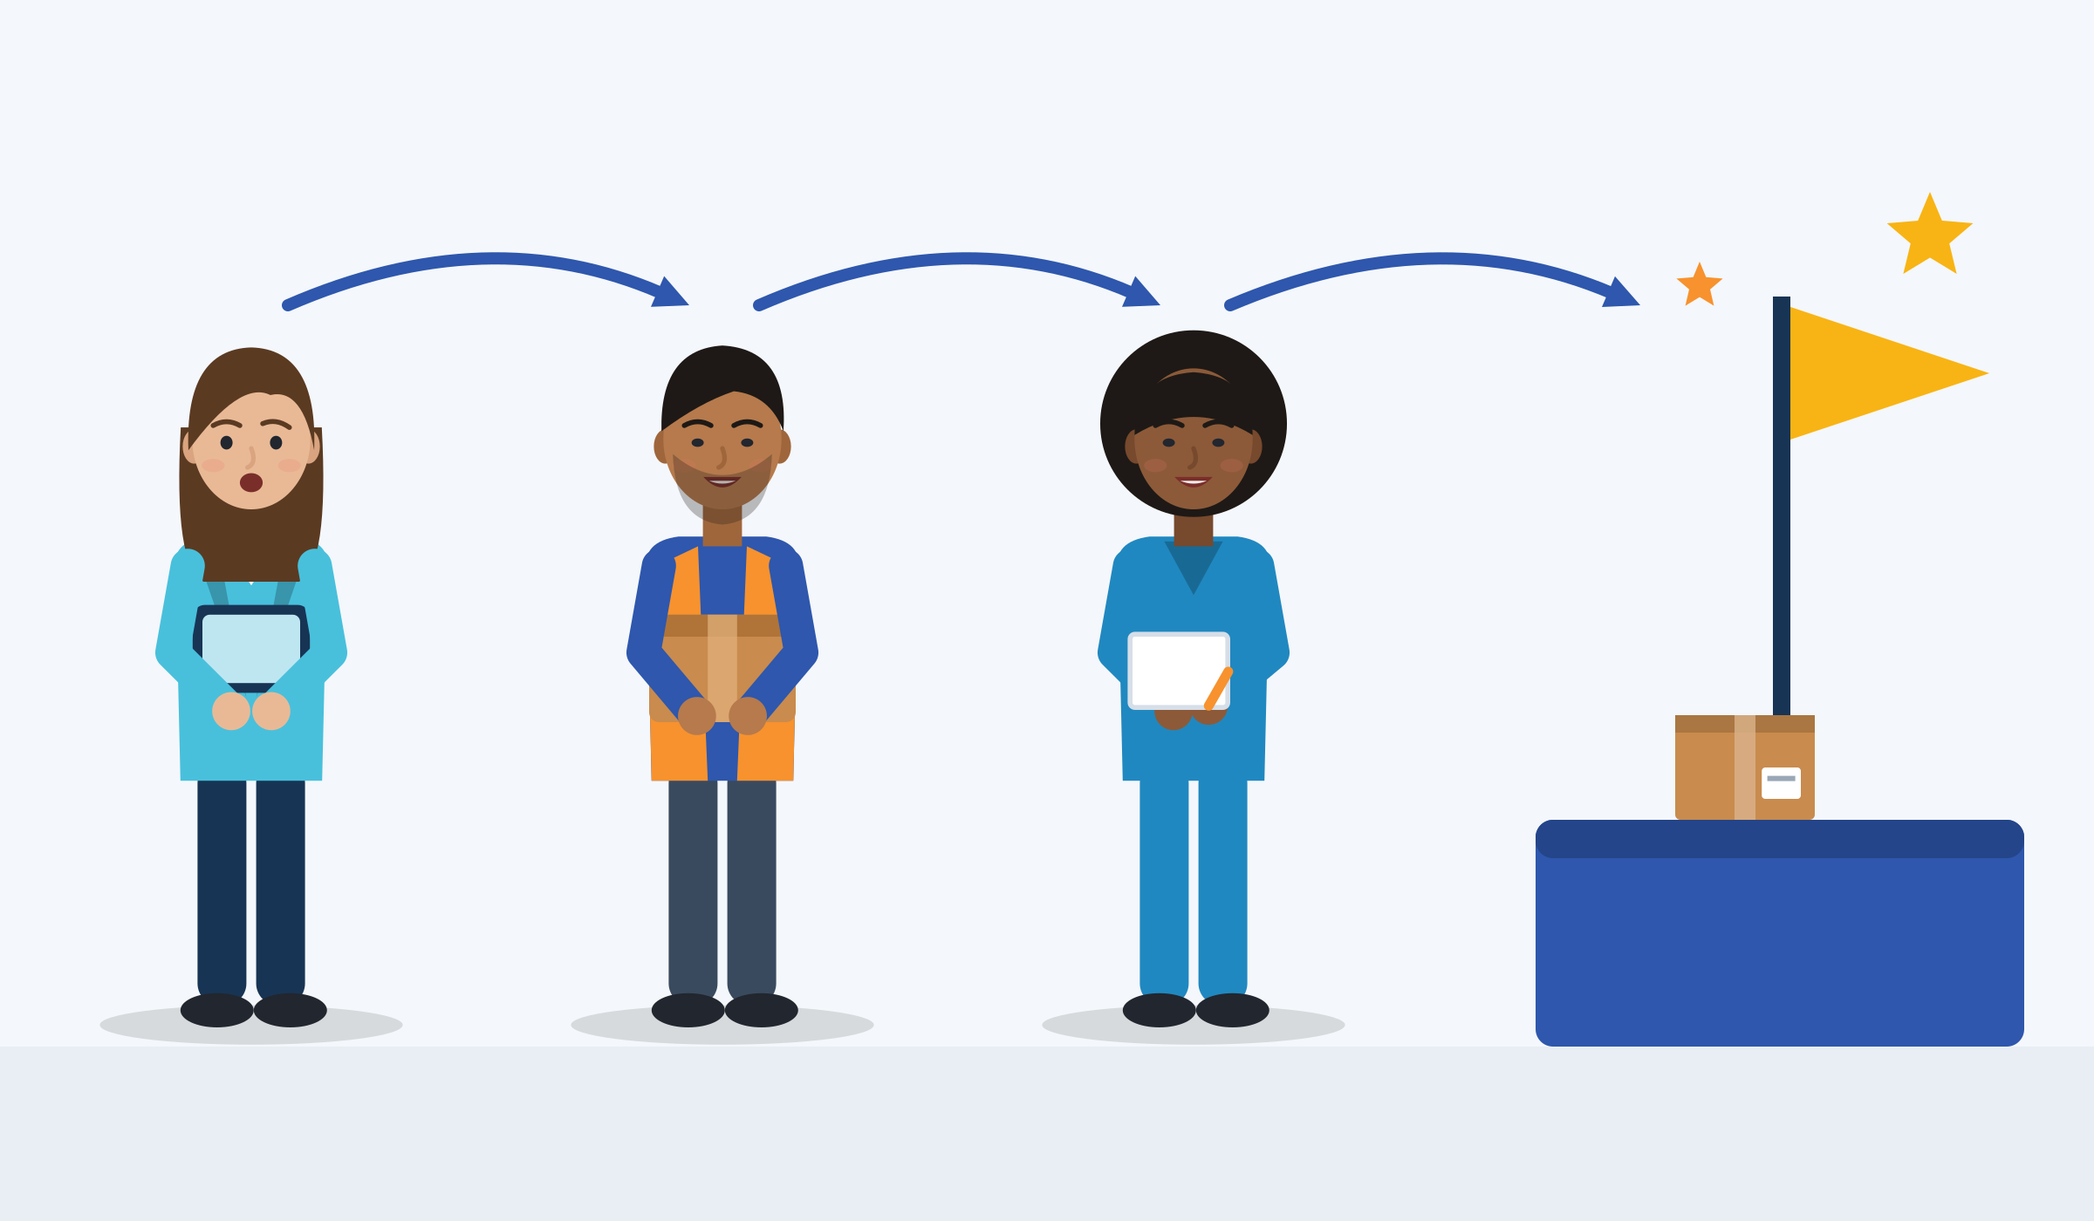
DEFINITION OF TEAMWORK · A LEARNABLE SKILL
What is teamwork, and can you learn it?
We depend on each other
In short
A team: two or more people with clear roles who depend on each other and share a goal that matters to them.
Taskwork is working with tools and machines. Teamwork is working with people: coordinating, checking, helping.
Shared responsibility: not one hero, and not one person to blame.
It can be trained: 72 controlled programmes with 8,439 people showed medium-sized positive effects.
Shared goal
Clear roles
Source: Salas, Sims & Burke (2005), Small Group Research, p. 562 · McEwan et al. (2017), PLoS ONE, meta-analysis of 51 articles
Module 6 · Teamwork
7
Notes:
Say: "A team is more than people in the same place. They need each other to reach a goal. And teamwork is not a talent you are born with: you can train it."
Run (5 min): ask first "Is a group at a bus stop a team? A football team? Your language class?" Collect answers. The difference: a shared goal and depending on each other.
Evidence: Salas et al. (2005, p. 562) define a team as "two or more individuals with specified roles interacting adaptively, interdependently, and dynamically toward a common and valued goal". McEwan et al. (2017): 51 articles, 72 controlled interventions, 194 effect sizes, 8,439 participants. Honest note: most studies come from health care, sport, the military and students, not from migrant workers.
Learnable skill: like football or cooking, teamwork gets better with practice and feedback. McEwan et al. (2017): “positive and significant medium-sized effects” on teamwork and on team performance. The picture: different roles (plan, carry, check), each step depends on the one before, one shared goal.
Tip: the EU's own word for it is ESCO skill S1.8.1 "working in teams": "Working confidently within a group with each doing their part in the service of the whole." Participants can copy this label into a CV.

Slide 8



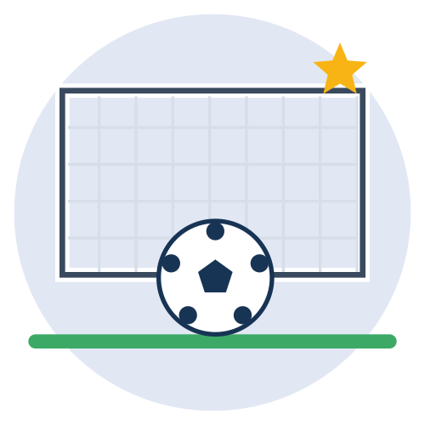


TEAMWORK IN DAILY LIFE, EDUCATION AND EMPLOYMENT
You already work in teams
Daily life: a big family dinner
Education: a group project
Work: a kitchen on Saturday night
Who shops, who cooks, who cleans? Without a plan, one person does everything.
Four people, one presentation, one grade. The group chat decides a lot.
Orders come fast. The cook, the helper and the waiter must hear each other.
Daily life: a football team
Education: an internship
Work: a warehouse picking team
Everyone has a position. You only win if you pass the ball.
You join a team with its own routines. You learn them by watching and asking.
The route plan changes during the shift. If one person misses it, the delivery is late.
Module 6 · Teamwork
8
Notes:
Say: "You have already been part of many teams. Today we use that experience."
Run (5 min): columns are daily life, education and work. Ask "Which of these teams have you been part of? What made it work?" A show of hands is enough; nobody has to tell a personal story.
Evidence: for young migrants, examples should come from kitchens, warehouses, cleaning crews, building sites, care teams and harvest teams, not from office project teams (research note §3.1). Cedefop (2022): more than 8 in 10 adults work in a team at least sometimes and 74% deal with clients or customers.
Tip: write participants' own team examples on the flipchart. You will reuse them in the reflection activity.

Slide 9
TEAMWORK IN EMPLOYMENT
Many young migrants start in hands-on team jobs
% of employed people aged 15-29 in elementary jobs: cleaners, kitchen helpers, labourers, warehouse and delivery work (2025).
Service and sales jobs (kitchens, shops, care) are the largest group for young workers born abroad: 25.3% vs 20.9%.
Most of your teamwork will happen on the floor, in shifts, often with people from many countries.
Source: Eurostat lfsa_egaisedm, 2025, own calculation (SMILE research note, teamwork §3.1) · ISCO-08 groups 5 and 9 · EL sample too small
Module 6 · Teamwork
9
Notes:
Say: "Young people born abroad work about twice as often in hands-on jobs as young people born in the country. These are team jobs: one late delivery or one wrong order affects everyone."
Evidence: own calculation from Eurostat lfsa_egaisedm (updated 10.9.2026), employed aged 15-29, ISCO-08 group 9 "elementary occupations". EU-27 16.2% vs 7.6%; DE 14.2 vs 3.8; IT 20.9 vs 7.2; NL 18.9 vs 13.6; TR 21.4 vs 14.6. Greece: sample too small. For Türkiye the LFS "foreign-born" group may not capture everyone under temporary protection.
Many are over-qualified: 37.6% of tertiary-educated non-EU citizens aged 20-34 work in low- or medium-skilled jobs vs 21.8% of nationals (Eurostat lfsa_eoqgan, 2025). Say clearly: this is not a personal failure.
Tip: ask "What kind of teamwork does a cleaning crew need? And a kitchen?" (timing, handovers, helping each other).

Slide 10


SKILLS AND ATTITUDES RELATED TO EFFECTIVE TEAMWORK
What good team members do, and how they think
Skills you can practise
Attitudes that make it work
Check that you understood: say it back.
Help a colleague who is overloaded.
Follow instructions, ask when unclear.
Give and accept feedback about the work.
Keep others informed.
Shared responsibility: I do my share.
Respect: people have different backgrounds and beliefs.
Fairness: tasks are shared fairly.
Trust: I can admit a mistake.
Openness: more than one good way to work.
On your CV, use the EU's words: “working in teams”, “assisting and supporting co-workers”, “accepting feedback”.
Source: ESCO S1.8.1-S1.8.6 · LifeComp S3.1-S3.3 (Sala et al., 2020, p. 43) · Council of Europe RFCDC Vol. 2, p. 20 · Salas et al. (2005), Table 1
Module 6 · Teamwork
10
Notes:
Say: "Skills are what you do. Attitudes are how you see the team. In a mixed team you need both."
Evidence: ESCO S1.8 "working with others" has six sub-skills: working in teams, giving instructions, giving feedback, accepting feedback ("React to valid and well-reasoned opinions and directions about one's work in a positive manner"), following instructions and procedures, assisting and supporting co-workers. LifeComp S3.1: "awareness that others may have different cultural affiliations, backgrounds, beliefs, values, opinions or personal circumstances"; S3.3: "Fair sharing of tasks, resources and responsibility within a group". RFCDC basic descriptor: "does his/her share of the group's work". Salas et al.: trust shows in "willingness to admit mistakes and accept feedback".
Run (3 min): each participant picks one skill they are strong in and one attitude they want to grow, and writes them down. They come back to it in the self-diagnosis at the end.
Tip: show the ESCO website if internet is available; the exact labels help on a Europass CV.

Slide 11
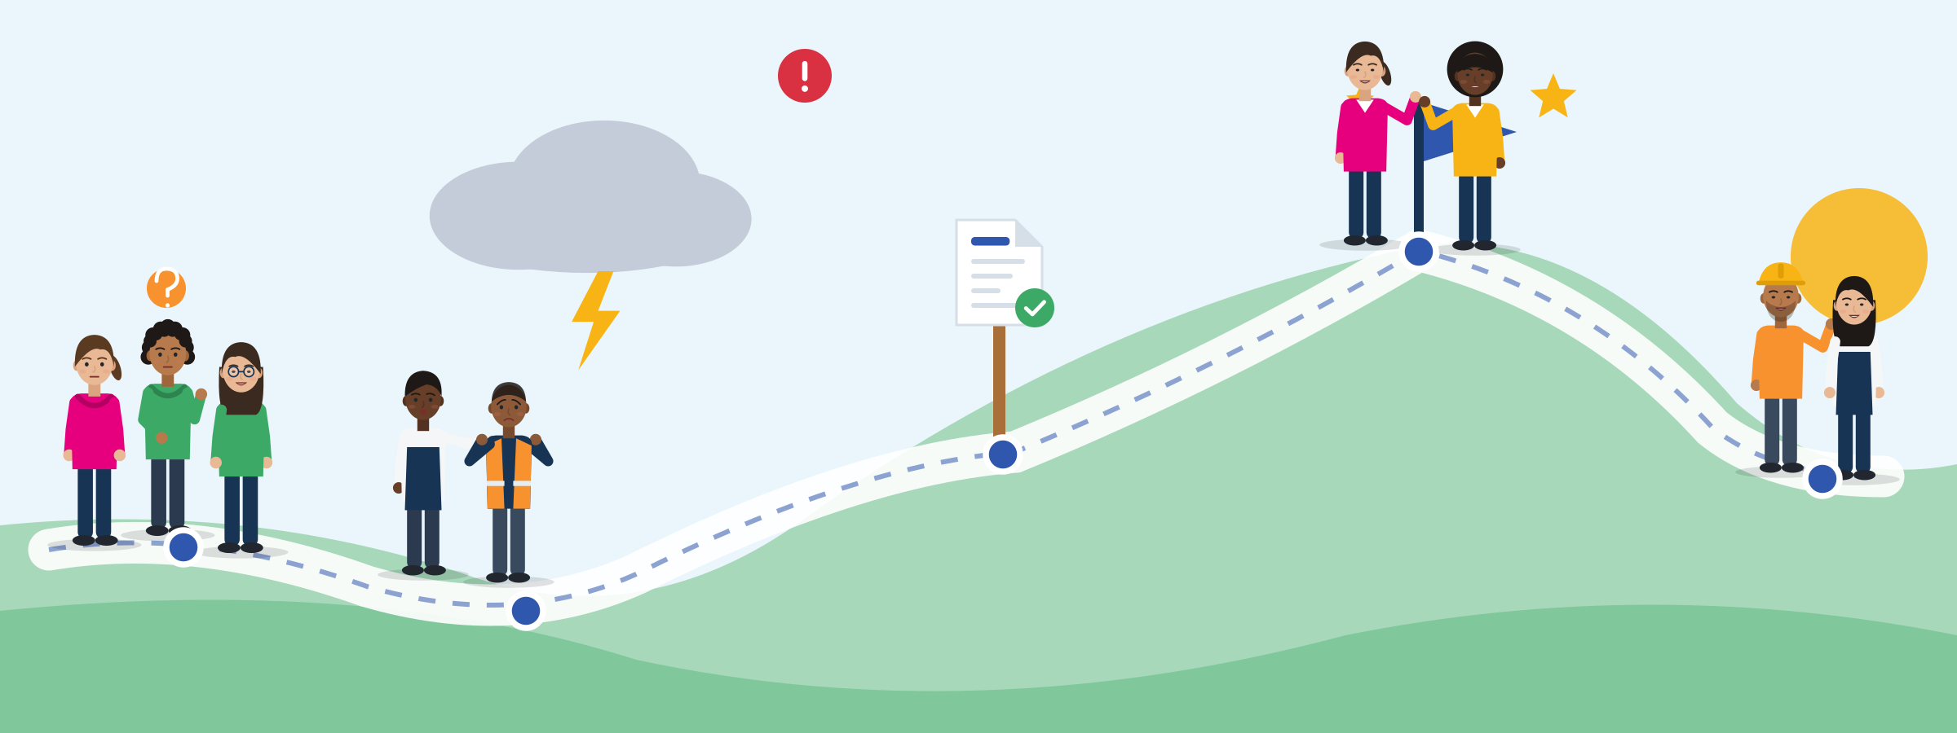
HOW TEAMS DEVELOP (TUCKMAN)
New team, new stages: a map, not a law
Forming
Storming
Norming
Performing
Getting to know: “I stay quiet and watch. Who decides here?”
Shared rules: “Now we know who does what.”
Working well: “We help each other without asking.”
First conflicts: “We disagree about tasks.” That is normal.
Adjourning
Ending well: “Thank you. Can you be my reference?”
A map, not a law: real teams often change in jumps, for example when a deadline comes closer.
Source: Tuckman (1965), Psychological Bulletin; Tuckman & Jensen (1977) · critique: Gersick (1988), Academy of Management Journal
Module 6 · Teamwork
11
Notes:
Say: "Every new team goes through stages. When you start a job, staying quiet is normal. Arguments in the second week are normal too. And when a job ends, end it well."
Evidence: Tuckman (1965) reviewed 50 articles (many on therapy and training groups) and proposed forming, storming, norming and performing. Tuckman & Jensen (1977) reviewed 22 later studies and added adjourning. Limits: the 1965 paper was a literature synthesis, and Gersick (1988), following 8 project teams, found progress in jumps triggered by deadlines rather than fixed stages. Use it as a map, not a law.
Run (3 min): ask "Which stage is your class, team or workplace in right now?" Participants point to a stage.
Stage quotes in full: forming "I stay quiet and watch. Who decides here?"; storming "We disagree about tasks. Is that bad?" No: it is normal; norming "Now we know who does what, and how we talk."; performing "We help each other without asking. Energy goes into the task."; adjourning "The season ends. I say thank you and ask for a reference."
Tip: adjourning matters in seasonal work and internships. Practise the phrase "Would you be willing to be a reference for me?"

Slide 12


MYTH OR FACT?
Common misconceptions about teamwork
“Teamwork is a personality thing. You have it or you don't.”
It can be trained: 72 controlled programmes with 8,439 people showed medium-sized positive effects (McEwan et al., 2017).
“A good team never argues.”
Conflict about the task is not reliably harmful. Conflict about persons, or about who does what, is (116 studies; de Wit et al., 2012).
“A team of the best individuals is the best team.”
In Google's study of 180 teams, how the team worked together mattered more than who was in it (re:Work, 2015).
“In a group, everyone works equally hard.”
People often make less effort in groups (“social loafing”, 78 studies). Visible tasks and a meaningful goal reduce it.
“Newcomers should stay quiet. Asking looks weak.”
Where it feels safe to ask and admit errors, teams learn more, and learning is linked to better results (51 teams; Edmondson, 1999).
Source: McEwan et al. (2017) · de Wit, Greer & Jehn (2012) · Google re:Work (2015) · Karau & Williams (1993) · Edmondson (1999)
Module 6 · Teamwork
12
Notes:
Say: "Let's test five things people often believe about teams."
Run (5 min): read each myth; participants stand up (or raise a card) if they think it is true, then reveal the fact.
Evidence notes: de Wit et al. (2012) pooled 116 studies (8,880 groups); relationship and process conflict had "stable negative relationships" with outcomes, task conflict did not. Google's study is an unreviewed report from one US tech company. Karau & Williams (1993): social loafing is "robust and generalizes across tasks and subject populations".
Tip: the myth about multicultural teams ("always better" or "always worse") comes in Unit 2.

Slide 13


ILLUSTRATIVE SCENARIO
One person did everything
Aylin, 19
Vocational training course near Cologne, group presentation
DISCUSS
What went wrong: the people, or the way tasks were shared?
How could the person with less German still contribute?
What could Aylin say at the first meeting?
Training course
Germany
Group project
Aylin and three classmates must prepare a presentation. Two never reply in the group chat. One says: “My German isn't good enough to help.” Aylin does everything the night before. All four get the same grade. Aylin is angry; nobody says anything.
Grounded in: social loafing is “robust and generalizes across tasks and subject populations” (Karau & Williams, 1993, 78 studies).
Module 6 · Teamwork
13
Notes:
Illustrative scenario (constructed): Aylin is invented. In the full story the others feel bad too, but nobody says anything. Unit 1 topic: misconceptions ("everyone works equally hard", "teamwork means one strong person carries the group").
Run (8 min): pairs discuss the three questions, then 3 answers in plenary.
Good answers: at the first meeting, split the work into visible, named parts with deadlines in writing. The person with less German can do research (also in other languages), images, slide design or timing. Social loafing shrinks when each contribution can be seen and the task feels meaningful (Karau & Williams, 1993).
Tip: do not label the others as "lazy". Ask what blocked them: language anxiety, no clear task, another job in the evening. The Council of Europe descriptor "When working as a member of a group, does his/her share of the group's work" (RFCDC, 2018) is a fair rule for everyone.

Slide 14





ACTIVITY
A group I was part of: what helped, what blocked?
TIME
15 min
STEPS
Alone (3 min): two columns, “What helped us work together” and “What blocked us”. Any group counts: school, sport, family, job, volunteering.
Sentence starters on the worksheet: “It helped when we” and “It was difficult because”. Drawing is fine.
Pairs (6 min, any shared language): each person shares one “helped” and one “blocked” item.
Whole group (6 min): the trainer clusters answers on the flipchart under four headings: clear goal and roles, communication, trust and safety, fairness.
GROUP
Individual, then pairs, then whole group
MATERIALS
Participant worksheet with two columns, sentence starters, flipchart
DEBRIEF
GOAL
Find what supports or blocks cooperation
Which helping factor did you create yourself?
Which blocker was about the set-up, not about people?
What will you repeat in your next team?
Module 6 · Teamwork
14
Notes:
Curriculum activity (Unit 1): participants reflect on a past group experience and identify what supported or hindered collaboration.
Trauma-informed: say clearly that people do not need to talk about migration, the journey, camps or family loss. Offer a neutral example of your own first (a school project, a football team). The right to pass applies.
The four headings come from the evidence: clear goal and roles (Hackman, 2002; Google "structure and clarity"), communication (closed loop, Salas et al., 2005), trust and safety (Edmondson, 1999), fairness (LifeComp S3.3).
Tip: let pairs speak their strongest language and report back in simple English.

Slide 15

02
UNIT 2 · ≈ 60 min
Teamwork in the Reality of Young Migrants
Culture, language, unwritten rules, power and emotions: barriers and opportunities in diverse teams.
Culture
Language
Unwritten rules
Power and fairness
Module 6 · Teamwork
15
Notes:
Unit 2 explores how teamwork is shaped by migration experiences, cultural diversity, language challenges and workplace realities, with both barriers and opportunities (curriculum).
Suggested timing: 35 min input + 25 min case study. Talk about workplace cultures and personal habits, never "people from country X are like this".

Slide 16





CULTURAL DIFFERENCES AND TEAMWORK STYLES
What is your picture of a team?
Military
Sports
Community
Family
Associates
Clear orders and ranks. The leader decides, the others carry it out.
Positions, a coach, a shared win. Fast passing and clear roles.
People help each other because they belong to the same place.
Care and loyalty. Colleagues stay in contact after work.
A friendly work relationship with limits. Private life stays private.
Source: Gibson & Zellmer-Bruhn (2001), Administrative Science Quarterly: interviews in six multinational companies in four locations
Module 6 · Teamwork
16
Notes:
Say: "People carry different pictures of what a team is. None is wrong, but they create different expectations."
Evidence: Gibson & Zellmer-Bruhn (2001) found five metaphors of teamwork (military, sports, community, family, associates) whose use "varies across countries and organizations", shaping expectations about roles, scope, membership and objectives. The short descriptions on the cards are our illustrations, not definitions from the study.
Run (5 min): ask "Which is your picture of a team? Which is the picture in your workplace or course?" Example (ours): someone who sees the team as a family may expect care and contact after work; a colleague who sees it as associates expects a limited work relationship. Both are normal.
Tip: the same person can use different pictures in different jobs. Avoid linking a picture to a nationality.

Slide 17


DIVERSE TEAMS: WHAT THE RESEARCH SAYS
Mixed teams bring resources and risks
What mixed teams can gain
What can go wrong
More creativity.
Higher member satisfaction, on average.
Different work and training backgrounds help a little.
Languages: a resource for customers and colleagues.
More disagreement about the task.
Less cohesion: less “together”.
Bias: supervisors may rate mixed teams worse than they are.
No automatic effect on performance, good or bad.
Diversity is a double-edged sword. Good team processes decide which side wins.
Source: Stahl et al. (2010), JIBS, 108 studies, 10,632 teams · Stahl & Maznevski (2021) · van Dijk et al. (2012), 146 studies · Bell et al. (2011)
Module 6 · Teamwork
17
Notes:
Say: "Being different is not the problem, and it is not an automatic advantage. What the team does with its differences decides."
Evidence: Stahl et al. (2010), 108 studies with 10,632 teams: cultural diversity "does not have a direct impact on team performance"; it brings more creativity and member satisfaction, but more task conflict and less cohesion; it was unrelated to communication effectiveness. Effects depended on team tenure, task complexity and co-location. The authors call diversity "a double-edged sword" (Stahl & Maznevski, 2021). van Dijk et al. (2012): the idea that demographic diversity harms performance "may be based on rater biases". Bell et al. (2011): functional-background variety had a small positive relationship with performance and innovation.
Do NOT use consultancy figures such as "diverse teams make X% more profit": Green & Hand (2024) could not verify McKinsey's findings.
Tip: ask "Which side of the sword have you seen? What did the team do about it?"

Slide 18
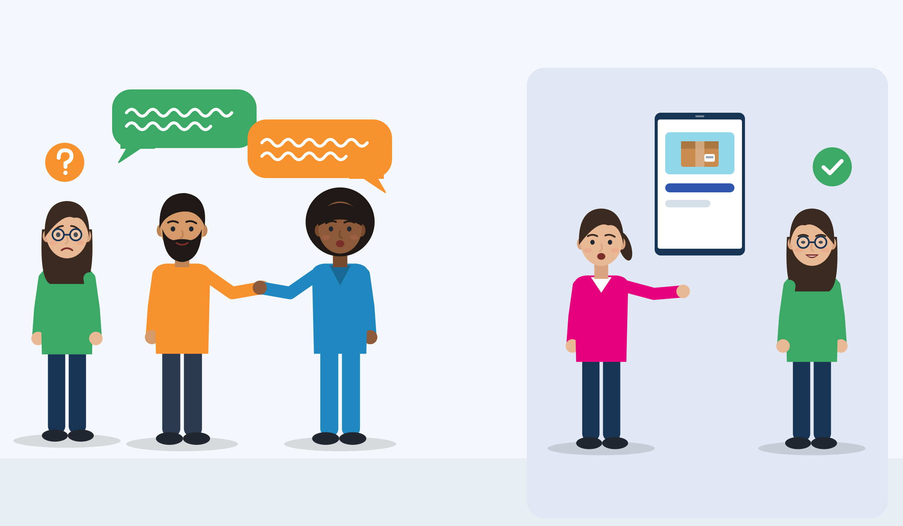
LANGUAGE BARRIERS AND COMMUNICATION CHALLENGES
Language barriers cut both ways
Switching language: others are left out
Both sides can help
It is common: 1 in 10 workplaces in the EU has staff who struggle with the language spoken at work.
How people see you: in multinational teams, colleagues with weaker language were seen as less competent.
Switching excludes: under stress, people switch to their mother tongue. Others feel left out; trust goes down.
Both sides can help: repeat back, one shared language for task talk, show, pictures, bilingual buddies.
Source: EU-OSHA (2025), ESENER 2024, Table 1 · Tenzer, Pudelko & Harzing (2014); Tenzer (2016) · EU-OSHA (2007), p. 23
Module 6 · Teamwork
18
Notes:
Say: "Language is a team issue, not only the newcomer's problem. Locals and newcomers both exclude people when they switch language."
Evidence: ESENER 2024: 10% of EU-27 establishments (41,458 surveyed) have employees who have difficulties understanding the language spoken at the premises (2019: 8%). Tenzer et al. (2014): 15 multinational teams in three German automotive companies, 90 interviews; team members "perceive colleagues with lower language proficiency as less competent" and "frequently relieve stress by switching into their mother tongue". EU-OSHA (2007, p. 23): "migrant workers believe that their language skills do not affect their work as much as their native co-workers think". Neeley (2013): non-native speakers felt status loss whatever their fluency.
Safety link: "failure to comprehend safety instructions and values means migrant workers revert to their own experiences and standards from their home countries" (EU-OSHA OSHwiki, 2022).
Different views: migrant workers often think their language affects their work less than their native colleagues think (EU-OSHA, 2007). Talk about it openly, and check understanding together. Switching happens at all levels, locals and newcomers alike.
Tip: never blame a language level. Ask "What can the team do so that everyone gets the task information?"

Slide 19

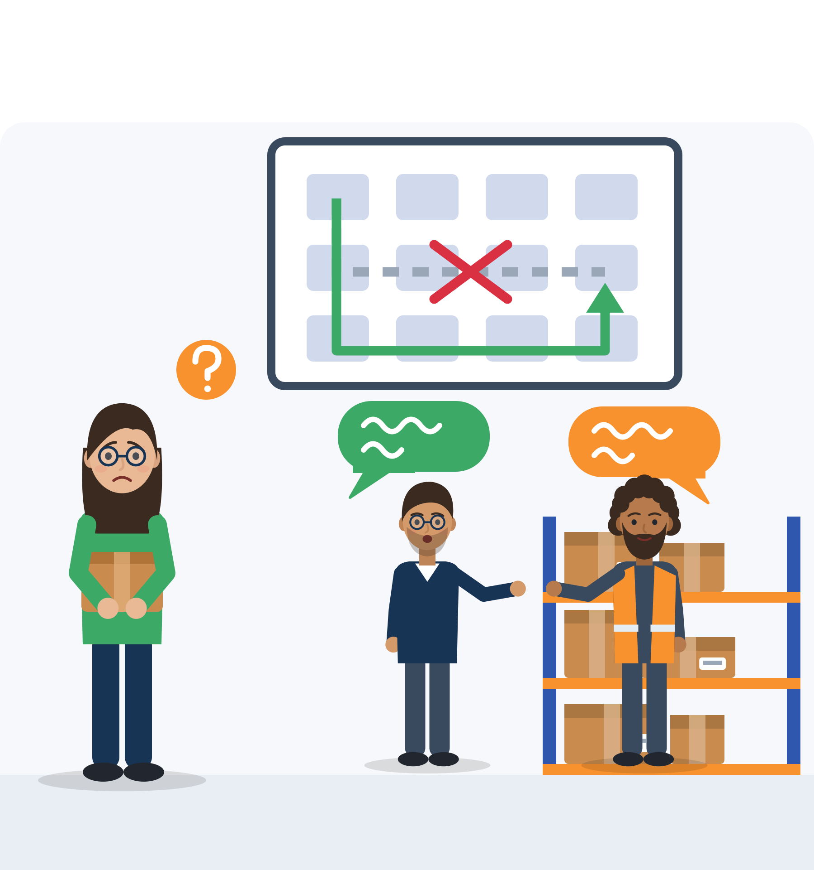
ILLUSTRATIVE SCENARIO
The plan changed in a language she doesn't speak
Daria, 24
Picking team of four, warehouse near Rotterdam
DISCUSS
Where is the line between private talk and task information?
What can Daria say, and when?
What could her colleagues and the team leader change?
Swap roles: Daria chats in her language and a local colleague is left out. What changes?
Logistics
Netherlands
Language and inclusion
Daria works in a picking team of four. Two long-time colleagues talk to each other in a language she doesn't speak, also when they change the route plan. Daria misses the change. The delivery is late, and the team leader blames her.
Grounded in: team members “frequently relieve stress by switching into their mother tongue, this way excluding many teammates” (Tenzer, 2016, on Tenzer et al., 2014); language can exclude from “informal interactions and from access to power structures” (Lønsmann, 2014).
Module 6 · Teamwork
19
Notes:
Illustrative scenario (constructed): Daria is invented. Unit 2 topic: language barriers and inclusion.
Run (7 min): small groups, one question each, then share. The fourth question shows that locals and migrants can both exclude by switching language.
Possible rule: private talk in any language; task information in the shared language and written in the group chat. Phrases: "Could we switch to English for a moment, so I can follow? It's about the route plan." "Can we write the decision in the group chat, so everyone has it?"
Tip: Lønsmann & Kraft (2018) found that language rules in production workplaces often "mirror the repertoires and practices of high-status employees". Ask: "Who decides which language is used here?"

Slide 20

SOCIAL NORMS AND UNWRITTEN GROUP EXPECTATIONS
The rules nobody writes down
Written rules
Job description
Safety signs
Contract and rota
Break times on paper
Greeting everyone in the morning
After-work drinks and birthdays
Unwritten expectations
Joining small talk and jokes
How to disagree with the boss
Who takes a break when
First names or titles
How fast to answer the group chat
Who sits where at lunch
Source: Language in the Workplace Project, Victoria University of Wellington (web pages) · Marra, Holmes & Riddiford (2009), pp. 6-7 · Council Recommendation on key competences (2018)
Module 6 · Teamwork
20
Notes:
Say: "Every team has rules nobody writes down. Nobody is born knowing them. You can ask about them."
Evidence: "Workers who do not exchange greetings at this time can be seen as diffident or rude by others"; "Workers who contribute to office humour are seen as being 'part of the team'" (Language in the Workplace Project). A skilled migrant: "[So I was] left out" and "Yes in like birthday parties or farewell parties um or happy hours, can't join in" (Marra et al., 2009, p. 6). These are New Zealand examples, not European data. The EU key competences include knowing "the codes of conduct and rules of communication generally accepted in different societies and environments".
Honest gap: no verified European study shows how young migrants learn unwritten norms about punctuality, breaks or after-work socialising. Present them as questions to explore ("Who decides when breaks happen here?"), not as national rules.
Run (5 min): participants add one unwritten rule from a team they know on a sticky note. Example (invented): Kerem, 24, intern, does not drink alcohol and works a second job on Fridays; after a month he notices that "Friday drinks" decisions and jokes shape the team. What small alternatives exist?

Slide 21
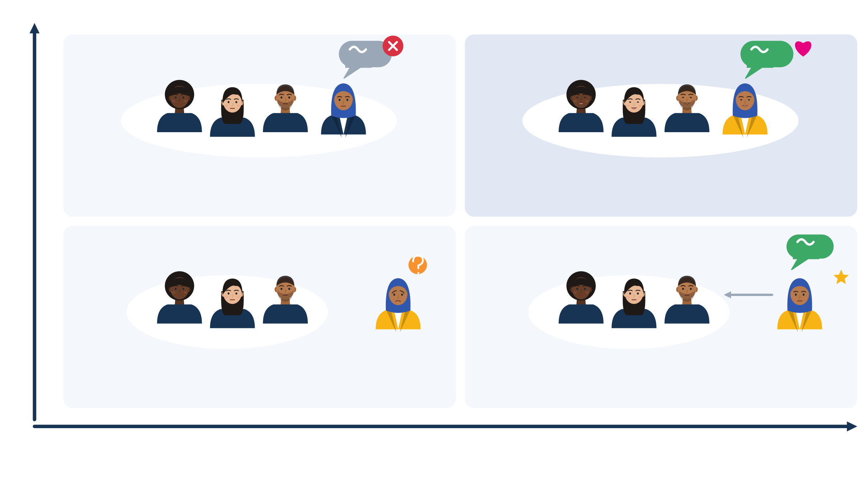
POWER RELATIONS, FAIRNESS AND INCLUSION
Inclusion: you belong, and you can be yourself
Belonging: low to high
Assimilation
Inclusion
Everyday exclusion at work
Muslim respondents, 13 EU countries, past 5 years:
18% got tasks below their qualification.
14% were talked over or interrupted.
13% had their opinions ignored.
35% felt racially discriminated against at work (Turkish background: 50%).
“One of us, if you never speak Arabic here.” You hide your difference.
An insider. Your languages, ideas and knowledge are valued.
Exclusion
Differentiation
Not an insider and not valued: talked over, left out of the chat.
“Our translator.” Valued for one skill, never asked your opinion.
Being yourself is valued: low to high
Source: Shore et al. (2011), Journal of Management · FRA (2024), Being Muslim in the EU, pp. 53-56 (2022 data)
Module 6 · Teamwork
21
Notes:
Say: "Inclusion means two things at the same time: you belong to the team, and you do not have to hide who you are."
Evidence: Shore et al. (2011) define inclusion as meeting two needs at once, belongingness and uniqueness. Low/low = exclusion; high belonging, low uniqueness = assimilation; low belonging, high uniqueness = differentiation; high/high = inclusion. FRA (2024): "the most common type of discriminatory experience is being given tasks below their qualification level, which 18 % have experienced"; 35% of Muslim respondents felt racially discriminated against at work in 5 years (Turkish background 50%; DE 51%, NL 43%).
Quadrants in full: assimilation "You're one of us, as long as you never speak Arabic here": you belong only if you hide what makes you different. Inclusion: you are an insider, and your languages, ideas and knowledge are valued. Exclusion: not an insider and not valued: talked over, left out of the chat, not invited. Differentiation: "You're our translator": valued for one skill, but never asked your opinion or invited to the team meal. The picture shows Nour (invented) in each situation.
Example for differentiation (invented): Nour, 22, speaks Arabic, English and some Dutch; in a cleaning company she is always called to translate, also during breaks, but never asked her opinion. A bilingual worker can become "indispensable", yet this "enables continued differentiation and distinction between 'migrant' and 'local' workers" (Kraft, 2020).
Tip: who gets the cleaning, the night shift or the chance to learn the machine is a teamwork question, and sometimes a discrimination question. Keep this grid on the flipchart for the case study.

Slide 22

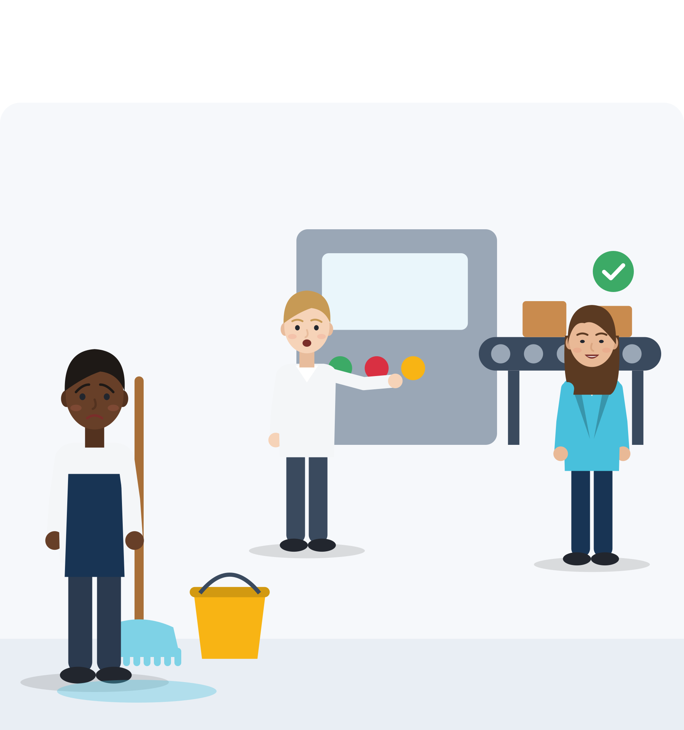
ILLUSTRATIVE SCENARIO
The cleaning is always yours
Yonas, 23
Food-production team near Bologna, technical diploma not yet recognised
DISCUSS
Is this a conflict about tasks, unfairness or discrimination? Or is it not clear yet?
What can Yonas ask for (a rota, a training plan)?
What could his colleagues do?
What would a fair way to share tasks look like?
Food production
Italy
Fair tasks
Yonas has a technical diploma that is not recognised yet. In his food-production team, the shift leader gives him the machine cleaning every day. New local colleagues who started after him are trained on the machines. Yonas says nothing, but he feels stuck.
Grounded in: “being given tasks below their qualification level” is the most common discriminatory experience at work for Muslim respondents (18%; FRA, 2024, p. 56).
Module 6 · Teamwork
22
Notes:
Illustrative scenario (constructed): Yonas is invented. Unit 2 topic: power relations, fairness and inclusion.
Run (7 min): groups of three. Stress that "not clear yet" is a valid answer: Yonas can first ask for information.
Phrases: "I've done the cleaning every day this week. Could we make a rota so we take turns?" "I'd like to understand how tasks are shared. Is there a plan I can see?"
Evidence: in FRA interviews with 237 exploited workers, some reported "being given twice as many rooms to clean" and being prevented "from learning and acquiring new skills on the job" (FRA, 2019, p. 75). Over-qualification of tertiary-educated non-EU citizens aged 20-34: 37.6% vs 21.8% of nationals; Italy (aged 20-64): 59.5% vs 19.3% (Eurostat lfsa_eoqgan, 2025). LifeComp S3.3: "fair sharing of tasks, resources and responsibility".
Tip: in Unit 3 we name what is missing here (equal status in the task).

Slide 23
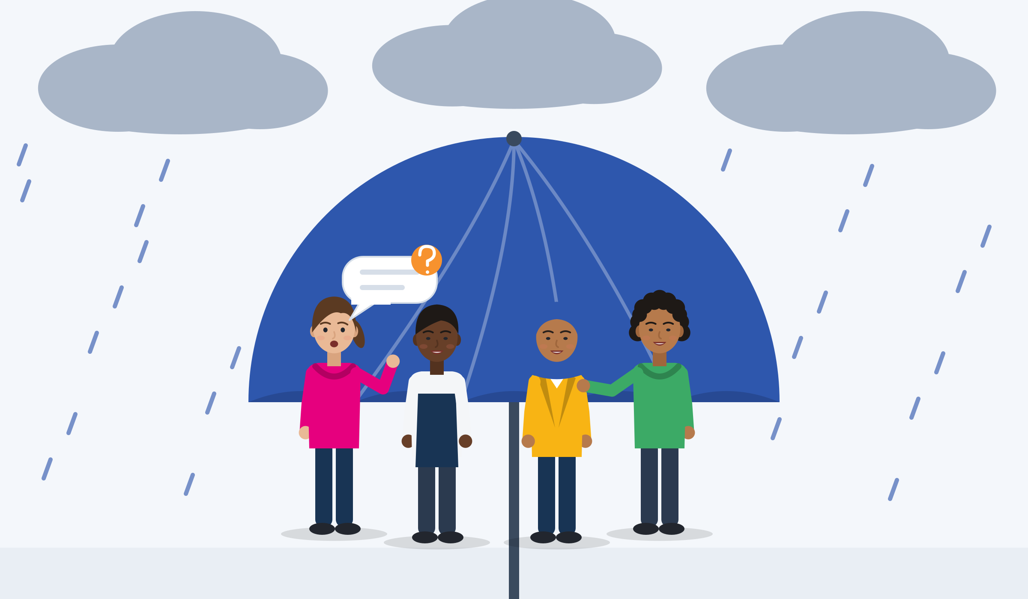
EMOTIONAL AND PSYCHOLOGICAL DIMENSIONS OF TEAMWORK
Feeling safe to ask, to try and to make mistakes
Worry: papers, money, family
Language anxiety
Short contract, probation
Stress travels into the team: concentration, trust and reactions to conflict.
Language anxiety: a second language at work can feel like losing status.
On probation, asking or admitting a mistake can feel dangerous.
Psychological safety: “a shared belief held by members of a team that the team is safe for interpersonal risk taking”. The team creates it.
Google, 180 teams: it came first of five team dynamics (internal study, not peer-reviewed).
Psychological safety
Source: Edmondson (1999), Administrative Science Quarterly, 51 work teams · Google re:Work (2015) · Neeley (2013) · Blackmore et al. (2020)
Module 6 · Teamwork
23
Notes:
Say: "In a safe team you can ask a question or say 'I made a mistake' without being laughed at. That safety is built by the whole team, especially the leader."
Evidence: Edmondson (1999), 51 work teams in a manufacturing company: psychological safety was linked to learning behaviour ("asking questions, seeking feedback, experimenting, reflecting on results, and discussing errors"), which mediated team performance. A meta-analysis pooled 136 samples with over 22,000 individuals (Frazier et al., 2017). Google: 180 teams (115 engineering, 65 sales). Neeley (2013): medium self-assessed fluency brought the most anxiety.
Background for trainers: a meta-analysis of 26 studies (5,143 adult refugees and asylum seekers) found PTSD and depression in about 31.5% each (Blackmore et al., 2020). Do not diagnose and do not ask for trauma stories. SMILE is not therapy: know your local referral options.
Full wording: worry about papers, money or family affects concentration, trust and reactions to conflict; speaking a second language at work can feel like losing status, even when you speak it well; on probation, asking a question or admitting a mistake can feel dangerous. Psychological safety is created by the team, not only by the newcomer. Google: five team dynamics "in order of importance": psychological safety, dependability, structure and clarity, meaning, impact.
Run (4 min): ask "What does a team do that makes you feel safe to ask a question?" Collect answers; they become a team agreement for the role-plays.

Slide 24

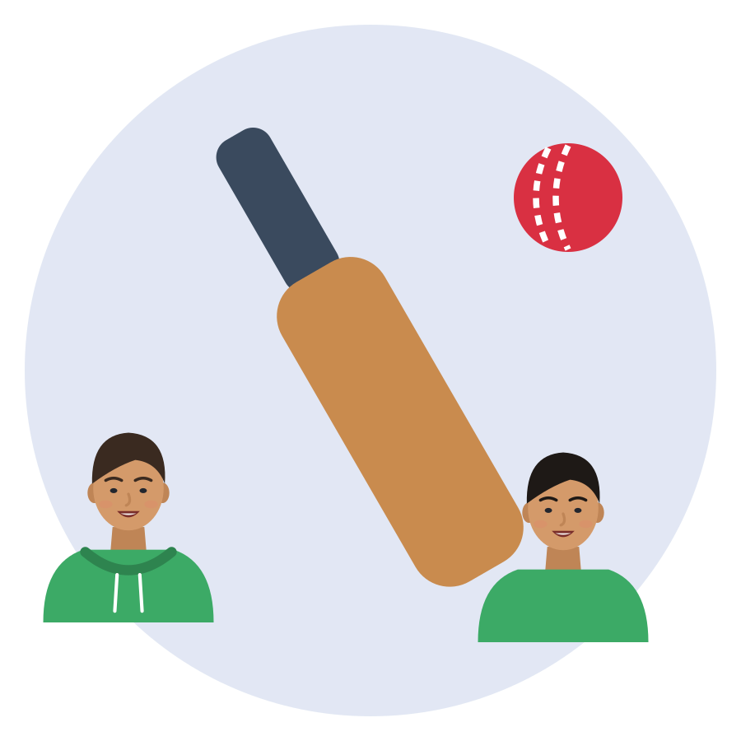


DOCUMENTED PROGRAMMES AND STUDIES
Real evidence: what helps mixed groups work
Türkiye
India
Türkiye
Germany
Perspective-taking in mixed schools
Teammates, not opponents
One-day events: no effect
Mentors for apprentices
Refugee children were about 25% more likely to get emotional support from host classmates. Segregation fell by 15-21%.
Mixed cricket teams built friendships across groups. Playing against the other group reduced friendships.
Joint Syrian-Turkish events, mostly one day or less, showed no effect on belonging and trust.
VerA tandems with retired experts: the programme reports a positive effect in about 3 of 4 cases. No control group.
Source: Alan et al. (2021), QJE (RCT) · Lowe (2021), AER (RCT) · Mittal, Parigi & Vollmer (2024), International Migration · Prognos AG (2023), VerA evaluation for BMBF/BIBB
Module 6 · Teamwork
24
Notes:
Say: "Putting people together is not enough. Working towards a shared goal, again and again, with clear skills, works better than one-day events."
Evidence: (1) Türkiye (Şanlıurfa, Mersin): more than 6,500 children aged 8-12 in 80 schools; refugee children "approximately 25% (21%) more likely" to receive emotional (academic) support from host classmates; violent events fell by more than 60%. Children, so evidence on mechanisms, not on jobs. (2) India: 1,261 men aged 14-30; all other-caste teammates added about 1 other-caste friend, all other-caste opponents removed about 3.5. (3) GIZ BILSY, Türkiye: 1,305 young people aged 12-30; "no impact" on belonging and trust; "70 per cent lasting a day or less". (4) VerA, Germany: 77% of apprentices with migration or refugee background (2020); 6,155 new mentorships 2019-2022; "in about three quarters" positive; no causal claim.
More: DUO for a JOB (Belgium) reports that 70% of the 1,118 young people it supported in 2025 found a job or training (own monitoring, no control group). Mixed football teams in Iraq improved behaviour within football, but effects "did not generalize to non-soccer contexts" (Mousa, 2020).
Tip: ask "Which of these ideas could work in your course or workplace?"

Slide 25

ACTIVITY
Case study: inclusive or exclusionary teamwork?
TIME
25 min
STEPS
Show the inclusion grid again (3 min).
Each group gets one card: the warehouse language (Daria), the cleaning (Yonas), “our translator” (Nour) or the Friday drinks (Kerem).
Groups (12 min): Where is the person in the grid? What would inclusion look like here?
Who shares responsibility: the newcomer, colleagues, team leader, employer? Agree one action for each.
Each group presents in 2 minutes (10 min). The trainer links each case to the evidence.
GROUP
Groups of 3-4
MATERIALS
Case study texts (invented scenario cards), inclusion grid on the flipchart, sticky notes
DEBRIEF
GOAL
See inclusion and exclusion in everyday teamwork, and who shares responsibility
What would make this team inclusive without asking anyone to become invisible?
Where is the ethical line between “helping out” and being used?
Module 6 · Teamwork
25
Notes:
Curriculum activity (Unit 2): real-life scenarios illustrate inclusive and exclusionary teamwork practices, highlighting ethical dimensions and shared responsibility.
All cards are constructed; say so clearly. Do not ask participants to perform their own experience of discrimination; they may choose to share.
Card texts (invented): Nour, 22, cleaning company: always called to translate, during her tasks and breaks, never asked her opinion, not invited to the team outing. Kerem, 24, office internship: team drinks every Friday; he doesn't drink alcohol and works a second job on Friday evenings.
Evidence links: over-qualification for Yonas (Eurostat, 2025); the "language broker" for Nour (Kraft, 2020); being "left out" of happy hours for Kerem (Marra et al., 2009).

Slide 26
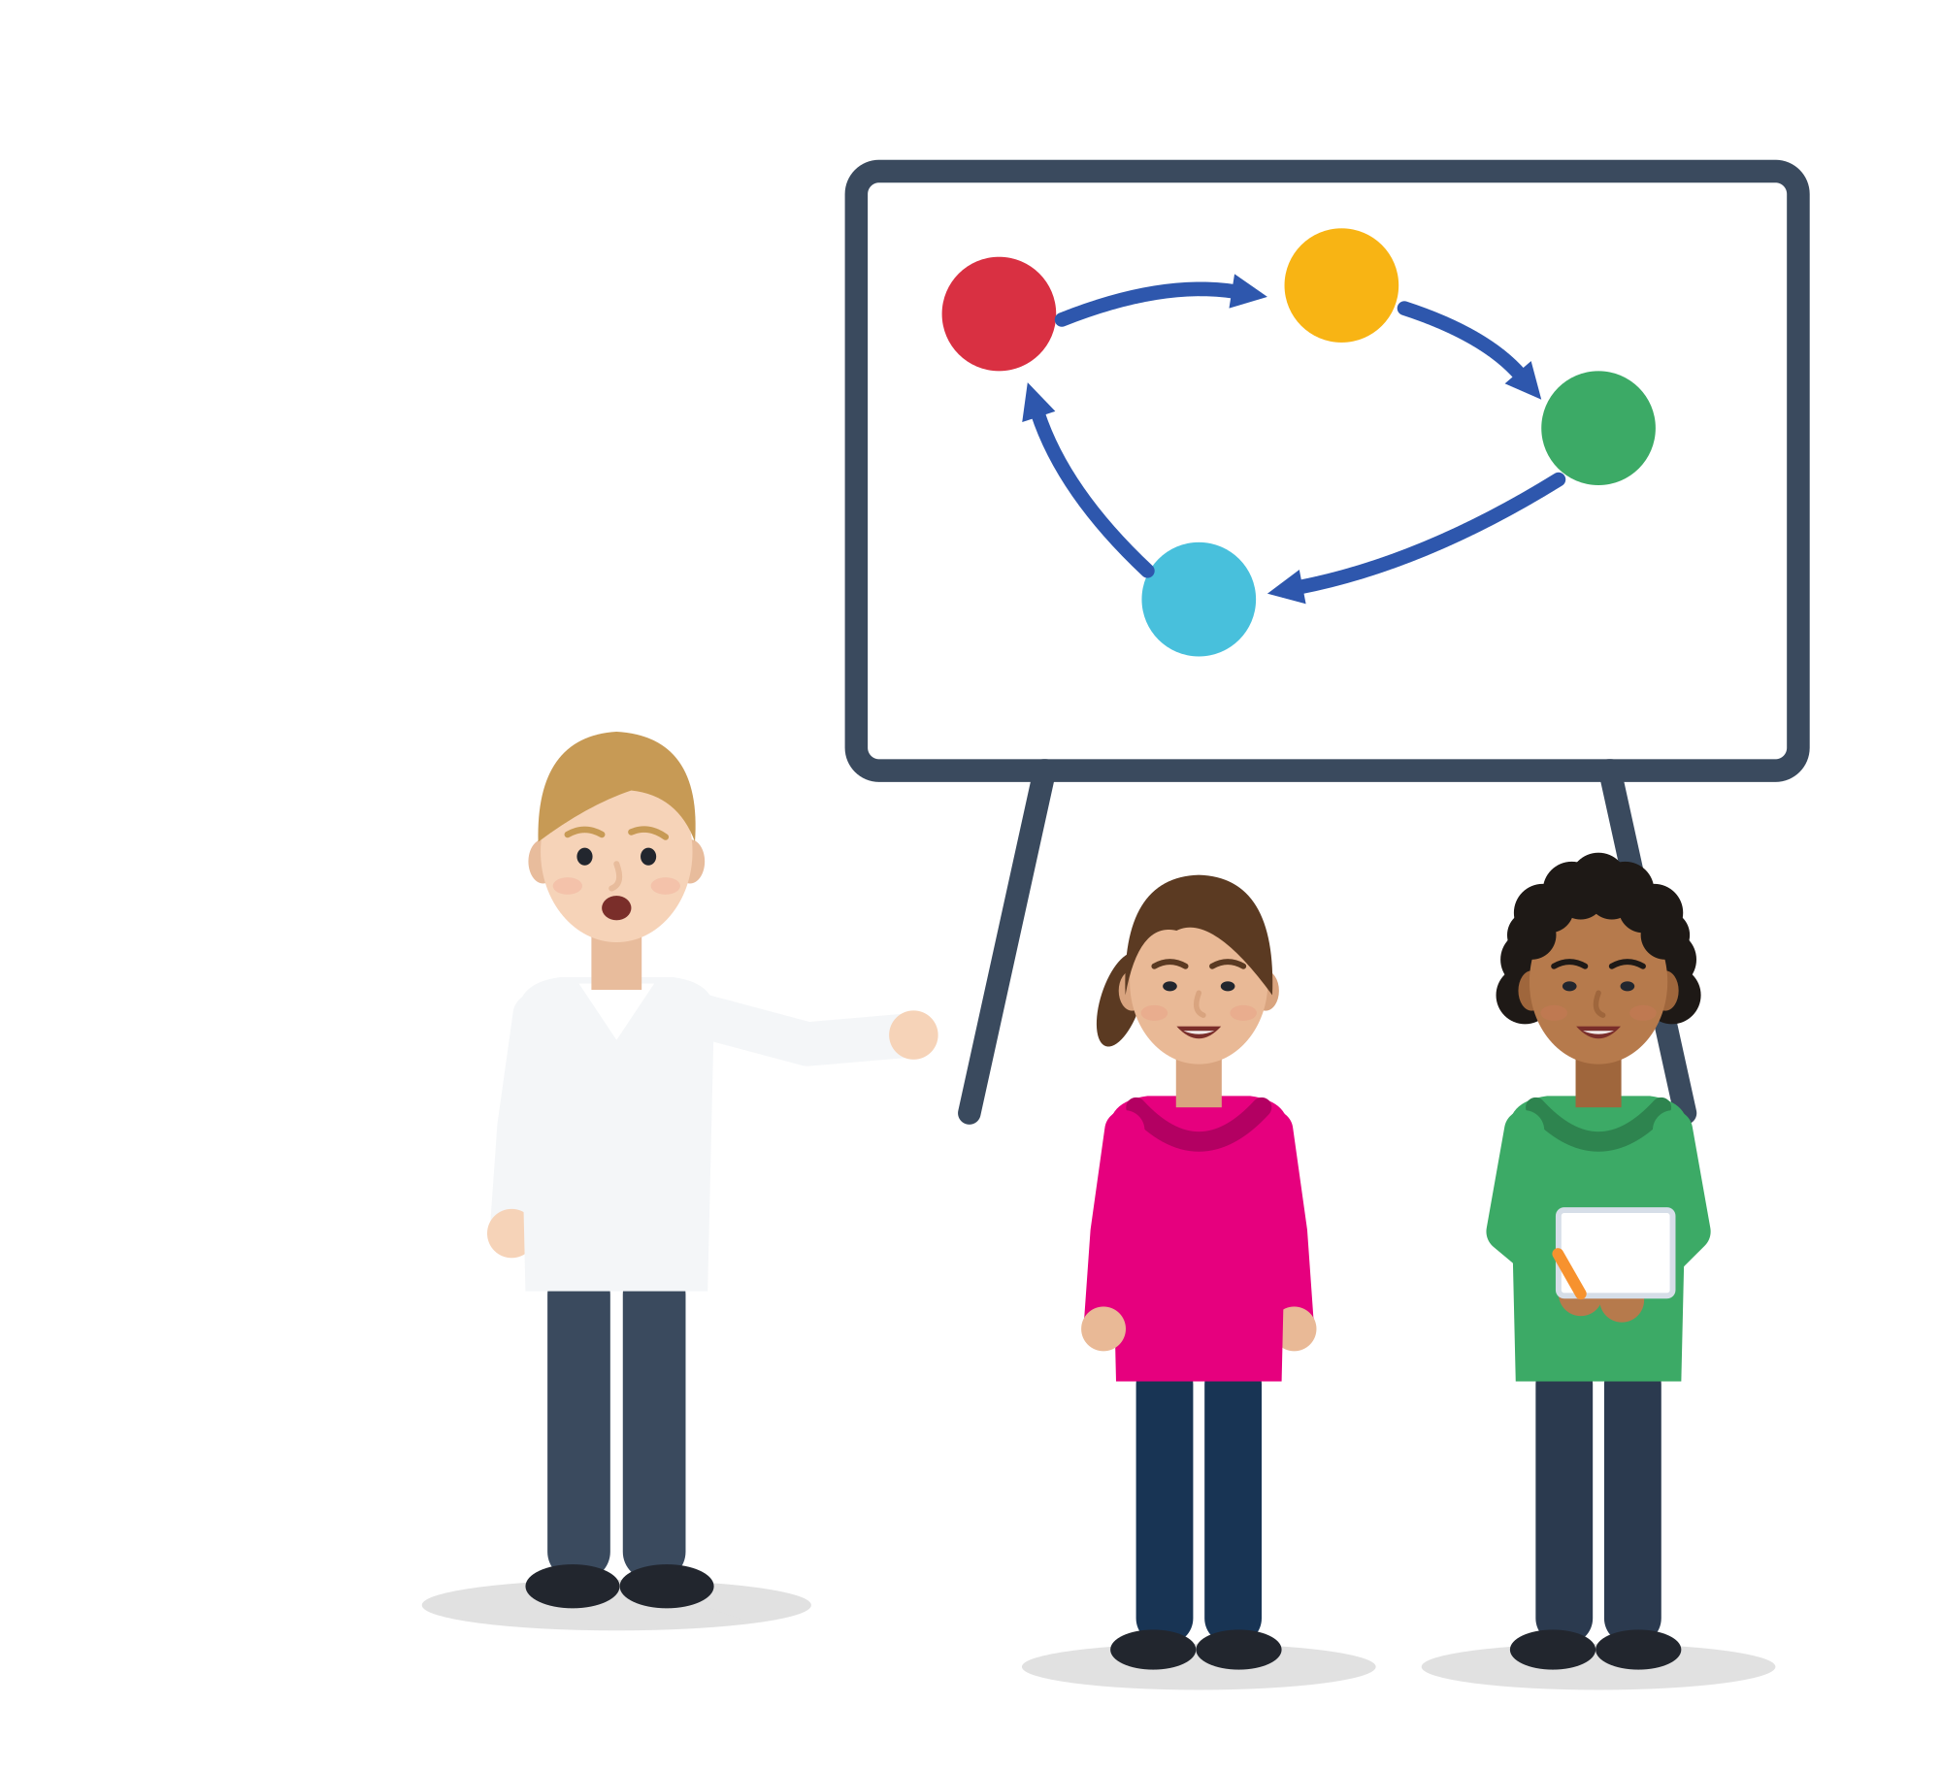
03
UNIT 3 · ≈ 75 min
Practical Strategies and Good Practices
Time to Take the Field: practise roles, clear communication, fair rules and feedback in realistic team situations.
Roles
Communication
Conflict
Feedback and fairness
Module 6 · Teamwork
26
Notes:
Unit 3 focuses on applied teamwork skills through concrete strategies, role-play and reflection (curriculum).
Suggested timing: 25 min input + 35 min simulation and role-plays + 15 min self-diagnosis and closing. The unit has many slides: if time is short, show the Big Five, the kitchen dialogue, the conflict types and the feedback slide, and use the others as handouts.

Slide 27
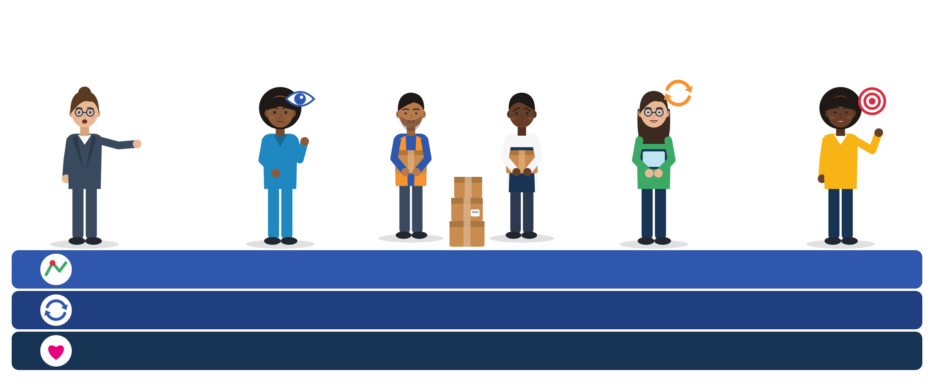
ROLES AND RESPONSIBILITIES IN TEAMS
The “Big Five” of teamwork, and the glue
Team leadership: sets direction, shares tasks, informs
Watching how it goes: for others too, not only you
Backup behaviour: see an overloaded colleague, help
Adaptability: change the plan together
Team orientation: team goals count, not only yours
Glue · Shared picture: everyone knows the task and the plan
Glue · Closed loop: say it, repeat it back, confirm
Glue · Mutual trust: you can admit a mistake and accept feedback
Source: Salas, Sims & Burke (2005), “Is there a ‘big five’ in teamwork?”, Small Group Research, Table 1, p. 560
Module 6 · Teamwork
27
Notes:
Say: "Research found five things strong teams do, and three things that glue them together. You can practise every one of them, even in your first week."
Evidence: Salas et al. (2005): five core components (team leadership, mutual performance monitoring, backup behaviour, adaptability, team orientation) rely on three coordinating mechanisms (shared mental models, closed-loop communication, mutual trust). Closed loop: the sender gives a message, the receiver acknowledges it, the sender checks it was understood. Trust shows in "willingness to admit mistakes and accept feedback".
For young migrants: you may not understand every word in a kitchen or warehouse, but you can close the loop: "Two salads, table 5, right?" Backup behaviour = noticing an overloaded colleague and helping.
Tip: ask "Which of these did you see in your last team? Which one is your strength?" The three bands at the bottom are the "glue" that holds the five together.

Slide 28


ROLES AND RESPONSIBILITIES: BELBIN TEAM ROLES
Team roles: a language for strengths, not a label
Nine Belbin roles
What research says
Plant: new ideas · Resource Investigator: contacts and chances
Co-ordinator: clarifies goals, shares tasks · Shaper: drives the pace
Monitor Evaluator: weighs options · Specialist: expert knowledge
Teamworker: supports people · Implementer: turns plans into action
Completer Finisher: checks details and finishes the job
A review of 43 studies: the evidence is “mixed”; some roles are hard to tell apart.
In 24 student teams, a mix of roles did not predict better results.
A version based on observers worked better (1,434 people).
Use roles to talk about strengths. One person can play several.
Someone who only gets physical tasks may be the team's Completer Finisher. That is a strength for your CV.
Source: Belbin (1981); belbin.com · Aritzeta, Swailes & Senior (2007) · Batenburg et al. (2013) · van Dierendonck & Groen (2008)
Module 6 · Teamwork
28
Notes:
Say: "Many employers know Belbin's team roles. They are useful words to describe your strengths, but they are not a scientific test of who you are."
Evidence: Belbin describes each role as "one of nine clusters of behavioural attributes" with "allowable weaknesses". Critique: the first independent psychometric study criticised the Self-Perception Inventory (Furnham, Steele & Pendleton, 1993); a review of 43 studies found "the evidence is mixed", with weak discriminant validity (Aritzeta et al., 2007); role diversity did not predict performance in 24 student teams (Batenburg et al., 2013); an observer-based version showed good construct validity with 1,434 persons (van Dierendonck & Groen, 2008).
Run (4 min): each person names two roles they often play; a partner gives one example they noticed today. Never use the roles for selection or grading.
Tip: the short role descriptions are our plain-English summaries of the official role names.

Slide 29






CLEAR AND INCLUSIVE COMMUNICATION
Kitchen rush: say it, repeat it back, confirm
Chef Two Caesar, no croutons, table five! And fire the risotto!
Samir Two Caesar salads, no croutons, table five. Sorry, what does “fire” mean here?
Chef “Fire” means: start cooking it now.
Samir Okay, risotto now. The salads are ready in four minutes.
Chef Correct. Thanks, Samir.
Invented scenario. Closed loop works at any language level. The kitchen can help too: call-backs, a picture list of dishes, one word per item.
Module 6 · Teamwork
29
Notes:
Illustrative scenario (constructed): Samir, 20, two weeks in a hotel kitchen in Antalya. On Saturday night the chef shouts orders fast, with kitchen words Samir does not know. Before this conversation, he nodded, guessed and prepared the wrong garnish twice; a colleague muttered "He never understands anything."
Say: "Closing the loop is not a sign of weak language. Pilots, nurses and chefs do it every day."
Grounding: 25.3% of employed young people born abroad work in service jobs and 16.2% in elementary jobs (Eurostat 2025, own calculation); 10% of EU workplaces have staff who struggle with the workplace language (ESENER 2024); closed-loop communication (Salas et al., 2005).
Run (5 min): pairs read the dialogue, then replace it with an example from their own job or course. Ask: "Whose job is it to make communication work?" Answer: everyone's, the chef too.

Slide 30
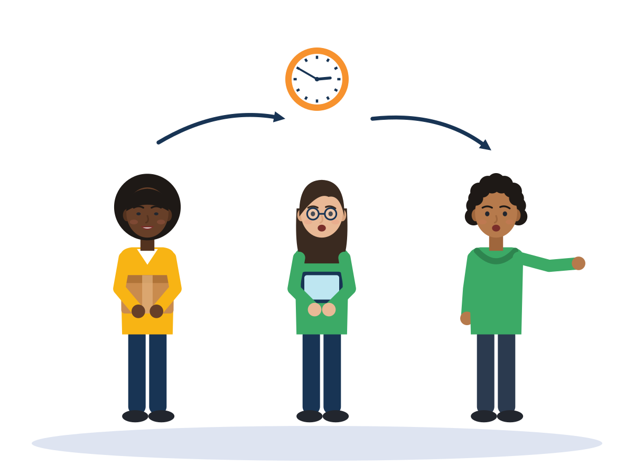
ACTIVITY
Group simulation: closed-loop rush
TIME
15-20 min
STEPS
Teams build “orders” (cups with coloured sticky notes) under time pressure.
One member gets the order sheet in simple English, one in a language the others do not read (or only pictograms), one is team leader.
Round 1 (4 min): no rules. Count the correct orders.
Round 2 (4 min): agree roles first, then close the loop every time: say, repeat back, confirm.
Rotate the “foreign-language” sheet, so locals and newcomers both experience it.
GROUP
Teams of 4-5
MATERIALS
Paper cups, coloured sticky notes, three kinds of order sheets
DEBRIEF
GOAL
Feel how clear roles and closed-loop talk reduce errors
Did errors fall in round 2? Why?
Who was left out in round 1, and why?
Which of the Big Five did you see: backup, watching, adaptability?
Module 6 · Teamwork
30
Notes:
Curriculum activity (Unit 3): group simulations and analysis of team dynamics.
Keep it playful and without penalties. Prepare one order sheet per team in a language nobody in that team reads, or use pictograms only.
Link the debrief to the kitchen dialogue (Samir) and to the Big Five slide.
Tip: if a team finishes round 2 with fewer errors, ask them what exactly they did differently and write it on the flipchart as a team rule.

Slide 31
ACTIVE AND RESPECTFUL PARTICIPATION
Small habits that let everyone take part
INSTEAD OF
TRY
A thumbs-up under a long voice note about shift swaps
“Confirming: I work Saturday 6-14, Ali works Sunday. Thanks!”
Silence, because you missed part of the meeting
“I didn't catch the last part. Could you tell me the main points?”
“Everyone agrees? Good, let's go.”
“Let's hear from everyone, one by one. Mariam, what do you think?”
Changing the plan in a language only some people speak
“Can we write the decision in the group chat, so everyone has it?”
“He never understands anything.”
“Let me show you once. Then you try.”
Source: Phrases: SMILE research note, teamwork §9 · DigComp 2.2, competences 2.4 and 2.5 (Vuorikari et al., 2022)
Module 6 · Teamwork
31
Notes:
Say: "Participation goes both ways: you speak up, and the team makes space for you."
Example (invented): Mariam, 20, works in a supermarket. The team swaps shifts in a WhatsApp group full of abbreviations and voice notes. She agrees with a thumbs-up, misunderstands the day, misses a shift and is blamed.
Evidence: DigComp 2.4: social skills such as the "ability to clarify misunderstandings" compensate "for the limitations of online communication"; 2.5 covers awareness of "cultural and generational diversity in digital environments". 22.1% of non-EU citizen employees have temporary contracts vs 10.7% of nationals (Eurostat, 2025): one missed shift can cost the job.
Run (5 min): pairs write a 3-rule agreement for a shift group chat (e.g. swaps confirmed in one written sentence with day and time).

Slide 32


USEFUL PHRASES
Phrases for checking, helping and including
Checking that you understood
Asking for and offering help
Language and group chat
“Just to check: you want me to clean the fryer first and then the floor, right?”
“Sorry, could you say that more slowly, or show me once?”
“Okay, two boxes to bay 4. Done.”
“I'm finished with my part. What can I help with?”
“You look busy. Shall I take the next delivery?”
“I'm not sure how to do this safely. Can someone show me before I start?”
“Could we switch to English for a moment, so I can follow? It's about the shift plan.”
“Can we write the decision in the group chat, so everyone has it?”
“Confirming: I work Saturday 6-14, Ali works Sunday. Thanks!”
Module 6 · Teamwork
32
Notes:
Run (5 min): pairs, one says a phrase, the other answers. Then swap. Check understanding with "Show me" or "Tell me in your words", not "Do you understand?"
Replace "English" with the language of the workplace (German, Dutch, Greek, Italian, Turkish). Trainers can translate the phrases into participants' strongest languages (multilingual support tools are optional material in the curriculum).
These phrases practise closed-loop communication and backup behaviour (Salas et al., 2005) and the netiquette of DigComp 2.5.
Tip: ask each participant to choose one phrase to use at work or in class this week.

Slide 33


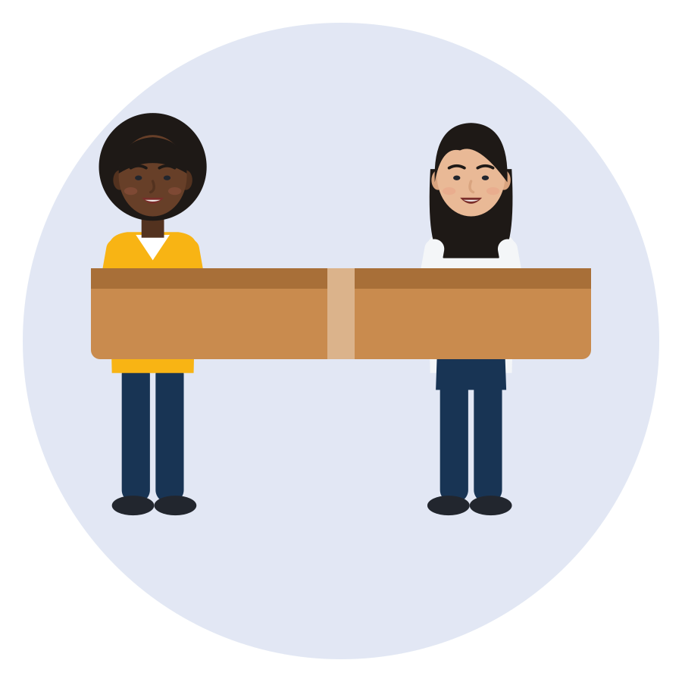

MANAGING CULTURAL DIFFERENCES
Four design rules for a fair mixed team
Equal status in the task
One shared goal
Tasks that need cooperation
Visible support from the boss
Everyone can learn the machine and take responsibility. Red flag: only the newcomer cleans.
The team wins or loses together. Red flag: “their” mistakes, “our” results.
Mixed pairs and shared stations. Red flag: locals and newcomers in separate corners.
The leader says: we are one team, and jokes about origin stop here. Red flag: the boss laughs along.
Source: Allport (1954), as summarised by Pettigrew (1998) · Pettigrew & Tropp (2006), 515 studies · Paluck, Green & Green (2019) · Mousa (2020)
Module 6 · Teamwork
33
Notes:
Say: "Putting locals and newcomers in one team is not enough. Four conditions make a mixed team work, and you can ask for them."
Evidence: Allport "specified four conditions for optimal intergroup contact: equal group status within the situation, common goals, intergroup cooperation and authority support" (Pettigrew, 1998). Across 515 studies (713 samples), contact "typically reduces intergroup prejudice", more so under these conditions, although they "are not essential" (Pettigrew & Tropp, 2006). Limits: randomised studies with delayed outcomes show weaker effects for ethnic or racial prejudice (Paluck et al., 2019), and mixed football teams changed behaviour within football only (Mousa, 2020). Teammates, not opponents: Lowe (2021).
Run (4 min): ask "Which rule was missing for Yonas?" (equal status). "And for Daria?" (cooperation, shared information).
Tip: these rules are also a message to employers. Managing cultural differences is a leader's job, not only the newcomer's.

Slide 34

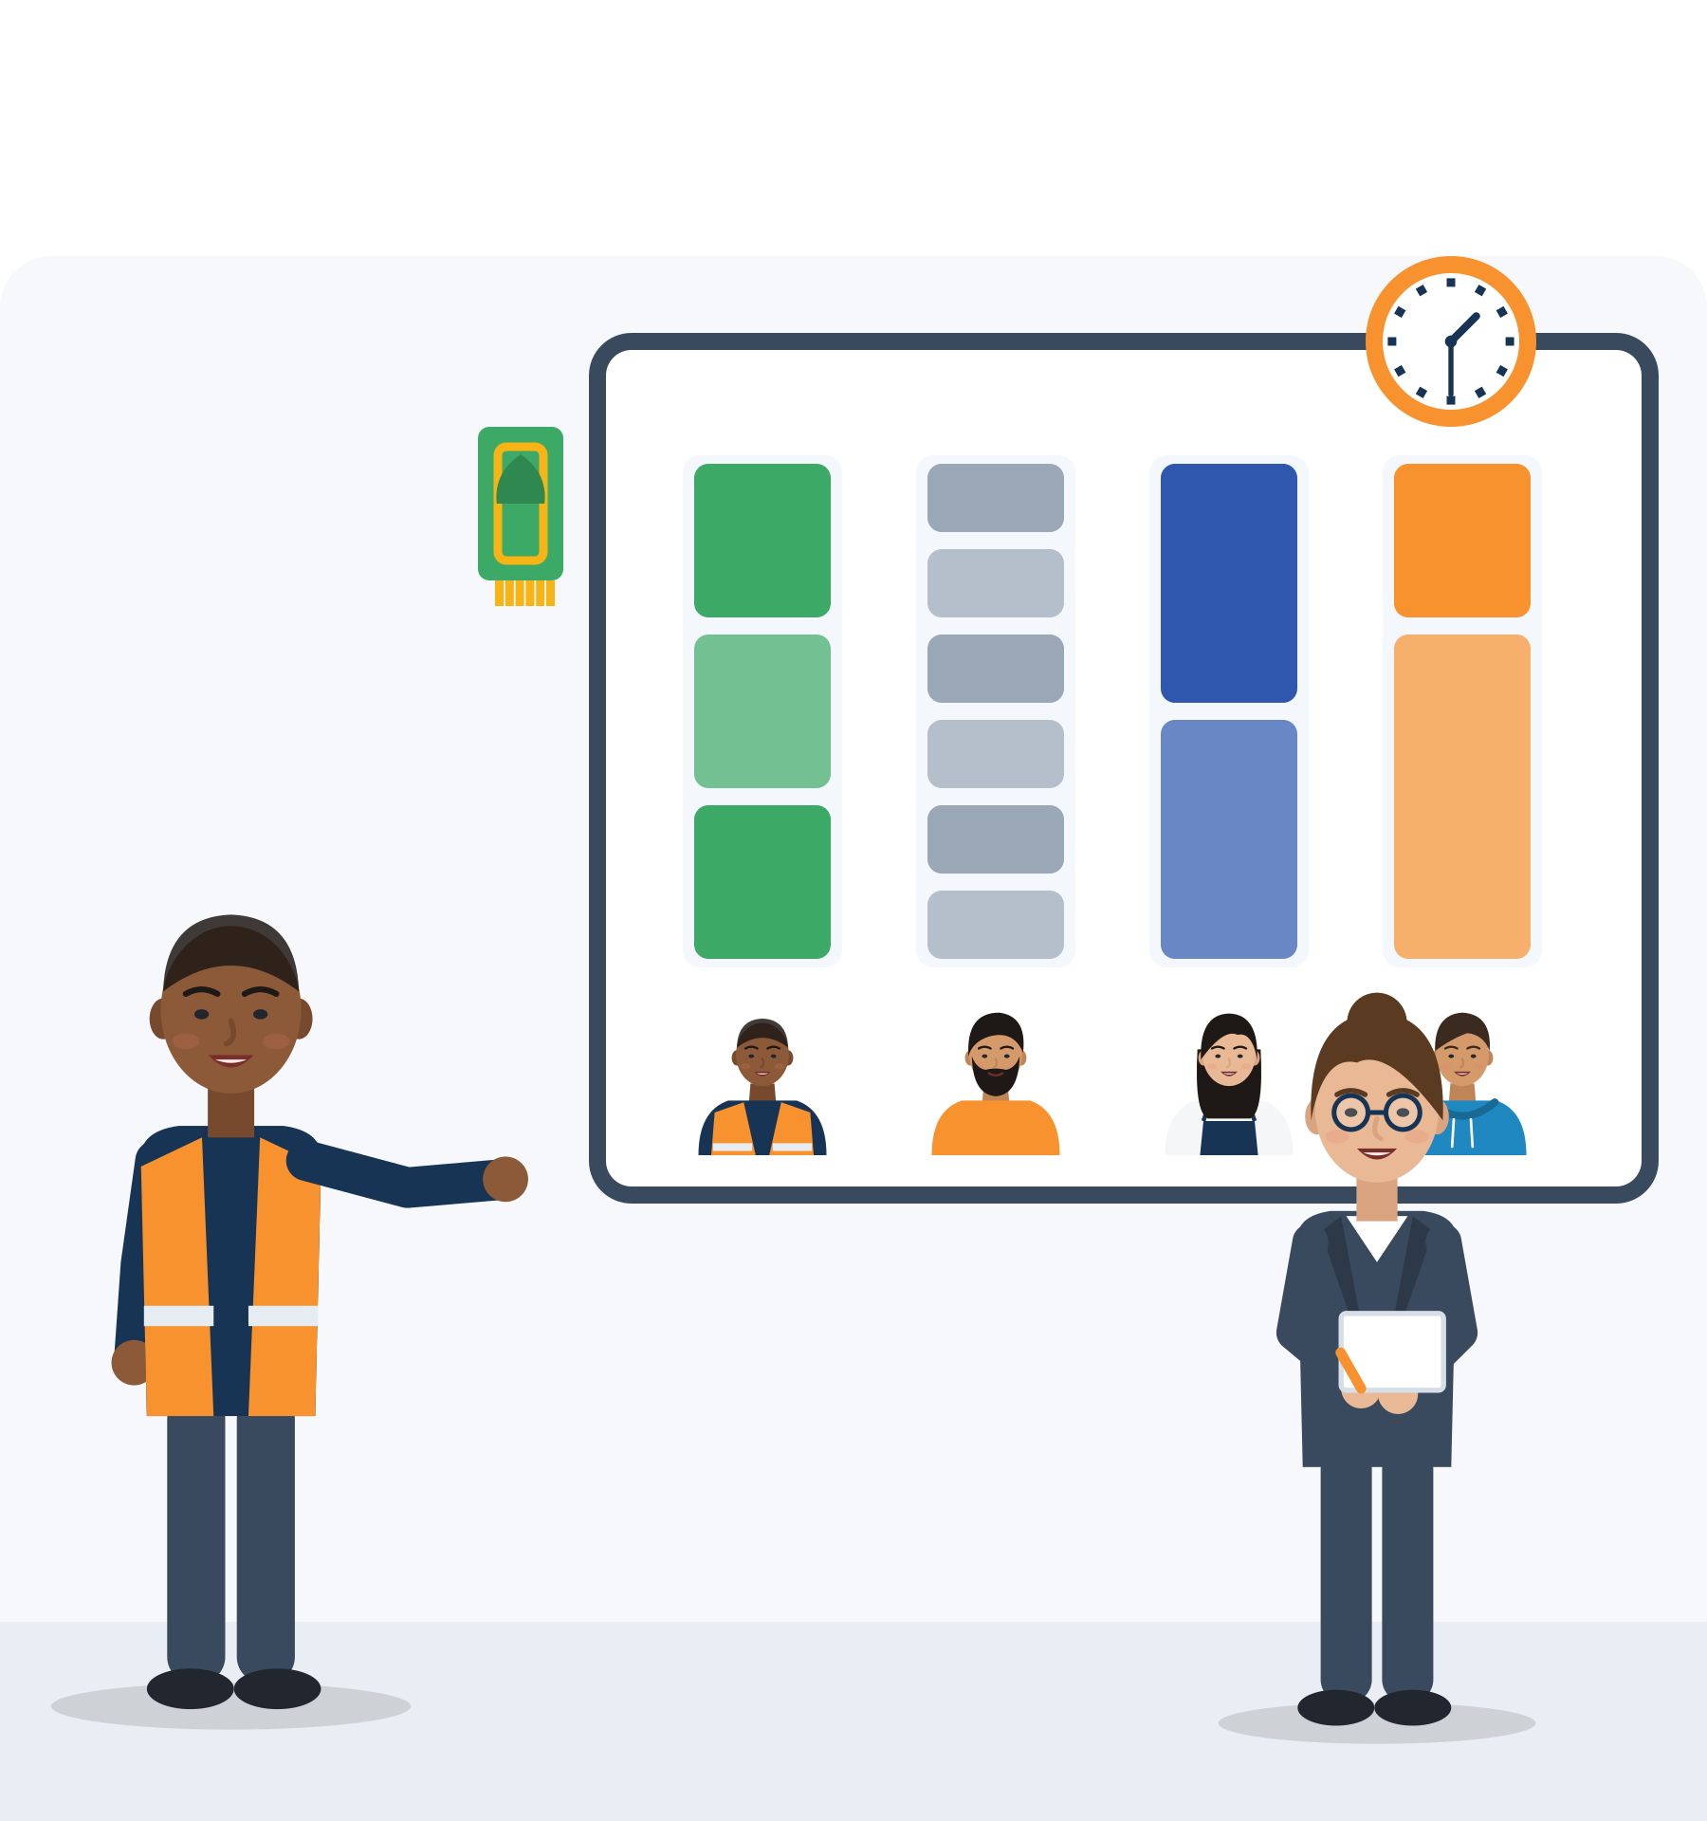
ILLUSTRATIVE SCENARIO
Prayer break or smoking break: what is fair?
Bilal, 21
Packaging team near Thessaloniki, day shift
DISCUSS
Is “fair” the same breaks for everyone, or breaks that fit different needs within the same total time?
Draft a break plan that keeps the line running.
How can the team discuss this without attacking anyone?
Packaging
Greece
Breaks and fairness
In Bilal's packaging team, the smokers take several short breaks a day. Bilal asks for a five-minute break at a fixed time to pray. One colleague says: “Extra breaks for religion are unfair.” Another answers: “Smokers take more breaks than anyone!” The team leader asks the team for a proposal.
Grounded in: 13% of Muslim respondents were prevented from religious practices “such as praying” at work (FRA, 2024, p. 56); EU Working Time Directive, Art. 4 (rest breaks).
Module 6 · Teamwork
34
Notes:
Illustrative scenario (constructed): Bilal is invented. Unit 3 topics: managing cultural differences, well-being and fairness. Not legal advice: rules differ by country and collective agreement.
Say: "This is a conflict about who does what and when. Fair rules can solve it without a debate about religion or smoking."
Evidence: EU Working Time Directive 2003/88/EC, Art. 4: "where the working day is longer than six hours, every worker is entitled to a rest break"; details are set by collective agreements or national law. Directive 2000/78/EC covers indirect discrimination: an "apparently neutral provision, criterion or practice" that puts people of a religion "at a particular disadvantage" unless objectively justified. Türkiye: Labour Law No. 4857, Art. 68 sets breaks of 15 min (work up to 4 h), 30 min (over 4 h up to 7.5 h) and 1 hour (over 7.5 h), arranged according to local customs and the needs of the job, at the same or different times.
The picture shows one possible answer, not the rule: a break board where every column has the same total break time, split in different ways.
Run (8 min): groups draft a plan. A possible answer: everyone has the same total break minutes and splits them as needed; colleagues cover each other's station ("Could I take my break at 13:30 instead? I'll make sure my station is covered.").

Slide 35




DEALING WITH CONFLICT AND DISAGREEMENT
What kind of conflict is this?
Task: what?
Process: who and when?
Relationship: you and me
Popular model: “artificial harmony”
Different ideas about how to do the work. Talk about it openly: it can improve the result.
Who cleans, who works nights, who takes breaks when. Agree fair rules and write them down.
Personal tension, insults, jokes about someone. Keep it out of the work and stop it early.
Lencioni's “Five Dysfunctions” is a business fable, not research. Its warning: smiling and avoiding hard topics hides problems.
Source: de Wit, Greer & Jehn (2012), 116 studies, 8,880 groups · De Dreu & Weingart (2003) · Lencioni (2002): popular model, no peer-reviewed validation found
Module 6 · Teamwork
35
Notes:
Say: "Naming the type of conflict helps: 'This is about how we share tasks, not about you.' Disagree about the work, agree fair rules for who does what, and keep personal attacks out."
Evidence: across 116 studies (8,880 groups), relationship and process conflict had "stable negative relationships" with group outcomes; task conflict was not strongly negative, and more positive when not mixed with relationship conflict (de Wit et al., 2012). The 2003 meta-analysis found negative links for both, so the safe message is: disagreeing about the work is not automatically bad.
Lencioni (2002) is a business fable with five layers: absence of trust ("the fear of being vulnerable"), fear of conflict ("the desire to preserve artificial harmony"), lack of commitment, avoidance of accountability, inattention to results. Employers know it; we found no peer-reviewed validation. Use it for discussion only. In mixed teams, artificial harmony is common: people smile, avoid hard topics, then complain later in their own language.
Tip: remember Tuckman's "storming" stage from Unit 1: conflict in a new team is normal. Ask: "Was the cleaning problem (Yonas) task, process or relationship?"

Slide 36

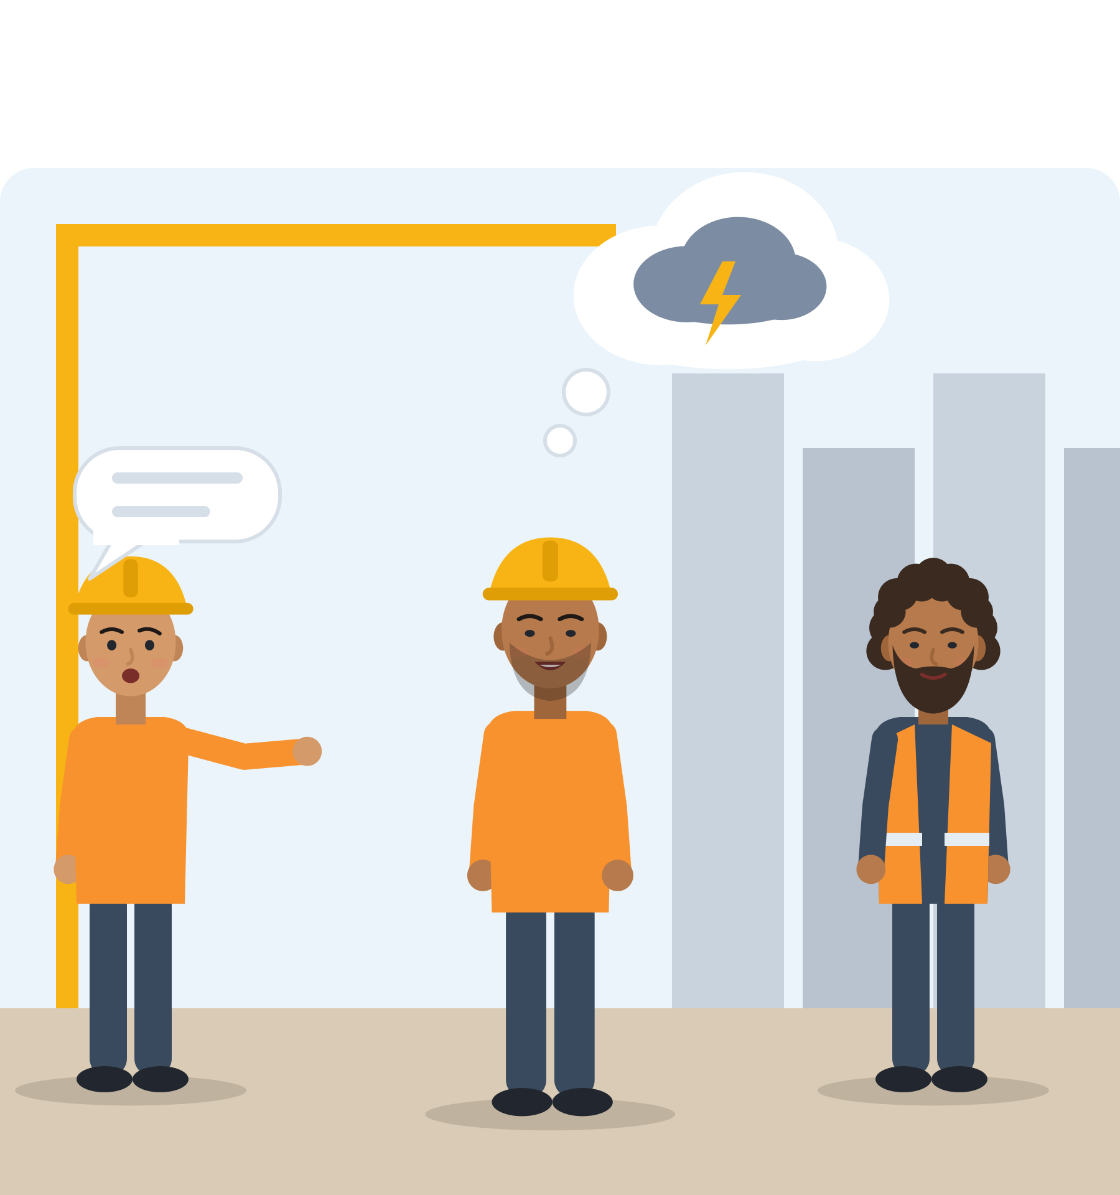
ILLUSTRATIVE SCENARIO
When the joke is about where you come from
Hamid, 22
Building site near Utrecht, first month on the crew
DISCUSS
When does a joke become harassment?
What could Hamid say, now or later?
What can the colleagues who laughed do?
What should the team leader do?
Construction
Netherlands
Humour and respect
At lunch on the building site, a colleague says to Hamid: “Careful, he'll steal your phone. That's what they do where he comes from.” Everyone laughs, Hamid too. He feels bad all afternoon. The next day, the same colleague makes a similar joke.
Grounded in: harassment is unwanted conduct creating “an intimidating, hostile, degrading, humiliating or offensive environment” (Directive 2000/43/EC, Art. 2(3)); FRA (2024), p. 64.
Module 6 · Teamwork
36
Notes:
Illustrative scenario (constructed): Hamid is invented. Unit 3 topic: conflict and disagreement; also inclusion and emotions (Unit 2). Not legal advice.
Say: "Humour is part of belonging, so people often laugh along. That does not make the joke okay."
Evidence: workers who join in humour "are seen as being 'part of the team'" (Language in the Workplace Project), which explains why Hamid laughs. Directive 2000/78/EC uses the same harassment wording for religion or belief. FRA (2024, p. 64): 27% of Muslim respondents experienced racist harassment in 5 years, and 13% of the most recent incidents happened at their workplace.
Run (7 min): groups discuss; collect bystander actions: don't laugh, say "not okay", check in with Hamid later, tell the team leader. Hamid does not have to answer on the spot; he can speak later in private, or talk to someone he trusts. Trauma-informed: participants may pass.

Slide 37
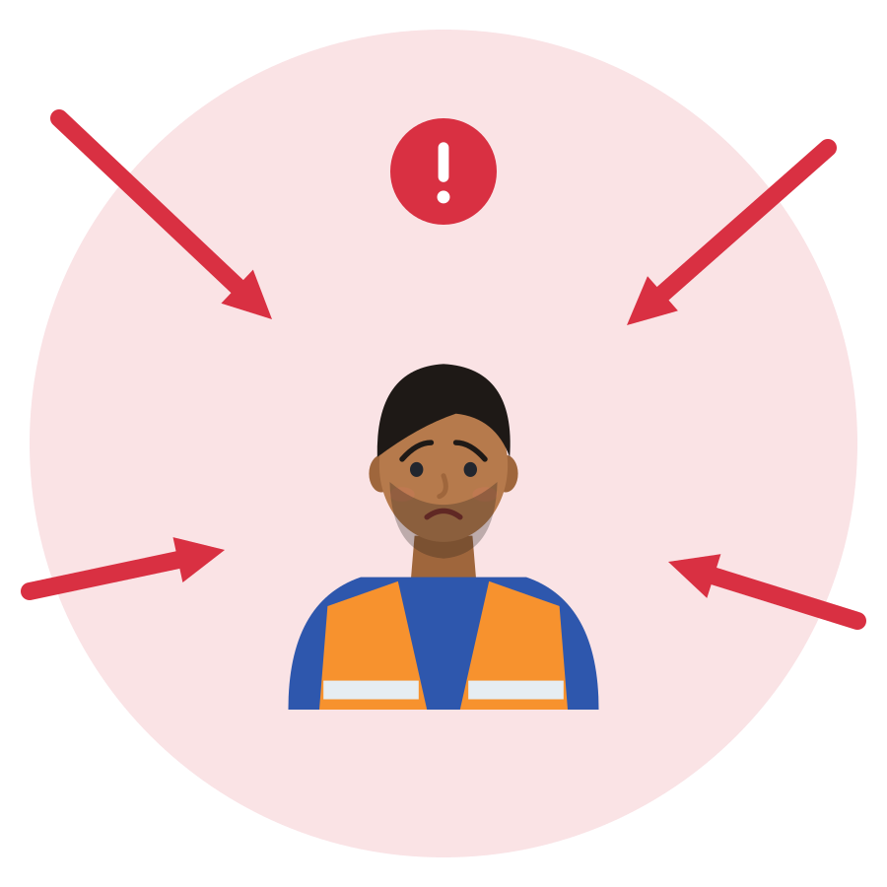

GIVING AND RECEIVING FEEDBACK
After a mistake: blame, or learn?
Team A: blame
Team B: learn
“Who did this? The new guy again.”
Lucas stays silent and hides his next mistake.
Nobody learns why it happened.
Next week: the same error.
Leader: “40 parcels went to the wrong city. We all stayed 30 minutes longer. Next time, please check the label twice.”
Lucas: “Thank you for telling me. So the problem was the label, right? I'll double-check.”
Together: could the label screen be clearer?
Give: fact, effect, next step. Receive: thank you, check, plan.
Source: Edmondson (1999), 51 work teams · Salas et al. (2005), Table 1 · ESCO S1.8.3-S1.8.4 · example constructed
Module 6 · Teamwork
37
Notes:
Illustrative scenario (constructed): Lucas, 25, on a three-month contract in a parcel hub, labelled a pallet wrongly. 40 parcels went to the wrong city and the team stayed 30 minutes longer. The team leader wants to talk. Lucas expects to be fired.
Say: "Feedback is about the work, not the person. A good structure makes it easier to give and to receive."
Evidence: "talking about errors" and "seeking feedback" are learning behaviours linked to performance in psychologically safe teams (Edmondson, 1999); trust shows in "willingness to admit mistakes and accept feedback" (Salas et al., 2005). ESCO S1.8.4 "accepting feedback": "React to valid and well-reasoned opinions and directions about one's work in a positive manner".
Run (6 min): role-play in pairs: the leader gives feedback (fact, effect, next step), Lucas receives (thank you, check, plan). Replay with a blaming leader and compare how Lucas feels. Remind participants that positive feedback counts too: "You explained that really clearly. It helped me a lot."

Slide 38




USEFUL PHRASES
Phrases for fair tasks, disagreement and feedback
Fair tasks
Disagreeing
When a joke hurts
Taking feedback
“I've done the cleaning every day this week. Could we make a rota so we take turns?”
“I'd like to understand how tasks are shared. Is there a plan I can see?”
“I see it differently. Can I explain my idea?”
“Could we try it once and compare?”
“Let's focus on the problem, not on who made it.”
“I know you mean it as a joke, but that comment about my country isn't okay for me.”
“Please don't make jokes about people's nationality here. We're one team.”
“Thank you for telling me. So the problem was the labels, right?”
“That was my mistake. I've fixed it, and next time I'll double-check.”
“What would you like me to do differently?”
Module 6 · Teamwork
38
Notes:
Run (5 min): pairs choose one card and practise each phrase twice: once calm, once a little nervous. The partner answers.
Links: fair tasks practise process conflict rules (LifeComp S3.3); disagreeing practises task conflict without personal attacks (de Wit et al., 2012); feedback phrases practise ESCO S1.8.3 and S1.8.4.
When a joke hurts: say it calmly, or later in private if that feels safer. Nobody must respond on the spot.
Tip: let participants write the phrase they find most useful on the back of their worksheet, in English and in their strongest language.

Slide 39
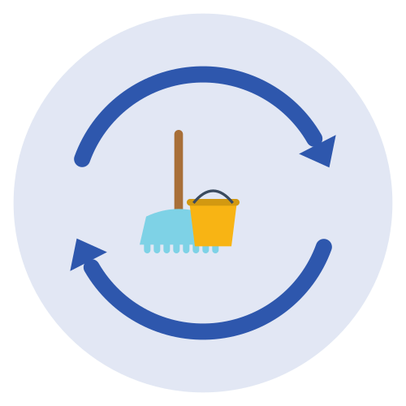



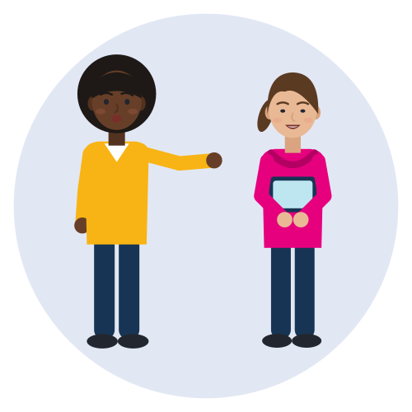

WELL-BEING AND FAIRNESS IN TEAMWORK
Team habits that keep people well and work fair
Rotate the hard tasks
Names on tasks
Breaks for everyone
Cleaning, night shifts and heavy lifting go on a visible rota.
Everyone's part is visible. Nobody does everything, and nobody hides.
Colleagues cover each other's station, so every person gets their break.
A short check-in
A buddy for newcomers
A clear stop for disrespect
“How is everyone today? Anything we need to know?” at the start of the shift.
One person shows the routines in the first weeks and answers questions.
Jokes about origin or religion stop. Anyone can say “not okay”.
Source: LifeComp S3.3 (Sala et al., 2020) · Karau & Williams (1993) · Hackman (2002) · EU Action Plan on Integration and Inclusion 2021-2027 (COM(2020) 758)
Module 6 · Teamwork
39
Notes:
Say: "Fairness is easier when it is visible. Well-being is easier when the team looks after each other."
Evidence: LifeComp S3.3: "Fair sharing of tasks, resources and responsibility within a group". Social loafing shrinks when contributions are visible (Karau & Williams, 1993). Hackman (2002): leaders cannot "cause" teamwork, they create conditions (a real team, a compelling direction, an enabling structure, a supportive context, competent coaching); some problems come from the set-up, such as no induction. The EU Action Plan commits to "promoting mentoring and buddy programmes between local communities and newly arrived migrants".
Run (4 min): each participant picks one habit to propose in their team or course, and writes down how they would ask for it ("Could someone show me the routine for the first week?").
Tip: top row = fairness, bottom row = well-being. If someone seems distressed, pause, offer a quiet break and talk privately; use your local referral list.

Slide 40
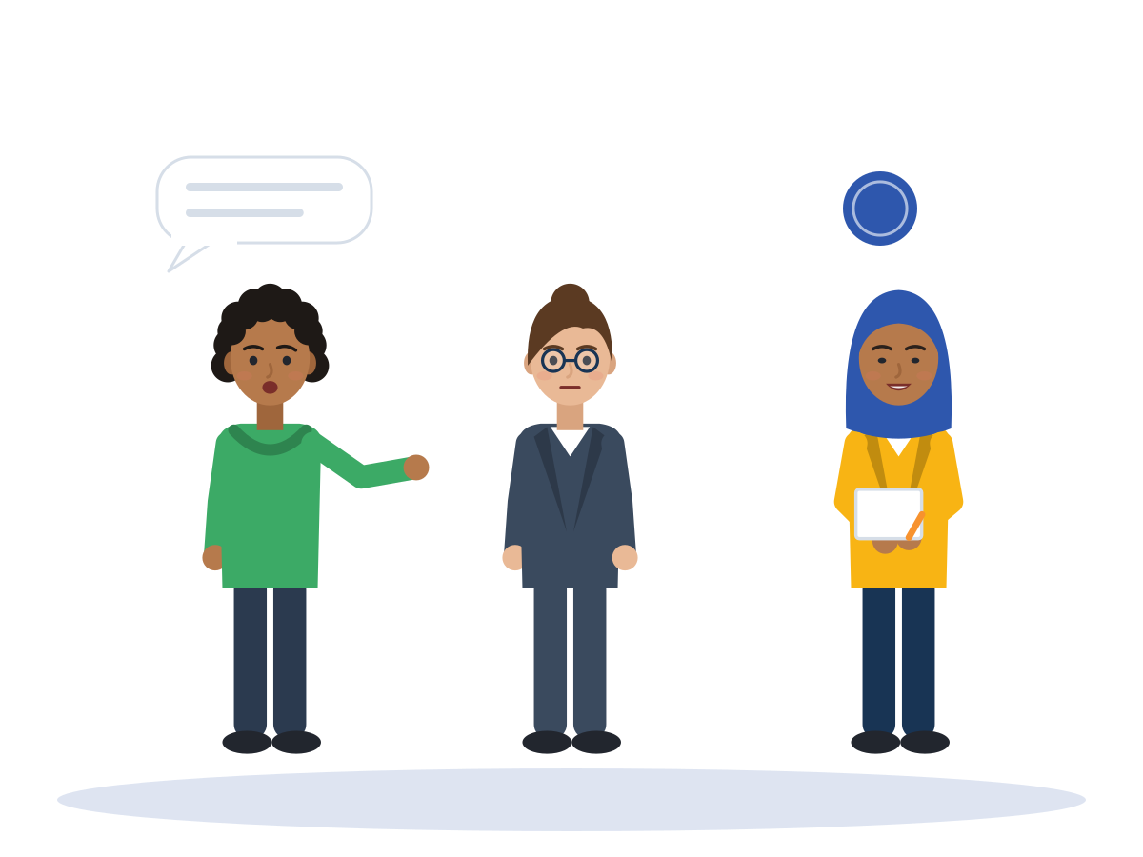
ACTIVITY
Role-play and reflection: four team situations
TIME
15-20 min
STEPS
Cards (all invented): the group project (Aylin), the prayer break (Bilal), the shift group chat (Mariam), the mistake at the parcel hub (Lucas).
Each round: 4 min play, 3 min feedback (observer first, then players). Swap roles.
Observer looks for 3-4 things: does their share, keeps others informed, checks understanding, disagrees with respect.
Practise feedback: fact, effect, next step. Receiving: thank you, check, plan.
Anyone can show the “pause” card. At the end, everyone says their own name to step out of the role.
GROUP
Triads: two players and one observer
MATERIALS
Role-play scenario cards, observer sheet, reflection questions, “pause” card
DEBRIEF
GOAL
Practise fair, clear and respectful teamwork in realistic situations
Which sentence worked best?
Was the conflict about the task, the process or the relationship?
What will you try in your real team next week?
Module 6 · Teamwork
40
Notes:
Curriculum activity (Unit 3): role-play and reflection. Participants take part in group simulations, analyse teamwork dynamics, then guided reflection and self-diagnosis follow.
Observer sheet: use Council of Europe RFCDC descriptors, e.g. "Builds positive relationships with other people in a group", "When working as a member of a group, does his/her share of the group's work", "Can communicate with conflicting parties in a respectful manner".
The person playing the "difficult" side stays firm but never abusive. No filming.
Tip: after the last round, do the guided reflection with the debrief questions, then move to the self-diagnosis checklist.

Slide 41

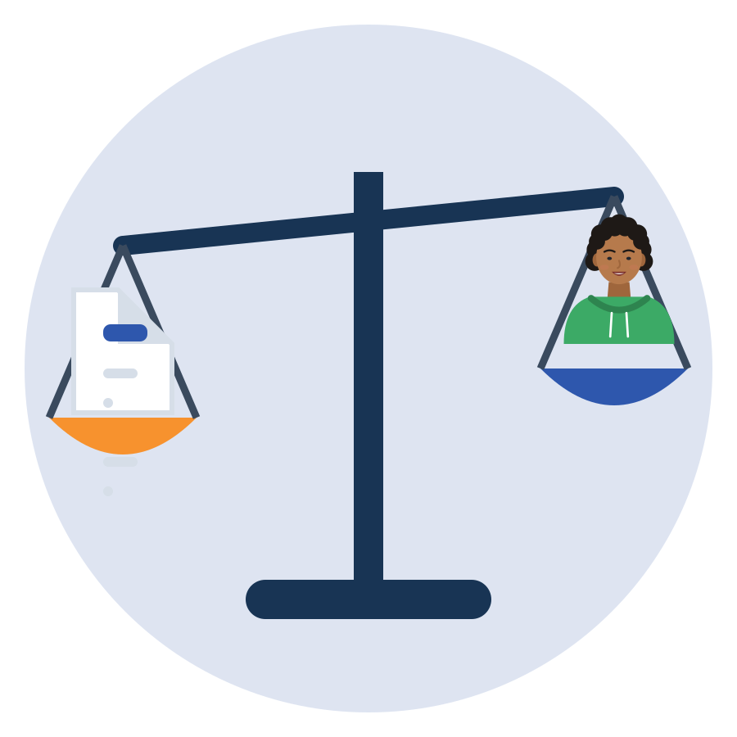
BE FAIR TO YOURSELF
Skills open doors, but they are not the whole story
What this skill can change
What it cannot fix alone
Check understanding and close the loop, even with basic language.
Share tasks visibly and speak up calmly when it is unfair.
Disagree about the task without attacking the person.
Notice when someone is left out, and include them.
Identical CV, different name: 55 of 100 got a positive answer with a Dutch name, 40 of 100 with a Turkish name.
Recognition of diplomas, residence permits and the right to work depend on laws and offices, not on you.
Discrimination is not your fault. It can be reported to an equality body, a union or an NGO.
Teamwork is shared: fair rules and fair leaders matter as much as your skills. Know your rights too.
Source: Thijssen et al., 2021, JEMS (correspondence test, NL, applicants aged 23-25)
Module 6 · Teamwork
41
Notes:
This slide protects participants from a "deficit" message: soft-skills training must not suggest that unemployment or discrimination is their fault.
Field experiments send identical CVs that differ only by name; the call-back gap therefore measures discrimination, not skills (Quillian et al., 2019, meta-analysis of 97 experiments).
Only 6% of Muslim respondents who felt discriminated against reported it (FRA, Being Muslim in the EU, 2024). Point to the help points slide.
Team-specific limits: a team leader who always gives the worst tasks to the same person, or who laughs along with jokes about origin, is not a communication problem that one newcomer can solve. Allport's "authority support" and Hackman's conditions put this responsibility on leaders and employers.
Discrimination at work is measured, not imagined: 10% of first-generation migrant workers reported discrimination linked to race, ethnicity or colour, vs 2% of all workers (Eurofound, 2019, EWCS 2015).
Same programme, unequal results: in the World Bank / İŞKUR employment support project in Türkiye, on-the-job training led to employment for 90% of Turkish men but 37% of Syrian men (labour-market note §3.3). Ask: "Why did the same training give different results?"

Slide 42





WHERE TO GET HELP
Official help points in the SMILE countries
 | Country | Jobs and training | Diplomas and recognition | Unfair or unsafe work
 | Türkiye | İŞKUR (iskur.gov.tr), Public Education Centres | YÖK denklik, MEB e-Denklik | Ministry of Labour (csgb.gov.tr), YİMER 157 helpline
 | Greece | DYPA (dypa.gov.gr) | DOATAP (doatap.gr) | Labour Inspectorate, phone 1555
 | Italy | Centri per l'Impiego, SIISL | CIMEA (free for protection holders) | Ispettorato Nazionale del Lavoro
 | Germany | Agentur für Arbeit, Jobcenter, Jugendmigrationsdienste (12-27) | Anerkennung in Deutschland, IQ Netzwerk | Faire Integration (free, multilingual)
 | Netherlands | UWV, werk.nl, your municipality | IDW (idw.nl) | Nederlandse Arbeidsinspectie, Juridisch Loket
Save the number or website of one help point in your phone today.
Source: Official websites, checked 1 October 2026 (SMILE research note, labour market)
Module 6 · Teamwork
42
Notes:
Ask participants which country they live in and open the matching website live if internet is available.
For unfair tasks, harassment or jokes about origin at work: first talk to the team leader, a works council or a union if there is one. The last column lists official places for unfair or unsafe work.
Only 6% of Muslim respondents who felt discriminated against reported it anywhere (FRA, 2024). Saving one help point today makes the next step easier.

Slide 43
SELF-CHECK
Teamwork self-diagnosis checklist (1/2)
Not yet
Sometimes
Usually
I repeat back important instructions to check I understood.
I ask a question when I do not understand, even if others seem to understand.
When a colleague is overloaded, I offer help.
I do my share of the group's work.
I keep others informed about information that matters for the team.
I accept feedback about my work without becoming defensive.
Module 6 · Teamwork
43
Notes:
Curriculum tool: teamwork self-diagnosis checklist (called "self-diagnosis questionnaire" in the assessment section). Run (10 min for both slides): participants tick one box per line, alone and in silence.
Each item comes from a framework: 1 closed-loop communication (Salas et al., 2005); 2 learning behaviour (Edmondson, 1999); 3 backup behaviour, ESCO S1.8.6; 4 RFCDC "does his/her share"; 5 RFCDC "keeps others informed"; 6 ESCO S1.8.4.
This checklist was compiled for SMILE from these frameworks. It is NOT a validated test: never use it for selection or grading.

Slide 44
SELF-CHECK
Teamwork self-diagnosis checklist (2/2)
Not yet
Sometimes
Usually
I give feedback respectfully, about the work, not the person.
I notice when someone is left out (e.g. by language) and try to include them.
I speak up, politely, when tasks are shared unfairly, also when it is not about me.
I can disagree about the task and still keep a good relationship.
I know my strengths in a team and one thing I want to improve.
Module 6 · Teamwork
44
Notes:
Sources: 7 ESCO S1.8.3 and the conflict types (de Wit et al., 2012); 8 LifeComp S3.1; 9 LifeComp S3.3; 10 RFCDC and de Wit et al.; 11 learning outcome 6 of the curriculum.
Participants circle their two strongest items and one item to develop. Optional: use the checklist at the start and at the end of the module to compare.
Collect only anonymous, optional feedback on which items the group finds hardest. That is the formative information the curriculum asks for.

Slide 45

REFLECTION
One thing I learned, one thing I will try
What did I learn about myself as a team member?
What one thing will I try in my team next week?
Which role do I often play in a team?
Who could give me honest feedback on it?
Optional: write down which key competence you used. It helps for Youthpass or your CV.
Module 6 · Teamwork
45
Notes:
Closing round (5 min): each participant says one thing they learned about themselves as a team member and one thing they will try next week. Keep it short; "pass" is allowed.
Youthpass is "a European recognition instrument for identifying and documenting learning outcomes" in Erasmus+ Youth and European Solidarity Corps projects; it is not a formal accreditation. Key competences used here: personal, social and learning to learn; multilingual; citizenship.
Tip: if the group meets again, start the next session by asking how the "one thing" went.

Slide 46


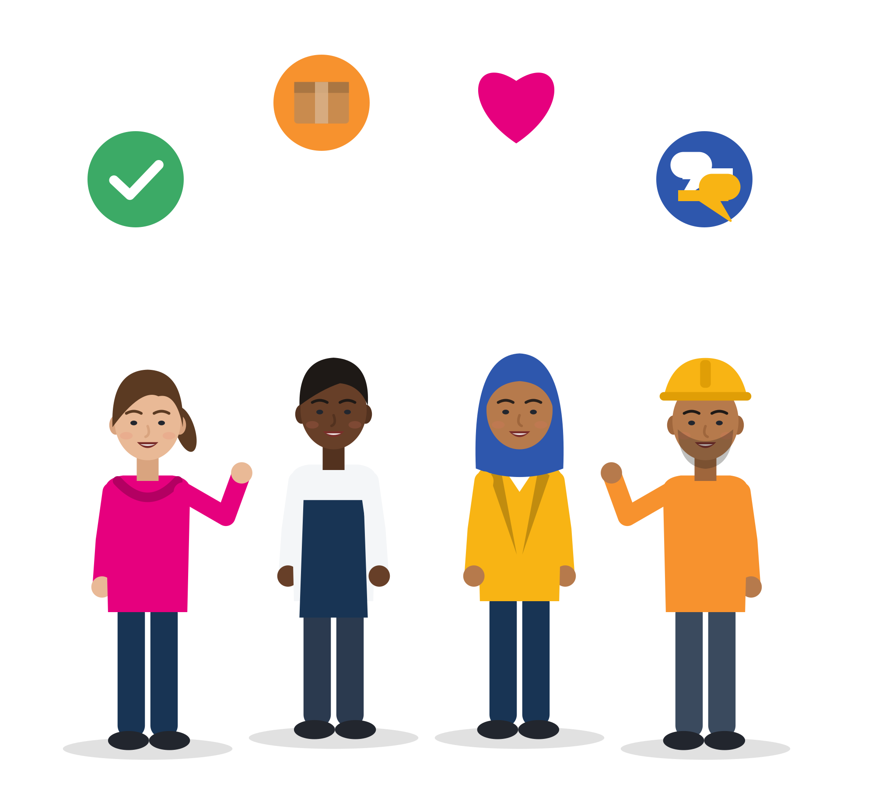

KEY MESSAGES
Check. Share. Include. Disagree with respect.
Teamwork is a shared responsibility and a skill you can learn. Mixed teams bring resources and risks: good habits decide which side wins. When the problem is unfair rules or disrespect, fixing it is not only your job.
Module 6 · Teamwork
46
Notes:
Summarise with the group: ask three volunteers to name one tool they will use (closing the loop, a task rota, naming the conflict type, fact-effect-next step feedback, a group-chat rule).
Close by linking back to the opening: teamwork is a shared responsibility, not individual performance (curriculum, Unit 1).

Slide 47
REFERENCES
Sources used in this presentation (1/2)
Alan, S., Baysan, C., Gumren, M., & Kubilay, E. (2021). Building social cohesion in ethnically mixed schools: An intervention on perspective taking. Quarterly Journal of Economics, 136(4), 2147-2194.
Belbin, R. M. (1981). Management teams. Heinemann. Critique: Aritzeta et al. (2007), JMS 44(1); Batenburg et al. (2013), JMD 32(8); van Dierendonck & Groen (2008).
Blackmore, R., et al. (2020). The prevalence of mental illness in refugees and asylum seekers: A systematic review and meta-analysis. PLoS Medicine, 17(9), e1003337.
Cedefop (2022). Setting Europe on course for a human digital transition (ESJS2). World Economic Forum (2025). The future of jobs report 2025.
Council of Europe (2018). Reference framework of competences for democratic culture, Vols. 1-2.
de Wit, F. R. C., Greer, L. L., & Jehn, K. A. (2012). The paradox of intragroup conflict: A meta-analysis. Journal of Applied Psychology, 97(2), 360-390. De Dreu & Weingart (2003).
Directives 2000/43/EC, 2000/78/EC (equal treatment) and 2003/88/EC (working time). Türkiye: İş Kanunu No. 4857, Art. 5 and 68.
Edmondson, A. (1999). Psychological safety and learning behavior in work teams. Administrative Science Quarterly, 44(2), 350-383. Frazier et al. (2017). Google re:Work (2015).
EU-OSHA (2025). First findings of ESENER 2024. EU-OSHA (2007). Literature study on migrant workers. OSHwiki “Migrant workers” (2022).
Eurofound (2019). How your birthplace affects your workplace. Publications Office.
Eurostat (2025 data). lfsa_egaisedm (own calculation), lfsa_eoqgan, lfsa_etpgan.
FRA (2024). Being Muslim in the EU. FRA (2019). Protecting migrant workers from exploitation in the EU: Workers' perspectives.
Gibson, C. B., & Zellmer-Bruhn, M. E. (2001). Metaphors and meaning: An intercultural analysis of the concept of teamwork. Administrative Science Quarterly, 46(2), 274-303.
Hackman, J. R. (2002). Leading teams: Setting the stage for great performances. Harvard Business School Press.
Karau, S. J., & Williams, K. D. (1993). Social loafing: A meta-analytic review and theoretical integration. JPSP, 65(4), 681-706.
Module 6 · Teamwork
47
Notes:
Full verified references with URLs and page numbers: SMILE research note "Teamwork" (arastirma/teamwork-icerik.md) and the shared labour-market note. The key references of the curriculum (OECD 2018, 2021; ILO 2020, 2021; European Commission 2019, 2020; UN 2016; UNHCR 2013) are listed in the curriculum itself.

Slide 48
REFERENCES
Sources used in this presentation (2/2)
Lencioni, P. (2002). The five dysfunctions of a team: A leadership fable. Jossey-Bass.
Lowe, M. (2021). Types of contact: A field experiment on collaborative and adversarial caste integration. American Economic Review, 111(6), 1807-1844.
Marra, M., Holmes, J., & Riddiford, N. (2009). Workplace communication for skilled migrants. LWP Occasional Paper 11; Language in the Workplace Project.
McEwan, D., et al. (2017). The effectiveness of teamwork training on teamwork behaviors and team performance. PLoS ONE, 12(1), e0169604.
Mittal, S., Parigi, S., & Vollmer, S. (2024). Social cohesion among Syrian and Turkish children, adolescents, and young adults in Turkey. International Migration, 63(3), e13346.
Neeley, T. B. (2013). Organization Science, 24(2). Kraft, K. (2020). Int. Journal of Multilingualism, 17(1). Lønsmann, D. (2014). Multilingua, 33(1-2).
Pettigrew, T. F., & Tropp, L. R. (2006). A meta-analytic test of intergroup contact theory. JPSP, 90(5), 751-783. Pettigrew (1998); Paluck et al. (2019); Mousa (2020).
Prognos AG (2023). Abschlussbericht: Evaluation der Initiative VerA, Phase III. BMBF/BIBB.
Sala, A., et al. (2020). LifeComp. Vuorikari, R., et al. (2022). DigComp 2.2. ESCO S1.8. European Commission (2020). Action plan on integration and inclusion 2021-2027.
Salas, E., Sims, D. E., & Burke, C. S. (2005). Is there a “big five” in teamwork? Small Group Research, 36(5), 555-599.
Shore, L. M., et al. (2011). Inclusion and diversity in work groups: A review and model for future research. Journal of Management, 37(4), 1262-1289.
Stahl, G. K., et al. (2010). Unraveling the effects of cultural diversity in teams. JIBS, 41(4), 690-709. Stahl & Maznevski (2021); van Dijk et al. (2012); Bell et al. (2011).
Tenzer, H., Pudelko, M., & Harzing, A.-W. (2014). The impact of language barriers on trust formation in multinational teams. JIBS, 45(5), 508-535. Tenzer (2016).
Thijssen, L., Lancee, B., Veit, S., & Yemane, R. (2021). Discrimination against Turkish minorities in Germany and the Netherlands. JEMS, 47(6), 1222-1239.
Tuckman, B. W. (1965). Developmental sequence in small groups. Psychological Bulletin, 63(6). Tuckman & Jensen (1977). Gersick (1988), AMJ 31(1).
Module 6 · Teamwork
48

Slide 49

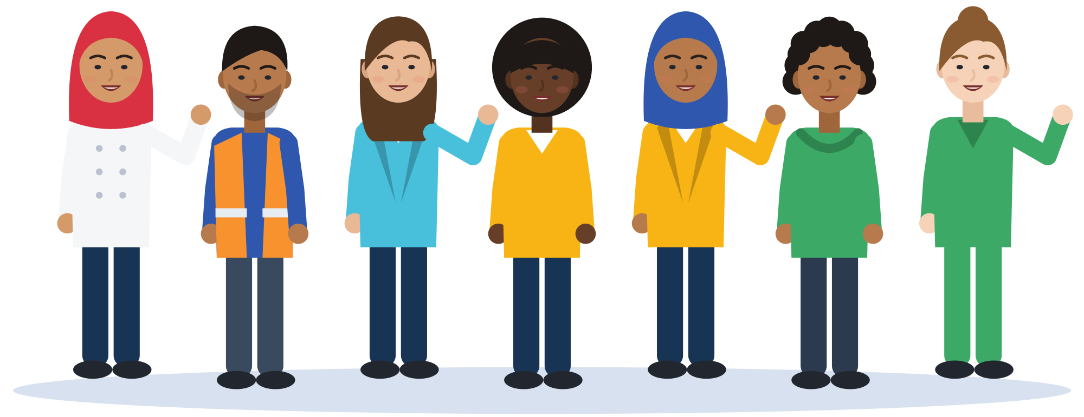
Thank you
THE SMILE PARTNERSHIP
Göç Sanat ve Spor Derneği (MIGARTS) (Türkiye, coordinator)
KYTTARO ENALLAKTIKON ANAZITISEON NEON (KEAN) (Greece)
Work in Progress APS (WiP) (Italy)
Smart Leap Education Research Consultancy GmbH (Germany)
Association of Entrepreneurship School (AES) (Türkiye)
BİR-İZ (Türkiye)
Stichting Unity Sphere Europe (SUSE) (Netherlands)
Questions, ideas, stories: the floor is yours.
KEEP LEARNING
smile-lms.smartleap.eu
MODULE
6 · Teamwork
PROJECT
SMILE · Erasmus+ KA220-YOU
PROJECT NO.
2024-1-TR01-KA220-YOU-000256357
Scan to join the SMILE learning platform
Free online course: lessons, activities, quiz and certificate.
Co-funded by the European Union. Views and opinions expressed are however those of the author(s) only and do not necessarily reflect those of the European Union or the Turkish National Agency. Neither the European Union nor the granting authority can be held responsible for them.
SKILLS = Opportunity
Empowerment Through Skills · Inclusion Through Opportunity
Module 6 · Teamwork
49
Notes:
Invite participants to continue on the SMILE learning platform (QR code). Collect the anonymous feedback on the hardest self-diagnosis items.

