Slide 1




MODULE 4 · TRAINER PRESENTATION
Leadership
Lead without a title: small, fair and realistic actions that help people move forward at work, in education and in your community.
3 hours
6 sessions
Ages 18-30
B1-B2 English
SMILE
Support Young Migrants Integration in the Labour market in Europe
Erasmus+ KA220-YOU · 2024-1-TR01-KA220-YOU-000256357
Empowerment Through Skills · Inclusion Through Opportunity
Notes:
Module 4 of the SMILE soft-skills curriculum. The curriculum presents leadership "not as formal authority, a manager title or seniority, but as a practical, learnable and ethical skill that can be demonstrated through everyday actions".
Welcome participants, introduce yourself and the SMILE project in one sentence: an Erasmus+ project of seven partners in Türkiye, Greece, Italy, Germany and the Netherlands that helps young migrants enter the labour market.
Open with one question and no pressure to answer: "When you hear the word leader, who do you see?" Most people name a boss or a politician. By the end of the module, we want them to also see themselves.

Slide 2






HOW WE WORK TOGETHER
Our agreement for this module
We never correct your language
Your story belongs to you
A safe space for everyone
Grammar mistakes are never corrected here. We listen to your ideas. Mix in words from other languages if it helps.
You never have to share your migration story. Our examples use invented characters.
Nobody is judged here. One voice at a time. Every question is a good question.
“Pass” is always OK
Actions, not labels
Everyone gets a turn
You can skip any activity or question. Take a break when you need one.
We talk about what people do, not what they “are”. No “you are shy”, no “born leader”.
We use rounds, so quiet voices are heard too. Speaking most is not the same as leading.
Module 4 · Leadership
2
Notes:
Co-create or confirm the agreement before content starts. Write it on a flipchart and keep it visible for the whole module.
Why: many young refugees carry heavy stress. A review of 26 studies (5,143 adult refugees and asylum seekers) found PTSD and depression in about 31.5% each (Blackmore et al., 2020, PLOS Medicine). Never ask participants to tell their migration story; use the constructed characters on the slides.
Language: do not correct grammar or pronunciation during sharing. Model the phrases instead (the "useful phrases" slides).
Leadership curriculum, section 4 (critical rule): "In order not to undermine young people's self-confidence, language/grammar errors made while they are sharing must never be corrected." Say this rule out loud at the start and keep it on the flipchart.
Why it matters for leadership: in a company that used English as its common language, non-native speakers who BELIEVED their fluency was medium were the most anxious; self-assessed, not objective, fluency explained their behaviour (Neeley, 2013). Correction lowers exactly this self-assessment.
The other two curriculum principles are on this slide too: a safe and inclusive space, and a focus on observable behaviour instead of personality traits. Behaviour, not labels: describe what people did ("you asked the quiet colleague for her view"), never who they "are" ("you are shy", "you are a natural leader").
Rounds model inclusive leadership: speaking time predicts who is seen as a leader, even after controlling for intelligence and personality (MacLaren et al., 2020). Rounds give quiet participants the same space.

Slide 3
MODULE MAP
Six sessions, from ideas to action
01
Understanding leadership
02
Leadership vs. authority
03
Breaking down leadership myths
Leadership as a behaviour, not a position. Micro-leadership. Activity: Leadership Around Us.
Power, responsibility, influence and trust. Activity: Who Holds Authority? Who Is Leading?
Born? Extrovert? Perfect language? Activity: Myth or Fact?
45 min
30 min
35 min
04
Leadership in multicultural environments
05
Barriers and coping strategies
06
Transfer to real life
Expectations, inclusiveness, intercultural awareness. Activity: Case Study (Elena & Marco).
Language insecurity, stereotypes, power imbalance. Activity: What Is Holding Me Back?
Work, education and community life. Activity: My Leadership in Action.
35 min
35 min
20 min
Module 4 · Leadership
3
Notes:
Times are shown exactly as written in the curriculum. Note the inconsistency: the curriculum states "Total Duration: 3 Hours", but the six sessions add up to 45 + 30 + 35 + 35 + 35 + 20 = 200 minutes (3 hours 20 minutes).
Practical options: plan about 3.5 hours including one short break, or agree with your organisation where to save 20 minutes (for example shorter warm-ups in Sessions 1 and 3). Protect Session 6: it is where each participant names a concrete action step.
Two-day option: Sessions 1 to 3 on day one, Sessions 4 to 6 on day two, starting with a 5-minute recap.

Slide 4
LEARNING OUTCOMES
What will we achieve?
1
Define leadership as an action-based and ethical soft skill that goes beyond hierarchy.
5
Recognise the personal, cultural and structural barriers (language barriers, etc.) that young migrants face on the path to leadership.
2
Understand the difference between “Authority (power)” and “Leadership (influence)” and explain the importance of this difference in work/education settings.
6
Develop realistic and low-risk strategies for demonstrating leadership in daily life.
3
Recognise that leadership is not innate, but an ability that can be developed through practice, experience and reflection.
7
Transfer skills such as taking the initiative, problem-solving and responsibility to real work and education scenarios.
4
Apply inclusive and respectful leadership behaviours suited to multicultural environments.
8
Discover personal strengths and identify concrete action steps for applying leadership in real life.
Module 4 · Leadership
4
Notes:
These are the eight learning outcomes of the SMILE curriculum (English edition, unchanged; the curriculum heading is "What Will We Achieve?").
Assessment is formative only: no exams, no grades. The curriculum's practical task in Session 6 (context, situation, realistic step, leadership skill) shows what each participant has taken away.

Slide 5

WHY THIS MATTERS
Employers want leadership. Titles come later.
61%
1.4%
4-33%
of employers name “leadership and social influence” a core skill for their workers. Only two skills are named more often.
of employed young people born abroad (15-29) in the EU are managers (native-born: 1.8%). At your age, leadership rarely has a title.
higher adult wages for US men who held leadership positions in high school, compared with similar men.
Employers look for leadership. You can show it long before you have a title.
Source: World Economic Forum, Future of Jobs Report 2025, p. 35 · Eurostat lfsa_egaisedm, 2025, own calculation (SMILE research note) · Kuhn & Weinberger (2005), Journal of Labor Economics
Module 4 · Leadership
5
Notes:
WEF 2025: survey of more than 1,000 employers (over 14 million workers, 55 economies). Leadership and social influence is the third core skill (61%), after analytical thinking (69%) and resilience, flexibility and agility (67%), and it is expected to grow to 2030. These are employers' expectations, not measured outcomes. In this survey "leadership" means influencing and mobilising people, which a warehouse worker or a care assistant also does.
Eurostat 2025, own calculation in the SMILE research note: employed persons aged 15-29, foreign-born (first generation) vs native-born with native-born parents, EU-27.
Kuhn & Weinberger (2005): US data, controlling for cognitive skills; the size of the effect (4% to 33%) depends on definitions and period. Interviewers look for "patterns of past leadership roles" (Arvey et al., 2006, p. 16).
Small acts count: a meta-analysis of 168 samples (N = 51,235) linked helping colleagues and voluntarily taking on tasks to managers' performance ratings and reward decisions (Podsakoff et al., 2009). Tip: ask "Where have you already organised or led something, without a title?" and keep the answers for Session 6.

Slide 6


01
SESSION 1 · 45 min
Understanding leadership
Leadership as a behaviour rather than a position: micro-leadership at work and in daily life.
Behaviour, not position
Micro-leadership
Claim and grant
Leadership Around Us
Module 4 · Leadership
6
Notes:
Focus (curriculum): leadership as a behaviour rather than a position; "micro-leadership" in the workplace and in daily life. Suggested timing: 5 min warm-up, 10 min input (next four slides), 25 min activity "Leadership Around Us", 5 min wrap-up.

Slide 7

LEADERSHIP AS A BEHAVIOUR
Leadership is something you do, not a title you have
Authority: a role others give you
Leadership: something you do
In short
Authority is a title, a contract, a position. The supervisor who makes the rota has it.
Leadership is helping people face a problem and move forward. Anyone, any level.
Micro-leadership: a small, voluntary action that helps others or the team move forward, without a title.
Heifetz: “Leadership is an activity.” “Many people exercise leadership without much authority, sometimes without any.”
One without the other: some bosses only give orders; some new workers show a better way.
Source: Heifetz (1994), Leadership Without Easy Answers · quotes from an interview in Flower (1995) · micro-leadership: working definition for SMILE
Module 4 · Leadership
7
Notes:
Warm-up (5 min): describe two pictures, or show two photos: a manager in an office, and a young worker helping a colleague lift a heavy box. Ask: "Who is leading?" Collect answers without judging.
The picture: left, a supervisor with a title badge next to the rota (authority: a role other people give you); right, a young worker without a title helps a stuck colleague find a way forward (leadership: an activity). Ask: "Who has authority? Who is leading? Can one person have both?"
Heifetz separates authority (a role others give you) from leadership (an activity). He adds that authority "can be both a resource and a constraint", and that leading without authority means you can raise an issue but cannot control the reaction. This is why Session 5 looks for low-risk steps.
The micro-leadership sentence is a working definition written for SMILE, not a quotation. The next slide explains it through three well-researched behaviours.
Tip: give one example from your own life of leading without a title. Modelling openness makes it easier for participants.

Slide 8

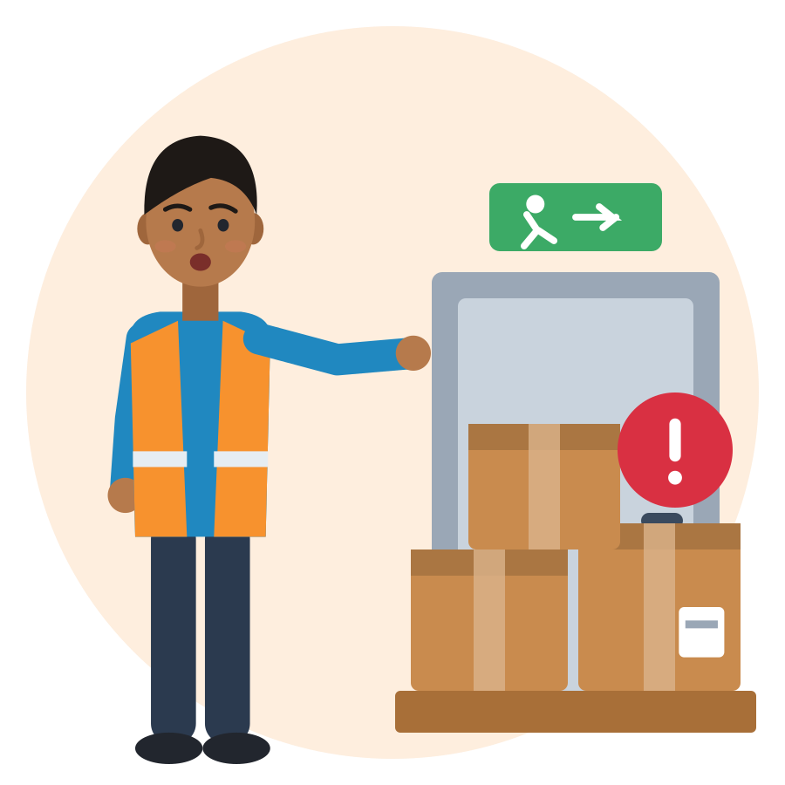
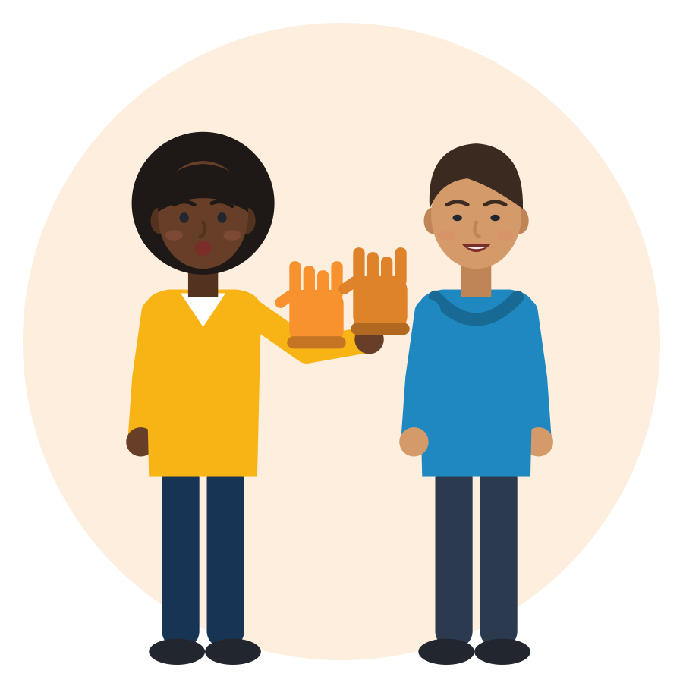
MICRO-LEADERSHIP IN THE WORKPLACE AND IN DAILY LIFE
Micro-leadership: small actions that move people forward
proactive
voice
helping
Take the initiative
Speak up
Help others
Act before someone asks, to make things better. Example: you prepare the handover note before the next shift asks.
Share an idea, a concern or a problem with someone who can act. Example: “The emergency exit is blocked by pallets.”
Support colleagues beyond your own task. Example: you show a new colleague where the protective gloves are.
Source: Proactive behaviour: Grant & Ashford (2008) · voice and silence: Morrison (2014) · helping and citizenship behaviour: Podsakoff et al. (2009)
Module 4 · Leadership
8
Notes:
Term check for trainers: "micro-leadership" is the curriculum's word. In research, Nicholls (1988) used "micro leadership" for a manager's task-level leadership, not for leadership without authority; the everyday meaning ("anyone, any level, small actions") comes from recent career writing without research behind it. So we keep the word and define it through three researched behaviours.
Proactive behaviour: self-initiated, future-oriented action to improve the situation (Grant & Ashford, 2008). Voice: voluntarily sharing suggestions, concerns or problems with someone who can act; silence is holding them back (Morrison, 2014; Van Dyne & LePine, 1998). Helping colleagues is linked to performance ratings and rewards (Podsakoff et al., 2009, 168 samples).
Ask for one everyday example per card: school, sport, family business, community centre. A show of hands is enough for shy groups.

Slide 9
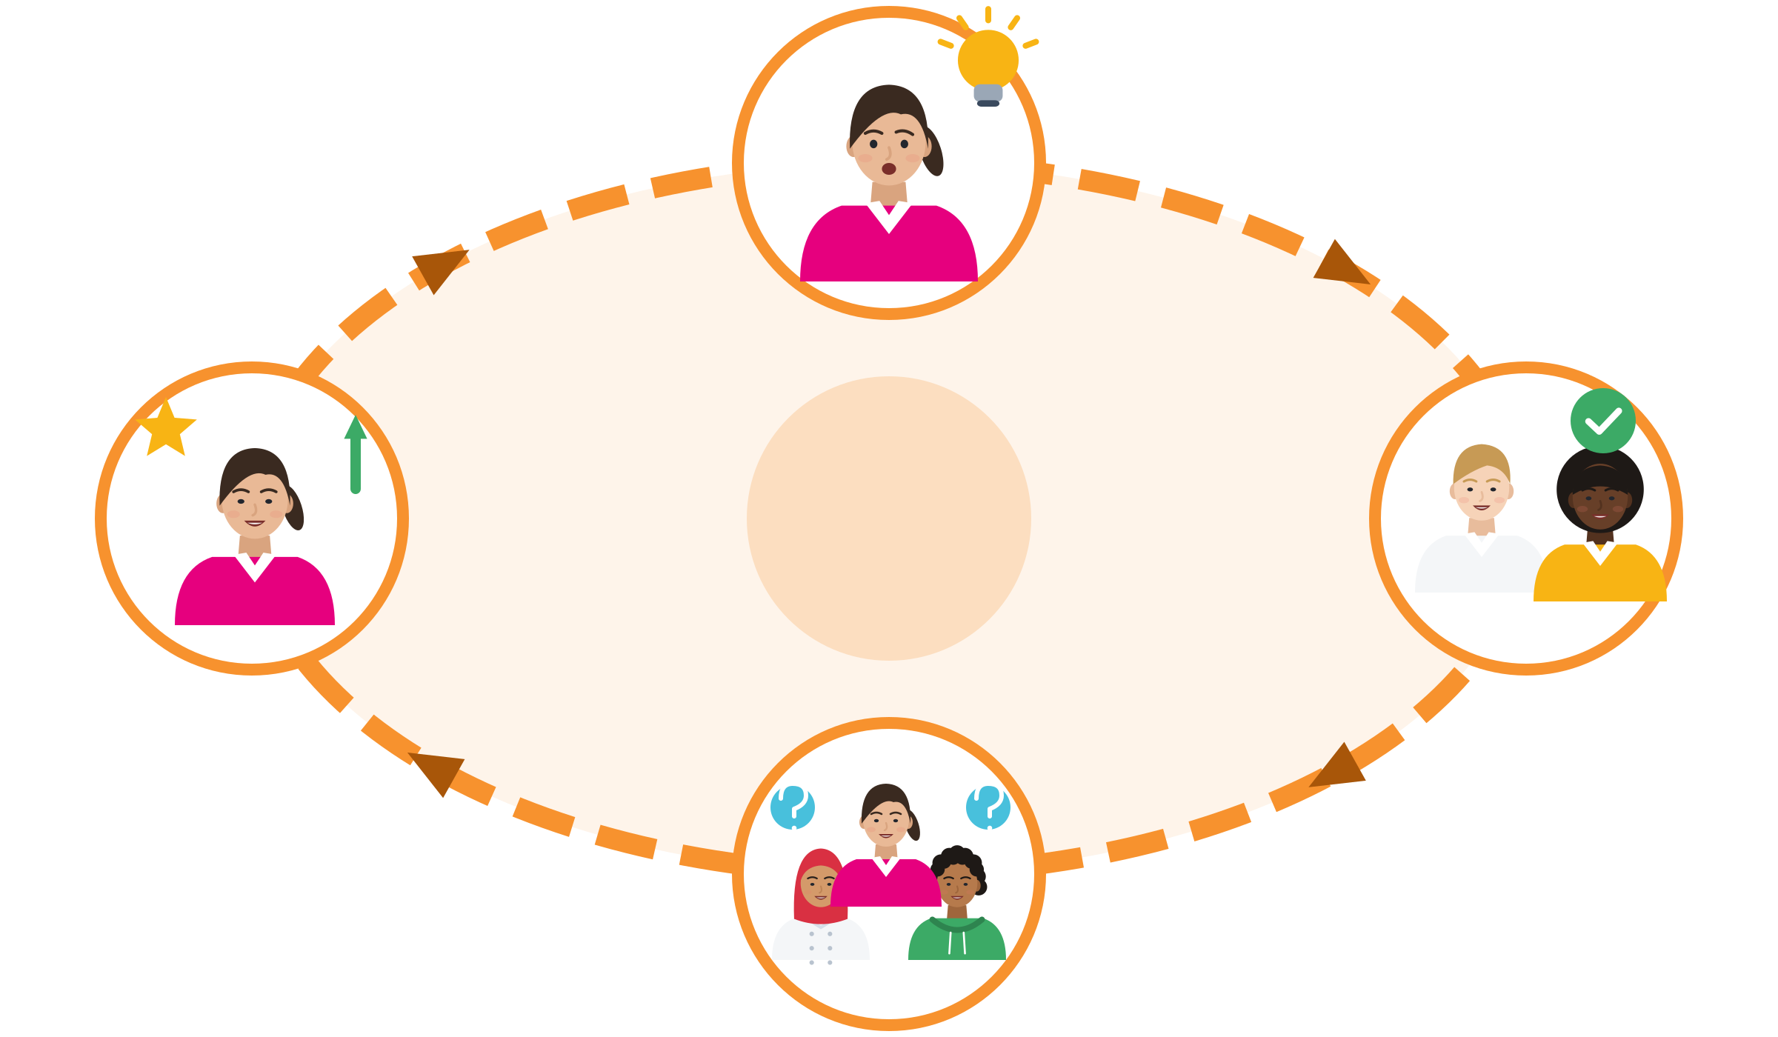
HOW LEADERS ARE MADE
Claim and grant: how people become leaders
1 · I act (claim)
Round by round
I act: I suggest, help or organise something.
Others respond: they follow, accept the idea or ask me for advice.
I am seen as a leader: next time, colleagues come to me first.
I act again, with more confidence. If nobody grants, the claim fades: allies matter.
4 · I act again
Leadership identity
2 · Others respond (grant)
3 · I am seen as a leader
Source: DeRue & Ashford (2010), Academy of Management Review, 35(4): leadership identity is claimed and granted
Module 4 · Leadership
9
Notes:
DeRue & Ashford (2010): leadership identity is built together. People claim a leader role by acting, and others grant it by following, accepting or asking for advice. Repeated claiming and granting makes someone a leader in their own eyes and in others' eyes. It is a social process, not a label you are born with.
Example: an apprentice in a German workshop suggests a clearer labelling system for tools (claim). The master tells others: "Ask her, she organised the shelf" (grant). Next time, colleagues go to her first.
Ask: "Who granted you leadership last time? Whose leadership did you grant this week?" Granting is also leadership. Trainers can grant leadership in the room by naming participants' ideas: "As Amina said."

Slide 10




DOCUMENTED: GLOBAL REFUGEE YOUTH CONSULTATIONS
Young refugees already lead, often without a title
Türkiye
Germany
Greece
Global
Medical translators
A homework club
Clubs with local youth
A voice in decisions
Refugee youth act as medical translators to help older refugees access healthcare.
Young refugees planned a peer homework club.
Young refugees suggested common clubs with Greek young people.
Participants asked for a refugee youth advisory council to advise UNHCR.
Source: UNHCR & Women's Refugee Commission (2016), We Believe in Youth: Global Refugee Youth Consultations, final report, PDF pp. 6, 11, 32
Module 4 · Leadership
10
Notes:
Real, documented examples: 56 consultations in 22 countries (including Turkey, Germany and Greece) with 1,267 refugee youth aged 15-24, October 2015 to June 2016. One of the seven core actions: "Reinforce Refugee Youth as connectors and peace builders".
Hold both sides: the same report lists ten challenges, including legal recognition and documents, discrimination, few employment opportunities and a "lack of opportunities to participate, be engaged, or access decision makers". Leadership training must recognise real barriers and real capacity.
Ask: "Have you seen something like this where you live?" Answers about what others did are enough; nobody needs to tell a personal story.

Slide 11





ACTIVITY
Leadership Around Us
TIME
25 min
STEPS
Think of one person you saw leading without a title: at school, at work, in an internship, in sport or in your community. It can be you.
In pairs, tell your example in a few sentences. Your partner writes it on a card in a few words, in any language.
Put the cards on the wall in three columns: take the initiative, speak up, help others.
Many cards fit more than one column. That is fine: talk about it.
GROUP
Pairs, then whole group
MATERIALS
Cards, pens, wall or flipchart with three columns
DEBRIEF
GOAL
Find and share examples of leadership “without a title”
What did these people DO?
Who granted them leadership?
Which of these actions could you do next week?
Module 4 · Leadership
11
Notes:
Curriculum activity (Session 1): participants find and share examples of leadership "without a title" from daily life, school or internships. Timing: 15 min pairs, 10 min wall and debrief.
Language rule (curriculum, critical): never correct grammar or pronunciation while participants share, and do not "recast" (repeat the sentence correctly). Respond to the content: "That is a strong example. What happened next?"
Behaviour, not labels: describe what people did ("you asked the quiet colleague for her view"), never who they "are" ("you are shy", "you are a natural leader").
Trauma-informed: ask for examples from daily life now, not from the journey. Participants may write or draw instead of speaking. Keep the cards: they are useful again in Session 6.

Slide 12

02
SESSION 2 · 30 min
Leadership vs. authority
Power, responsibility and influence: inspiring others and building trust without a formal role.
Authority or leadership?
Sources of power
Who is leading?
Trust
Module 4 · Leadership
12
Notes:
Focus (curriculum): power, responsibility and influence; inspiring others and building trust without formal roles. Suggested timing: 5 min input (2×2 grid and sources of power), 20 min activity "Who Holds Authority? Who Is Leading?", 5 min close with trust.

Slide 13
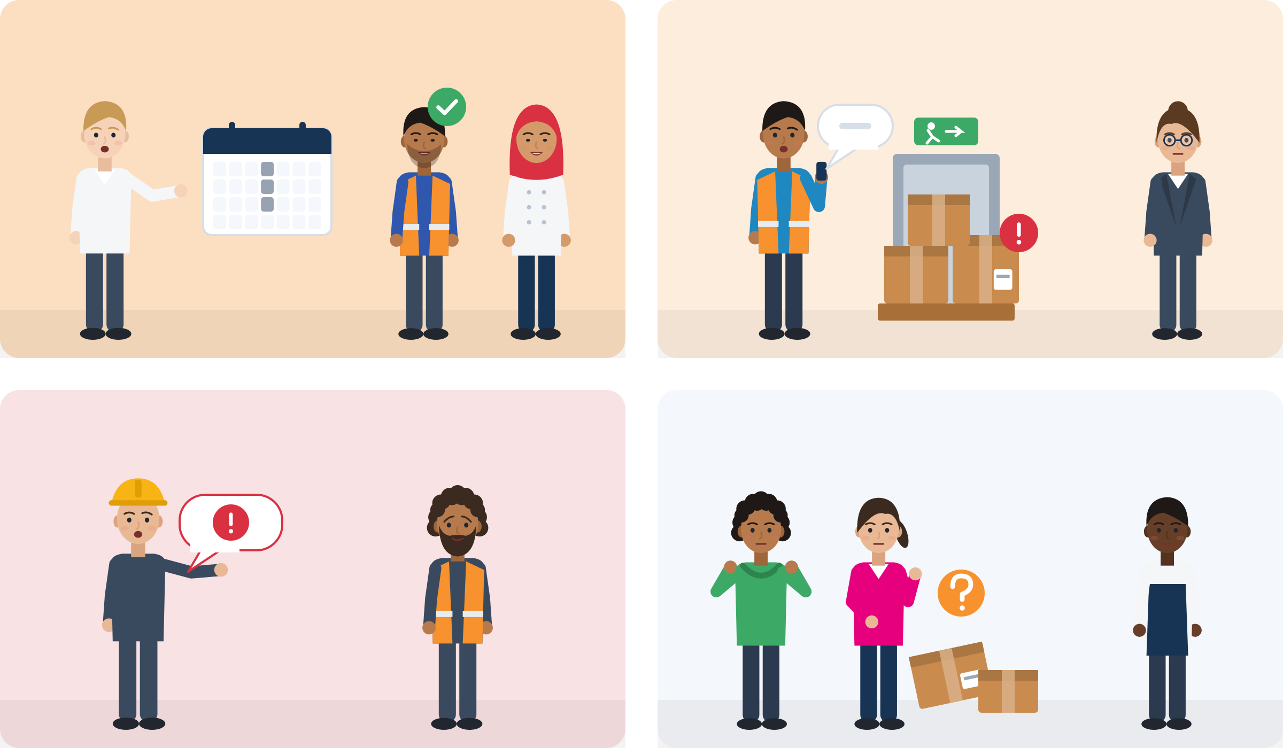
AUTHORITY (POWER) AND LEADERSHIP (INFLUENCE)
Authority and leadership are not the same thing
Authority AND leadership
Leadership WITHOUT authority
Authority comes with a role: a title, a contract, a position.
Leadership comes from what you do: people choose to follow.
Responsibility is part of both: own your part, with or without a title.
Heifetz: “Many people in positions of authority don't exercise leadership.”
Authority WITHOUT leadership
Neither
Left: has authority (a title) · Right: no authority · Top: leads · Bottom: does not lead
Source: Heifetz (1994) · quote from an interview in Flower (1995)
Module 4 · Leadership
13
Notes:
Walk through the four boxes. Ask for one more example per box from participants' work, school or community life.
The four pictures: (1) authority AND leadership: the supervisor explains why, listens to the team and makes the rota fair. (2) Leadership WITHOUT authority: a new colleague sees a safety risk, takes a photo and shows the team leader. (3) Authority WITHOUT leadership: the boss only gives orders and threatens: "Do it, or go home." (4) Neither: everyone sees the problem, everyone waits for someone else to act.
Key message for the curriculum outcome on authority vs leadership: authority can be given and taken away with a job; leadership is a behaviour you can practise in any job, also on a temporary contract.
Hostile supervisor behaviour has a name in research: "abusive supervision" (Tepper, 2000). If someone describes a real abusive boss, acknowledge it, do not analyse the case in public, and offer a private conversation and the help points slide.

Slide 14

POWER, RESPONSIBILITY AND INFLUENCE
Six sources of power: three need no title
Usually comes with a title
Reward: I can give you something: a bonus, a better shift.
Coercive: I can punish you: fewer hours, a warning.
Legitimate: my role gives me the right to ask: “I am the shift leader.”
Needs no title: open to anyone
Expert: you know how: the fastest packing method, a machine, a language.
Informational: what you explain convinces: “This label system saves us time. Here is why.”
Referent: people respect and trust you because you are fair and helpful.
Source: French & Raven (1959), bases of social power; informational power added by Raven (1965); summary in Raven (2008), Analyses of Social Issues and Public Policy, 8(1)
Module 4 · Leadership
14
Notes:
Power is the potential to influence. The top row usually comes with a position. The bottom row is open to anyone: a new worker with no reward or coercive power can still have expert power (she knows the fastest method), referent power (colleagues trust her because she is fair) and informational power (she explains clearly why a change saves time).
Ask: "Which of the bottom three do you already have?" Most participants have expert power they do not use at work: languages, a trade, digital skills.
Influence tactics are what people do with power: explaining with reasons, asking for others' ideas, appealing to shared values, applying pressure. Our research note could not verify a ranking of which tactics work best, so do not present one.

Slide 15

ACTIVITY
Who Holds Authority? Who Is Leading?
TIME
20 min
STEPS
Each group gets the four case cards. Read one case at a time.
For each case, mark: Who has authority? Who is leading?
Which source of power does each person use? Is anyone putting pressure on others?
What did the person without authority risk? How did they make it less risky?
Plenary: each group presents one case in two minutes.
GROUP
Groups of 3
MATERIALS
Case cards (next slide), pens, paper
DEBRIEF
GOAL
Tell apart the person who “exerts pressure” and the person who leads
Can a person have authority and also lead?
What did the leaders do that anyone could do?
Module 4 · Leadership
15
Notes:
Curriculum activity (Session 2): using simple case analyses, participants distinguish between characters who "exert pressure" and those who "lead". Timing: 12 min groups, 8 min plenary.
Language rule (curriculum, critical): never correct grammar or pronunciation while participants share, and do not "recast" (repeat the sentence correctly). Respond to the content: "That is a strong example. What happened next?"
If a participant brings a real abusive boss into the discussion: acknowledge, do not analyse it in public, offer a private talk and a referral. Keep the cases in the third person.

Slide 16
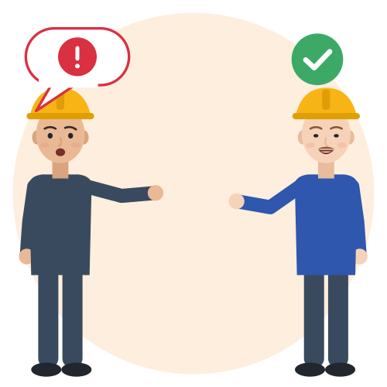
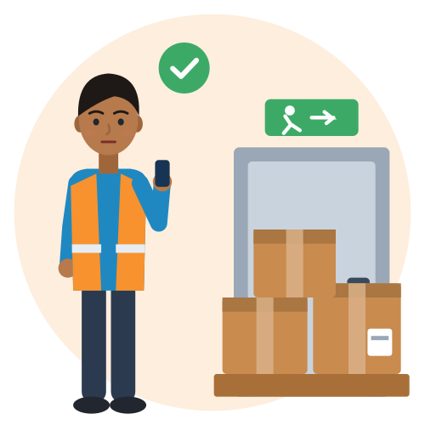


CASE CARDS (ILLUSTRATIVE, CONSTRUCTED)
Case cards: pressure or leadership?
The building site
The blocked exit, Rotterdam
The foreman shouts at workers who do not understand him and threatens to “send them home”. Dragan, a senior labourer, calmly repeats the instruction with gestures and checks that everyone understood.
Amir, 20, trainee on a temporary contract, sees pallets blocking an emergency exit. With a colleague he takes a photo and tells the team leader: “Maybe we can choose another place for the pallets.”
The shift swaps, Milan
The late pay, Istanbul
In a hotel kitchen, the same two people always get weekend nights. Fatou, 23, a dishwasher, suggests a simple shared swap table. The head chef agrees because it saves him time.
Omar, 19, works informally in a textile workshop. The owner pays late. With two colleagues, Omar politely asks for a fixed payday and looks up free advice on workers' rights.
Source: Illustrative scenarios (constructed), grounded in: Eurostat lfsa_etpgan 2025 (NL non-EU temporary contracts 44.9%) · Heifetz in Flower (1995) · Podsakoff et al. (2009)
Module 4 · Leadership
16
Notes:
All four cases are invented. Groundings: in the Netherlands, 44.9% of non-EU employees aged 20-64 are on temporary contracts (Eurostat 2025); 91.6% of working Syrians in Türkiye worked informally (2017 data; Pinedo Caro, ILO, 2020, p. 11); people weigh safety and futility before speaking up to someone with power (Morrison, 2014).
Possible answers. Building site: the foreman has authority and uses pressure (coercive power); Dragan leads with expert and referent power. Exit: Amir uses informational power; a photo, a colleague and a suggestion instead of a complaint make it low-risk. Kitchen: Fatou leads without authority; the head chef grants it. Workshop: collective, polite voice.
Trainer note for the workshop case: do not give legal advice in the session; refer to qualified services (help points slide).

Slide 17

BUILDING TRUST WITHOUT A FORMAL ROLE
Why people follow you without a title: trust
Ability
Three questions people ask
Ability: can you do it? Show your skill in small tasks, step by step.
Care: do you care about others? Help, listen, share information.
Fairness: do you follow fair rules? Keep promises, give credit, no gossip.
Trust
Fairness
Care
Source: Mayer, Davis & Schoorman (1995), Academy of Management Review: ability, benevolence and integrity
Module 4 · Leadership
17
Notes:
Trust is the willingness to rely on another person even though you could be hurt by their actions. People judge three things: ability, benevolence (care) and integrity (fairness) (Mayer, Davis & Schoorman, 1995). Leadership without authority runs on trust, because people follow voluntarily.
Care and fairness can be shown from day one, before language and job skills are perfect: keep promises, share information fairly, do not gossip, give credit.
Close Session 2 with a round: "Which of the three can you build this week?" One word per person is enough.

Slide 18

03
SESSION 3 · 35 min
Breaking down leadership myths
“Leaders are born.” “Leaders are extroverts.” “Leaders must speak the language perfectly.” What does the evidence say?
Born or made?
Extroverts only?
Perfect language?
Learning from mistakes
Module 4 · Leadership
18
Notes:
Focus (curriculum): breaking down myths that hold young migrants back, such as "Leaders are born", "Leaders are extroverts" or "Leaders must speak the language perfectly". The whole session is the activity "Myth or Fact?"; the next four slides are its evidence and practice material.

Slide 19

ACTIVITY
Myth or Fact?
TIME
35 min
STEPS
Put a “Myth” sign on one side of the room and a “Fact” sign on the other.
Read a statement twice, slowly. Everyone moves to where they think it belongs.
Volunteers say why. Nobody has to explain. Then show the evidence.
Reflection card: “A belief that stopped me before” and “What I think now”.
Trainer shares one own mistake and what they learned from it.
GROUP
Whole group (standing line), then individual cards
MATERIALS
Two signs: “Myth” and “Fact”; myth slide; reflection cards
DEBRIEF
GOAL
Challenge limiting personal beliefs and practise learning from mistakes
Which myth did you believe most?
Who benefits if young migrants believe these myths?
Module 4 · Leadership
19
Notes:
Curriculum activity (Session 3): challenging limiting personal beliefs and practising learning from mistakes. Timing: 5 min set-up, 20 min statements with evidence, 10 min reflection cards.
Language rule (curriculum, critical): never correct grammar or pronunciation while participants share, and do not "recast" (repeat the sentence correctly). Respond to the content: "That is a strong example. What happened next?"
Accessibility: if moving is difficult, use coloured cards (green = fact, red = myth). Statements are on the next slide with icons; read each one twice.
Modelling mistakes: Brown (2018) links leadership to courage and vulnerability, such as admitting what you do not know. This is popular-practice literature, not research evidence; use it for language and inspiration.

Slide 20


MYTH OR FACT?
Five leadership myths and what the evidence says
“Leaders are born.”
Mostly made. In a twin study, genes explained about 30% of who held leader roles; 70% came from life experiences.
“Leaders must be extroverts.”
Extraversion helps only moderately. With proactive teams, less extraverted leaders who listened got better results.
“Leaders must speak the language perfectly.”
In 36 multinational teams, language level had only a weak effect on who was seen as a leader. Confidence mattered more.
“Leadership means having a title.”
“Many people exercise leadership without much authority, sometimes without any.” (Heifetz)
“The person who talks most has the best ideas.”
People who talk most are more often seen as leaders, even when intelligence and personality are the same. That is a perception, not proof.
Source: Arvey et al. (2006) · Judge et al. (2002) · Grant, Gino & Hofmann (2011) · Paunova (2017) · Heifetz in Flower (1995) · MacLaren et al. (2020)
Module 4 · Leadership
20
Notes:
Born: 426 US male twins; about 30% of the variance in leadership role occupancy was genetic, 70% non-shared environment. The authors stress that a genetic influence "does not mean that it is unchangeable" (Arvey et al., 2006). Leadership training improves on-the-job leadership behaviour (Lacerenza et al., 2017, meta-analysis of 335 samples).
Extroverts: extraversion is the most consistent personality correlate of leadership, but moderate (ρ = .31; .24 for effectiveness; Judge et al., 2002). In a pizza delivery chain and a lab study, groups with proactive employees did better under less extraverted leaders (Grant, Gino & Hofmann, 2011).
Talking most: speaking time predicts who emerges as a leader, even after controlling for intelligence, personality and gender (MacLaren et al., 2020). Lesson for participants: practise short, prepared contributions. Lesson for leaders and trainers: use rounds and written input.
Language: details on the next slide.

Slide 21


MYTH 3 IN DETAIL: LANGUAGE
Perfect language is not the entry ticket to leading
What helps you
Be honest: accent bias exists
In 36 multinational teams, confidence mattered more than English level for who was seen as a leader.
Fear follows how fluent you THINK you are, not how fluent you are.
About 3 in 10 young people born outside the EU (15-29) rate their host language as intermediate or lower.
One study: SAME answers, foreign accent, less often recommended for a manager job.
The reason: seen as less “politically skilled”, not as worse communicators.
Other studies are mixed: one found less trust, a careful repeat found no effect.
Researchers say changing your accent is “very difficult”. A better strategy: show that you stand up for your team.
Source: Paunova (2017) · Neeley (2013) · Eurostat lfso_21lang02, 2021, own calculation (29.8%) · Huang, Frideger & Pearce (2013), p. 1015 · Barlow et al. (2024)
Module 4 · Leadership
21
Notes:
Paunova (2017): more than 230 people, 46 nationalities, 36 self-managing teams: English proficiency had only a weak effect on deference; core self-evaluations (self-confidence) strengthened it. Neeley (2013): in a French company using English, those who believed they had medium fluency were the most anxious. This is the research behind our rule never to correct participants' language.
Accent bias: with identical scripted answers, non-native speakers were less likely to be recommended for a middle-management job or to get start-up funding, fully explained by lower perceived political skill (Huang et al., 2013). Effects depend on the accent and the job (Hosoda & Stone-Romero, 2010).
Mixed evidence: Lev-Ari & Keysar (2010) found accented statements judged less true; a preregistered close replication found no effect of accent or exposure (Barlow et al., 2024), and a 2024 review lists failed and partial replications (Truong & Weber, 2024). Teach it as "some studies found this, others did not", never as a fixed law.
Eurostat 2021: 29.8% of non-EU-born 15-29-year-olds rate their host-language skills as intermediate, basic or none; in the Netherlands almost half (46.6%).

Slide 22


ILLUSTRATIVE SCENARIO
One sentence, one photo
Lina, 22
Apprentice in a bakery chain, Cologne
DISCUSS
What was more important here: perfect grammar or a clear idea?
What made her step low-risk?
Which one sentence could you prepare for your next meeting or class?
Bakery
Germany
Speaking up
Lina has an idea to reduce waste in the bakery. She thinks her German is “not good enough” for the team meeting. She prepares one sentence and one photo: “Ich habe eine Idee für weniger Abfall. Darf ich zeigen?” (I have an idea for less waste. May I show you?) Her manager asks her to try it for one week.
Grounded in: English level had only a weak effect on who was treated as a leader in multinational teams; self-confidence strengthened it (Paunova, 2017). Anxiety follows self-assessed fluency (Neeley, 2013).
Module 4 · Leadership
22
Notes:
Illustrative scenario (constructed). Read it aloud, then pairs discuss the questions for 3 minutes.
Practice: each participant writes one sentence for an idea they could bring to work, school or a course, in the host language, English or both, and says it to a partner.
Language rule (curriculum, critical): never correct grammar or pronunciation while participants share, and do not "recast" (repeat the sentence correctly). Respond to the content: "That is a strong example. What happened next?"

Slide 23


SPEAK UP WITH THE LANGUAGE YOU HAVE
Phrases for ideas, imperfect language and mistakes
Proposing an idea
With imperfect language
Mistakes and credit
“I have an idea that could save us time. Can I show you?”
“What if we tried this for one week and then checked?”
“In my last job we did it like this. Maybe it could work here too?”
“My German is still improving, so I will say it simply.”
“Let me show you. It is easier with a picture.”
“Did I explain that clearly? I can say it in another way.”
“I made a mistake with the order. Here is how I will fix it.”
“This was Ahmed's idea. Thank you, Ahmed.”
“Could you give me feedback on how I handled that?”
Module 4 · Leadership
23
Notes:
These phrases support the second part of the curriculum activity: "practising learning from mistakes". Saying "I made a mistake, here is how I will fix it" builds more trust than hiding the mistake.
Practise in pairs. Replace "German" with Dutch, Italian, Greek or Turkish. Trainers can translate the phrases into participants' strongest languages.
Language rule (curriculum, critical): never correct grammar or pronunciation while participants share, and do not "recast" (repeat the sentence correctly). Respond to the content: "That is a strong example. What happened next?"

Slide 24

04
SESSION 4 · 35 min
Leadership in multicultural environments
Different cultures expect different things from leaders. Inclusive leaders make space for everyone.
Expectations
Inclusiveness
Elena & Marco
Respectful words
Module 4 · Leadership
24
Notes:
Focus (curriculum): the leadership expectations of different cultures, inclusiveness and intercultural awareness. Suggested timing: 5 min input (next two slides), 30 min Case Study (Elena & Marco). Rule for the whole session: talk about workplace cultures and personal experiences ("In my last job, the boss expected"), never national stereotypes ("Germans are").

Slide 25


LEADERSHIP EXPECTATIONS OF DIFFERENT CULTURES
Some things work almost everywhere. Some need checking.
Valued in many cultures
Check the local rules
GLOBE, a study in 62 cultures: some aspects of inspiring, “transformational” leadership are valued almost everywhere.
Inspiring leaders are role models, give energy, make people think and see each person.
How directly can I disagree with my supervisor?
First names, or “Mr” and “Mrs”?
Do I wait to be asked, or do I offer ideas?
Is my silence respect, or does it look like “no initiative”?
Different expectations are not different values. Ask: “What do you expect from a new team member here?”
Source: Den Hartog et al. (1999), The Leadership Quarterly, 10(2): GLOBE, 62 cultures · transformational leadership: Bass & Riggio (2006)
Module 4 · Leadership
25
Notes:
GLOBE found that aspects of charismatic/transformational leadership were "strongly and universally endorsed", while other attributes were culturally contingent and some were universally seen as impediments (Den Hartog et al., 1999). Javidan et al. (2006) argue that general advice ("be open-minded") is not enough; people need specific understanding of how expectations differ.
Only this general finding is verified in our research note. Do NOT add GLOBE attribute lists or country scores for TR, EL, IT, DE or NL.
Young people who grew up with paternalistic leadership (strong authority combined with fatherly care; Pellegrini & Scandura, 2008) may read a flat, first-name style as lack of seriousness, or their own respectful silence may be read as lack of initiative. These are misunderstandings about expected behaviour, not about values.
Activity (3 min): participants add their own questions to the right column from their experience of workplaces or schools.

Slide 26

INCLUSIVENESS
Inclusion: I belong AND my difference is welcome
Fit in, but hide your difference
Inclusion: both dials up
Two dials
Belonging: I am part of the team (top row).
Difference valued: my language, ideas and experience are welcome (right column).
Anyone can turn the dials up, not only the boss: ask the quiet colleague “What do you think?”, explain a key word to the newest person, thank people by name.
Left out
Different, but outside
The star is what you bring: your language, ideas and experience.
Source: Shore et al. (2011), Journal of Management: belonging and uniqueness · Nembhard & Edmondson (2006): leader inclusiveness
Module 4 · Leadership
26
Notes:
Inclusion means feeling that you belong AND that your uniqueness is valued (Shore et al., 2011); inclusive leaders support both (Randel et al., 2018). This 2×2 grid is built from these two dimensions for teaching.
The four pictures: fit in, but hide your difference (you are part of the team only if you never mention your language, prayer or food); inclusion, both dials up (you are part of the team, and your language, ideas and experience are welcome); left out (nobody includes you, and nobody is interested in what you bring); different, but outside (people find your background interesting, but you are not part of the real team).
Leader inclusiveness = "words and deeds exhibited by leaders that invite and appreciate others' contributions"; in 23 neonatal intensive-care units it predicted psychological safety and engagement in improvement work (Nembhard & Edmondson, 2006). Psychological safety: "a shared belief held by members of a team that the team is safe for interpersonal risk taking" (Edmondson, 1999).
VET strategy from the curriculum: model inclusive leadership through your own behaviour as a trainer. Use rounds, thank by name, rotate who speaks first.

Slide 27
ACTIVITY
Case Study (Elena & Marco)
TIME
30 min
STEPS
Read the case aloud in short parts. Check key words together, with pictures if needed.
In groups: What happened? Facts only, no judging.
What did each person probably expect? What did each person feel?
Write two inclusive, respectful solutions: one for each person.
Check your solutions with the two dials: belonging and difference.
Plenary: what works almost everywhere, and what needs local rules?
GROUP
Groups of 3-4, then whole group
MATERIALS
Elena & Marco case text (partner material), flipchart, pens
DEBRIEF
GOAL
Inclusive, respectful solutions to a cultural misunderstanding
Was anyone “wrong”, or did they expect different things?
Which sentence could have prevented the misunderstanding?
Module 4 · Leadership
27
Notes:
Curriculum activity (Session 4): "Developing inclusive and respectful solutions in a scenario involving a cultural misunderstanding."
The Elena & Marco case text is a separate partner material (listed under "Materials needed" in the curriculum); it is NOT part of the curriculum text. Use the version provided by the SMILE partners and do not change it. This deck deliberately does not summarise or reproduce its plot.
If the case text is not available, use the alternative constructed scenario on the next slide (Mehmet and Sanne). It has different names and a different story; it is not the Elena & Marco case.
Timing: 5 min reading, 8 min facts and expectations, 10 min solutions, 7 min plenary. Language rule (curriculum, critical): never correct grammar or pronunciation while participants share, and do not "recast" (repeat the sentence correctly). Respond to the content: "That is a strong example. What happened next?"
Avoid national stereotypes; ask about experiences ("In my last job, the boss expected").

Slide 28


ILLUSTRATIVE SCENARIO · ALTERNATIVE TO THE PARTNER CASE
Alternative case: first names and silence
Mehmet, 25
New at a logistics company in Utrecht; internship before in Istanbul
DISCUSS
Whose behaviour was “wrong”? Or did they expect different things?
What could Mehmet do? Hint: ask about expectations.
What could Sanne do as an inclusive leader?
Netherlands
Expectations
Mehmet's supervisor asks everyone to call her “Sanne”. Every morning she asks the team: “Any ideas?” Mehmet stays silent out of respect and calls her “Mrs. de Vries”. After two weeks, Sanne tells HR that Mehmet “lacks initiative”.
Grounded in: GLOBE (62 cultures): some leadership expectations are shared across cultures, others are culturally contingent (Den Hartog et al., 1999).
Module 4 · Leadership
28
Notes:
Illustrative scenario (constructed). This is NOT the Elena & Marco case; use it if the partner text is missing, or as an extension.
Possible answers: Mehmet can ask "Is it OK if I suggest ideas in the meeting, or should I talk to you first?" Sanne can invite contributions by name or ask everyone to write one idea first (inclusive leadership: Nembhard & Edmondson, 2006).
Keep it about this workplace, not about "the Dutch" or "Turks". Language rule (curriculum, critical): never correct grammar or pronunciation while participants share, and do not "recast" (repeat the sentence correctly). Respond to the content: "That is a strong example. What happened next?"

Slide 29


RESPECTFUL WORDS ACROSS CULTURES
Phrases for misunderstandings and inclusion
After a misunderstanding
Including others
Asking about expectations
“I think we misunderstood each other. What did you mean by that?”
“I see it a bit differently. Can I explain why?”
“Where I grew up this means something else, but I want to understand how it works here.”
“We haven't heard from Maria yet. What do you think?”
“Do you need help with that? I can show you how I do it.”
“Let's make sure everyone has the information. I'll write it in the group.”
“What do you expect from a new team member here?”
“Is it OK if I suggest ideas in the meeting, or should I talk to you first?”
Module 4 · Leadership
29
Notes:
Use these phrases in the Elena & Marco solutions: groups can write the exact sentence each person could say.
Practise in pairs, then swap roles. Language rule (curriculum, critical): never correct grammar or pronunciation while participants share, and do not "recast" (repeat the sentence correctly). Respond to the content: "That is a strong example. What happened next?"

Slide 30

05
SESSION 5 · 35 min
Barriers and coping strategies
Language insecurity, stereotypes and power imbalance are real. Find low-risk, ethical steps anyway.
Three kinds of barriers
Who gets the title?
Stereotype threat
What Is Holding Me Back?
Module 4 · Leadership
30
Notes:
Focus (curriculum): structural barriers such as language insecurity, stereotypes (prejudices) and power imbalance. Suggested timing: 5 min input (next three slides, keep it short), 30 min activity "What Is Holding Me Back?". Have a list of local psychosocial and legal services ready before this session.

Slide 31
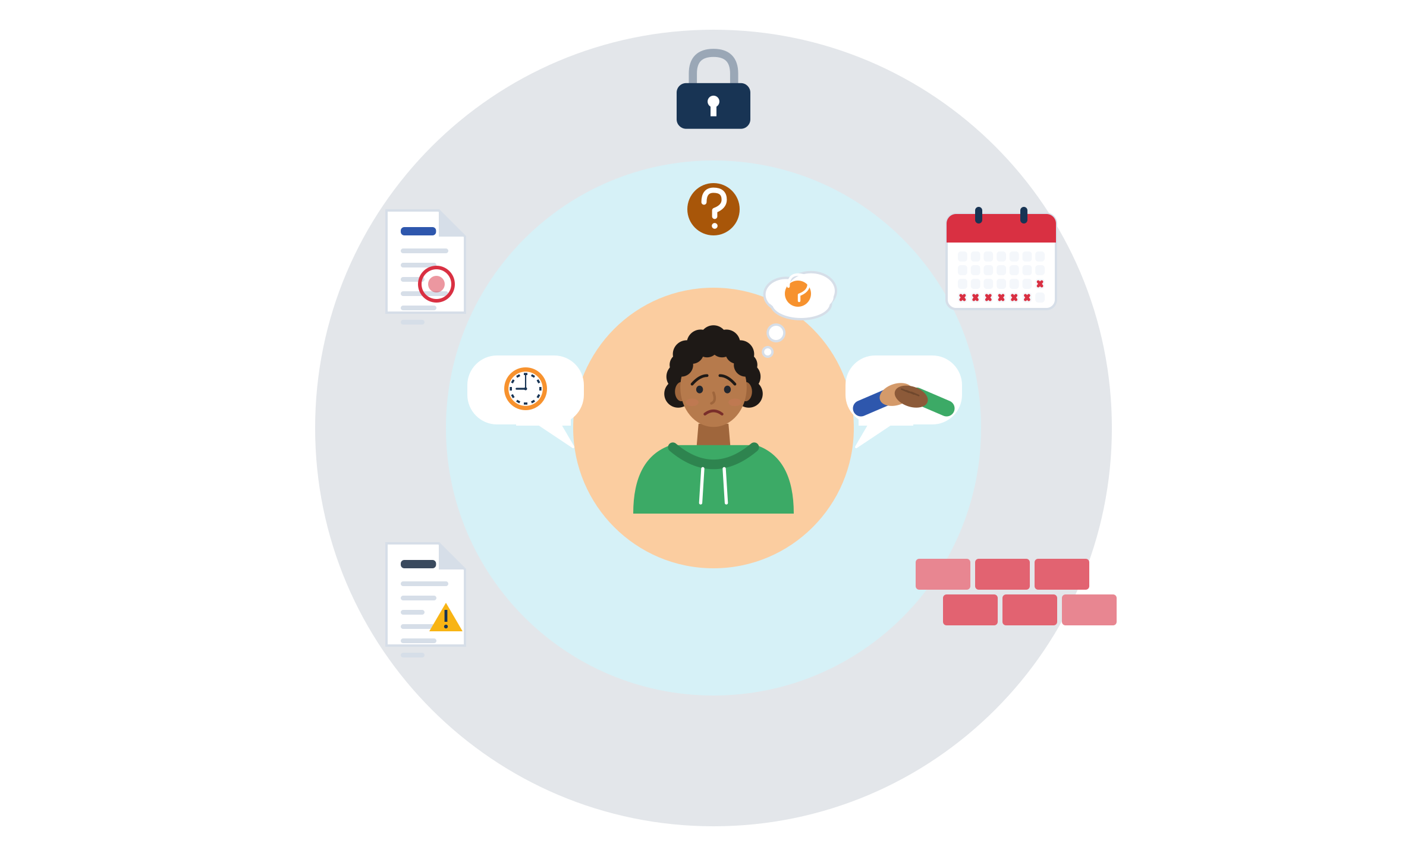
PERSONAL, CULTURAL AND STRUCTURAL BARRIERS
Three kinds of barriers: not all of them are yours
Personal: fear of mistakes, self-doubt, “my language is not good enough”. Work on these step by step.
Cultural: wait to be asked or offer ideas? How formal with the boss? Ask and learn the local rules.
Structural: temporary or informal jobs, diplomas not recognised, discrimination, language requirements. Not your fault: these need allies, rights and support.
Personal
Cultural
Structural
Source: SMILE curriculum, Learning outcome 5 and Session 5 focus · examples from the SMILE research note on leadership
Module 4 · Leadership
31
Notes:
Structural facts for the trainer: 22.1% of non-EU employees have temporary contracts vs 10.7% of nationals (Netherlands 44.9%; Eurostat 2025). In Türkiye, 91.6% of an estimated 940,921 working Syrians worked informally (2017 data; Pinedo Caro, ILO, 2020, p. 11). Fear of losing work makes speaking up risky: people weigh safety and futility before using their voice (Morrison, 2014).
Many participants led teams, classes or family businesses before migration and are now the newest, least powerful person at work. Validate this. Micro-leadership is one way to make hidden competence visible.
Ask: "Which layer can you change alone? Which needs other people?"

Slide 32
STRUCTURAL BARRIERS: POWER IMBALANCE
Who gets the manager title? Even with a degree, not equal
Share of workers who are managers (%). Born abroad means fewer titles, also with a university degree.
Skills under-used: 41.4% of non-EU graduates work below their level (nationals: 20.0%).
Less secure jobs: 22.1% of non-EU employees are on temporary contracts (nationals: 10.7%).
Source: Eurostat lfsa_egaisedm, 2025, employed 20-64, own calculation (SMILE research note) · Eurostat lfsa_eoqgan and lfsa_etpgan, 2025
Module 4 · Leadership
32
Notes:
Eurostat 2025, own calculation in the SMILE research note: share of employed people aged 20-64 working as managers (ISCO 1), foreign-born (first generation) vs native-born with native-born parents. Small-cell values flagged as unreliable were not used. For ages 15-29 the shares are 1.4% vs 1.8%.
Message: the gap persists among graduates, so it is not only about skills. Recognition of diplomas, networks and bias play a role. That is why we practise visible micro-leadership AND talk about rights.
Over-qualification is highest in Greece (85.3%) and Italy (59.5%) for non-EU graduates (Eurostat 2025). Example for discussion (constructed): Samir, 28, a civil engineer, works as a picker in Italy while his diploma recognition is pending. One low-risk step in his control: offering to train two new pickers on the scanner and keeping a record of it.

Slide 33

STEREOTYPES AND PREJUDICE
When you feel judged: stereotype threat
Three counter-moves help
1 · Name it: “This is the worry talking.”
What it is: the worry “they will think people like me are not serious” can make a capable person freeze.
Research: a clear effect in experiments with immigrant students, much smaller in real test situations.
So: freezing is a normal reaction to pressure, not proof that you cannot do it.
Prejudice is real: 4.7% of workers born outside the EU report discrimination in their current job (native-born: 0.2%).
3 · Remember one thing you did well
2 · Prepare one clear point
Source: Steele & Aronson (1995) · Appel, Weber & Kronberger (2015), d = 0.63, 19 experiments · Shewach et al. (2019), d = -.14 · Eurostat lfso_21disc01, 2021, own calculation
Module 4 · Leadership
33
Notes:
Stereotype threat: "being at risk of confirming, as self-characteristic, a negative stereotype about one's group" (Steele & Aronson, 1995). With immigrant students the mean effect over 19 experiments was d = 0.63 (Appel et al., 2015).
Honest caveat: in settings resembling real high-stakes testing the effect is much smaller (d = -.14), and there is evidence of publication bias (Shewach et al., 2019). Use the idea to explain why a capable person may freeze, never to suggest participants will underperform.
Discrimination when looking for work: 55% of Muslim respondents with a Turkish background and 47% with a Syrian background felt racially discriminated against in the previous five years (FRA, Being Muslim in the EU, 2024, p. 53). In the Netherlands and Greece, about 12% of non-EU-born workers report discrimination in their current job (12.2% and 12.8%; Eurostat 2021).

Slide 34
ACTIVITY
What Is Holding Me Back?
TIME
30 min
STEPS
Write one barrier on a card, in any language, without your name. You can also share it openly.
Mix the cards in the box. The trainer reads them aloud without names.
In groups, take 2-3 cards. Ask: What is in my control? Who could be an ally? What is the smallest safe step?
Check each step: is it low-risk, ethical and fair to others?
Put your best steps on the group “toolbox” poster.
GROUP
Individual cards (anonymous), then groups of 3
MATERIALS
Blank cards, a box, flipchart “toolbox” poster
DEBRIEF
GOAL
Find low-risk and ethical steps you can take despite a barrier
Which barriers are not your fault?
Which small step gives you more control?
Module 4 · Leadership
34
Notes:
Curriculum activity (Session 5): participants share their own barriers anonymously or openly and find "low-risk" and ethical steps they can take despite them. Timing: 10 min cards, 15 min groups, 5 min plenary.
Examples of low-risk steps: prepare one clear sentence; ask a question instead of complaining; propose an option; document a safety issue; ask a colleague to support the idea; ask the supervisor about expectations; use a counselling service. Never push participants to confront an employer alone.
Example card to model the task (constructed): Zeynep, 23, German-born with Turkish parents, wears a headscarf: "They don't see me as a team leader." In her control: two prepared leadership examples, asking for feedback, an anti-discrimination counselling service. Not in her control: the bias itself. Never suggest that someone must change their identity to lead (FRA 2024, p. 16: 45% of Muslim women who wear religious clothing felt discriminated against when looking for work).
Trauma-informed: if a card describes danger, exploitation or abuse, do not discuss it as a "case". Say it is serious and share the referral list with everyone. Language rule (curriculum, critical): never correct grammar or pronunciation while participants share, and do not "recast" (repeat the sentence correctly). Respond to the content: "That is a strong example. What happened next?"

Slide 35


BE FAIR TO YOURSELF
Skills open doors, but they are not the whole story
What this skill can change
What it cannot fix alone
Make your ideas and skills visible, even with imperfect language.
Build trust: be fair, keep promises, give credit.
Choose low-risk ways to speak up, alone or together with others.
Name your informal leadership in your CV and interviews.
Identical CV, different name: 55 of 100 got a positive answer with a Dutch name, 40 of 100 with a Turkish name.
Recognition of diplomas, residence permits and the right to work depend on laws and offices, not on you.
Discrimination is not your fault. It can be reported to an equality body, a union or an NGO.
Train your skills AND know your rights. Both are part of a fair start.
Source: Thijssen et al., 2021, JEMS (correspondence test, NL, applicants aged 23-25)
Module 4 · Leadership
35
Notes:
This slide protects participants from a "deficit" message: soft-skills training must not suggest that unemployment or discrimination is their fault.
Field experiments send identical CVs that differ only by name; the call-back gap therefore measures discrimination, not skills (Quillian et al., 2019, meta-analysis of 97 experiments).
Only 6% of Muslim respondents who felt discriminated against reported it (FRA, Being Muslim in the EU, 2024). Point to the help points slide.
Leadership-specific example of a barrier that is not the person's fault: with the same scripted answers, accented applicants were less often recommended for a middle-management job (Huang, Frideger & Pearce, 2013). The authors say "changing one's accent is very difficult" and suggest other strategies, such as showing you stand up for your team.
The manager gap among graduates (previous chart) also shows that leadership titles depend on recognition, networks and bias, not only on skills.

Slide 36





WHERE TO GET HELP
Official help points in the SMILE countries
 | Country | Jobs and training | Diplomas and recognition | Unfair or unsafe work
 | Türkiye | İŞKUR (iskur.gov.tr), Public Education Centres | YÖK denklik, MEB e-Denklik | Ministry of Labour (csgb.gov.tr), YİMER 157 helpline
 | Greece | DYPA (dypa.gov.gr) | DOATAP (doatap.gr) | Labour Inspectorate, phone 1555
 | Italy | Centri per l'Impiego, SIISL | CIMEA (free for protection holders) | Ispettorato Nazionale del Lavoro
 | Germany | Agentur für Arbeit, Jobcenter, Jugendmigrationsdienste (12-27) | Anerkennung in Deutschland, IQ Netzwerk | Faire Integration (free, multilingual)
 | Netherlands | UWV, werk.nl, your municipality | IDW (idw.nl) | Nederlandse Arbeidsinspectie, Juridisch Loket
Save the number or website of one help point in your phone today.
Source: Official websites, checked 1 October 2026 (SMILE research note, labour market)
Module 4 · Leadership
36
Notes:
Ask participants which country they live in and open the matching website live if internet is available.
Leadership link: speaking up about unfair treatment is voice, and voice is safer with support. In the FRA survey, only 6% of Muslim respondents who felt discriminated against reported it anywhere (FRA, 2024). Show participants where they could go before they need it.
For Türkiye add ALO 170 (Ministry of Labour, SGK and İŞKUR line) for questions about work and social security.

Slide 37

06
SESSION 6 · 20 min
Transfer to real life
From this room to work, education and community life: one concrete step for tomorrow.
Real examples
Leadership on your CV
My Leadership in Action
Module 4 · Leadership
37
Notes:
Focus (curriculum): integrating what has been learned into employment and community life. Suggested timing: 5 min (show the next four slides quickly, or give them as hand-outs), 15 min activity "My Leadership in Action". If time is short, protect the activity.

Slide 38




DOCUMENTED PROGRAMMES AND ORGANISATIONS
Real examples: migrants and refugees leading change
Generation 2.0 RED
Greece
UNIRE
Italy
New Dutch Connections
Netherlands
Grew out of an informal group of second-generation migrants. It reports that its campaigns led to Greek citizenship rights for the second generation.
Started by refugees as the first national network of refugees in Italy. Aim: refugees speak for themselves where policy is made.
Training, coaches, buddies and stage evenings for employers. It reports 417 participants and at least 74 placements or jobs in 2025.
Jugendliche ohne Grenzen
Germany
Genç UPSHIFT
Türkiye
Melissa Network
Greece
Nationwide association of young refugees since 2005. Principle: people affected speak with their own voice. Youth conferences, school events.
UNICEF and the Ministry of Youth and Sports: teams of young people develop ideas for social problems, with training and mentoring.
Founded in Athens in 2014 with migrant and refugee women leaders, so that women “rebuild their lives, lead action, and foster inclusion”.
Source: Organisation websites, accessed 1 Oct 2026 (g2red.org, unirerifugiati.org, jogspace.net, melissanetwork.org) · New Dutch Connections, Jaarverslag 2025, pp. 7-8 · UNICEF Türkiye (2022)
Module 4 · Leadership
38
Notes:
Results are self-reported by the organisations; say "the programme reports". New Dutch Connections 2025: 417 participants (205 in Utrecht), 145 volunteers, coaches and buddies, at least 74 work placements and/or jobs, 39 "Future Citizens" stage performances. Participants' legal status is not decisive for taking part.
Generation 2.0 RED merged with i-RED in 2013; the citizenship claim is the organisation's own statement. Genç UPSHIFT (launched February 2022): the figures in the launch press release (162 Youth Centres in 81 provinces) are targets; no outcome data were found. UNIRE and Melissa Network publish no quantified outcomes.
Jugendliche ohne Grenzen is an openly political advocacy group: present it as an example of self-organisation and voice, not as a political recommendation. More: the Global Refugee-led Network (globalrefugeenetwork.org) and SINGA Deutschland's Newcomer Startup Award.

Slide 39


ILLUSTRATIVE SCENARIO
This is not real work experience? Yes, it is.
Yusuf, 19
Volunteer at a community centre, Gaziantep
DISCUSS
Which leadership actions do you see in Yusuf's week?
How could he talk about this in a job interview?
What informal leadership do you have that is not on your CV yet?
Volunteering
Türkiye
Your CV
Two evenings a week, Yusuf helps families fill in forms in Turkish and Arabic at a community centre. He thinks: “This is not real work experience.” His trainer helps him write a CV line: “Volunteer interpreter: supported around 20 families per month with appointments and forms; coordinated with two staff members.”
Grounded in: interviewers look for “patterns of past leadership roles” (Arvey et al., 2006, p. 16); leadership experience at school had a wage return (Kuhn & Weinberger, 2005).
Module 4 · Leadership
39
Notes:
Illustrative scenario (constructed). The numbers in the CV line are an example; each participant uses their own real numbers.
EntreComp link: this is "Mobilising others" (2.5) and "Taking the initiative" (3.1) in the EU entrepreneurship competence framework (Bacigalupo et al., 2016).
Use the cards from the Session 1 wall: which of those examples could go on a CV? Language rule (curriculum, critical): never correct grammar or pronunciation while participants share, and do not "recast" (repeat the sentence correctly). Respond to the content: "That is a strong example. What happened next?"

Slide 40



USE IT AT WORK AND IN INTERVIEWS
Phrases for interviews, teamwork and safety
In a job interview
Organising and coordinating
Speaking up about safety
“I don't have a manager title yet, but I have organised volunteers at a community centre.”
“One example of when I took the initiative is this:”
“In the community centre, I coordinated volunteers and translated for families.”
“Who can take this task? I can do the first part.”
“Let's agree: who swaps, and when? I'll put it in a list.”
“Before we finish, can we check who does what?”
“Sorry to interrupt. I think there is a safety problem here.”
“I noticed the exit is blocked. Who should I tell about this?”
“Can we check this together before we continue?”
Module 4 · Leadership
40
Notes:
Interview practice in pairs: one person asks "Tell me about a time you showed leadership", the other answers with one example from the Session 1 wall or the Yusuf scenario.
Remind participants how often employers ask for leadership (61% of employers name it a core skill, WEF 2025). This is the curriculum's VET strategy: link leadership to finding a job. Language rule (curriculum, critical): never correct grammar or pronunciation while participants share, and do not "recast" (repeat the sentence correctly). Respond to the content: "That is a strong example. What happened next?"

Slide 41



FREE EUROPEAN TOOLS
Make your skills visible
EU Skills Profile Tool
Europass
ESCO skill names
ENIC-NARIC
Describe your skills and experience in your language and English side by side. Arabic, Farsi, Pashto, Turkish, Ukrainian and more.
Free CV editor and profile in 31 languages. Use it to turn your skills profile into a CV.
Use the EU's own words for soft skills, e.g. “collaborating in teams and networks”, on your CV.
National centres that compare and recognise foreign diplomas. Refugees can be assessed even with missing papers.
Source: ec.europa.eu/migrantskills · europass.europa.eu · esco.ec.europa.eu · enic-naric.net (Lisbon Recognition Convention, Art. VII)
Module 4 · Leadership
41
Notes:
The EU Skills Profile Tool is "not intended as a recognition or authentication tool": it helps you describe skills, not certify them.
Leadership link: in ESCO, the EU's skills vocabulary, "leading others" and "taking a proactive approach" are transversal skills. Participants can use these exact words on a CV or in the Skills Profile Tool.
Ask participants to record one informal leadership experience (organising, translating, coaching a younger player) in the EU Skills Profile Tool after the session.

Slide 42

ACTIVITY
My Leadership in Action
TIME
15 min
STEPS
Choose a context: work, education or community.
Describe a situation there that needs leadership.
Write one realistic step: what, when and with whom.
Name the skill you will use: initiative, speaking up, helping or including.
Round: say your step in one sentence: “Tomorrow I will (your step).” Everyone answers: “Good luck!”
GROUP
Individual, then a round with everyone
MATERIALS
Self-assessment and action plan worksheet, pens
DEBRIEF
GOAL
One concrete and realistic leadership action for tomorrow
How will you know that it worked?
Who could support you?
Module 4 · Leadership
42
Notes:
Curriculum activity (Session 6): each participant identifies one concrete and realistic leadership action that they can apply in their life tomorrow. The worksheet is also the curriculum's practical task: context, a situation that requires leadership, a realistic step and the leadership skill used.
Timing: 10 min worksheet, 5 min round. No evaluation in the round: only "Good luck!". Language rule (curriculum, critical): never correct grammar or pronunciation while participants share, and do not "recast" (repeat the sentence correctly). Respond to the content: "That is a strong example. What happened next?"
Optional follow-up message one week later: "Did you try your step? What happened?" Practice and spaced follow-up make leadership training transfer better to real life (Lacerenza et al., 2017).

Slide 43

FOR TRAINERS
How we assess and how we teach this module
Formative assessment: no exams, no grades
Four strategies for VET trainers
Can the participant identify leadership situations?
Can they explain leadership without authority?
Do they take on responsibility in the activities?
Practical task: a context, a situation that needs leadership, a realistic step and the skill used.
Detach leadership from titles; encourage shared responsibility.
Always use scenarios from the workplace and real life.
Often remind young people how leadership helps them find a job.
Model inclusive leadership through your own behaviour.
Observe actions, not personalities. Praise what people did, not who they “are”.
Source: SMILE curriculum, Leadership: section 5 (assessment and self-assessment) and section 7 (practical strategies for VET trainers)
Module 4 · Leadership
43
Notes:
Curriculum section 5: assessment aims entirely at increasing self-confidence and awareness. The three criteria and the practical task are on the left. Use the Session 6 worksheet as evidence; never rank participants.
Curriculum section 7: the four VET strategies on the right. In work-based learning, ask apprentices and interns to bring one real situation from their workplace to each session.
Behaviour, not labels: describe what people did ("you asked the quiet colleague for her view"), never who they "are" ("you are shy", "you are a natural leader").

Slide 44
SELF-CHECK
Self-check: my leadership actions
Not yet
Sometimes
Often
I can name a situation around me that needs leadership.
I can explain the difference between authority and leadership.
I take on small tasks or responsibility without being asked.
I share an idea or a concern, even when my language is not perfect.
I help or include a newer or quieter person.
I keep my promises and give credit to others.
I can describe one leadership example for my CV or an interview.
Module 4 · Leadership
44
Notes:
The curriculum lists "self-assessment and action plan worksheets" as materials but does not give a questionnaire. This checklist was written for SMILE from the curriculum's assessment criteria and the micro-leadership behaviours of Session 1. It is NOT a validated test: never use it for selection or grading.
Participants tick privately and circle one statement they want to move to "Often" in the next month. Optional: use it at the start and the end of the module to compare.

Slide 45

REFLECTION
My leadership in action: one step for tomorrow
Where: at work, in education or in my community?
What is my one realistic step, and with whom?
Which situation needs leadership?
Which leadership skill will I use?
Write it on a card and keep it in your phone case or wallet. Next time, tell us what happened.
Module 4 · Leadership
45
Notes:
Closing round: each participant reads only their step. If the group meets again, start the next session by asking how it went. Celebrate attempts, not only successes: trying a step that did not work is also leadership practice.

Slide 46




KEY MESSAGES
Leadership is what you do, not the title you have.
It can be learned. Small, fair and low-risk actions count, and your language does not need to be perfect. Some barriers are bigger than one person: then allies, rights and support are your tools.
Module 4 · Leadership
46
Notes:
Ask three volunteers to complete one sentence: "One thing I will do differently after today is." Keep it short and positive.

Slide 47
REFERENCES
Sources used in this presentation (1/2)
Appel, M., Weber, S., & Kronberger, N. (2015). The influence of stereotype threat on immigrants: Review and meta-analysis. Frontiers in Psychology, 6, 900.
Arvey, R. D., Rotundo, M., Johnson, W., Zhang, Z., & McGue, M. (2006). The determinants of leadership role occupancy: Genetic and personality factors. The Leadership Quarterly, 17(1), 1-20.
Barlow, S., et al. (2024). Effects of exposure and explicit stereotypes on veracity judgments of Polish-accented English speech: A preregistered close replication. Studies in Second Language Acquisition, 46(5), 1320-1336.
Bass, B. M., & Riggio, R. E. (2006). Transformational leadership (2nd ed.). Lawrence Erlbaum.
Den Hartog, D. N., House, R. J., Hanges, P. J., et al. (1999). Culture specific and cross-culturally generalizable implicit leadership theories. The Leadership Quarterly, 10(2), 219-256.
DeRue, D. S., & Ashford, S. J. (2010). Who will lead and who will follow? Academy of Management Review, 35(4), 627-647.
Eurostat (2026). lfsa_egaisedm, lfsa_eoqgan, lfsa_etpgan (2025 data); lfso_21disc01, lfso_21lang02 (2021 data). Extracted 1 October 2026.
FRA (2024). Being Muslim in the EU: Experiences of Muslims. Publications Office of the EU.
French, J. R. P., & Raven, B. (1959). The bases of social power. In D. Cartwright (Ed.), Studies in social power (pp. 150-167). Summary: Raven, B. H. (2008), Analyses of Social Issues and Public Policy, 8(1), 1-22.
Grant, A. M., & Ashford, S. J. (2008). The dynamics of proactivity at work. Research in Organizational Behavior, 28, 3-34.
Grant, A. M., Gino, F., & Hofmann, D. A. (2011). Reversing the extraverted leadership advantage. Academy of Management Journal, 54(3), 528-550.
Heifetz, R. A. (1994). Leadership without easy answers. Belknap Press. Interview: Flower, J. (1995), The Healthcare Forum Journal, 38(4).
Huang, L., Frideger, M., & Pearce, J. L. (2013). Political skill: Explaining the effects of nonnative accent on managerial hiring and entrepreneurial investment decisions. Journal of Applied Psychology, 98(6), 1005-1017.
Judge, T. A., Bono, J. E., Ilies, R., & Gerhardt, M. W. (2002). Personality and leadership. Journal of Applied Psychology, 87(4), 765-780.
Kuhn, P., & Weinberger, C. (2005). Leadership skills and wages. Journal of Labor Economics, 23(3), 395-436.
Module 4 · Leadership
47
Notes:
Full verified references with URLs, page numbers and further sources cited in the speaker notes (e.g. Lacerenza et al., 2017; Javidan et al., 2006; Randel et al., 2018; Edmondson, 1999; Pinedo Caro, ILO, 2020; Bacigalupo et al., 2016): SMILE research note "Leadership" (arastirma/leadership-icerik.md) and the shared labour-market note.
Curriculum reference corrections (from the research note): "Harvard Business Review (2015). What makes a leader?" is Goleman's article (1998, reprinted 2004); EntreComp is Bacigalupo et al. (2016); the UNESCO GCED guide is dated 2015. The IOM (2022) and UNHCR (2020) titles could not be verified.

Slide 48
REFERENCES
Sources used in this presentation (2/2)
MacLaren, N. G., et al. (2020). Testing the babble hypothesis: Speaking time predicts leader emergence in small groups. The Leadership Quarterly, 31(5), 101409.
Mayer, R. C., Davis, J. H., & Schoorman, F. D. (1995). An integrative model of organizational trust. Academy of Management Review, 20(3), 709-734.
Morrison, E. W. (2014). Employee voice and silence. Annual Review of Organizational Psychology and Organizational Behavior, 1, 173-197.
Neeley, T. B. (2013). Language matters: Status loss and achieved status distinctions in global organizations. Organization Science, 24(2), 476-497.
Nembhard, I. M., & Edmondson, A. C. (2006). Making it safe. Journal of Organizational Behavior, 27(7), 941-966.
New Dutch Connections (2026). Jaarverslag 2025 [Annual report 2025].
Organisation websites, accessed 1 October 2026: Generation 2.0 RED, UNIRE, Jugendliche ohne Grenzen, Melissa Network; UNICEF Türkiye (2022), Genç UPSHIFT press release.
Paunova, M. (2017). Who gets to lead the multinational team? Human Relations, 70(7), 883-907.
Podsakoff, N. P., Whiting, S. W., Podsakoff, P. M., & Blume, B. D. (2009). Consequences of organizational citizenship behaviors: A meta-analysis. Journal of Applied Psychology, 94(1), 122-141.
Shewach, O. R., Sackett, P. R., & Quint, S. (2019). Stereotype threat effects in settings with features likely versus unlikely in operational test settings. Journal of Applied Psychology, 104(12), 1514-1534.
Shore, L. M., Randel, A. E., Chung, B. G., Dean, M. A., Holcombe Ehrhart, K., & Singh, G. (2011). Inclusion and diversity in work groups. Journal of Management, 37(4), 1262-1289.
Steele, C. M., & Aronson, J. (1995). Stereotype threat and the intellectual test performance of African Americans. Journal of Personality and Social Psychology, 69(5), 797-811.
Thijssen, L., Lancee, B., Veit, S., & Yemane, R. (2021). Discrimination against Turkish minorities in Germany and the Netherlands. Journal of Ethnic and Migration Studies, 47(6), 1222-1239.
UNHCR & Women's Refugee Commission (2016). “We believe in youth”: Global Refugee Youth Consultations final report.
World Economic Forum (2025). The future of jobs report 2025.
Module 4 · Leadership
48

Slide 49
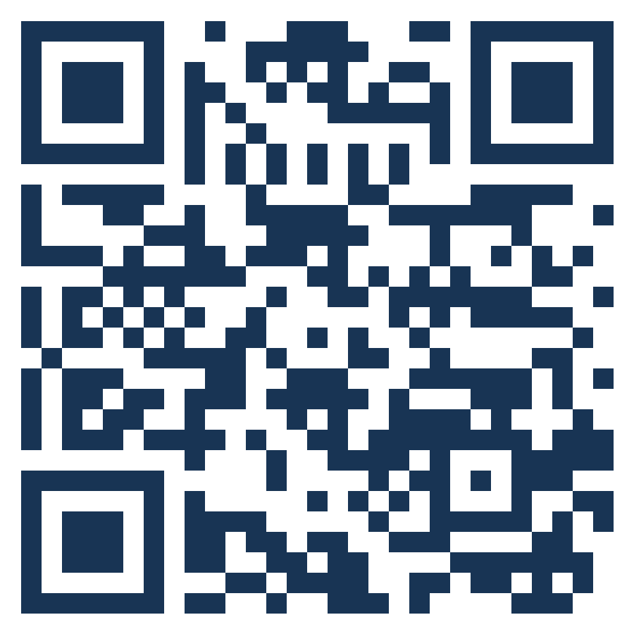

Thank you
THE SMILE PARTNERSHIP
Göç Sanat ve Spor Derneği (MIGARTS) (Türkiye, coordinator)
KYTTARO ENALLAKTIKON ANAZITISEON NEON (KEAN) (Greece)
Work in Progress APS (WiP) (Italy)
Smart Leap Education Research Consultancy GmbH (Germany)
Association of Entrepreneurship School (AES) (Türkiye)
BİR-İZ (Türkiye)
Stichting Unity Sphere Europe (SUSE) (Netherlands)
Questions, ideas, stories: the floor is yours.
KEEP LEARNING
smile-lms.smartleap.eu
MODULE
4 · Leadership
PROJECT
SMILE · Erasmus+ KA220-YOU
PROJECT NO.
2024-1-TR01-KA220-YOU-000256357
Scan to join the SMILE learning platform
Free online course: lessons, activities, quiz and certificate.
Co-funded by the European Union. Views and opinions expressed are however those of the author(s) only and do not necessarily reflect those of the European Union or the Turkish National Agency. Neither the European Union nor the granting authority can be held responsible for them.
SKILLS = Opportunity
Empowerment Through Skills · Inclusion Through Opportunity
Module 4 · Leadership
49
Notes:
Invite participants to continue on the SMILE learning platform (QR code). Remind them of their one step for tomorrow, and of the help points slide if they need advice about work or discrimination.

