Slide 1




MODULE 3 · TRAINER PRESENTATION
Adaptability
Handle new rules, new words and sudden changes at work, keep who you are, and know the fair conditions you can expect.
6 hours
3 sections
Ages 18-30
B1-B2 English
SMILE
Support Young Migrants Integration in the Labour market in Europe
Erasmus+ KA220-YOU · 2024-1-TR01-KA220-YOU-000256357
Empowerment Through Skills · Inclusion Through Opportunity
Notes:
Module 3 of the SMILE soft-skills curriculum. Duration in the curriculum: 6 hours in total, 3 hours of theoretical input and guided discussion plus 3 hours of hands-on learning (case studies, role-play activities, reflection exercises). It can run as one full day or as two half-days.
Welcome participants, introduce yourself and the SMILE project in one sentence: an Erasmus+ project of seven partners in Türkiye, Greece, Italy, Germany and the Netherlands that helps young migrants enter the labour market.
Core message of the whole module (say it now and repeat it at the end): adapting is a skill you can learn. It does not mean giving up who you are, and it works best when employers offer fair, clear and lawful conditions.

Slide 2




HOW WE WORK TOGETHER
Our agreement for this module
Any English is good English
Your story belongs to you
Listen to understand
“Pass” is always OK
We listen to ideas, not grammar. Nobody corrects your language here. Mix words from other languages if it helps.
You never have to share your migration story. Our examples use invented characters.
One voice at a time. Every question is a good question.
You can skip any activity or question. Take a break when you need one.
Module 3 · Adaptability
2
Notes:
Co-create or confirm the agreement before content starts. Write it on a flipchart and keep it visible for the whole module.
Why: many young refugees carry heavy stress. A review of 26 studies (5,143 adult refugees and asylum seekers) found PTSD and depression in about 31.5% each (Blackmore et al., 2020, PLOS Medicine). Never ask participants to tell their migration story; use the constructed characters on the slides.
Language: do not correct grammar or pronunciation during sharing. Model the phrases instead (the "useful phrases" slides).
For this module, add one more rule: nobody has to say how much of their culture, faith or language they keep. In the identity activities (Berry grid, card sort) participants place invented situations, or keep their own notes private.
Heavy themes (waiting for asylum papers, illness in the family, exploitation) are only discussed through invented characters. Never ask about legal status, flight routes or family losses.

Slide 3
MODULE MAP
Three sections, from understanding to action
01
Section 1: Understanding Adaptability
02
Section 2: Adaptation in the Reality of Young Migrants
03
Section 3: Practical Strategies and Good Practices
What adapting is and is not, a learnable skill, flexibility, openness and resilience, common misconceptions.
Culture and norms, language, work culture, stress and uncertainty, rights and fair working conditions.
Asking, language repair, change, feedback, networks, well-being. Case study, role-play and reflection.
≈ 80 min
≈ 100 min
≈ 150 min
Module 3 · Adaptability
3
Notes:
The curriculum fixes only the total: 6 hours, split into 3 hours of theoretical input and guided discussion and 3 hours of hands-on learning. It gives no time per section. The minutes on this slide are a suggestion: 15 min opening + 80 + 100 + 150 + 15 min closing (checklist and action step) = 6 hours of learning time. Plan breaks on top.
Full title of Section 3 in the curriculum: "Practical Strategies and Good Practices (Taking Action)".
Two half-days option: Day A = opening + Sections 1 and 2 (about 3 h 15 min). Day B = 10-minute recap + Section 3 + closing (about 2 h 45 min). Start Day B by asking: "What did you notice about adapting since last time?"

Slide 4
LEARNING OUTCOMES
By the end of this module, you will be able to
1
Explain the concept of adaptability and its importance in the employment/workplace context.
4
Apply practical strategies to manage change, uncertainty and feedback in the workplace.
2
Identify the key skills and attitudes related to adaptability in the context of migration.
5
Demonstrate adaptability skills (in practice) through role-play and real-life scenarios.
3
Recognise the common challenges (language, culture, etc.) that young migrants face in work environments.
6
Reflect on your own adaptability strengths and areas for development in relation to employment (carry out a self-assessment).
Module 3 · Adaptability
4
Notes:
These are the six learning outcomes of the SMILE curriculum (English edition; only "their own" changed to "your own" in outcome 6).
Assessment is formative: no grades. Outcome 5 is observed in the role-plays, outcome 6 is the employment-focused adaptability checklist at the end of the module.

Slide 5
WHY THIS MATTERS
Employers need people who can adapt
67% of employers call “resilience, flexibility and agility” a core skill. Only analytical thinking scores higher (69%).
Net +66: one of the five fastest-rising skills to 2030.
90 studies: career adaptability goes with employability, job satisfaction, income and less job stress.
Source: World Economic Forum (2025), Future of Jobs Report 2025, Fig. 3.3 and 3.4, pp. 34-36 · Rudolph, Lavigne & Zacher (2017), meta-analysis of 90 studies
Module 3 · Adaptability
5
Notes:
Say: "Employers all over the world say they need people who can adapt. You have already adapted to a lot. Today we turn that into a skill you can name and show."
Evidence: WEF surveyed more than 1,000 employers (more than 14 million workers, 55 economies) in 2024. 67% named "resilience, flexibility and agility" a core skill; the report speaks of "the critical role of adaptability and collaboration alongside cognitive skills" (p. 34). Expected change to 2030: net +66, the 5th fastest-rising skill (Fig. 3.4). It grows fastest in agriculture, telecoms and IT services (p. 37). Caveat: these are employers' expectations, not measured outcomes.
The EU uses the same language: ESCO lists "adapt to change" as a transversal skill ("Alter one's attitude or behaviour to accommodate modifications in the workplace"), next to "deal with uncertainty" and "cope with pressure". The EU key competences (2018/C 189/01) include "the ability to cope with uncertainty and complexity".
Rudolph et al. (2017): career adaptability predicted employability, satisfaction, engagement, income, lower job stress and lower turnover intentions, beyond other personal characteristics.
Tip: ask "Which job do you want? Where would you need to adapt there?" Collect 3-4 answers on the flipchart and come back to them in Section 3.

Slide 6
WHY THIS MATTERS
A new country brings many changes at once
2×
+10 points
20 years
Non-EU employees are twice as likely to have a temporary contract as nationals (22.1% vs 10.7%).
If refugees spoke the host language as well as natives, their employment rate would be about 10 percentage points higher.
Refugees in the EU needed up to 20 years to reach the employment rate of people born in the country. A slow start is normal, not a personal failure.
Short contracts, a new language and a slow start are normal. Adapting helps, and so do support and fair rules.
Source: Eurostat lfsa_etpgan, 2025 · European Commission & OECD, Working Paper 1/2016, 2014 data · European Commission & OECD, 2016, 2014 data
Module 3 · Adaptability
6
Notes:
Use these facts to say: "If you feel that everything changes at once, you are not imagining it. Many first jobs are short, the language is new, and the start is slow for almost everyone."
Extra facts: among young non-EU employees (15-29) in the Netherlands, 65.9% have a temporary contract (Eurostat lfsa_etpgan, 2025). In Germany, refugees who arrived in 2013-2019 reached 63% employment after 7 years and 68% after 8 years (Brücker et al., IAB-Kurzbericht 10/2024).
Tip: avoid a "deficit" tone. The numbers describe barriers in the system, not weaknesses of young migrants.

Slide 7
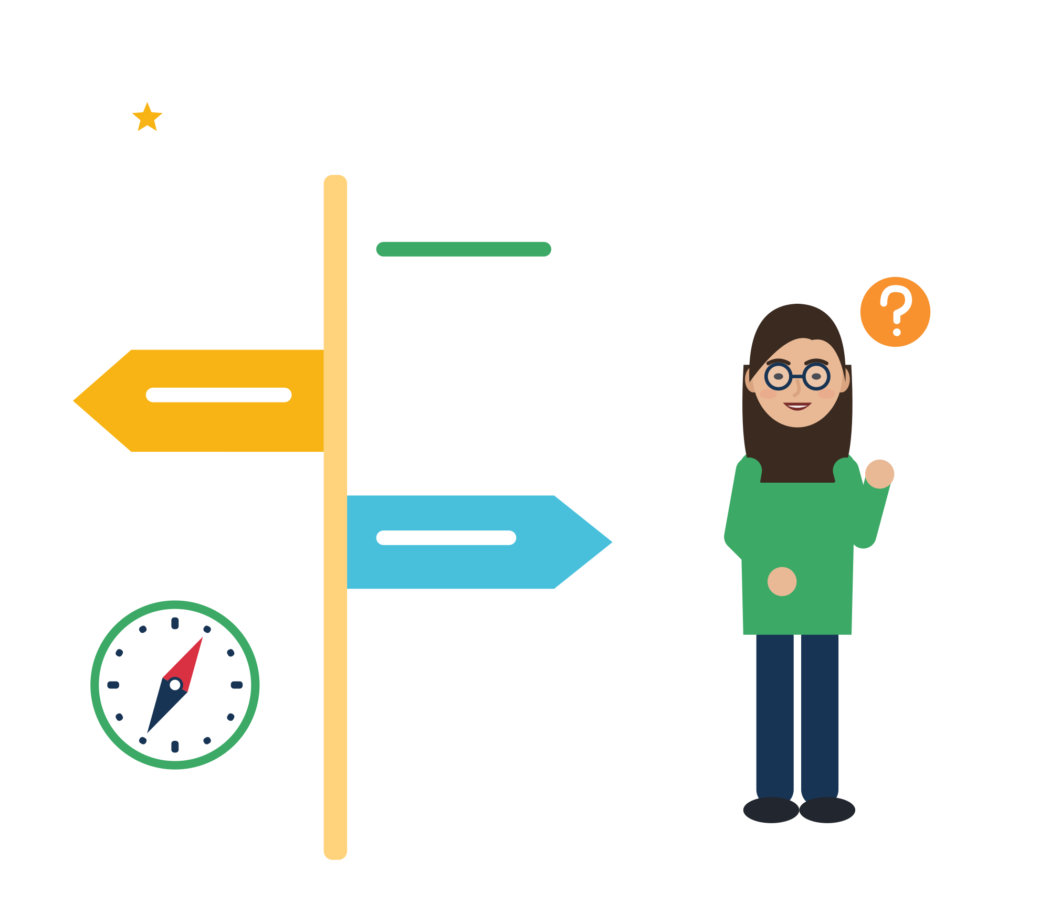

01
SECTION 1 · ≈ 80 min
Understanding Adaptability
Adapting is a skill you can learn, and it never means giving up who you are.
Definition
A learnable skill
Skills and attitudes
Misconceptions
Module 3 · Adaptability
7
Notes:
Section 1 covers curriculum units 1.1 to 1.4. Suggested timing (the curriculum gives none): 1.1 definition 15 min, 1.2 learnable skill 15 min, 1.3 skills and attitudes 15 min, 1.4 misconceptions 35 min (myth vote, Berry grid, card sort, scenario).

Slide 8

DEFINITION OF ADAPTABILITY
What is adaptation, and what is it not?
In short
Change how you act
New tasks, people, rules, tools
Adapting means changing how you think, feel or act when things change.
At work: new tasks, people, rules and tools, and getting back on track after a mistake.
Principled and two-way: you choose how and keep your values; the new place makes room for you.
Adapting is NOT giving up who you are, accepting unfair, unsafe or unpaid work, doing everything alone, or staying silent.
Keep your values
The new place makes room for you
Source: Council of Europe (2018), RFCDC Vol. 1, pp. 44-50 · ESCO transversal skill “adapt to change” · European Commission (2020), Action Plan on Integration and Inclusion, COM(2020) 758
Module 3 · Adaptability
8
Notes:
Start with a question before you show the bullets: "Name one change people meet in a new job." Collect quick answers (new boss, new machine, night shift, new language, new rules). Do not ask about personal migration stories.
Definitions to read aloud: the Council of Europe defines flexibility and adaptability as the skills "to adjust one's thoughts, feelings or behaviours in a principled manner to new contexts and situations" (RFCDC, 2018). ESCO: "adapt to change: Alter one's attitude or behaviour to accommodate modifications in the workplace."
The EU Action Plan calls integration "a two-way process": migrants make an active effort, and the host society "should create the opportunities" (COM(2020) 758). That is why the side panel matters: adapting has limits.
Tip: write "Adapting is / Adapting is not" on two flipchart sheets and keep them on the wall for the whole module. Add to them after each section.
The picture: Samir walks into a new workplace. He changes how he acts (new tasks, people, rules, tools), but the bag with the heart, his values, comes with him. The colleague at the open door is the two-way part. Full side-panel text from the earlier version: Adapting is NOT giving up who you are, accepting unfair, unsafe or unpaid work, doing everything alone, or staying silent so nobody notices you.

Slide 9
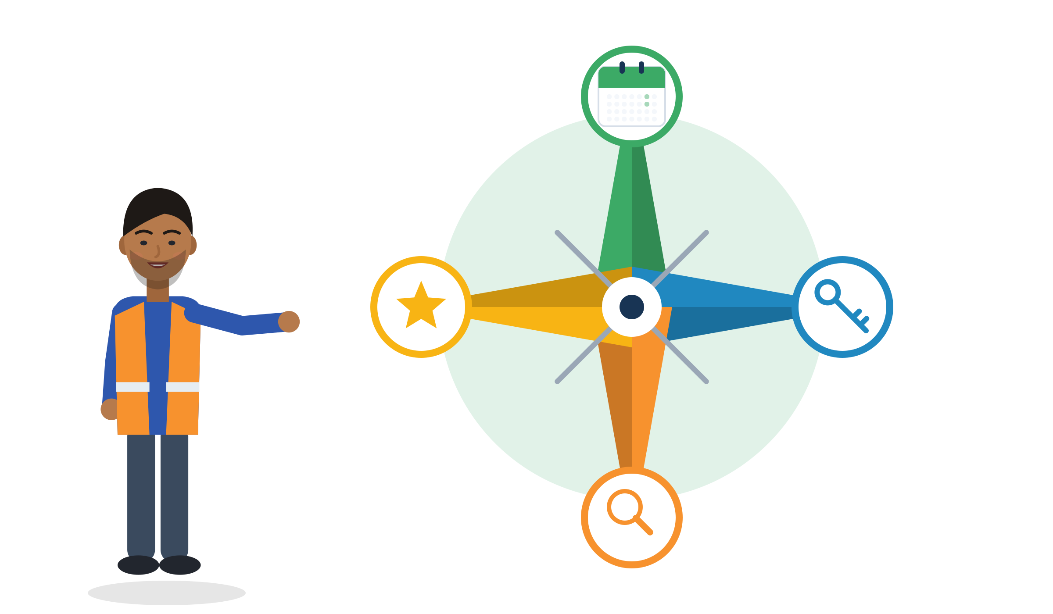
ADAPTABILITY AS A LEARNABLE SKILL
Career adaptability: four Cs you can build
Example: Yusuf, 20, warehouse
Concern: what is my next step?
Concern: a 12-month plan: B1, then a forklift licence.
Control: he books the language exam himself.
Curiosity: he asks two colleagues how they got their jobs.
Confidence: he lists three problems he already solved.
Context counts: it can block or boost your 4 Cs.
Confidence: what have I already solved?
Control: what can I decide?
Curiosity: what can I explore this week?
Source: Savickas & Porfeli (2012), Career Adapt-Abilities Scale, 13 countries · Rudolph, Lavigne & Zacher (2017), 90 studies · Wehrle, Kira & Klehe (2019)
Module 3 · Adaptability
9
Notes:
Say: "Adaptability is not a gift you are born with. Researchers describe it as resources you can build: four Cs." Career adaptability means "psychosocial resources for managing occupational transitions, developmental tasks, and work traumas" (Savickas & Porfeli, 2012). The scale was built by researchers from 13 countries.
Evidence with refugees: among 330 Syrian refugees in Greece and the Netherlands, psychological resources led to more confident job search "mostly due to their enhanced career adaptability", but the link was weaker when they faced more social barriers (Pajic et al., 2018). Interviews with 36 refugees in Germany showed adaptability used under "fundamental uncertainties" and "lost time"; social connections and local job opportunities helped (Wehrle et al., 2019).
Run it (8 min): each participant writes one answer per C for themselves on a sticky note, in any language. Share in pairs only if they want. Example Yusuf is invented.
Tip: the "Context counts" line protects participants from blame: if a residence rule or a missing recognition blocks the plan, that is not a lack of adaptability.
The four Cs as questions: Concern = think about your future and make a plan. Control = take responsibility for your own choices. Curiosity = look at options and ask people. Confidence = believe that you can solve problems. The picture: Yusuf points at his compass; each point of the compass is one C.

Slide 10

ADAPTABILITY AS A LEARNABLE SKILL
“Not yet”: a helpful idea, not a magic switch
The idea: abilities can grow with effort, good strategies and help from others.
Say “not yet”: “I don't speak work-German yet. This month I will learn 20 words used on my line.”
Honest evidence: short mindset courses had very small effects on school grades (d = 0.08; after bias correction d = 0.05, not significant).
What makes the difference: practice, feedback, support from peers and a fair chance to learn.
You can grow it
The resources and skills behind resilience “can be cultivated and practiced” (American Psychological Association).
Source: Dweck (2006) · Sisk et al. (2018), 43 studies · Macnamara & Burgoyne (2023), 63 studies · Yeager et al. (2019) · APA (n.d.), Resilience
Module 3 · Adaptability
10
Notes:
Say: "Growth mindset is a useful way of talking about learning: not yet. But a mindset alone will not change your career. Practice, feedback and fair chances do."
Evidence in detail: mindset and achievement correlate at r = .10 (273 effect sizes, N = 365,915). Mindset interventions: d = 0.08 (43 studies, N = 57,155; Sisk et al., 2018); with publication-bias correction d = 0.05, not significant (63 studies, N = 97,672; Macnamara & Burgoyne, 2023). Burnette et al. (2023) found d = 0.14 when programmes targeted groups expected to benefit and were delivered well, and d = 0.32 for mental health. A US national experiment (under 1 hour online) raised grades of lower-achieving students by 0.10 grade points, mainly where peer norms supported it (Yeager et al., 2019).
Explain "d" simply: it is a measure of size; 0.08 is a very small effect. Most studies were with school and university students, not workers.
Tip: ask each person to turn one "I can't" into "I can't yet + my next step + who can help". Keep it about work or learning, not about personal history.

Slide 11
SKILLS AND ATTITUDES RELATED TO ADAPTABILITY
Flexibility, openness and resilience
Skill or attitude | What it means | In official words | At work, for example
Flexibility | Changing your plan or way of working when things change. | LifeComp: “the ability to manage transitions and uncertainty, and to face challenges” | A new shift plan: you ask what changes, then plan your week again.
Openness | Being curious about new ways, and OK with not knowing everything yet. | RFCDC: “willingness to tolerate uncertainty and to deal with it constructively” | “Can you show me how you do it here?”
Resilience | Getting back on your feet after a hard time, with help from other people. | APA: adapting well to difficult experiences; it depends on social resources and “can be cultivated and practiced” | After a bad first week, you talk to a mentor and try again.
All three can be trained. None of them means “accept everything”.
Source: Sala et al. (2020), LifeComp, P2 Flexibility · Council of Europe (2018), RFCDC, tolerance of ambiguity · APA (n.d.), Resilience
Module 3 · Adaptability
11
Notes:
These are the three skills and attitudes named in curriculum unit 1.3. The middle column gives the official European wording, so participants see that these are recognised competences, not personality traits.
LifeComp (the EU framework for the "personal, social and learning to learn" key competence) describes Flexibility with three descriptors: P2.1 "Readiness to review opinions and courses of action in the face of new evidence"; P2.2 "Understanding and adopting new ideas, approaches, tools, and actions in response to changing contexts"; P2.3 "Managing transitions in personal life, social participation, work and learning pathways, while making conscious choices and setting goals".
APA definition of resilience: "The process and outcome of successfully adapting to difficult or challenging life experiences, especially through mental, emotional, and behavioral flexibility and adjustment to external and internal demands." It names "the availability and quality of social resources" as part of it.
Run it (5 min): each participant chooses the one they use most and the one they want to grow. Keep the answers for the checklist at the end.

Slide 12

RESILIENCE: YOU DO NOT HAVE TO BE TOUGH ALONE
Pack your resilience backpack
Hope: a goal and more than one way to reach it.
Efficacy: I can do this task, step by step.
Resilience: when I fall, I can get up again, maybe slowly.
Optimism: good things can happen, and I work for them.
My people, the outside pocket: a cousin who explains payslips, a mentor, a youth worker.
Hope
Efficacy
Resilience
Optimism
My people
Source: Luthans, Avolio, Avey & Norman (2007), psychological capital · Avey et al. (2011), 51 samples, N = 12,567 · APA (n.d.), Resilience
Module 3 · Adaptability
12
Notes:
The four inside pockets are "psychological capital" (HERO: Hope, Efficacy, Resilience, Optimism). Together they predicted performance and satisfaction better than each one alone (Luthans et al., 2007). A meta-analysis of 51 samples (12,567 employees) linked them to better performance, satisfaction and well-being, and to less job stress, anxiety and turnover intention (Avey et al., 2011).
The outside pocket is the most important message: the APA definition puts social resources inside resilience. Resilient people are not people who never need help.
Run it (7 min, optional): participants draw a backpack and write one thing per pocket. They keep the drawing; nobody has to show it.
Tip: avoid the message "resilient people don't need help" and avoid praising people for "surviving everything". Talk about resources that grow.

Slide 13


MYTH OR FACT?
Common misconceptions about adaptability
“Adapting means becoming like them and forgetting my culture.”
Keeping both cultures goes with the best adjustment: 83 studies with 23,197 people.
“A good newcomer accepts everything without questions.”
In the EU: key terms in writing by day 7, probation max. 6 months, changes in writing. Adapting is not submitting.
“Some people are just born adaptable.”
The resources behind resilience “can be cultivated and practiced” (APA). Practice and support matter more than mindset alone.
“If I adapt enough, success is guaranteed.”
Structures matter too. A meta-analysis of 97 field experiments found hiring discrimination in all 9 countries studied.
“Feeling stressed means I am weak or not adapting.”
Stress is a normal reaction to big change. WHO asks employers to act first on workload and schedules.
Source: Nguyen & Benet-Martínez (2013) · Directive (EU) 2019/1152, Art. 5, 6, 8 · APA (n.d.) · Quillian et al. (2019) · WHO (2022), Guidelines on mental health at work
Module 3 · Adaptability
13
Notes:
Curriculum unit 1.4 asks to stress that adapting does not mean "submitting" or "losing one's own identity". Myths 1 and 2 are exactly these two.
Run it as a quick vote (8 min): read each myth, participants stand up or raise a card if they think it is true, then reveal the fact.
Evidence: Nguyen & Benet-Martínez (2013) say the results "clearly invalidate" the old view of bicultural people as "marginal" and "stumped between two worlds". Quillian et al. (2019): 97 experiments, more than 200,000 applications, including Germany and the Netherlands. WHO (2022): about 15% of working-age adults have a mental disorder at any time.
Tip: myth 4 is important for fairness. Personal adaptability cannot replace fair structures (Pajic et al., 2018: social barriers weakened the benefit of personal resources).

Slide 14
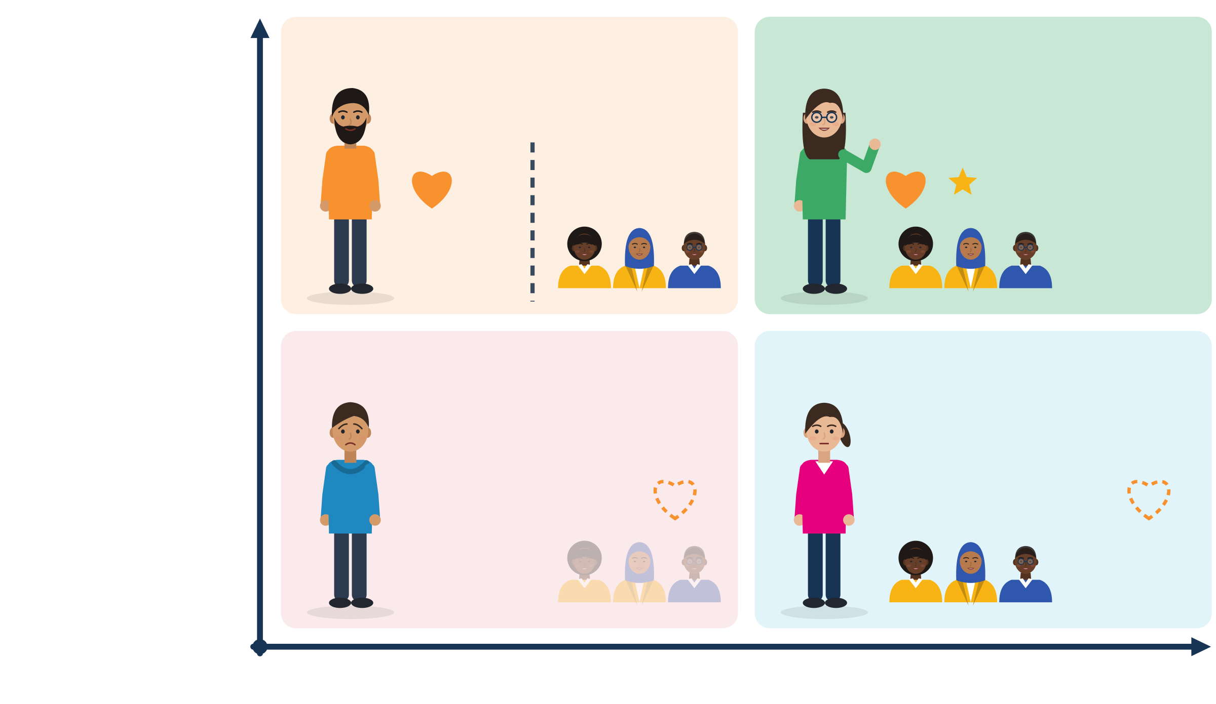
BERRY'S ACCULTURATION STRATEGIES
Two questions, four ways to adapt
yes
Separation: keep mine, stay apart
Integration: keep mine AND take part
What research shows
Young people: 5,366 immigrant youth in 13 countries. Integration had the best well-being and everyday adaptation. Belonging nowhere had the worst.
83 studies: keeping both cultures is strongly linked to better adjustment.
But: what you can choose also depends on how the new society responds.
Keep my own culture?
Marginalisation: belong nowhere
Assimilation: give up mine to fit in
no
Take part in the new society?
yes
Source: Berry (1997), Applied Psychology 46(1) · Berry, Phinney, Sam & Vedder (2006), 5,366 youth aged 13-18 · Nguyen & Benet-Martínez (2013), 23,197 people
Module 3 · Adaptability
14
Notes:
Berry asks two questions: (1) Is it important to keep my own culture and identity? (2) Is it important to take part in the new society? Yes + yes = integration; no + yes = assimilation; yes + no = separation; no + no = marginalisation.
Reading the picture: the orange heart is "my own culture", the small group is "the new society". Close = connected, far or faded = lost. Separation: I keep my culture, but I stay away from the new society. Integration: I keep my culture AND I take part; two cultures, one me. Marginalisation: I lose my own culture and I am not part of the new one; I belong nowhere. Assimilation: I give up my culture to fit in completely. The four people are invented and stand for situations, not for types of people.
Evidence: in the largest study of immigrant youth (5,366 young people aged 13-18 in 13 countries, plus 2,631 national youth), the "integration" profile had the best psychological and sociocultural adaptation; the "diffuse" profile (unclear, belonging nowhere) had the worst (Berry et al., 2006). Meta-analysis: 83 studies, 23,197 participants, a strong positive link between biculturalism and adjustment (Nguyen & Benet-Martínez, 2013).
Caution: Berry (1997) frames outcomes as depending on both the society of origin and the society of settlement. If the workplace excludes people, integration is harder. That is not the newcomer's failure.
Activity (10 min): give invented situation cards, e.g. "Amina speaks Arabic at home and keeps her faith practices. At work she learns the team's jargon and joins the Friday team lunch." or "I speak Turkish with my cousin at break" and "I learn Dutch work slang". Groups place them on a big 2×2 grid. Most land in integration. Participants never have to place their own life.

Slide 15


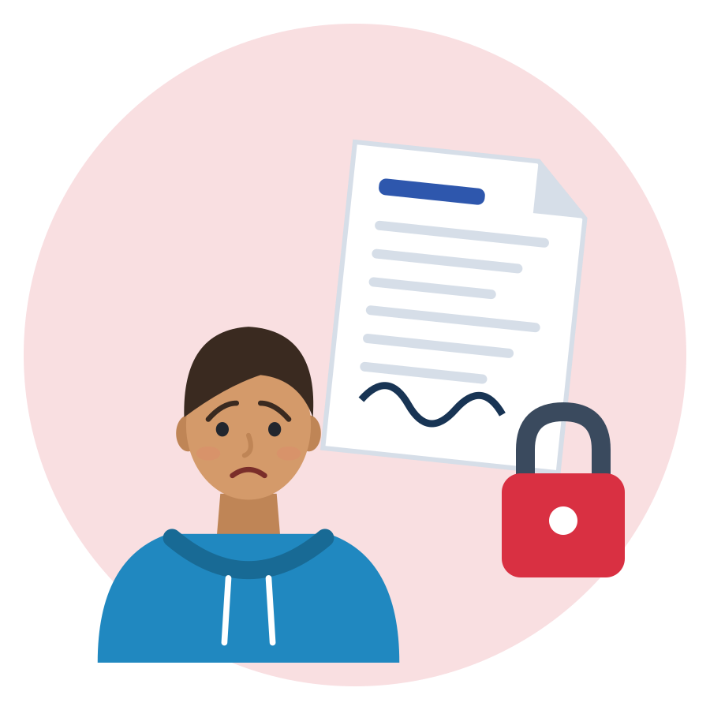
ADAPTING IS NOT SUBMITTING
Principled, opportunistic or coerced?
adapting
not adapting
not adapting
Principled
Opportunistic
Coerced
You choose to adjust and keep your values. Example: you learn how clients here like to be greeted.
You change only for an advantage, against your values. Example: you tell each person what they want to hear.
Someone forces you. Example: you must sign a contract you cannot read, or give up prayer in your legal break. Get advice.
Source: Council of Europe (2018), Reference Framework of Competences for Democratic Culture, Vol. 1, pp. 44-50, incl. footnote 11
Module 3 · Adaptability
15
Notes:
This is the key text for "adapting is not submitting". Read aloud: flexibility and adaptability "need to be distinguished from the unprincipled or opportunistic adjustment of behaviour for personal benefit or gain" and "from externally coerced adaptation" (RFCDC, 2018).
Footnote 11 of the RFCDC: "the enforced assimilation of cultural minorities to a majority culture should never be condoned. All individuals have a fundamental right to choose their own cultural affiliations, beliefs and lifestyle."
Card sort (10 min, groups of 3): give situation cards and ask groups to sort them into the three columns. Ideas: wearing the company safety shoes; using first names with the boss; working unpaid "to show motivation"; changing your name on your CV because a colleague says so; learning the team's break routine; handing over your passport "for the paperwork".
Balance: the New York Declaration (UN, 2016) commits states to "combating xenophobia, racism and discrimination" and also notes "the obligation for refugees and migrants to observe the laws and regulations of their host countries". Following laws and safety rules is principled adaptation.

Slide 16


ILLUSTRATIVE SCENARIO
After-work drinks
Zeynep, 20
Intern in an office team in Utrecht, month 1
DISCUSS
What does Zeynep want to keep? What does she want to join?
Find three options that keep both.
Which friendly sentence could she say to the team?
Internship
Netherlands
Belonging
Zeynep doesn't drink alcohol. On Friday the whole team goes to the pub after work and invites her. She likes the team, but she is afraid that saying no will make her an outsider. She also doesn't want to act against her values.
Grounded in: keeping your own culture while taking part goes with the best adaptation (Berry et al., 2006); bridging ties were linked to jobs and income for migrants in the Netherlands (Lancee, 2010).
Module 3 · Adaptability
16
Notes:
Units 1.4 and 2.1: integration means keeping your own values and joining in. Options the group may find: go and order a soft drink; suggest a lunch walk or coffee another day; join for the first 30 minutes.
Useful sentence: "I don't drink, but I'd love to come for a soft drink." Saying no is also a valid choice, not a failed test. A good team also offers activities everyone can join: adaptation is two-way.
Why it matters for work: in the Netherlands, migrants' bridging (inter-ethnic) ties were positively associated with employment and income (Lancee, 2010).
Tip: do not ask participants whether they drink or pray. Keep the discussion on Zeynep.

Slide 17

02
SECTION 2 · ≈ 100 min
Adaptation in the Reality of Young Migrants
Culture, language, work culture and stress: real challenges, and the fair conditions that make adaptation healthy.
Culture, language
Work culture
Stress
Rights and fair work
Module 3 · Adaptability
17
Notes:
Section 2 covers curriculum units 2.1 to 2.5. Suggested timing (the curriculum gives none): 2.1 culture and norms 15 min, 2.2 language 10 min, 2.3 work culture 20 min, 2.4 stress and uncertainty 20 min, 2.5 rights and fair conditions 35 min.

Slide 18

CULTURAL DIFFERENCES AND SOCIAL NORMS
New place, new norms: most of them are hidden
What you notice in week 1
Greetings
Break times
Food at work
Clothes and uniforms
Language and jargon
How close you are to the boss
What “on time” means
What you learn slowly, by asking and watching
How criticism is given
How people disagree
What a “yes” really means
Unwritten rules about phones and small talk
Source: Hofstede (2015), dimension data, used only as a conversation starter: national averages, not descriptions of individuals or companies
Module 3 · Adaptability
18
Notes:
Unit 2.1: getting used to a new way of life. Say: "Every workplace has rules you can see and rules nobody writes down. The hidden ones cause most misunderstandings, for everyone who is new, not only for migrants."
Run it (10 min): ask "What could surprise a newcomer in a workplace here?" Groups add sticky notes above or below the waterline. Talk about workplace cultures and personal habits, never "Germans are X, Syrians are Y".
Evidence, with care: Hofstede's Power Distance Index ranks how strongly people accept unequal power, e.g. how directly you speak to a boss: Germany 35, Netherlands 38, Italy 50, Greece 60, Türkiye 66 (national averages). A person moving into a Dutch or German team may be surprised that first names and open questions to the boss are normal; the reverse can happen in a Turkish or Greek workplace. Use it only as a conversation starter.
We found no verified country data on punctuality or feedback directness, so do not present such differences as facts.
The picture: Samir looks at the tip of the iceberg from his boat. The labels above the water are what newcomers notice in week 1; the dark labels under the water are learned slowly, by asking and watching.

Slide 19
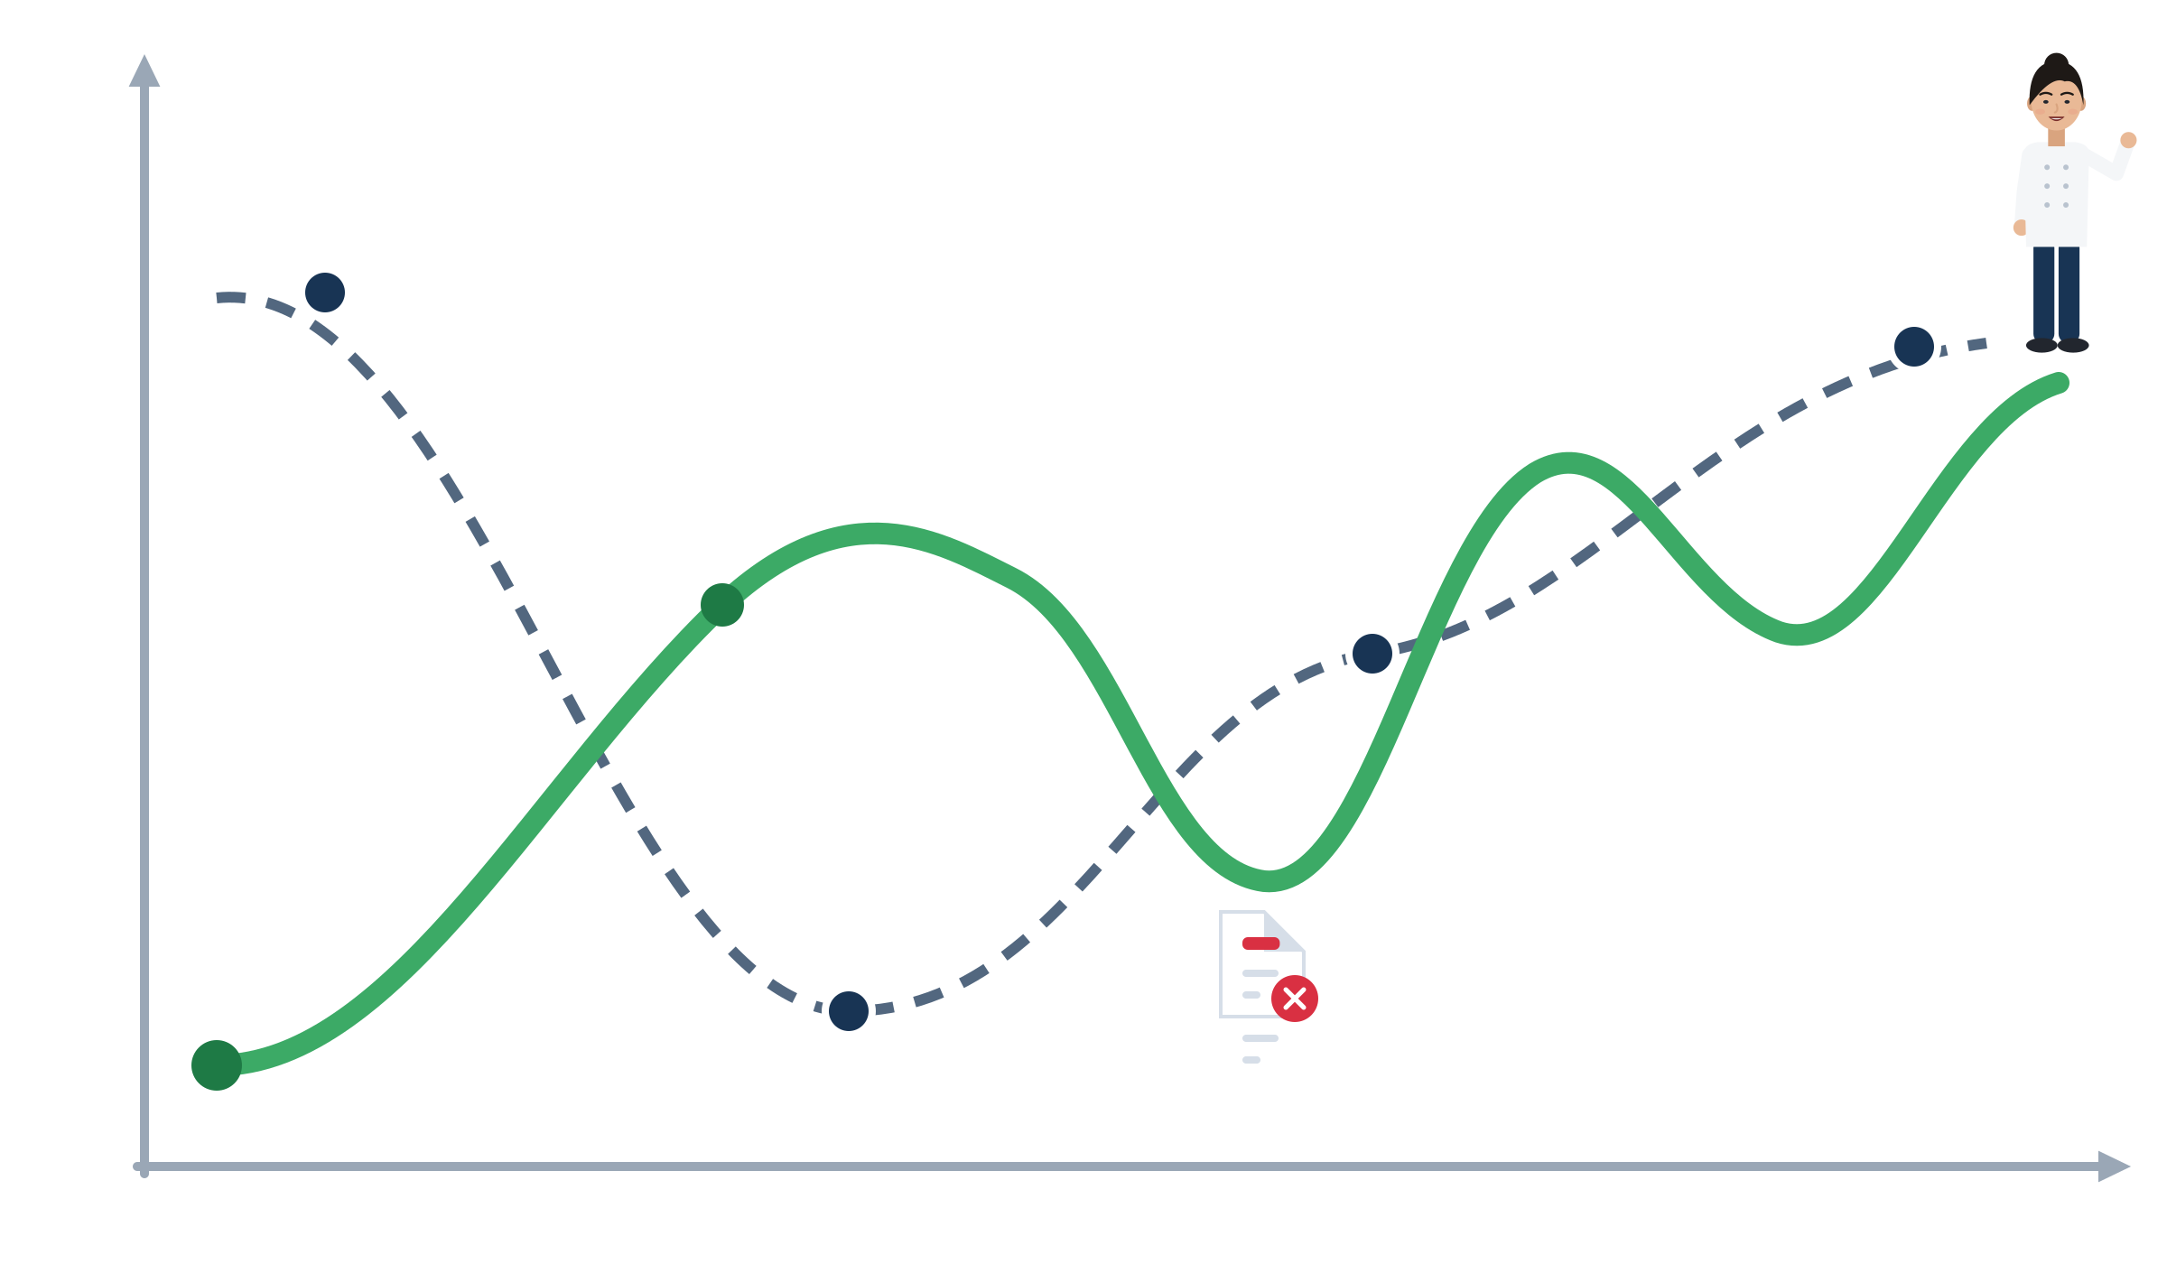
CULTURE SHOCK: TEACH IT, THEN QUESTION IT
Culture shock has no fixed timetable
How I feel
Honeymoon
Adjustment
The classic story (U-curve): honeymoon, crisis, recovery, adjustment.
Research: students in New Zealand had the most problems at the start, easing after about 4 months. No honeymoon.
Reviews: the curves “have not withstood critical empirical testing”.
Many people go up and down many times, e.g. after a rejection letter.
A real path: up and down
Recovery
Hardest at the start
Crisis
A rejection letter
Time
Your path is yours. Ask: what helped at the low points?
Source: Oberg (1960) · La Brack (2010), NAFSA, incl. Ward et al. (1998) as reported there · Ward, Bochner & Furnham (2001)
Module 3 · Adaptability
19
Notes:
Units 2.1 and 2.4. Oberg (1960) called culture shock "an occupational disease of people who have been suddenly transplanted abroad". The U-curve (honeymoon, crisis, recovery, adjustment) is the classic picture.
What research says: Ward et al. (1998) followed Japanese students in New Zealand for 12 months; adjustment problems were highest at entry and eased after about four months (findings as reported by La Brack, 2010; the original was not opened). La Brack concludes the curves "have not withstood critical empirical testing". Today researchers describe culture contact through feelings, behaviour and thinking (stress and coping, culture learning, identity) (Ward, Bochner & Furnham, 2001).
Many refugees never had a "honeymoon": the hardest days were the first ones. Others feel fine for a year and then crash after a rejection letter. Both are normal.
Optional activity (5 min): draw the up-and-down line of an invented character ("Elif's first year in Milan"). Participants may draw their own line privately, never required to show it. Keep the curve descriptive, not a timetable people must follow.
The picture: the dashed line is the classic U-curve (honeymoon: everything is new and exciting; crisis: things go wrong, you feel lost; recovery: you learn the rules; adjustment: you feel at home). The green line is one possible real path: hardest at the start, better later, down again after a rejection letter, then up. It is a drawing, not data.

Slide 20

LANGUAGE BARRIERS AND COMMUNICATION CHALLENGES
Language: the most named obstacle, and it can be learned
1st
43.8%
+4 points
Lack of language skills was the most often named specific obstacle to a suitable job: 930,000 non-EU citizens in 2021.
of foreign-born non-EU citizens speak the host language as a mother tongue or at a proficient level (2021).
Denmark: more early language classes for refugees meant higher employment, still visible 18 years later.
Every worker should get the basic terms of the contract in a language they understand. That is the employer's job.
Source: Eurostat lfso_21obst02 and lfso_21lang03 (2021 LFS module) · Arendt, Bolvig, Foged, Hasager & Peri (2020), NBER WP 26834 · FRA (2019)
Module 3 · Adaptability
20
Notes:
Unit 2.2: obstacles when expressing yourself. Ask first: "Which work situations are hardest in a new language?" Typical answers: phone calls, fast instructions, jokes, meetings, official letters.
Evidence: 930,000 foreign-born non-EU citizens (15-74) named lack of language skills as the main obstacle, about 1 in 4 of those who named any obstacle (Eurostat lfso_21obst02, own calculation in the research note). The Danish reform added about US$2,510 of yearly earnings and the effect lasted 18 years (Arendt et al., 2020). In Denmark, one hour less commuting to the language centre meant 46-71 more class hours (Foged & van der Werf, 2023).
Language is also a rights risk: FRA interviewed 237 exploited workers and found contracts "in a language that the worker did not understand". FRA's opinion: "all workers should be given a written contract in a language they can understand, at least as regards the basic terms of their employment" (FRA, 2019).
Tip: say clearly that accent and grammar mistakes are not a soft-skills problem. Section 3 shows how to repair misunderstandings.

Slide 21
WORKPLACE EXPECTATIONS AND WORK CULTURE
Many start in jobs below their education level
What it means: an engineer packing parcels, a teacher working in a kitchen.
It does not measure your value. Recognition, language and contacts take time.
Plan the bridge: EU Skills Profile Tool, recognition centres (ENIC-NARIC), one contact in your field.
Source: Eurostat lfsa_eoqgan, 2025: employed university graduates aged 20-64 working in low- or medium-skilled jobs (over-qualification rate)
Module 3 · Adaptability
21
Notes:
Unit 2.3: entering a new professional environment often means starting below your level. The chart shows the over-qualification rate: graduates who work in low- or medium-skilled jobs. Türkiye is not in this Eurostat table.
Greece is a special case: non-EU citizens there have a higher employment rate than Greeks (73.9% vs 71.0%), but 85.3% of non-EU graduates work below their level. Having a job is not the same as having a job that fits your skills. For young non-EU graduates (20-34): Italy 51.3%, Greece 83.2% (low reliability). The EU Action Plan says: "Almost 40% are overqualified for the job they do. We cannot afford to waste this potential."
Constructed example for discussion: Oksana, 27, civil engineer from Ukraine, packs parcels at night in Naples and feels her identity "disappearing". Ask: "What could her 4 Cs plan look like?" (language, recognition, one bridge contact).
Tip: keep the message two-sided. A first job below your level can be a step, and over-qualification is a policy problem the EU itself names, not a personal failure.

Slide 22


ILLUSTRATIVE SCENARIO
The first week: nobody told me the rules
Samir, 20
Order picker in a warehouse near Rotterdam, week 1
DISCUSS
What does Samir need to know, and from whom?
Write 3 questions he can ask his team leader.
Which document should he receive this week?
Logistics
Netherlands
Unwritten rules
On day 2 the team leader tells Samir off: he took his break “at the wrong time”. He went at 10:00 because he saw others go then. Nobody told him the break schedule, and he has nothing in writing yet. He feels embarrassed and decides to stay invisible.
Grounded in: newcomers adjust through role clarity, and asking speeds it up (Bauer et al., 2007, 70 samples); key job information, incl. working time, in writing by day 7 (Directive (EU) 2019/1152, Art. 5).
Module 3 · Adaptability
22
Notes:
Units 2.3 and 3.1. Possible questions: "What are the break times on this shift?" "Who should I tell when I go on a break?" "Is there a written schedule or a list of rules for new people?"
Answer to question 3: under Directive (EU) 2019/1152, the employer must give key information in writing from day 1 and no later than the 7th calendar day: workplace, job, start date, probation, pay, working hours and shift-change arrangements (Art. 4-5).
Context: the first months are an adaptation window. In German dual training, apprentices with the citizenship of the 8 main asylum-origin countries rose from 2,763 (2012) to 48,562 (2020). Early contract dissolution is higher for foreign-citizen apprentices (38.2% vs 28.3% in 2024), but BIBB stresses it "is not a dropout rate", because many sign a new contract (BIBB, 2026).
Tip: "staying invisible" feels safe but slows adjustment. Bauer et al. (2007): information seeking supports role clarity, confidence and social acceptance.

Slide 23
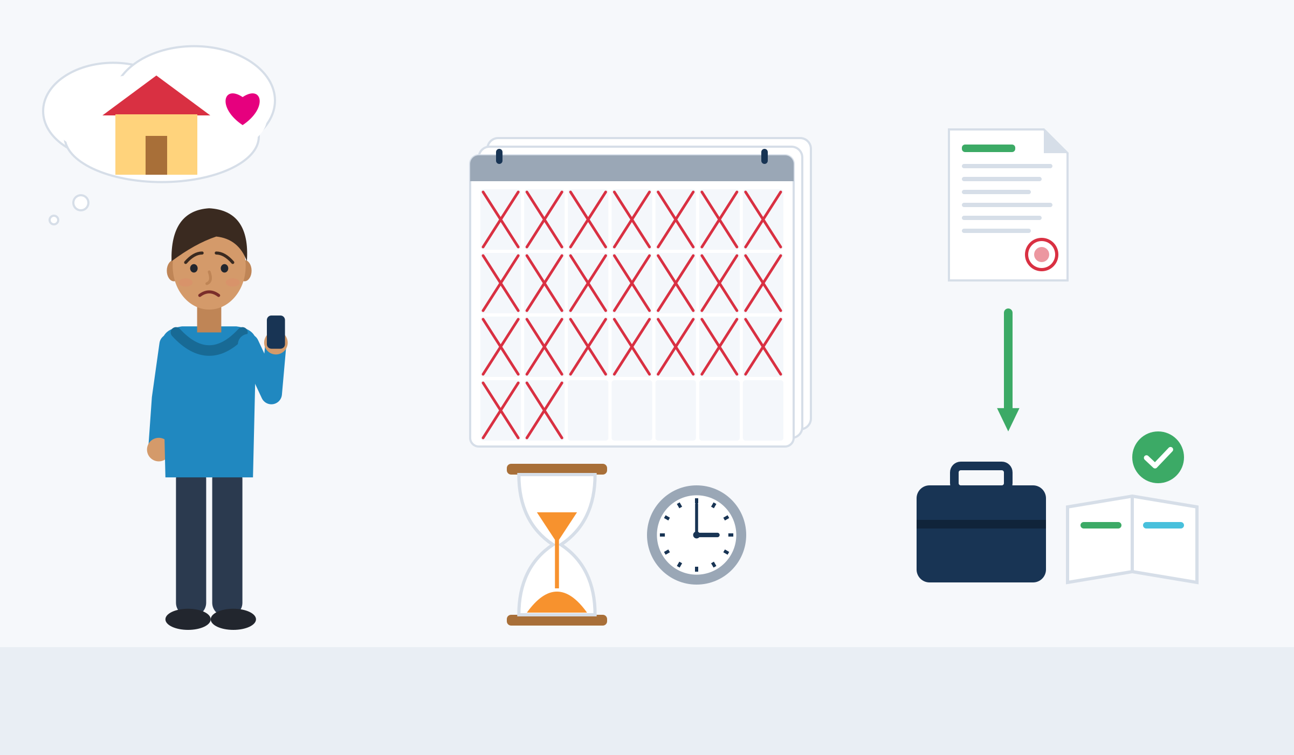
EMOTIONAL AND PSYCHOLOGICAL ASPECTS
Stress and uncertainty are normal reactions to change
Homesickness
Waiting for papers
A decision helps
After arrival, new stress starts: waiting for papers, long stays in shelters and insecure status can harm health and slow down work.
Waiting is heavy: each extra year of waiting for an asylum decision cut later employment by 4-5 points (Switzerland).
A decision helps: in Germany, a decision, whatever it was, sped up the first job and language course.
Homesickness is common after a move: a real feeling, not a weakness.
Job and language course sooner
Source: Bakker, Dagevos & Engbersen (2014) · Hainmueller, Hangartner & Lawrence (2016) · Kosyakova & Brenzel (2020) · Stroebe, Schut & Nauta (2015)
Module 3 · Adaptability
23
Notes:
For trainers (shown on the slide in the earlier version): SMILE is not therapy. Never ask for migration stories. If someone is distressed: pause, offer a break, talk privately and use your local referral list.
Unit 2.4: coping with stress and uncertainty. Say: "Stress after a big move is normal. Much of it comes from waiting and uncertainty, which you do not control. That is not a lack of adaptability."
Evidence: in a Dutch dataset of about 4,000 refugees, a long stay in asylum accommodation and insecure residence status harmed mental health and hindered integration (Bakker et al., 2014). Swiss data: each extra year of waiting cut later employment by 4-5 percentage points (a 16-23% drop), "consistent with psychological discouragement" (Hainmueller et al., 2016). Homesickness: a review of 55 studies links it to adjustment and health problems (Stroebe et al., 2015).
The burden is real: a meta-analysis of 26 studies (5,143 adult refugees and asylum seekers) found PTSD and depression in about 31.5% each (Blackmore et al., 2020). WHO (2022) lists "migrant status" among the factors through which discrimination and inequality at work damage mental health.
Tip: talk about "people" and invented characters, not about "you". Have your referral list (counselling, legal advice, unions) ready before this slide.

Slide 24

ADAPTABILITY, RIGHTS AND FAIR WORKING CONDITIONS
Healthy adaptation is a two-way deal
Your part: learn routines, tools and words. Ask, also for feedback. Adjust greetings, small talk and pace. Record hours, pay and messages.
The employer's part: key information in writing by day 7. Pay for all hours, also on probation. Changes in writing, with notice. Training, safety, respect, no discrimination.
Red flags are not “adapting”: pressure to sign now, handing over your passport, paying for a job, unpaid hours. Stop and get advice.
Your part: adapting
The employer's part: fair conditions
Source: European Commission (2020), COM(2020) 758 · Directive (EU) 2019/1152, Art. 5, 6, 8, 13 · Faire Integration (2026), FAQ and warning signs
Module 3 · Adaptability
24
Notes:
Unit 2.5: the direct link between healthy adaptation and the fair conditions offered by the employer. The EU Action Plan calls integration "a two-way process whereby migrants and EU citizens with migrant background are offered help to integrate and they in turn make an active effort to become integrated"; the host society "should create the opportunities" (COM(2020) 758).
Warning signs listed by Faire Integration (Germany): pressure to sign immediately, paying money for documents, handing over your passport or ID, not getting copies of signed documents, threats that others would "work for less money". FAQ: "You will be paid normally during the probationary period."
WHO (2022) puts the employer first: organisational interventions on workload and schedules (Rec. 1) and manager training (Rec. 4) come before individual stress training (Rec. 8A).
Run it (5 min): ask "Which of these is the employer's job, which is mine?" with 6-8 quick examples.
The picture: Samir builds the bridge from his side (green planks: learning, asking, keeping records), the employer from the other side (navy planks: written contract, payslip, safety). Healthy adaptation is where they meet.

Slide 25






KNOW YOUR BASICS
Six things every worker in the EU should know
Job information in writing
Probation has a limit
Required training is free
Your employer must give you the main information about your job in writing within 7 days: place, pay, hours, notice.
A probation period can last at most 6 months in general.
Training the employer requires is free for you and counts as working time.
Working time has limits
Unpaid wages can be claimed
Keep your own record
On average no more than 48 hours a week, 11 hours rest every day, at least 4 weeks paid holiday a year.
Even without papers, workers can claim unpaid wages, also through a union or another organisation.
Write down your hours, breaks and payments every day. Photos of rotas and messages help too.
Source: Directive (EU) 2019/1152 Art. 5, 8, 13 · Directive 2003/88/EC Art. 3, 6, 7 · Directive 2009/52/EC Art. 6, 13
Module 3 · Adaptability
25
Notes:
Rules are EU minimum standards; national law can give more. Rules for Türkiye differ: point Turkish participants to İŞKUR and the Ministry of Labour (ÇSGB) pages on the help points slide.
Keep the tone practical: the aim is confidence, not fear. Link to the activity on reading a contract or payslip if time allows.
More from Directive (EU) 2019/1152: changes must be given in writing "at the latest on the day on which it takes effect" (Art. 6); if the work pattern is mostly unpredictable, a worker may refuse an assignment outside agreed reference hours or without reasonable notice "without adverse consequences" (Art. 10); workers are protected against dismissal for using these rights (Art. 17-18).
Türkiye (Labour Law 4857): probation max. 2 months (4 with a collective agreement), and "wages and other rights for the days worked are protected" (Art. 15); without a written contract, the employer must give a written document on conditions, working time and pay within two months (Art. 8). Syrians under temporary protection: the employer applies for the work permit after 6 months of registration; the permit is tied to that employer and pay must be at least the minimum wage (ILO, 2026).

Slide 26


ILLUSTRATIVE SCENARIO
Three unpaid trial days
Dawit, 23
Looking for his first café job in Berlin
DISCUSS
Which parts are normal adapting? Which are warning signs?
Write 2 polite questions Dawit can ask the owner.
Where can he get free advice in Germany?
Hospitality
Germany
Rights
A café owner likes Dawit and says he can “show what he can do” with three unpaid trial days. He also asks for Dawit's passport “for the paperwork”. Dawit really wants this job. A friend says: “That's how it works here. Just adapt.”
Grounded in: Faire Integration lists handing over your passport as a warning sign and says “You will be paid normally during the probationary period”; FRA (2019) documents unpaid work in exchange for contracts.
Module 3 · Adaptability
26
Notes:
Unit 2.5. Polite questions: "Is the trial period paid?" "I prefer to keep my passport. I can give you a copy." "When will I receive my contract in writing?"
Advice in Germany: Faire Integration offers free, anonymous counselling "in various languages of origin" for refugees and migrants from outside the EU, in all federal states; since 1 January 2026 it is funded by the Federal Ministry of Labour. (Faire Mobilität advises workers from Central and Eastern Europe, so for third-country nationals the right address is Faire Integration.)
Honest limit: national rules on short unpaid trial days differ and were not verified in our research. We know that probation is paid work and that a passport should not be handed over. Do not tell participants that trial days are always illegal; tell them to check with a counsellor. In Türkiye, wages for days worked are protected even during probation (Law 4857, Art. 15).
Debrief: "Just adapt" mixes up adaptation and coercion (RFCDC). FRA (2019) heard from workers in Portugal that it is "common practice nowadays to work without pay, only in exchange for a work contract".

Slide 27





WHERE TO GET HELP
Official help points in the SMILE countries
 | Country | Jobs and training | Diplomas and recognition | Unfair or unsafe work
 | Türkiye | İŞKUR (iskur.gov.tr), Public Education Centres | YÖK denklik, MEB e-Denklik | Ministry of Labour (csgb.gov.tr), YİMER 157 helpline
 | Greece | DYPA (dypa.gov.gr) | DOATAP (doatap.gr) | Labour Inspectorate, phone 1555
 | Italy | Centri per l'Impiego, SIISL | CIMEA (free for protection holders) | Ispettorato Nazionale del Lavoro
 | Germany | Agentur für Arbeit, Jobcenter, Jugendmigrationsdienste (12-27) | Anerkennung in Deutschland, IQ Netzwerk | Faire Integration (free, multilingual)
 | Netherlands | UWV, werk.nl, your municipality | IDW (idw.nl) | Nederlandse Arbeidsinspectie, Juridisch Loket
Save the number or website of one help point in your phone today.
Source: Official websites, checked 1 October 2026 (SMILE research note, labour market)
Module 3 · Adaptability
27
Notes:
Ask participants which country they live in and open the matching website live if internet is available.
More contacts from the adaptability research note: Germany: Faire Integration (faire-integration.de/en), free and multilingual, for third-country nationals. Netherlands: FairWork (fairwork.nu/en), an NGO against exploitation of migrant workers with an "I seek help" contact. Italy: the Integrazione Migranti portal ("Vivere e lavorare in Italia"). Greece: GSEE (union confederation). Türkiye: ALO 170 (Ministry of Labour hotline, WhatsApp support; from abroad +90 216 170 1 122).
Türkiye: ILO Information Centres (BİLMER) in Adana, Gaziantep, Istanbul, Konya, Mersin, Şanlıurfa, Bursa and Hatay give free information on work permits, registration and social security.

Slide 28

03
SECTION 3 · ≈ 150 min
Practical Strategies and Good Practices (Taking Action)
Tools you can use tomorrow: ask, repair, plan, use feedback, build bridges, look after yourself.
Ask and repair
Change and feedback
Networks and well-being
Practice
Module 3 · Adaptability
28
Notes:
Section 3 covers curriculum units 3.1 to 3.7. Suggested timing (the curriculum gives none): 3.1-3.6 tools about 45 min, 3.7 case study 45 min and role-play 60 min. Most of the 3 hours of hands-on learning happen here.

Slide 29
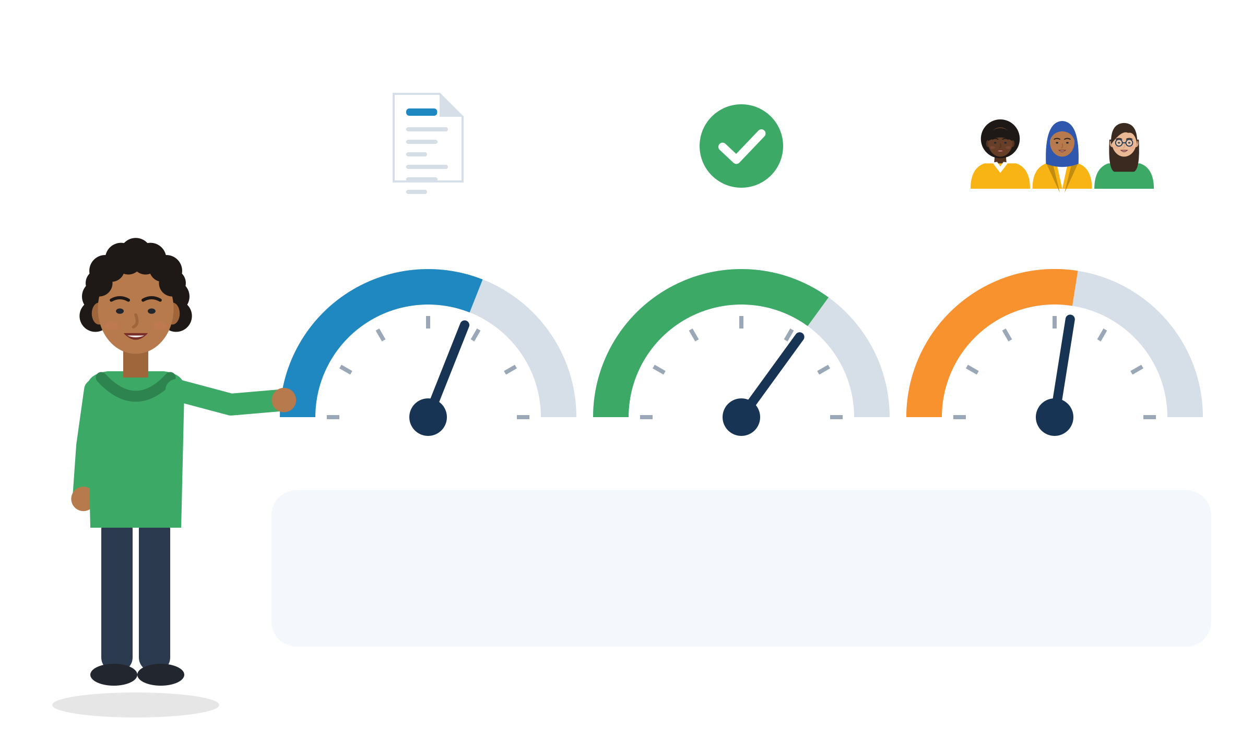
LEARNING AND ASKING QUESTIONS IN THE WORKPLACE
Three dials for your first month
Turn them up
Clarity: ask one clarifying question a day in your first weeks. Write down new words and steps.
Confidence: ask for feedback at agreed moments, e.g. after week 1 and week 4.
Connection: learn three names. Join one break or one lunch. Ask a colleague how they started.
Clarity: I know what to do
Confidence: I can do it
Connection: I belong
Source: Bauer, Bodner, Erdoğan, Truxillo & Tucker (2007), meta-analysis of 70 newcomer samples, Journal of Applied Psychology 92(3)
Module 3 · Adaptability
29
Notes:
Unit 3.1: taking the initiative without being afraid of making mistakes. New employees adjust through three things: role clarity, self-efficacy and social acceptance. A meta-analysis of 70 newcomer samples found that this adjustment carries the effect of onboarding and of newcomers' own information seeking on job satisfaction, commitment, performance, intention to stay and turnover (Bauer et al., 2007).
Run it (5 min): each participant writes one action per dial for their next (or current) first month in a job, training or internship.
Tip: link to Samir's scenario: asking is not a sign of weakness, it is how newcomers adjust.

Slide 30
TAKING INITIATIVE WITHOUT FEAR OF MISTAKES
From silent worry to a small brave step
INSTEAD OF
TRY
“I nod and hope I understood.”
“Just to check: do you mean X or Y?”
“I made a mistake. Better to hide it.”
“I think I made a mistake here. Can you show me how to fix it?”
“If I ask, they will think I am slow.”
“New people are expected to ask. The first weeks are the best time.”
“I can't do this.”
“I can't do this yet. Next step: watch a colleague do it once.”
Source: Bauer et al. (2007) · Anseel, Beatty, Shen, Lievens & Sackett (2015), feedback seeking declines with tenure · Dweck (2006), “not yet”
Module 3 · Adaptability
30
Notes:
Unit 3.1. People seek less feedback the longer they are in a job, so the first weeks are the natural time to ask (Anseel et al., 2015).
Mistakes: in many jobs, reporting a mistake early is a safety rule, not only a courtesy. Hiding it usually makes it bigger.
Run it (5 min): pairs write one more "instead of" sentence from their own experience of being new (school, course, job) and turn it into a "try" sentence.
Tip: model it yourself: tell a short, light story of a mistake you made as a newcomer and what you said.

Slide 31


USEFUL PHRASES
Phrases for asking, repairing and changing plans
Asking and learning
Repairing a language accident
Change and uncertainty
“Could you show me once more? I want to do it right.”
“Just to check: do you mean X or Y?”
“What's the most important thing to get right in this task?”
“Who should I ask when you're not here?”
“Sorry, I said that wrong. What I meant was: the delivery has arrived.”
“Let me try that another way.”
“Can you say that more slowly, please?”
“I don't know the word. It's the thing you use to open boxes.”
“What exactly changes, and from when?”
“Could I get that in writing, please?”
“Tomorrow is hard because of my language course. Could I swap with someone?”
“Can I come back to you in an hour?”
Module 3 · Adaptability
31
Notes:
Units 3.1 to 3.3. The repair phrases follow the CEFR B1 scales "Asking for clarification", "Compensating" and "Monitoring and repair" (Council of Europe, 2020). Describing a word you don't know ("the thing you use to") is an official language strategy, not a failure.
Practise in pairs: one says the phrase, the other answers. Then swap. Trainers can translate the phrases into participants' strongest languages.

Slide 32





MANAGING LANGUAGE DIFFICULTIES
A language accident, repaired in 20 seconds
Mariam The delivery from this morning is finished.
Manager Finished? OK, then I'll reorder everything today.
Mariam Sorry, I said that wrong. What I meant was: the delivery has arrived. It's all in the back room.
Manager Ah, it's here! Then we don't need to reorder.
Mariam Just to check: no reorder today, and I put the boxes on the shelves now?
Invented scenario. Three steps: notice, correct, confirm. At B1 the CEFR says you “can start again using a different tactic when communication breaks down”.
Module 3 · Adaptability
32
Notes:
Unit 3.2: tactics for recovering from communication mishaps. Illustrative scenario (constructed): Mariam, 19, works in retail in Athens. She notices the problem because the manager plans a reorder and a colleague looks confused.
Grounding: lack of language skills is the most often named specific obstacle to a suitable job for non-EU citizens (Eurostat, 2021). The CEFR Companion Volume treats "monitoring and repair" and "asking for clarification" as skills; at B1 a learner "Can ask someone to clarify or elaborate what they have just said" (Council of Europe, 2020, pp. 69-70).
Run it (10 min): pairs read the dialogue, then invent their own language accident (a false friend, a wrong number, "yes" meaning "I heard you") and repair it with notice, correct, confirm.
Tip: praise the repair, never the grammar. The goal is that the message arrives.

Slide 33
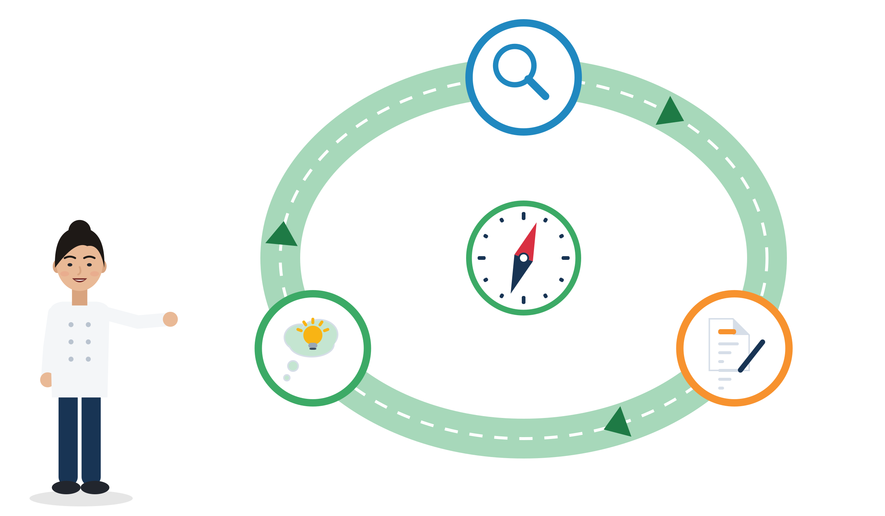
COPING WITH CHANGE AND UNCERTAINTY
Anticipate, act, reflect: a loop for every change
Anticipate
For every change
Anticipate: What will change? What will be hard? What do I need?
Act: ask, plan and try one small step. Get key changes in writing.
Reflect: What worked? What will I do differently next time?
OECD Learning Compass
Reflect
Act
Source: OECD (2019), OECD Learning Compass 2030 concept notes: “a cycle of anticipation, action and reflection” · OECD (2018), Education 2030
Module 3 · Adaptability
33
Notes:
Unit 3.3: thinking in an agile way. Example: "Next week the team moves to the night shift." Anticipate: what will be hard (transport, sleep, my language class)? Act: ask about transport, swap the language class, ask for the new rota in writing. Reflect: what worked, what would I do differently?
OECD (2018) says young people "will need to cope with failure and rejection, and to move forward in the face of adversity", and that the constructs behind its competencies "include adaptability, creativity, curiosity and open-mindedness". The Council of Europe adds tolerance of ambiguity: "Willingness to undertake tasks when only incomplete or partial information is available".
Use this loop as the debrief structure for every role-play in this section.

Slide 34

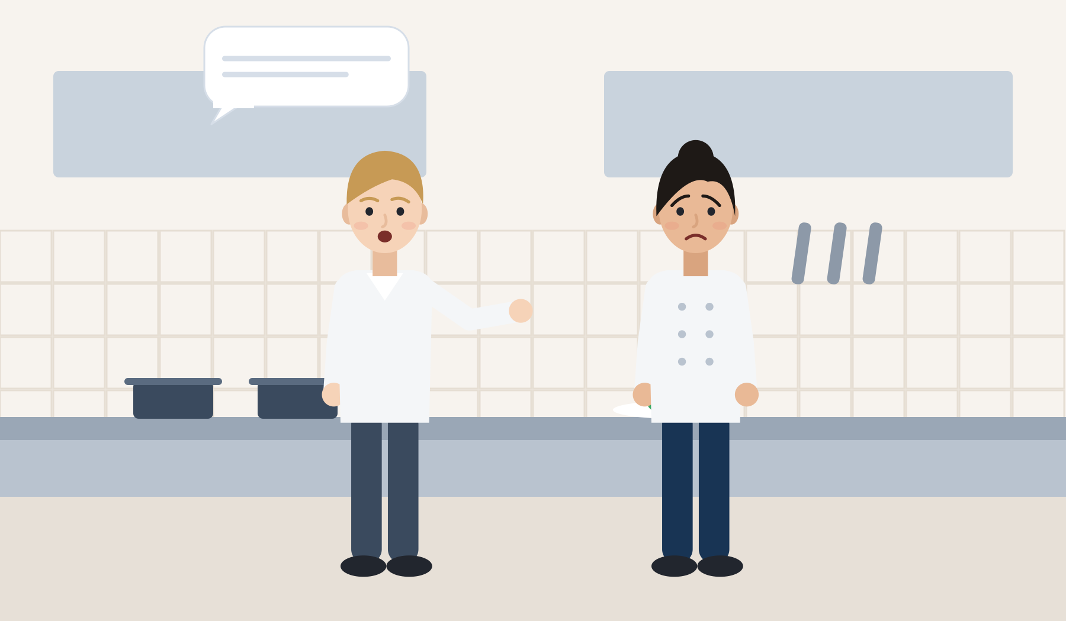
ILLUSTRATIVE SCENARIO
Your shift changes tomorrow
Elif, 22
Kitchen assistant in a hotel in Milan
DISCUSS
What can Elif influence, and what not?
What exactly should she ask, and what in writing?
Role-play: a calm request for a swap or another solution.
Hospitality
Italy
Shift change
On Monday afternoon the chef tells Elif: “From tomorrow you work the evening shift.” Her Italian class is on Tuesday and Thursday evenings. Elif feels panic. She wants to keep the job and the class. She has a temporary contract and is afraid to say anything.
Grounded in: changes must be given in writing at the latest on the day they take effect (Directive (EU) 2019/1152, Art. 6); temporary contracts: 22.1% of non-EU employees vs 10.7% of nationals (Eurostat, 2025).
Module 3 · Adaptability
34
Notes:
Units 3.3 and 2.5. Useful phrases: "What exactly changes, and from when?" "Tomorrow is hard because of my language course. Could I swap with someone?" "Could I get the new schedule in writing, please?"
Legal background: the written information must state shift-change arrangements (Art. 4(2)(l)). If the work pattern is mostly unpredictable, the worker may refuse an assignment without reasonable notice, without adverse consequences (Art. 10). National rules add details; do not give legal advice, refer to a counsellor or union.
Fear is realistic: a temporary contract makes it harder to say no. Discuss safe ways to ask and where to get support if the answer is unfair.
Tip: use the anticipate-act-reflect loop from the previous slide to plan Elif's next 24 hours.

Slide 35

RECEIVING AND USING FEEDBACK
Use feedback without taking it personally
Listen: breathe, let the person finish.
Find the message: what exactly should change? Separate it from the tone.
Ask: “Can you give me an example, so I understand?”
Try it: do it the new way, notice what is different.
Check back: “I'll try that and check with you on Friday.”
Not feedback: shouting, insults or humiliation. Talk to someone you trust or get advice.
Check back
Try it
Ask for an example
Find the message
Listen
Feedback is information you can ask for.
Source: Ashford & Cummings (1983), feedback as an individual resource · Anseel et al. (2015), meta-analysis of feedback-seeking behaviour
Module 3 · Adaptability
35
Notes:
Unit 3.4: turning criticism into growth without taking it personally. Feedback is a resource people can actively seek (Ashford & Cummings, 1983). There are two ways: inquiry (asking directly) and monitoring (watching how others are treated); they are not the same (Anseel et al., 2015).
Honest note: the direct link between feedback seeking and performance is small (Anseel et al., 2015). Seeking feedback is mainly a learning and relationship tool, not a magic switch.
Run it (5 min): pairs practise steps 2 and 3 with a short sentence of criticism ("This is too slow."). The receiver finds the message and asks for an example.

Slide 36
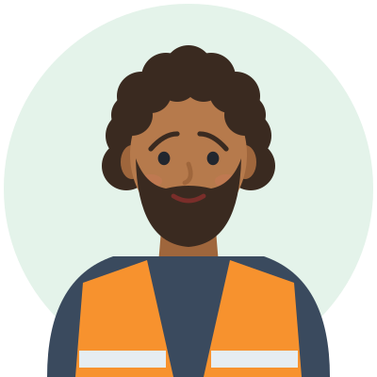

ILLUSTRATIVE SCENARIO
Feedback that feels harsh
Ahmad, 25
Logistics worker in Rotterdam, month 2
DISCUSS
What is the message? What is the tone?
What could Ahmad ask to understand what to fix?
How could he ask to talk in private next time?
When does tone become bullying, a reason to get help?
Logistics
Netherlands
Feedback
In front of three colleagues, the team leader looks at Ahmad's pallet and says: “This is wrong. Do it again.” Then she walks away. Ahmad's face is hot. Where he grew up, criticism in public meant shame. He thinks about saying nothing for the rest of the week, or quitting.
Grounded in: feedback is a resource you can seek (Ashford & Cummings, 1983; Anseel et al., 2015); norms about hierarchy and direct talk differ between workplaces (Hofstede, national averages only).
Module 3 · Adaptability
36
Notes:
Unit 3.4. Useful phrases: "Thanks for telling me. What should I do differently next time?" "Can you give me an example, so I understand?" "I'd prefer to talk about this in private, if that's OK."
Separate the message (how the pallet should be built) from the tone (short, public). Direct feedback can be normal in some workplaces; repeated humiliation, insults or threats are not, and are a reason to talk to a trusted person, the works council, a union or an advice service.
Second case for the same skill (used in the role-play): Kofi, 24, a trained electrician from Ghana in a German apprenticeship, suggests a faster wiring method. The Meister says: "We don't do it like that here." Separate the safety or legal standard (follow it), the company habit (learn it, maybe propose a change later) and identity (not up for negotiation). Phrase: "Can you explain why it's done this way? I'd like to understand the standard."

Slide 37
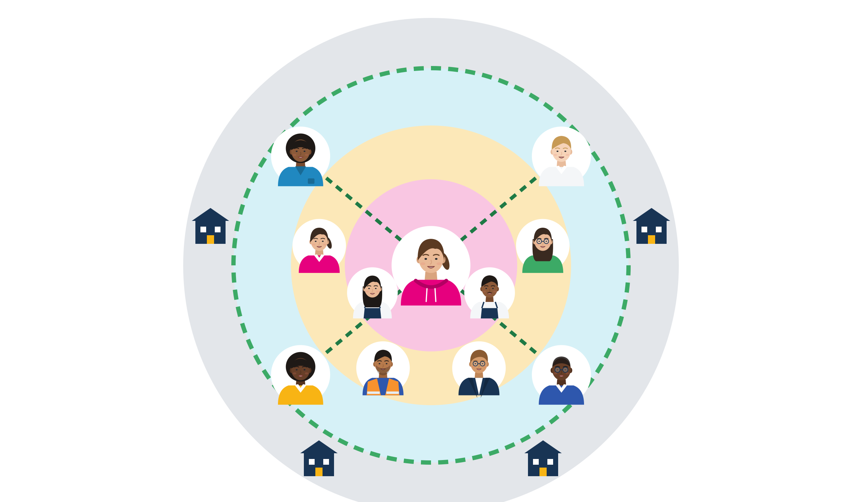
BUILDING WORKPLACE RELATIONSHIPS
Your network: keep your circle, build bridges
Organisations
Close circle: family and close friends: support, language and identity. Keep them close.
Regular contacts: colleagues, classmates, your language teacher, neighbours.
Occasional contacts, your bridges: a coach, a former trainer, a teammate's uncle. They often hear about jobs you don't hear about.
Organisations: youth services, the job centre, NGOs and unions: bridges whose job is to help.
Bridges
Regular contacts
Close circle
Source: Granovetter (1973) · Rajkumar et al. (2022), Science: LinkedIn experiments with 20+ million people · Lancee (2010), migrants in the Netherlands
Module 3 · Adaptability
37
Notes:
Unit 3.5: creating trusted connections and a network. Close friends often know the same things you know; acquaintances ("weak ties") bring new information (Granovetter, 1973). LinkedIn experiments with more than 20 million people over 5 years (600,000 new jobs) showed that moderately weak ties produced the most job mobility; in less digital industries strong ties mattered more (Rajkumar et al., 2022).
In the Netherlands, migrants' bridging ties (contacts across groups) were positively associated with employment and income; close bonding ties did not affect economic outcomes, but they matter for support and identity (Lancee, 2010).
Constructed example: Musa, 21, in Palermo, mentions at his football club that he has a forklift licence. A teammate's uncle needs a driver.
Activity (15 min): draw three circles, write initials (not full names) of contacts, add one bridge person to contact this month, and practise a 20-second "who I am and what I can do" pitch in pairs.

Slide 38



DOCUMENTED CASES AND PROGRAMMES
Real evidence: bridges and information help
DE · trial
TR · ILO
DE · survey
A bridge to employers
Information centres
Language and counselling
Munich: an NGO sent refugees' CVs to matching employers. After 12 months: about 12 points more in work, almost 20 for people still without a status.
Free information on work permits and social security in Türkiye. The ILO reports 30,100 workers counselled and 967 businesses formalised.
Refugees' employment in Germany reached 68% after 8 years. Finished language courses and job-centre counselling went with higher employment.
Source: Battisti, Giesing & Laurentsyeva (2019), Labour Economics 61, field experiment · ILO (2026), knowledge brief, data to May 2026 · Brücker et al. (2024), IAB-Kurzbericht 10/2024
Module 3 · Adaptability
38
Notes:
Munich job-matching experiment: no effect after 6 months; after 12 months about +12 percentage points (only marginally significant, so weak evidence), almost +20 points for refugees without a recognised status (control group: 24% employed), +15.6 points for lower-educated refugees (Battisti et al., 2019). Message: a bridge person who knows employers matters most for those in the most uncertain position.
BİLMER (ILO with the Ministry of Labour, chambers of tradesmen and municipalities): more than 10,800 business consultations, 30,100 workers counselled, 967 businesses formalised; the centres also helped people "avoid overcharging by private intermediaries" (ILO, 2026; programme monitoring, not an impact evaluation).
IAB-BAMF-SOEP survey: 63% employed after 7 years, 68% after 8; for the 2015 cohort women 31% and men 75% in 2022. Faster asylum procedures and shorter work bans went with higher employment; residence obligations hindered it (Brücker et al., 2024). Adaptation takes years, and rules matter as much as effort.

Slide 39

MANAGING STRESS AND EMOTIONAL WELL-BEING
Stress check: how you see it changes what you can do
Something happens: “From tomorrow you work nights.”
Threat or challenge? A danger, a loss, or a challenge I can face?
Can I influence it? What can I do? Which people and resources do I have?
Yes, action plan: ask, propose a swap, get it in writing, get advice if rules are broken.
No, care plan: calm your body, keep small routines, talk to someone you trust.
Yes: action plan
Can I influence it?
No: care plan
Threat or challenge?
Something happens
Stress is a normal reaction, not a weakness.
Source: Lazarus & Folkman (1984), stress appraisal and coping · WHO (2022), Guidelines on mental health at work, Rec. 1, 4 and 8A
Module 3 · Adaptability
39
Notes:
Say: "Stress is a normal reaction, not a weakness. If the employer breaks the rules, coping means advice and support, not only calming down." The picture: Elif on the road; after "Can I influence it?" the road splits into an action plan and a care plan.
Unit 3.6 (and 2.4). The transactional model: stress is not only what happens, it is also how I appraise it. Primary appraisal: is this a threat, a loss or a challenge? Secondary appraisal: what resources and options do I have? Coping can target the problem (act, ask, plan) or the emotions (calm down, talk, move) (Lazarus & Folkman, 1984).
WHO (2022) recommends organisational interventions on psychosocial risks such as workload and schedules (Rec. 1) and manager training in mental health (Rec. 4, strong recommendation) first; individual stress-management skills based on mindfulness or cognitive-behavioural approaches are a conditional recommendation (Rec. 8A).
Worksheet (10 min): two columns "Can I influence it? Yes: action plan / No: care plan + who I can talk to", filled for an invented character: Hasan, 21, in a vocational course in Gaziantep with İŞKUR support, has his final exam next week; his mother is ill in another country; he can't sleep and thinks about quitting. Offer, never require, personal sharing.
Option: end with a one-minute breathing or grounding exercise. Watch for participants who are activated by the topic; offer a break and a private talk.

Slide 40





ACTIVITY
Case study: adapting or a rights issue?
TIME
45 min
STEPS
Each group gets one case text: Samir, Elif, Dawit, Oksana or Hasan. Read it aloud; icons help low-literacy groups.
Answer: What is happening? What is in my control? What is the employer's responsibility? What is my next step?
Draw two columns on the flipchart: “I can” and “They must”.
Add one phrase the person could really use.
Each group reports in 2 minutes. Others add one idea.
GROUP
Groups of 3-4
MATERIALS
Case study texts, flipchart, markers
DEBRIEF
GOAL
Separate what I can do from what the employer must do
Which part was adaptation, and which part was a rights issue?
What would a fair employer have done?
Which phrase would you really use?
Module 3 · Adaptability
40
Notes:
Curriculum unit 3.7: case study (materials: case study texts, flipchart). All cases are constructed; names are invented. Samir (warehouse, unwritten rules), Elif (shift change), Dawit (unpaid trial days, passport) are on earlier slides. Oksana, 27, civil engineer from Ukraine, packs parcels at night in Naples (grounding: 51.3% of young tertiary-educated non-EU citizens in Italy are over-qualified, Eurostat 2025; task: a 12-month 4 Cs plan). Hasan, 21, vocational course in Gaziantep, final exam next week, mother ill abroad (grounding: homesickness is common, Stroebe et al., 2015; WHO Rec. 8A and 4).
Trauma-informed: use third-person cases only, allow "pass", avoid cases set in countries of origin, and watch for activation with Hasan's case. Have the referral list ready.
The "I can / They must" columns keep the curriculum's message visible: adaptability must always be supported by fair and inclusive working conditions.

Slide 41




USEFUL PHRASES
Phrases for feedback, boundaries, rights and people
Receiving feedback
Boundaries, staying connected
“Thanks for telling me. What should I do differently next time?”
“Can you give me an example, so I understand?”
“I'd prefer to talk about this in private, if that's OK.”
“I don't drink, but I'd love to come for a soft drink.”
“I can't join this time. How about lunch next week?”
“I need my break at prayer time. Is there a quiet place I can use?”
Rights, polite but clear
Network and stress
“When will I receive my contract in writing?”
“Is the trial period paid?”
“I prefer to keep my passport. I can give you a copy.”
“Hi, I'm new here. I work on the packing line. How long have you been here?”
“If you hear about any jobs in logistics, I'd be really interested.”
“I'm finding this week stressful. Can we talk for five minutes?”
Module 3 · Adaptability
41
Notes:
Units 1.4, 2.5, 3.4, 3.5 and 3.6. Use these phrases as prompt cards for the role-play rounds. Participants choose two phrases they would really use and say them aloud to a partner.
Boundary phrases keep the connection: they say no to one thing and yes to the relationship (integration, not separation).

Slide 42

ACTIVITY
Role-play: three workplace moments
TIME
60 min
STEPS
Round 1, language accident: Mariam and the delivery. Use notice, correct, confirm.
Round 2, feedback: Ahmad in front of the team, or Kofi: “We don't do it like that here.”
Round 3, change: Elif's new shift. Ask for details, a swap and the change in writing.
Each round: 3 min prepare, 3 min play, 3 min feedback. Rotate roles.
Observer checks: a clear question, a calm tone, a confirmation at the end.
De-role: say your real name and one thing you liked.
GROUP
Trios: speaker, other person, observer
MATERIALS
Role-play scenario cards, phrase cards, observer card
DEBRIEF
GOAL
Practise repair, feedback and change in a safe space
Anticipate: what did you expect?
Act: what did you say?
Reflect: what would you change next time?
Module 3 · Adaptability
42
Notes:
Curriculum unit 3.7: role-play activities (material: role-play scenario cards). Debrief with the OECD loop (anticipate, act, reflect).
The other person is firm but never abusive. Pause and rewind are allowed; "pass" is always OK. No filming.
Kofi card: 24, trained electrician from Ghana, German apprenticeship; the Meister says "We don't do it like that here." The speaker separates safety or legal standard, company habit and identity, and asks: "Can you explain why it's done this way? I'd like to understand the standard." Grounding: principled versus coerced adaptation (RFCDC, 2018).
Whole group (10 min): one volunteer trio replays a better version of one round.

Slide 43


BE FAIR TO YOURSELF
Skills open doors, but they are not the whole story
What this skill can change
What it cannot fix alone
Learn new routines, words and tools faster.
Ask, check and repair misunderstandings.
Cope better with change, stress and feedback.
Build bridges to people who hear about jobs.
Identical CV, different name: 55 of 100 got a positive answer with a Dutch name, 40 of 100 with a Turkish name.
Recognition of diplomas, residence permits and the right to work depend on laws and offices, not on you.
Discrimination is not your fault. It can be reported to an equality body, a union or an NGO.
Adapt AND know your rights. Adapting never means accepting unfair work.
Source: Thijssen et al., 2021, JEMS (correspondence test, NL, applicants aged 23-25)
Module 3 · Adaptability
43
Notes:
This slide protects participants from a "deficit" message: soft-skills training must not suggest that unemployment or discrimination is their fault.
Field experiments send identical CVs that differ only by name; the call-back gap therefore measures discrimination, not skills (Quillian et al., 2019, meta-analysis of 97 experiments).
Only 6% of Muslim respondents who felt discriminated against reported it (FRA, Being Muslim in the EU, 2024). Point to the help points slide.
Adaptability-specific limits: social barriers weakened the benefit of personal resources for Syrian refugees in Greece and the Netherlands (Pajic et al., 2018); each extra year of waiting for an asylum decision cut later employment by 4-5 points (Hainmueller et al., 2016).
Same programme, unequal results: in the World Bank / İŞKUR employment support project in Türkiye, 90% of Turkish men but 37% of Syrian men were employed after on-the-job training (World Bank IEG, 2024). Ask: "Why did the same course give different results?"

Slide 44
SELF-CHECK
Employment-focused adaptability checklist (1/2)
I do this
Sometimes
Not yet
I have, or asked for, written information on my job, pay, hours, breaks and probation by day 7.
I know how long my probation is, and that it is paid work.
I keep my passport and ID myself, and I keep copies of everything I sign.
I know one place to get free advice on work rights in my country.
In my first weeks, I ask at least one clarifying question a day.
I ask for feedback at agreed moments, for example after week 1 and week 4.
I can separate the message of feedback from its tone.
Module 3 · Adaptability
44
Notes:
Curriculum material: "Employment-focused adaptability checklist". This version was constructed for SMILE from the draft in the research note, based on Directive (EU) 2019/1152 (Art. 4-5, 8), Faire Integration, Bauer et al. (2007) and Ashford & Cummings (1983). It is NOT a validated test: never use it for selection or grading.
Part 1 = rights in the first week and learning and asking. The rights items come first on purpose: rights are the base of healthy adaptation.
How to use it (10 min for both parts): participants tick alone, in any language. No total score. Each person circles two strengths and one "not yet" item for their action step.

Slide 45
SELF-CHECK
Employment-focused adaptability checklist (2/2)
I do this
Sometimes
Not yet
I can say when I don't understand and ask for repetition or an explanation.
I can fix a misunderstanding and check that it is fixed.
When something changes, I ask what changes, from when, and if I will get it in writing.
I can name one example of when I adapted well, for job interviews.
I have at least one “bridge” contact outside my close circle.
I keep what matters to me (language, faith, food, family contact) while I learn new workplace norms.
I know what helps me under stress and who I can talk to.
Module 3 · Adaptability
45
Notes:
Part 2 = language, change, people and well-being. Sources for trainers: CEFR B1 "Asking for clarification" and "Monitoring and repair" (Council of Europe, 2020); Directive (EU) 2019/1152 Art. 6; ESCO "adapt to change"; Lancee (2010) and Rajkumar et al. (2022); Berry et al. (2006) and RFCDC; APA and WHO (2022).
The worksheet version can add two more draft items ("I write down new words and procedures"; "I use anticipate, act, reflect for big changes") and the red-flag list: pressure to sign immediately, a contract I cannot read or no copy; requests to hand over documents or pay for a job; unpaid hours or unpaid "trial" work; threats ("others will do it for less", "you'll lose your permit"). Red flags mean: stop and get advice.
Optional: use the checklist at the start and the end of the SMILE training course to see change. Collect only anonymous, optional feedback on which items the group finds hardest.

Slide 46

REFLECTION
One change, one step, this month
When did I adapt without losing myself?
Who could be my bridge person?
What will I ask at work or in training this month?
What is my first small step, and when?
Write in any language. Sharing is optional.
Module 3 · Adaptability
46
Notes:
Curriculum unit 3.7: reflection exercises. Silent writing for 5 minutes in any language, then optional sharing in pairs.
Closing round: each participant says only their first small step and the day they will do it. Keep it short and positive. If the group meets again, start by asking how it went.

Slide 47

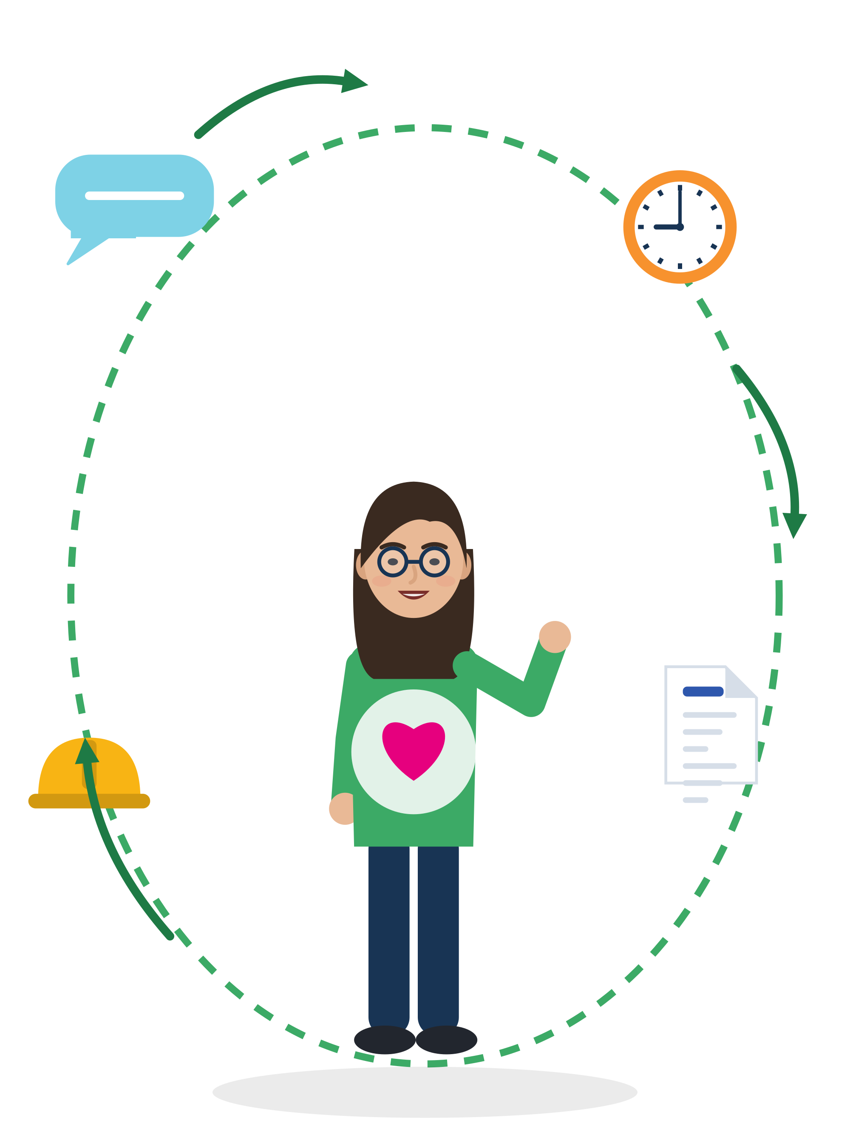


KEY MESSAGES
Adapt your actions, not your identity.
Adapting is a skill you can learn: ask, repair, plan, use feedback, build bridges. It is two-way: fair, clear and lawful conditions are the employer's part. When something feels wrong, get advice.
Module 3 · Adaptability
47
Notes:
Summarise with the group: ask three volunteers to name one tool they will use (three dials, repair phrases, anticipate-act-reflect, feedback steps, network map, stress check). Point back to the "Adapting is / Adapting is not" flipchart from Section 1.

Slide 48
REFERENCES
Sources used in this presentation (1/2)
American Psychological Association. (n.d.). Resilience. Retrieved October 1, 2026, from apa.org/topics/resilience
Anseel, F., Beatty, A. S., Shen, W., Lievens, F., & Sackett, P. R. (2015). How are we doing after 30 years? A meta-analytic review of feedback-seeking behavior. Journal of Management, 41(1), 318-348.
Arendt, J. N., Bolvig, I., Foged, M., Hasager, L., & Peri, G. (2020). Integrating refugees: Language training or work-first incentives? (NBER WP 26834).
Battisti, M., Giesing, Y., & Laurentsyeva, N. (2019). Can job search assistance improve the labour market integration of refugees? Labour Economics, 61, 101745.
Bauer, T. N., Bodner, T., Erdoğan, B., Truxillo, D. M., & Tucker, J. S. (2007). Newcomer adjustment during organizational socialization. Journal of Applied Psychology, 92(3), 707-721.
Berry, J. W., Phinney, J. S., Sam, D. L., & Vedder, P. (2006). Immigrant youth: Acculturation, identity, and adaptation. Applied Psychology, 55(3), 303-332.
Brücker, H., Ehab, M., Jaschke, P., & Kosyakova, Y. (2024). Arbeitsmarktintegration von Geflüchteten (IAB-Kurzbericht 10/2024). IAB.
Council of Europe. (2018). Reference framework of competences for democratic culture: Vol. 1. Context, concepts and model.
Council of Europe. (2020). Common European Framework of Reference for Languages: Companion volume.
Directive (EU) 2019/1152 on transparent and predictable working conditions in the European Union.
European Commission. (2020). Action plan on integration and inclusion 2021-2027 (COM(2020) 758 final).
European Commission & OECD. (2016). How are refugees faring on the labour market in Europe? (Working Paper 1/2016).
Eurostat. (2026). lfsa_eoqgan, lfsa_etpgan, lfso_21obst02, lfso_21lang03 [Data sets]. Accessed October 1, 2026.
Faire Integration. (2026). FAQ: Employment contract, minimum wage, exploitation. faire-integration.de/en
FRA. (2019). Protecting migrant workers from exploitation in the EU: Workers' perspectives. Publications Office of the EU.
Module 3 · Adaptability
48
Notes:
Full verified references with URLs and page numbers: SMILE research note "Adaptability" (arastirma/adaptability-icerik.md) and the shared labour-market note. Further sources quoted in the notes (e.g. Avey et al., 2011; Blackmore et al., 2020; Kosyakova & Brenzel, 2020; Pajic et al., 2018; Quillian et al., 2019; Stroebe et al., 2015) are listed there.
Curriculum references, as written in the curriculum: "OECD. (2021). Skills for Social Progress" is a year mix-up: the book with this title is OECD 2015. "International Labour Organization. (2021). Integrating Migrants into the Labour Market" could not be matched to an ILO publication. The curriculum text is unchanged; please flag both to the editors. The other curriculum references (OECD 2018; European Commission 2019 key competences; WHO 2022; UN 2016 New York Declaration) were verified and are used in this deck.

Slide 49
REFERENCES
Sources used in this presentation (2/2)
Hainmueller, J., Hangartner, D., & Lawrence, D. (2016). When lives are put on hold: Lengthy asylum processes decrease employment among refugees. Science Advances, 2(8), e1600432.
International Labour Organization. (2026). Türkiye: Information Centres for stronger equality of opportunity and treatment [Knowledge brief].
La Brack, B. (2010). Theory reflections: Cultural adaptations, culture shock and the “curves of adjustment”. NAFSA.
Lancee, B. (2010). The economic returns of immigrants' bonding and bridging social capital: The case of the Netherlands. International Migration Review, 44(1), 202-226.
Lazarus, R. S., & Folkman, S. (1984). Stress, appraisal, and coping. Springer.
Nguyen, A.-M. D., & Benet-Martínez, V. (2013). Biculturalism and adjustment: A meta-analysis. Journal of Cross-Cultural Psychology, 44(1), 122-159.
OECD. (2019). OECD Learning Compass 2030: A series of concept notes. OECD.
Rajkumar, K., Saint-Jacques, G., Bojinov, I., Brynjolfsson, E., & Aral, S. (2022). A causal test of the strength of weak ties. Science, 377(6612), 1304-1310.
Rudolph, C. W., Lavigne, K. N., & Zacher, H. (2017). Career adaptability: A meta-analysis. Journal of Vocational Behavior, 98, 17-34.
Sala, A., Punie, Y., Garkov, V., & Cabrera, M. (2020). LifeComp: The European framework for personal, social and learning to learn key competence (EUR 30246 EN).
Savickas, M. L., & Porfeli, E. J. (2012). Career Adapt-Abilities Scale. Journal of Vocational Behavior, 80(3), 661-673.
Sisk, V. F., Burgoyne, A. P., Sun, J., Butler, J. L., & Macnamara, B. N. (2018). To what extent and under which circumstances are growth mind-sets important to academic achievement? Psychological Science, 29(4), 549-571.
Thijssen, L., Lancee, B., Veit, S., & Yemane, R. (2021). Discrimination against Turkish minorities in Germany and the Netherlands. Journal of Ethnic and Migration Studies, 47(6), 1222-1239.
World Economic Forum. (2025). The future of jobs report 2025. WEF.
World Health Organization. (2022). WHO guidelines on mental health at work. WHO.
Module 3 · Adaptability
49
Notes:
Macnamara & Burgoyne (2023), Psychological Bulletin 149(3-4), 133-173, is the second mindset meta-analysis quoted on the "Not yet" slide; full entry in the research note.

Slide 50


Thank you
THE SMILE PARTNERSHIP
Göç Sanat ve Spor Derneği (MIGARTS) (Türkiye, coordinator)
KYTTARO ENALLAKTIKON ANAZITISEON NEON (KEAN) (Greece)
Work in Progress APS (WiP) (Italy)
Smart Leap Education Research Consultancy GmbH (Germany)
Association of Entrepreneurship School (AES) (Türkiye)
BİR-İZ (Türkiye)
Stichting Unity Sphere Europe (SUSE) (Netherlands)
Questions, ideas, stories: the floor is yours.
KEEP LEARNING
smile-lms.smartleap.eu
MODULE
3 · Adaptability
PROJECT
SMILE · Erasmus+ KA220-YOU
PROJECT NO.
2024-1-TR01-KA220-YOU-000256357
Scan to join the SMILE learning platform
Free online course: lessons, activities, quiz and certificate.
Co-funded by the European Union. Views and opinions expressed are however those of the author(s) only and do not necessarily reflect those of the European Union or the Turkish National Agency. Neither the European Union nor the granting authority can be held responsible for them.
SKILLS = Opportunity
Empowerment Through Skills · Inclusion Through Opportunity
Module 3 · Adaptability
50
Notes:
Invite participants to continue on the SMILE learning platform (QR code). Collect anonymous, optional feedback on the checklist items the group found hardest.

