Slide 1




MODULE 2 · TRAINER PRESENTATION
Empathy
Listen, understand and respond with respect: empathy for work, teams and community life in a new country.
3 hours
3 units
Ages 18-30
B1-B2 English
SMILE
Support Young Migrants Integration in the Labour market in Europe
Erasmus+ KA220-YOU · 2024-1-TR01-KA220-YOU-000256357
Empowerment Through Skills · Inclusion Through Opportunity
Notes:
Module 2 of the SMILE soft-skills curriculum, written by the Greek partner KEAN. Duration in the curriculum: 3 hours (1.5 h theory: concepts, discussion, examples; 1.5 h practical or reflective work). It can run as one 3-hour session or as two 1.5-hour sessions.
Welcome participants, introduce yourself and the SMILE project in one sentence: an Erasmus+ project of seven partners in Türkiye, Greece, Italy, Germany and the Netherlands that helps young migrants enter the labour market.
Say early what empathy is NOT in this module: not pity, not rescuing people, not agreeing with everyone. It is a skill for listening, understanding and responding with respect, and it works in both directions.

Slide 2




HOW WE WORK TOGETHER
Our starting agreement
Any English is good English
Your story belongs to you
Listen to understand
“Pass” is always OK
We listen to ideas, not grammar. Nobody corrects your language here. Mix words from other languages if it helps.
You never have to share your migration story. Our examples use invented characters.
One voice at a time. Every question is a good question.
You can skip any activity or question. Take a break when you need one.
Module 2 · Empathy
2
Notes:
Co-create or confirm the agreement before content starts. Write it on a flipchart and keep it visible for the whole module.
Why: many young refugees carry heavy stress. A review of 26 studies (5,143 adult refugees and asylum seekers) found PTSD and depression in about 31.5% each (Blackmore et al., 2020, PLOS Medicine). Never ask participants to tell their migration story; use the constructed characters on the slides.
Language: do not correct grammar or pronunciation during sharing. Model the phrases instead (the "useful phrases" slides).
In this module the group builds its own agreement in the curriculum's Opening Ritual (first slides of Unit 1). Show these four points as a starting draft that the group can keep, change or extend.
Add one rule for this module: nobody is asked about legal status, flight routes or losses. Every activity that uses personal experience (Object Stories, storytelling circle, Migration Map) has a "small everyday story" or "invented character" version.

Slide 3
MODULE MAP
Three units, one journey: understand, explore, practise
01
Unit 1: Understanding Empathy
02
Unit 2: Empathy in Diverse Settings
Opening ritual and Object Stories. 1.1 Defining empathy, 1.2 Empathy and sympathy, 1.3 Communication and teamwork.
Mini case studies. 2.1 Empathy Onion, 2.2 Barriers to empathy, 2.3 Empathy in conflict resolution.
≈ 65 min
≈ 50 min
03
Break
04
Unit 3: Empathy in Practice
Movement and grounding. Quick check on the safety thermometer.
3.1 Active listening, 3.2 Empathy Lab, 3.3 Reflection. Closing ritual: gratitude circle.
≈ 10 min
≈ 55 min
Module 2 · Empathy
3
Notes:
The curriculum fixes only the total: 3 hours, 1.5 h theory + 1.5 h practice. Its heading "Suggested pacing for single-session delivery" is followed by no breakdown, only a request to adapt timing and flow to group size, language needs and the emotional energy in the room. All minutes in this deck are therefore a suggestion (from the SMILE research note), not curriculum.
The curriculum also gives no minutes for the two rituals, the mini case studies or the activities in 1.1 to 3.3. If time is short, shorten your inputs, never the opt-out moments and the debriefs.
Two-session option (curriculum: 2 × 1.5 h): Session A = opening ritual, Unit 1, 2.1 and 2.2. Between sessions, participants can fill one Empathy Map about a situation from their week (optional; the curriculum suggests journaling or empathy mapping between sessions). Session B = 2.3, Unit 3, Empathy Manifesto and gratitude circle.

Slide 4
LEARNING OUTCOMES
By the end of this module, you will be able to
1
Define empathy and explain its role in interpersonal and intercultural communication, including its ethical and political dimensions.
2
Identify common barriers to empathy and develop strategies to overcome these barriers in various social settings, including biases rooted in colonial histories or cultural hierarchies.
3
Practise active listening and perspective-taking in real-life scenarios, using tools such as empathy mapping and role-play to explore layered identities and social systems.
4
Apply empathetic responses in workplace and community interactions in order to foster inclusion and collaboration, while remaining aware of power dynamics and avoiding a “saviour” mindset.
Module 2 · Empathy
4
Notes:
These are the four learning outcomes of the SMILE Empathy curriculum (English edition, unchanged).
Assessment is formative: reflection journals, peer feedback circles and creative outputs (collage, manifesto). Empathy maps, onion diagrams and scenario reflections are the evidence of learning; the Active Listening checklist and the journaling prompts are the self-assessment tools.
Read outcome 4 aloud and say: "Empathy is not rescue." The saviour idea comes back in Unit 2.

Slide 5
WHY THIS MATTERS
Half of employers call empathy a core skill
50% of employers name “empathy and active listening” a core skill: 7th of 26 skills.
Hard to replace: skills rooted in human interaction currently “show no substitution potential” by generative AI.
142 occupations in the EU skills list (ESCO) need “listen actively”, e.g. healthcare assistant, child day care worker.
Source: World Economic Forum (2025), Future of Jobs Report 2025, Fig. 3.3 p. 35 and p. 44 · ESCO, skill “listen actively”, accessed 1 Oct 2026
Module 2 · Empathy
5
Notes:
Ask the group to guess the empathy bar before you reveal the chart. Then say: "Half of employers call empathy a core skill, and a computer cannot do it for you."
WEF Future of Jobs Report 2025: survey of more than 1,000 employers (14 million workers, 55 economies). "Empathy and active listening" is 7th of 26 core skills, named by 50% of employers (Fig. 3.3, p. 35). Its net expected growth to 2030 is +46, 13th of 26 (Fig. 3.4, p. 37). Caveat: these are employers' expectations, not measured outcomes.
ESCO, the EU skills classification used by public employment services and Europass, lists "listen actively" as essential for 142 occupations, from healthcare assistant and child day care worker to hospital porter and migrant social worker (ESCO API, accessed 1 Oct 2026). Participants can use these exact words on a CV.

Slide 6


WHY THIS MATTERS
Empathy is daily work, and it can be trained
14%
18%
18 trials
of personal care workers in the EU were non-EU citizens in 2018. Immigrants made up 13% of all key workers.
of care workers in Germany are not German citizens: 307,000 people in June 2024, up from 6% in 2014.
In 18 randomised trials with 1,018 adults, empathy training worked, with a medium effect (g = 0.63).
Many of you already do empathic work: care, service, interpreting for family. It is a skill you can name and grow.
Source: Fasani & Mazza (2020), IZA Policy Paper 155, p. 8 · Bundesagentur für Arbeit (2025), pp. 11-12 · Teding van Berkhout & Malouff (2016), Journal of Counseling Psychology
Module 2 · Empathy
6
Notes:
Message: empathy is not "being nice". It is a named work skill, and many participants already use it every day: caring for siblings, interpreting for neighbours, calming customers.
Care evidence: patients of high-empathy family physicians more often had good blood-sugar control (56% vs 40%; Hojat et al., 2011, 891 patients). A systematic review concluded: "Empathy lowers patients' anxiety and distress and delivers significantly better clinical outcomes" (Derksen, Bensing & Lagro-Janssen, 2013).
Training evidence: the effect was 0.51 after correcting for publication bias. The EU framework LifeComp also states that "empathy can be improved through specific training" (Sala et al., 2020, p. 44). This answers "I am just not an empathic person".
Tip: ask "Who here has ever translated for a family member or a neighbour?" A show of hands is enough. This is empathic mediation, described as a B1 skill in the CEFR Companion Volume (Council of Europe, 2020, p. 114).

Slide 7






FOR TRAINERS
How this module teaches: safe, relational, embodied
Three stages
Trauma-informed practice
Check-in and check-out
Short inputs with stories and metaphors (bridges, mirrors), then guided practice, then personal reflection. Keep inputs short.
Grounding with breath, movement or sensory objects. Opt-out for intense activities. Ask before any story is shared.
Emotion cards, a body scan or one word at the start and end. The safety thermometer gives non-verbal feedback.
Decolonial and feminist
Embodied learning
Cultural connections
Before each session, reflect on your positionality: “What power do I hold in this space? How can I share it?”
Empathy Walks, “step into the circle if”, drawing, collage, music and gesture: empathy beyond words.
Local examples such as bureaucracy in Greece. Participants bring songs, proverbs and stories. Multilingual prompts and symbols.
Source: SMILE curriculum, Module 2, §5 Training Methodologies · SAMHSA (2014), six principles of a trauma-informed approach
Module 2 · Empathy
7
Notes:
Trainer-facing slide: summarise it in one minute, or skip it on screen and use it to prepare. It condenses the curriculum's methodology: participatory, experiential and trauma-informed pedagogy drawing on feminist, decolonial and psychosocial frameworks. Empathy is framed as a political and relational act, not a neutral skill.
Trauma-informed checklist (SAMHSA, 2014, pp. 10-11): safety; trustworthiness and transparency; peer support; collaboration and mutuality; empowerment, voice and choice; cultural, historical and gender issues. SAMHSA also says "one does not have to be a therapist to be therapeutic" (p. 11). Why it matters: a meta-analysis of 26 studies found PTSD in 31.46% and depression in 31.5% of adult refugees and asylum seekers (Blackmore et al., 2020).
Facilitator role (curriculum): co-learner and guide who holds space for vulnerability and complexity. Model curiosity and humility: "I don't know, but let's explore it together." Do the activities yourself (bring an object, draw an onion). Let participants choose groups, roles and how much they share.
Movement activities ("step into the circle if", the Council of Europe COMPASS activity "Take a step forward") always use role cards, never participants' own lives; avoid statements about deportation, detention or violence. Keep a local referral list ready (psychosocial services, legal aid, helplines): disclosures can happen.

Slide 8
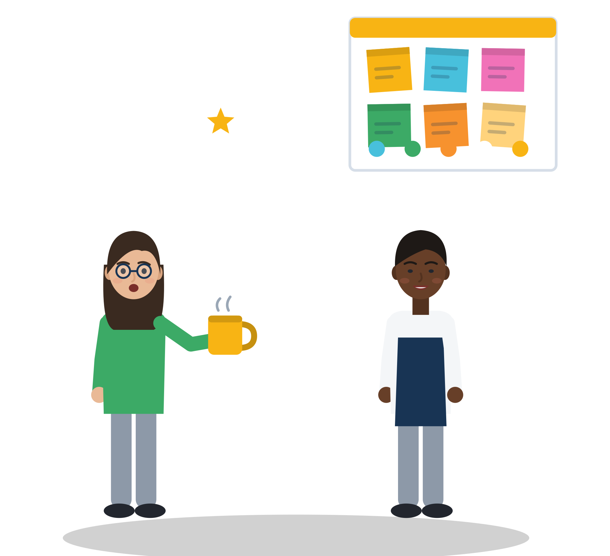

01
UNIT 1 · ≈ 65 min
Understanding Empathy
Empathy is cognitive, emotional and ethical, and it is not the same as sympathy.
Agreement Ritual
Object Stories
Empathy vs sympathy
Empathy Relay
Module 2 · Empathy
8
Notes:
Unit 1 introduces empathy as a multidimensional skill and distinguishes it from sympathy. Participants explore empathy in communication and teamwork and reflect on their own empathic capacities through storytelling, visual tools and embodied activities.
Suggested timing (not in the curriculum): Agreement Ritual and check-in 15 min, Object Stories 12, 1.1 wall and dimensions 12, 1.2 sympathy vs empathy and Empathy Map 14, 1.3 Empathy Relay and video 12.

Slide 9

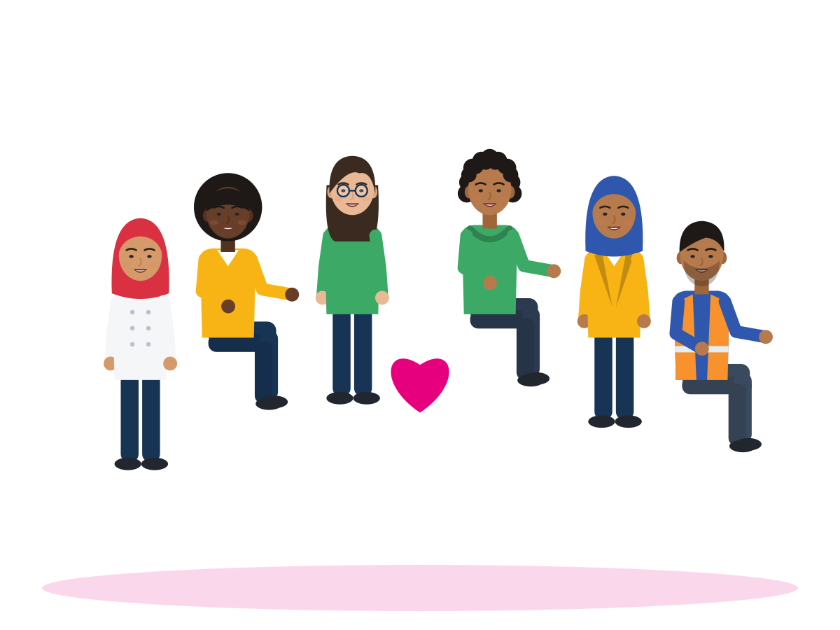



OPENING RITUAL
Agreement Ritual: how we want to be together
TIME
10 min
STEPS
Read the three starters on the wall: “We listen to understand”, “We honour silence”, “We speak from lived experience”.
Each person writes one more agreement on a sticky note, in any language.
Read it aloud, or ask a neighbour to read it for you.
Agree on 5-7 rules. Two are always there: “You can always pass” and “What is personal stays in the room”.
Everyone signs the poster or adds a symbol or hand-print. It stays on the wall all day.
GROUP
Whole group
MATERIALS
Flipchart, sticky notes, markers
DEBRIEF
GOAL
Shared values for safety, respect and mutual responsibility
Which rule is most important for you today? Why?
Module 2 · Empathy
9
Notes:
Curriculum: at the start of the workshop, participants create a shared "agreement ritual" using prompts such as "We listen to understand" or "We honour silence"; the group establishes the common values it shares for communication. "We speak from lived experience" is the third statement the curriculum gives under "Creating a safe space".
Model consent from the first minute: "You can always say pass. You never have to tell your story here."
Point back to the poster later, especially in 2.2 (barriers) and before the storytelling circle in 3.3.
Tip: if writing is hard for someone, a drawing or a symbol is a full contribution.

Slide 10
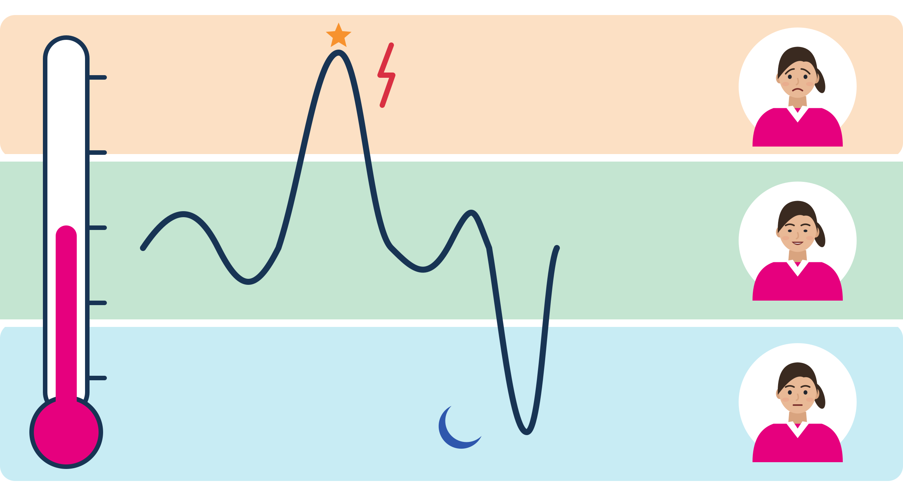
CHECK-IN · SAFETY THERMOMETER
How are you arriving today?
Where are you now?
Too much
Too much: heart racing, irritated or panicky. It is hard to think or to listen.
Inside my window: I can think and feel at the same time. I am ready to learn.
Too little: numb, tired or far away. I want to switch off.
Inside my window
Too little
Up: more alarm, stress goes up. Down: less energy, shutting down.
Source: SMILE curriculum: safety thermometer (optional tool) · window of tolerance (Siegel, 1999)
Module 2 · Empathy
10
Notes:
Say: "Inside our window we can think and feel at the same time. Above it we panic or get angry, below it we go numb. Both are normal reactions to stress, not weakness."
How to run (3 min): everyone shows a number with their fingers (1 = too little, 3 = inside my window, 5 = too much) or puts a dot on a printed thermometer. No explanations needed. Repeat after Unit 2 and at the end as the check-out.
Anyone at the extremes gets a quiet, private check-in during the next activity, never a public question. Offer grounding (curriculum: breathwork, movement, sensory objects such as textured fabrics): a few slow breaths, standing up, holding a textured object.
Background: the window of tolerance (Siegel, 1999); above it hyperarousal (panic, irritability), below it hypoarousal (numbing, withdrawal), as summarised by Psychology Tools. The curriculum lists the safety thermometer as a visual tool for check-ins, pacing and grounding.
The picture: the green band is the window. The line shows a day that mostly stays inside it, with one moment of too much and one of too little. The thermometer on the left is the 1 to 5 finger scale.

Slide 11

ACTIVITY
Object Stories: a moment of being understood
TIME
12 min
STEPS
Choose an object that represents “being understood”. Bring one, or pick one from the table.
Think of a small, everyday story you are happy to share in a training room.
In pairs, share the story behind the object: 3 minutes each.
The listener asks one question and says one thing they noticed. No advice.
Swap roles.
GROUP
Pairs
MATERIALS
Objects participants bring, or a table of neutral objects: a key, a cup, a scarf, a map
DEBRIEF
GOAL
Remember how empathy feels from the inside
What did the listener do that made you feel understood?
How did empathy feel in that moment?
Module 2 · Empathy
11
Notes:
Curriculum (Unit 1 activity): participants bring or choose an object that represents "being understood" and share the story behind it in pairs, exploring how empathy felt in that moment. It creates an atmosphere of vulnerability, trust and relational depth.
Trauma tip: objects can trigger memories of loss. Before starting, say: "Choose a story you are comfortable sharing here. A small, everyday story is perfect." Provide neutral objects so nobody has to bring a personal item. Share your own light example first to model length and depth.
Collect the listener behaviours from the debrief on a flipchart ("looked at me", "did not interrupt", "asked a question"). This is the first draft of the Active Listening checklist in Unit 3.

Slide 12
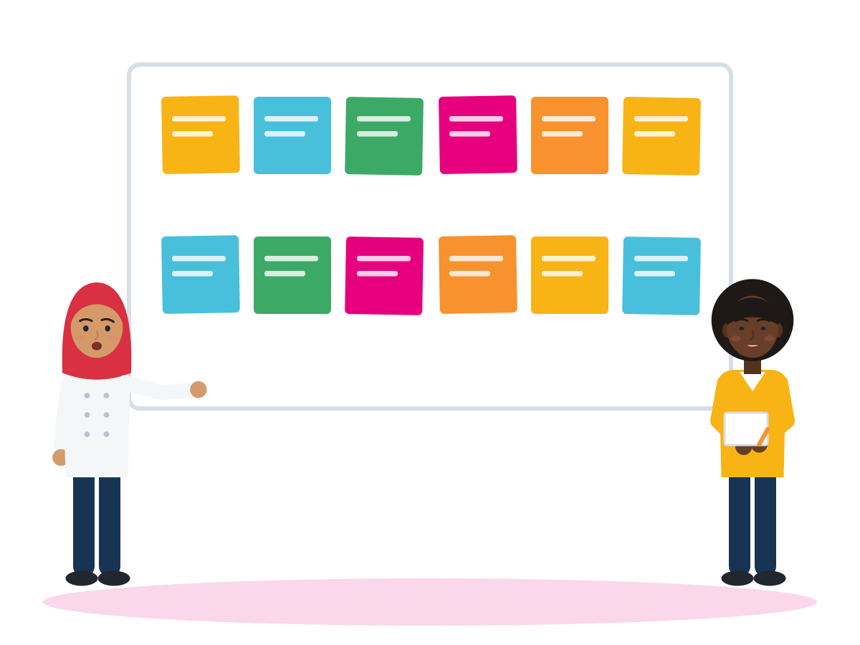
ACTIVITY · 1.1 DEFINING EMPATHY
Empathy Brainstorming Wall
TIME
12 min
STEPS
Write on sticky notes: what does empathy look like? One idea per note, any language.
Put all notes on the wall. Together, group similar ideas.
The trainer introduces the three dimensions (next slide).
Move the notes into three colours: thinking, feeling or responding.
Agree on one shared sentence that starts “For us, empathy means”.
GROUP
Whole group
MATERIALS
Sticky notes in three colours, or Jamboard or Miro
DEBRIEF
GOAL
Co-create a working definition of empathy
Which dimension do you use most often?
Which one do you find more difficult?
What does empathy look like at a border crossing?
Module 2 · Empathy
12
Notes:
Curriculum 1.1: participants co-create a working definition of empathy through a shared Empathy Brainstorming Wall (sticky notes or Jamboard). Colour-coded sticky notes help them map their responses visually; a group discussion with the three prompts on the slide follows.
Border-crossing prompt, trauma-informed: let participants answer from a role: the officer, the traveller or the interpreter. Nobody has to speak about their own crossing.
The curriculum asks for examples from migration and intercultural contexts: dealing with bureaucracy, language barriers, misunderstandings within the community. Colour examples: "I imagined how the officer saw my file" (thinking), "I felt my friend's fear" (feeling), "I stayed and translated" (responding).
If Jamboard is not available, use Miro (also named in the curriculum) or paper.

Slide 13



1.1 DEFINING EMPATHY AND ITS CORE COMPONENTS
Three dimensions of empathy
Cognitive: think
Emotional (affective): feel
Ethical: respond
Perspective-taking: seeing from another person's point of view. “The officer has 40 people waiting and rules she did not make.”
Emotional resonance: an emotional echo that builds connection. Your friend is scared before an exam, and you feel it too.
Sensitivity and responsiveness to difference. You translate for a neighbour, but you ask first and let her speak for herself.
Source: SMILE curriculum, Unit 1.1 (citing Smaling, 2007) · LifeComp, S1 Empathy (Sala et al., 2020, Table 2, p. 20)
Module 2 · Empathy
13
Notes:
Say: "Empathy has three parts. Think: I try to understand how you see it. Feel: I let your feeling touch me without taking it over. Respond: I act in a way that respects you and your difference." Use the same three colours as on the wall.
EU wording (LifeComp S1): empathy is "The understanding of another person's emotions, experiences and values, and the provision of appropriate responses". Council of Europe (RFCDC, 2018, Vol. 1, p. 48): "Empathy is the set of skills required to understand and relate to other people's thoughts, beliefs and feelings, and to see the world from other people's perspectives".
Evidence: in a study of 265 adults, cognitive empathy and empathic concern predicted sensitivity to injustice for others, while emotional empathy did not (Decety & Yoder, 2016). Feeling matters, but thinking and caring guide fair action.
Reference note: the curriculum cites Smaling (2007). The chapter exists (Analecta Husserliana vol. 94, Springer; Crossref dates it 2006), but its text could not be checked, so do not quote it directly. The curriculum calls the second dimension "Emotional"; many sources say "affective". It is the same idea.

Slide 14




1.2 EMPATHY AND SYMPATHY: TWO CONTRASTING SCENARIOS
Same news, two answers
Dawit · scene 1 My diploma is not recognised here. Four years of study, and now it doesn't count.
Youth worker A Oh, poor you. But at least you are safe now. You should be happy with any job.
Dawit · scene 2 My diploma is not recognised here. Four years of study, and now it doesn't count.
Youth worker B You studied for four years and now it doesn't count here. That must be very frustrating. What would help you most?
Invented scenario. In small groups: which answer is sympathy, which is empathy? Use the six-question checklist.
Module 2 · Empathy
14
Notes:
Curriculum 1.2: using two contrasting scenarios, small groups use a checklist to identify the key distinctions, followed by a whole-group discussion. A short comic strip or role-play shows one character responding with sympathy and the other with empathy. Let two volunteers read this as a mini role-play.
Checklist for the groups (5 min). Does the answer (a) try to see the situation from the other person's side? (b) avoid judging? (c) recognise a feeling? (d) show that the feeling was understood? (e) start with "at least"? (f) jump to advice, or to "you should be grateful"? Items a-d are signs of empathy; e and f are signs of sympathy at a distance.
Grounding: 3 in 4 people with a diploma from outside the EU have never asked for it to be recognised (75.1%; Eurostat lfso_21educ02, 2021), and 41.4% of employed non-EU graduates work below their education level (Eurostat lfsa_eoqgan, 2025). Dawit's situation is common.

Slide 15
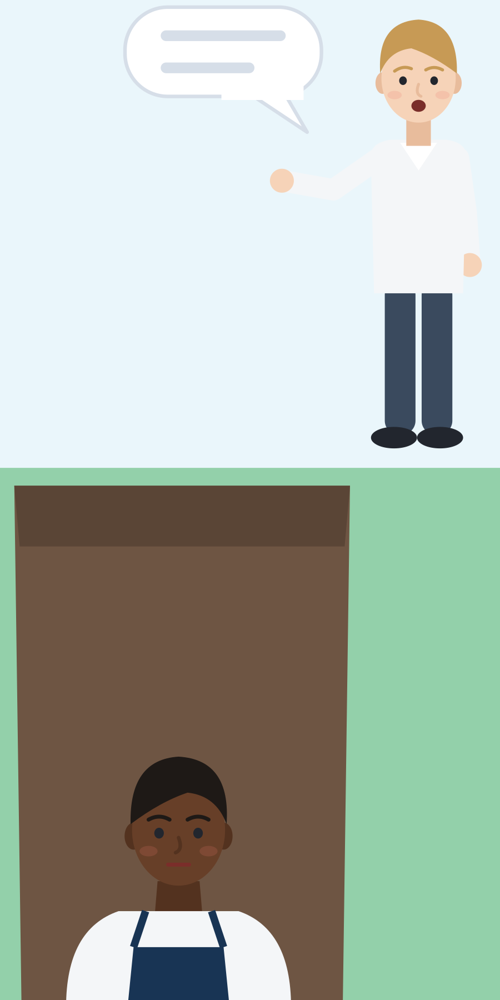
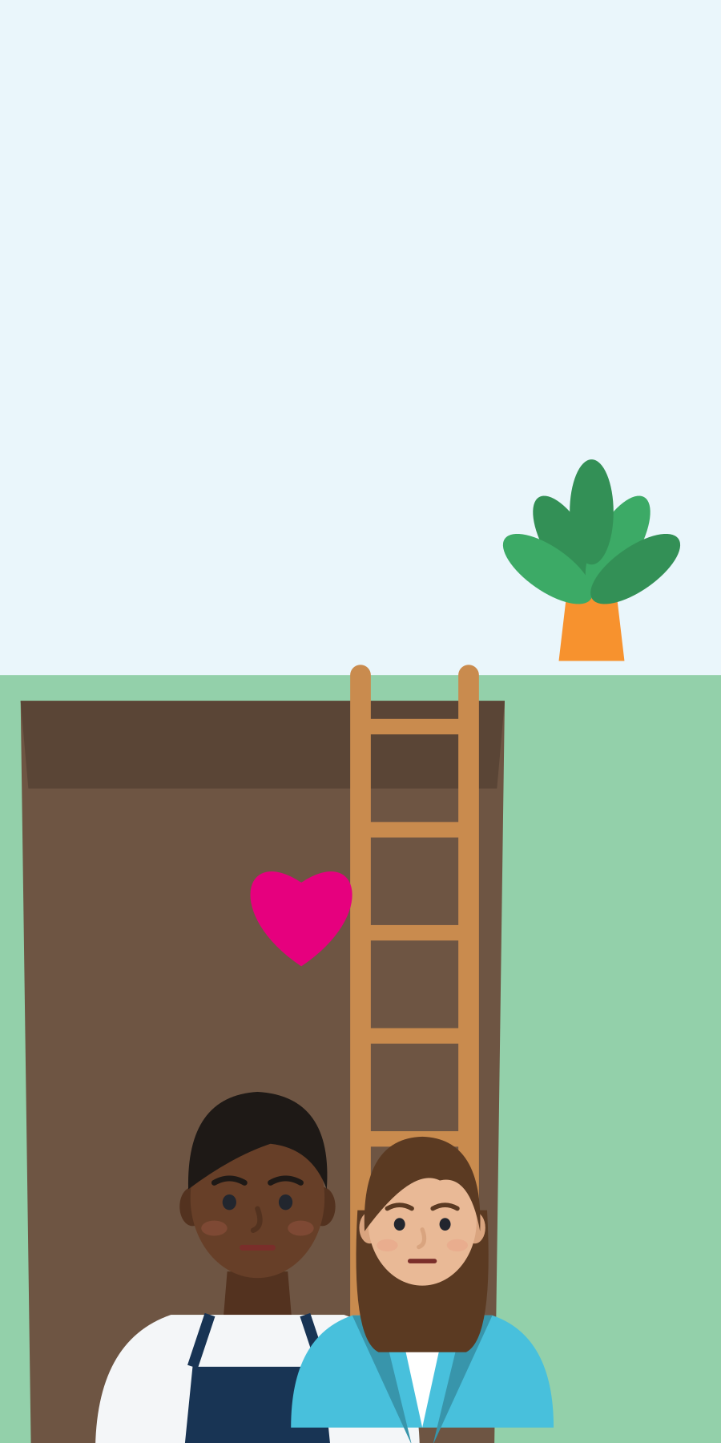
1.2 EMPATHY AND SYMPATHY: WHAT IS THE DIFFERENCE?
Feeling sorry for, or feeling with?
Sympathy at a distance
Empathy
Looks at the problem from outside.
Starts with “At least”.
Judges, or jumps to quick advice.
“You should be grateful.”
Tries to see it from the other person's side.
Does not judge.
Names the feeling: “That sounds really hard.”
Stays with the person: “Tell me more.”
Khader's critique: sympathy can stay outside and moralise. Empathy needs depth, goes both ways and asks why the injustice happens.
Source: Khader (2018), Metaphilosophy 49(1-2), 13-26 · SMILE curriculum, Unit 1.2
Module 2 · Empathy
15
Notes:
Say: "In everyday English, sympathy often means feeling sorry for someone from a safe place. Empathy means trying to feel and understand with them."
Khader input as the curriculum presents it: sympathy is criticised as an external and moralistic approach, while empathy has depth and reciprocity. Khader's own abstract goes further: rights violations are caused "not only by empathy deficits; they are caused also by empathy excesses toward some people and savior mentalities that can coexist with empathy". So empathy needs an analysis of what causes injustice. We return to this in 2.2.
The pictures: Dawit is in a hard place. Youth worker A talks to him from above, at a safe distance; youth worker B climbs down and stays with him. Ask the group which picture matches which answer from the dialogue.
Words differ between authors: the Council of Europe uses "sympathy" for "compassionate empathy" or "empathic concern", a positive part of empathy (RFCDC, 2018, Vol. 1, p. 48). Teach the behaviours, not a fight about vocabulary.
The curriculum places the Brené Brown video in 1.3. It also fits here, after the groups have found the difference themselves. Watch it yourself first and adapt the checklist to what it actually shows.

Slide 16
1.2 REWRITE THE SYMPATHETIC RESPONSE
Rewrite it: from “at least” to “I hear you”
SYMPATHETIC ANSWER
MORE EMPATHIC ANSWER
“At least you have a job.”
“That sounds exhausting. What is the hardest part?”
“Don't worry, everyone has problems with papers.”
“Waiting for papers is really stressful. What do you need first?”
“You should just ignore your boss.”
“It sounds like you felt ignored. Do you want to talk, or do you want ideas?”
“I know exactly how you feel.”
“I can't fully know what this is like for you, but I want to understand.”
Module 2 · Empathy
16
Notes:
Curriculum 1.2: participants rewrite the sympathetic response to make it more relational and emotionally attuned.
How to run (5 min): pairs cover the right column and write their own version first, then compare. There is no single right answer. Check with the four signs: the other person's side, no judgement, feeling named, understanding shown.
The last line is the curriculum's move "from projection to presence": "I know exactly how you feel" projects my story onto you; "I can't fully know, but I want to understand" stays present with you. LaCapra (2014), cited by the curriculum in 2.3, calls a similar attitude "empathic unsettlement": being moved without claiming the other person's experience (as described by Koopman, 2010).
Tip: let participants write the empathic line in their own language first, then translate.

Slide 17
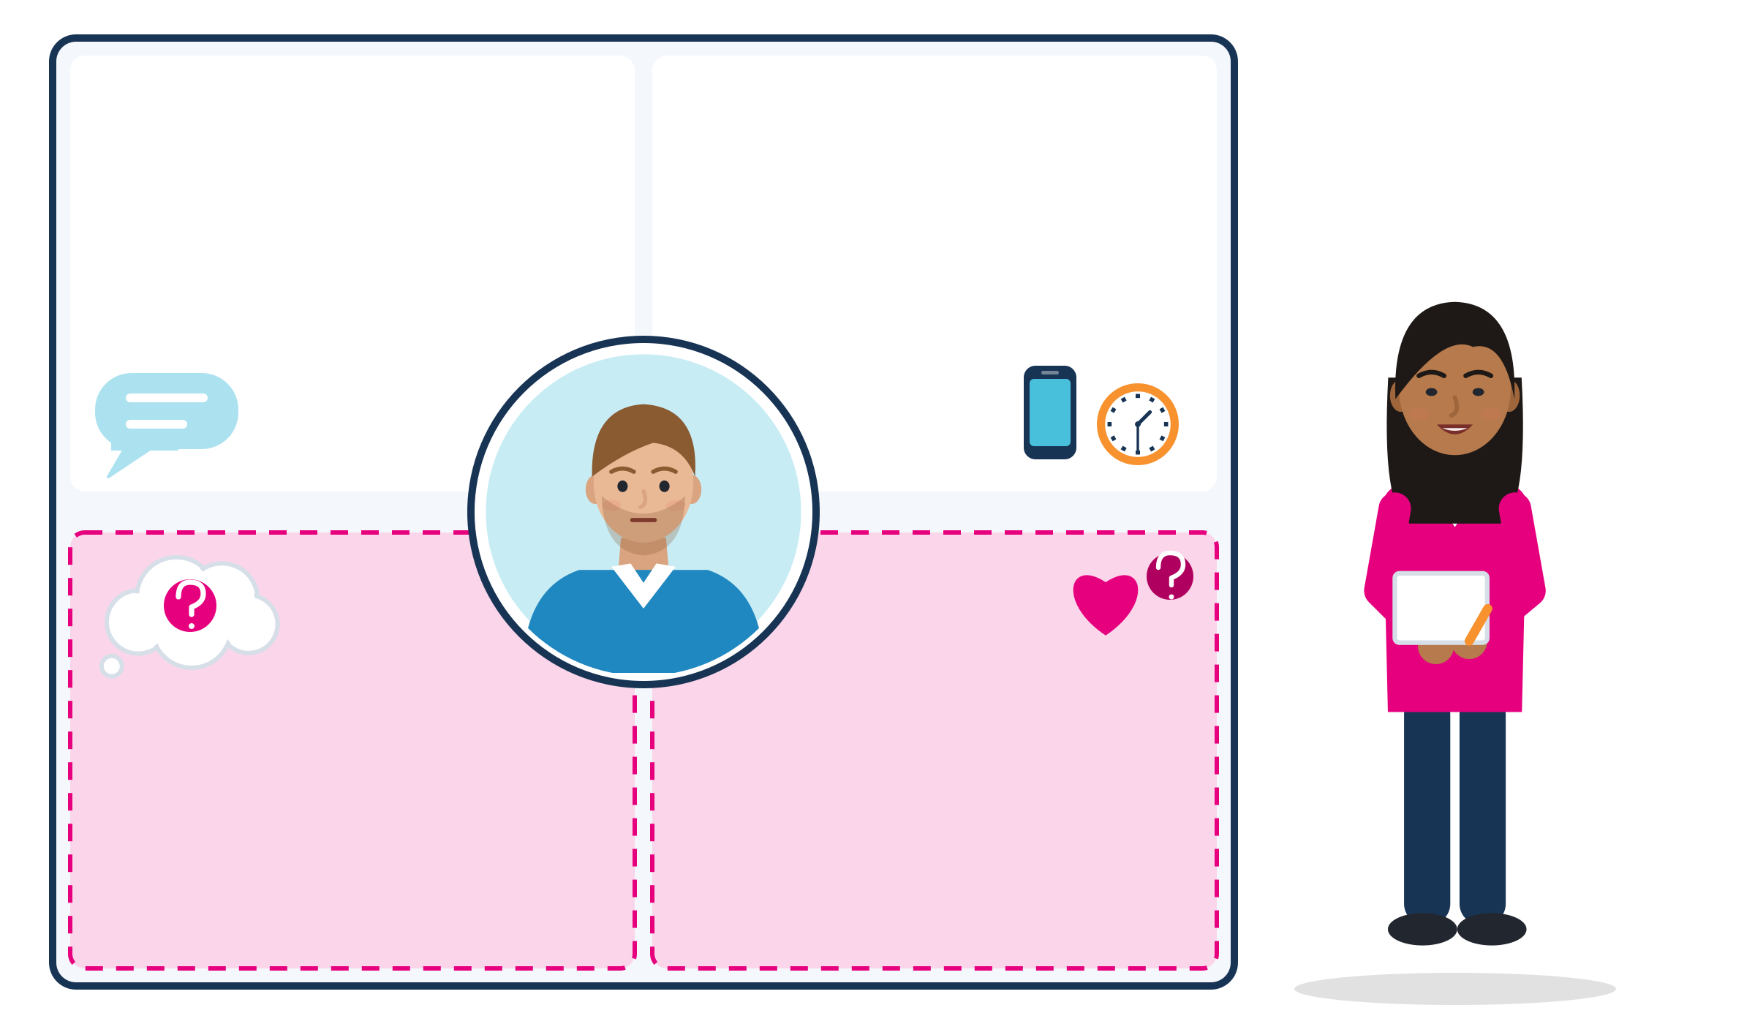
1.2 EMPATHY MAP WORKSHEET
Empathy Map: observe first, then guess
Says (observed)
Does (observed)
Then talk
Checks his phone all the time. Works through his break.
“We are short of people this week.”
Start with the goal: what does this person need? (Finish the week without accidents.)
Add: what does the person see and hear?
Then choose your words: “I know this week is very busy. Can we talk for two minutes about my shifts?”
Thinks (a guess?)
Feels (a guess?)
“Head office will blame me for every mistake.”
Pressure. Fear of accidents. Tired.
Invented example: Leyla maps her shift manager before she asks about her shifts.
Source: Gray (2017), Updated empathy map canvas, XPLANE (Gamestorming toolkit) · example invented
Module 2 · Empathy
17
Notes:
Curriculum 1.2: an Empathy Map worksheet is used to explore each character's inner world, helping participants move "from projection to presence". The materials list describes it as mapping what a person might think, feel, say and do.
Key idea from the creator of the tool: thoughts and feelings "can be guessed or inferred but never observed" (Gray, 2017). So we fill the observable boxes first and mark every guess with a question mark.
How to run (8 min): pairs choose a character from the two scenes (Dawit, youth worker A or B) and fill the worksheet: says, does, sees, hears, then thinks, feels and needs. The example on the slide (invented): Leyla changes her opening from "You always give me the worst shifts" to a request that fits her manager's pressure.
The picture: the top half (white) is what Leyla can see and hear; the bottom half (pink, dashed) is only her guess about her manager. The manager is in the middle, Leyla stands outside the map.
Tip: the map is also a tool for difficult conversations at work. Participants can use it before they talk to a supervisor, a landlord or an office.

Slide 18
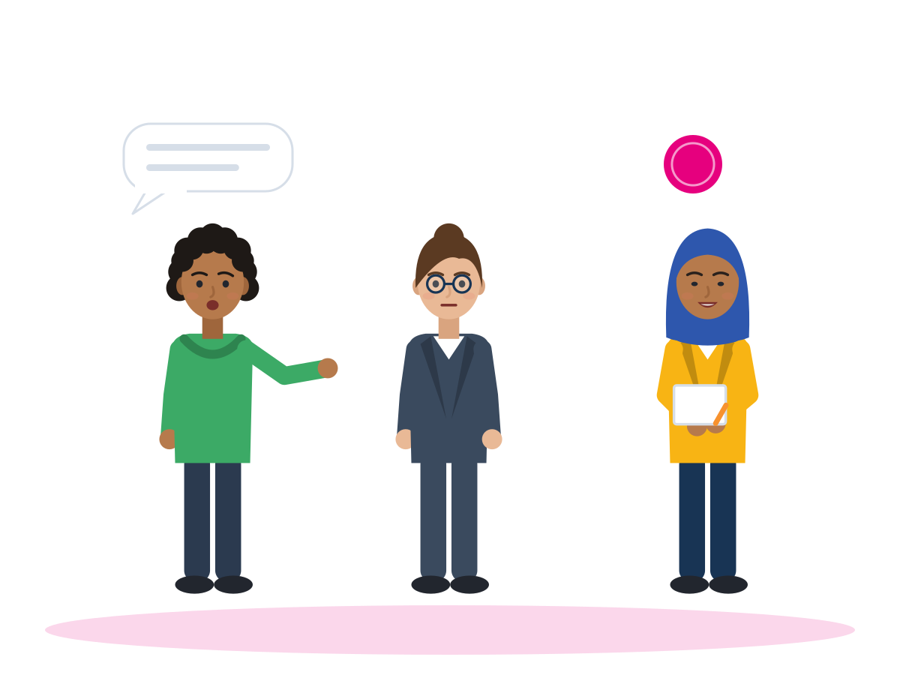
ACTIVITY · 1.3 EMPATHY IN COMMUNICATION AND TEAMWORK
Empathy Relay: listen, paraphrase, validate
TIME
10 min
STEPS
Person A talks for 2 minutes about a small, current challenge: finding a room, a difficult shift, a hard course.
Person B listens in silence. No questions, no advice.
B paraphrases in their own words: “So, if I understand you correctly, the main problem is the rent.”
B names the feeling carefully: “It sounds like you feel worried. Am I right?”
A says what B got right. Then swap roles.
GROUP
Pairs
MATERIALS
Timer, phrase cards (“So, if I understand you correctly”, “It sounds like”)
DEBRIEF
GOAL
Listen without interrupting and show the other person they were understood
What felt easy, and what felt difficult?
What made it safe for you to share?
What made you hesitate?
Module 2 · Empathy
18
Notes:
Curriculum 1.3: in pairs, one person shares a personal challenge while the other listens silently, then paraphrases what was said in their own words and validates the emotional content. Roles are swapped. A group debrief explores what felt easy and what felt difficult.
Keep the challenge small and current, never a migration story. If someone prefers, they can talk about an invented character's challenge.
Language tip: pairs can choose a shared language for the telling and use English only for the paraphrase, or the other way round.
Validating is not agreeing: "It is possible to empathise with someone, and still disagree with their attitudes or values" (LifeComp, Sala et al., 2020, p. 46).

Slide 19
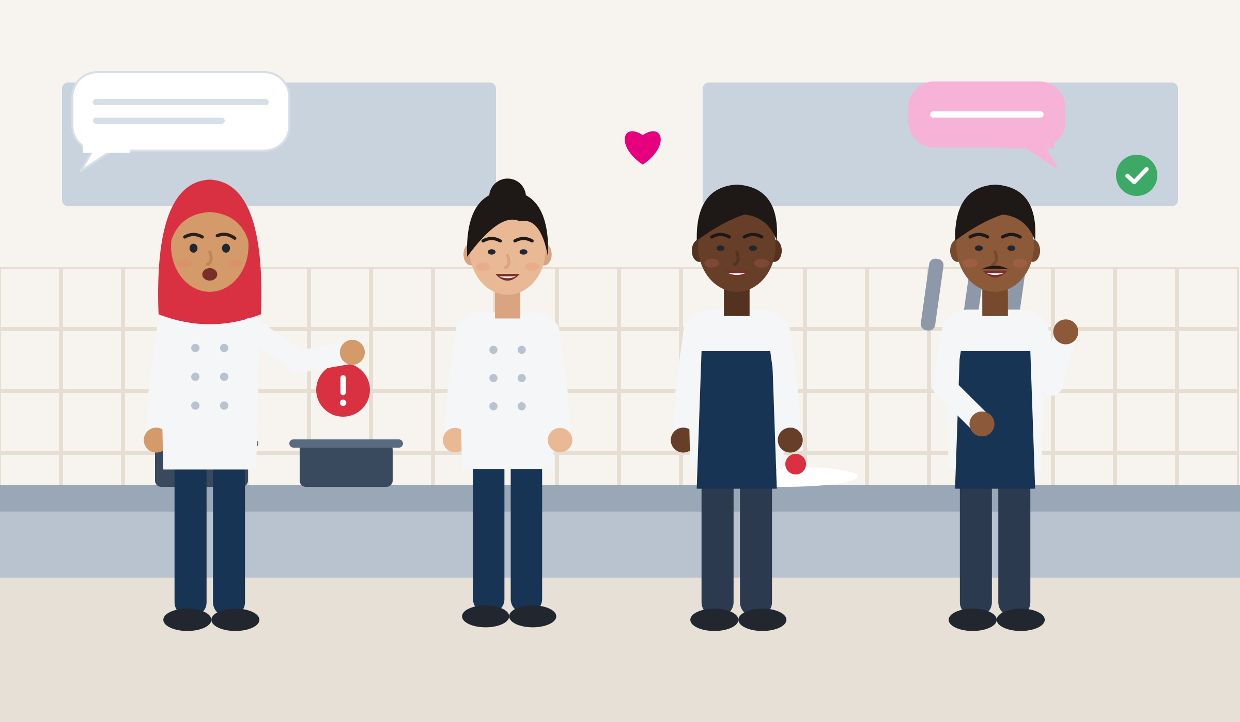
1.3 THE ROLE OF EMPATHY IN COMMUNICATION AND TEAMWORK
At work, trust comes before teamwork
Speak up early
Listen and check
Safe to speak: people report a mistake or a problem early when they expect to be heard.
Intercultural teams: a different style is not a bad intention. Ask before you judge.
Handovers and feedback: summarise and check. “So the main point is the new machine, right?”
Empathic leaders: employees with highly empathic senior leaders more often said they were engaged (76% vs 32%) and innovative (61% vs 13%).
Watch: The Power of Empathy (Brené Brown, RSA Short, about 3 minutes, subtitles on). Which answer felt close, which felt distant?
Source: Van Bommel (2021), Catalyst, survey of about 900 US employees (correlational) · Royal Society of Arts (2013), Brené Brown on empathy [video]
Module 2 · Empathy
19
Notes:
Curriculum 1.3: the facilitator links the Empathy Relay to workplace collaboration, trust-building and intercultural teamwork. Brené Brown's "Power of Empathy" video supports the discussion with accessible language and emotional clarity.
Video facts: the curriculum link (youtube.com/watch?v=1Evwgu369Jw) works; YouTube titles it "Brené Brown on Empathy" (RSA). The original animation runs 2:53. The curriculum calls it "Power of Empathy" in 1.3 and "The Power of Empathy" in its materials list: it is the same video. Watch it yourself before the session, and do not claim more about where its ideas come from than you can check.
Use the numbers carefully: the Catalyst figures are correlational and come from US employees. The curriculum cites this research as "Harvard Business Review (2021). Empathy Is the Most Important Leadership Skill", but that article is a Forbes column (Brower, 19 Sept 2021) reporting the Catalyst study (Van Bommel, 2021). The Center for Creative Leadership also found that managers seen as more empathic by their teams were rated as better performers by their bosses (6,731 managers, 38 countries; Gentry, Weber & Sadri, 2016); the reasons were not evaluated.
The picture: a kitchen team at the start of a shift. Amira points out a problem at the stove, the supervisor listens and checks what he heard. Ask: what makes it safe for Amira to speak?
Teamwork is everyday work: more than 8 in 10 workers in Europe work in a team at least sometimes, and 3 in 4 deal with clients or customers (Cedefop, European Skills and Jobs Survey, 2021 data).

Slide 20
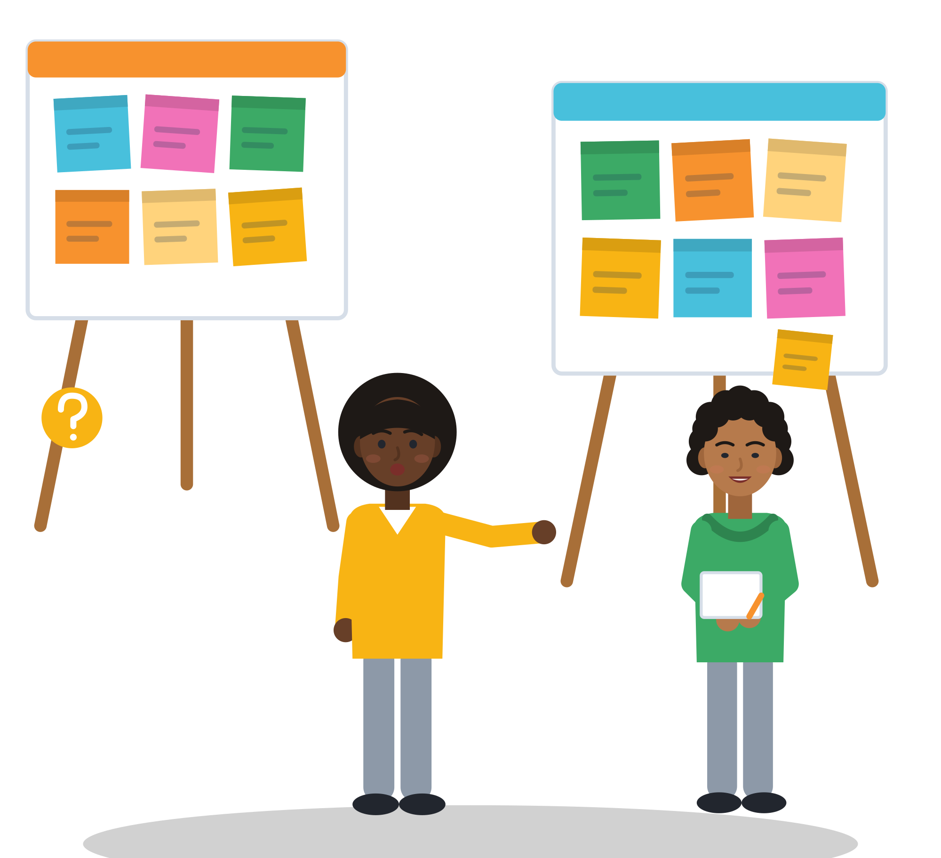
02
UNIT 2 · ≈ 50 min
Empathy in Diverse Settings
Layered identities, bias, stress and history: what blocks empathy, and how to communicate ethically across difference.
Mini case studies
Empathy Onion
Gallery Walk
Pause and Rewind
Module 2 · Empathy
20
Notes:
Unit 2 explores empathy as a tool for navigating cultural differences, layered identities and systemic barriers. Participants examine how bias, stress and colonial legacies can hinder empathy, and practise communicating ethically across difference.
Suggested timing (not in the curriculum): mini case studies 8 min, 2.1 Empathy Onion and layer dialogue 14, 2.2 Gallery Walk and input 14, 2.3 Pause and Rewind 14. Repeat the safety thermometer at the end of this unit.

Slide 21
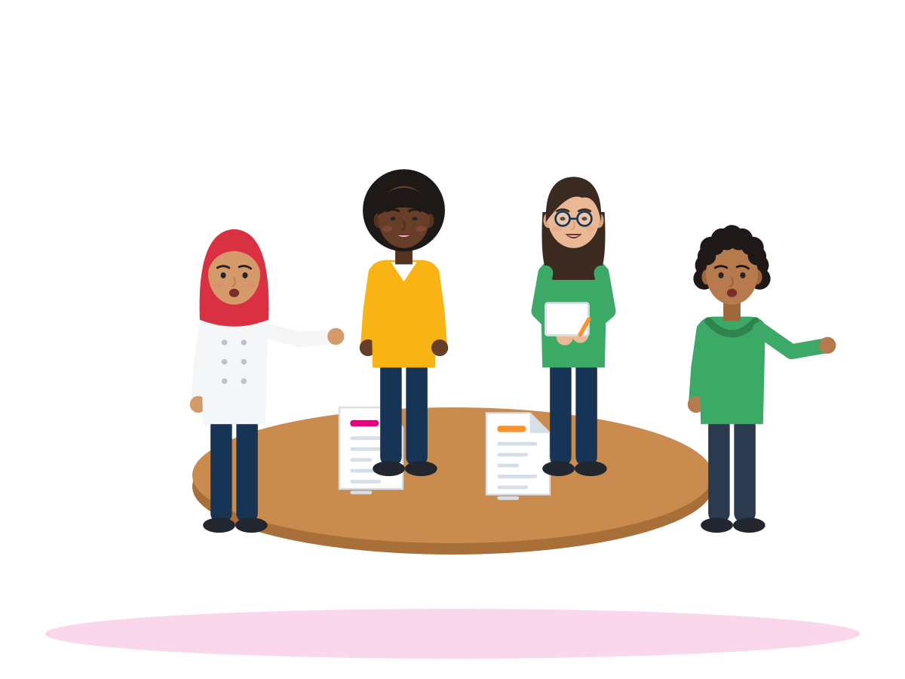
ACTIVITY · UNIT 2
Mini case studies: what blocks empathy here?
TIME
8 min
STEPS
Each group reads one case card. An example is on the next slide.
Who feels what? Name at least two people in the story.
Which blocker do you see: bias, miscommunication or stress?
Which need is not met: safety, respect, information, belonging or choice?
Propose one empathic response, from any person in the story. Share it in one minute.
GROUP
Groups of 3-4
MATERIALS
Case cards: short, anonymised stories (invented cases are marked)
DEBRIEF
GOAL
Find empathy blockers and unmet needs
Which needs were overlooked most often?
Which response would really change the situation?
Module 2 · Empathy
21
Notes:
Curriculum (Unit 2 activity): short, anonymised real-world stories from young migrants are presented to analyse empathy blockers (bias, miscommunication, stress). Participants identify unmet needs and propose empathetic responses.
Where the cases come from: this deck uses only documented facts, so the case cards are constructed scenarios grounded in published reports (AIDA/ECRE country reports, FRA surveys) and clearly marked as invented. Never ask participants to give their own case as material.
Suggested cards: the bureaucracy case (next slide), the stressed supervisor (2.3), the customer angry at an accent (3.2 phrases notes), the volunteer who takes over (2.2 notes).
The needs question prepares the Gallery Walk prompt "Which needs are being overlooked?" in 2.2.

Slide 22


ILLUSTRATIVE SCENARIO
No number, no job. No job, no number.
Ibrahim, 22
Recognised as a refugee last month, Athens
DISCUSS
What does each person feel: Ibrahim, the officer, the employer?
Which needs are not met?
Is the problem a person, or the system?
What would a fair, empathic response look like from each of them?
Bureaucracy
Greece
Job offer
Ibrahim has a job offer. The employer needs his social security number (AMKA). The officer says: “I can only activate it with proof of employment.” The employer cannot hire him without the number. He must leave the camp within 30 days, and the interpreter service has stopped. The officer has 40 people waiting.
Grounded in: since Dec 2023 the AMKA needs proof of employment; support ends 30 days after recognition; camp interpretation stopped in July 2025 (AIDA Greece 2025 Update).
Module 2 · Empathy
22
Notes:
Illustrative scenario (constructed), grounded in the AIDA Country Report Greece, 2025 Update (GCR/ECRE, July 2026): AMKA activation for adult beneficiaries requires proof of employment under a Joint Ministerial Decision of 14 Dec 2023 (pp. 25, 219); reception conditions end within 30 days of a positive decision (p. 196); METAdrasi halted camp interpretation in early July 2025 (p. 197). The curriculum itself names "bureaucracy in Greece" as a localised example.
More facts from the same report: 62% of asylum-applicant households surveyed in 2022-2024 had no bank account; 87% had a tax number (AFM), but 35% needed help to get it (p. 221). The European Commission referred Greece to the EU Court of Justice over the AMKA rule in November 2025 (pp. 25, 219).
Key message: empathy here means seeing the system behind the person, and also understanding the officer who works inside the same system. Concrete empathic responses: the officer writes down the exact document needed; the employer writes a letter of intent.
Come back to this case after the Empathy Onion: which ring causes the problem?
The picture: Ibrahim at the counter of the citizens' service centre, with the job offer in his hand. The arrows show the loop: no number without a job, no job without a number. The calendar stands for the 30 days.

Slide 23
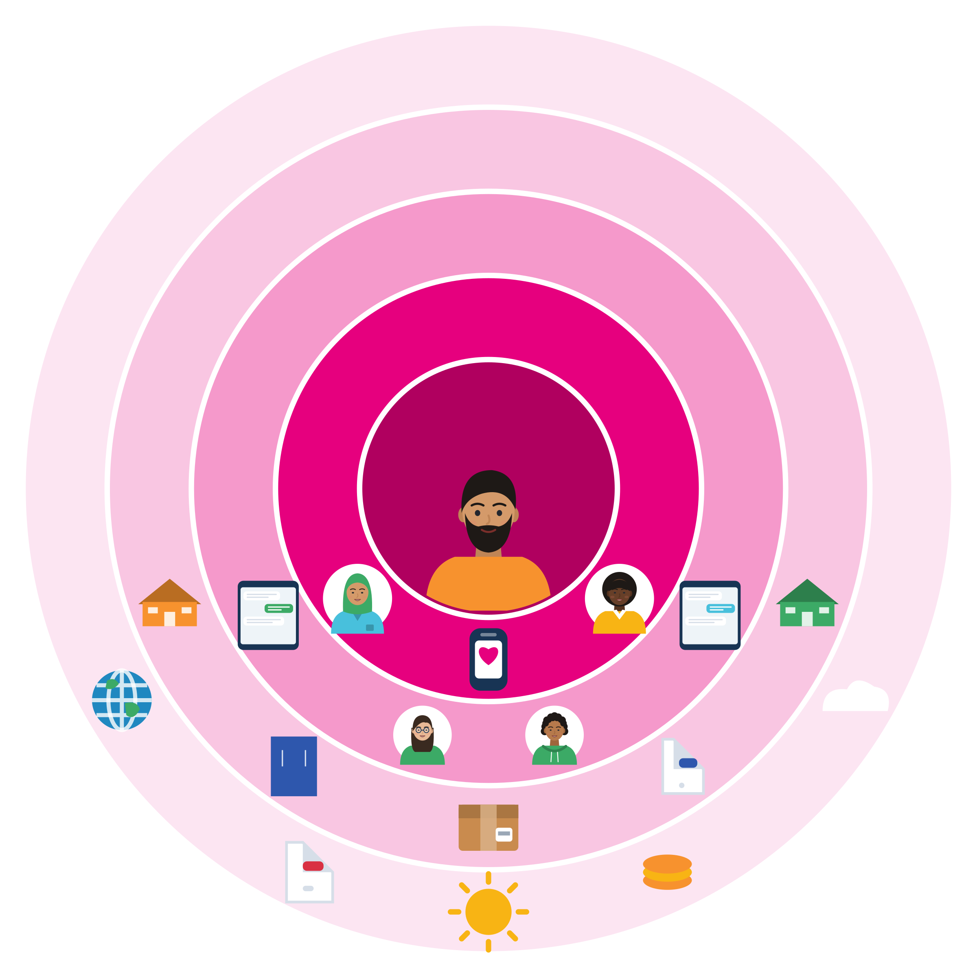
2.1 CULTURAL SENSITIVITY AND PERSPECTIVE-TAKING
The Empathy Onion: the circles that shape us
World/earth
From the inside out
Community
Individual: my body, feelings, languages, beliefs and story.
Family: the people who raised me, or who are like family to me, here and far away.
Social network: friends, classmates, colleagues, online groups.
Community: neighbourhood, cultural or religious groups, school, workplace, local offices.
World/earth: laws, history, the economy, news, climate, war and peace.
Social network
Family
Individual
Source: SMILE curriculum, Unit 2.1 (KEAN) · related model: Bronfenbrenner's ecological systems (Bronfenbrenner, 1994)
Module 2 · Empathy
23
Notes:
The Empathy Onion is the curriculum's own visual tool; no published model with this name was found, so present it as the SMILE tool. Its theoretical parent is Bronfenbrenner's ecological model: microsystems (family, peer group, workplace), the links between them (mesosystem), settings we are not in but which affect us (exosystem, e.g. a parent's workplace or an office), the macrosystem ("a societal blueprint" of beliefs and opportunity structures) and the chronosystem ("change or consistency over time") (Bronfenbrenner, 1979; 1994).
Say: "To understand someone, look at their circles too. A behaviour that seems rude at work may be shaped by family duties, community rules, the asylum system or news from home." Invented example: Omar sends half his wage home, waits for an asylum interview and has just seen bad news from his city. A colleague who sees only the inner circle thinks he is "always tired and grumpy". Time matters too: the same person changes after a year in a new country.
The picture: Omar in the centre; family (also on the phone, far away), friends and chats, the neighbourhood, school, work and offices, then news, money, climate and the wider world.
Curriculum notes: 2.1 names the outer layer "world/earth", the materials list says "world". The curriculum cites Zembylas (2018) here: empathy education should be decolonising, aware of history and power, not only of individual feelings.
Evidence that perspective-taking can be practised: in mixed Turkish-Syrian classrooms in Şanlıurfa and Mersin, a weekly perspective-taking curriculum reduced peer violence by more than 60% and ethnic segregation by 15-21% (Alan et al., 2021, cluster RCT; children aged 8-12, not young adults).

Slide 24


2.1 A DIALOGUE BETWEEN TWO LAYERS
My community self speaks to my individual self
Community self In our community, we don't talk about feelings with strangers.
Individual self But I want my supervisor to know why I am so tired this month.
Community self People will think you are weak.
Individual self Maybe. But staying silent makes me feel alone at work.
Community self Then choose your words, and choose who you tell.
Invented example. Your turn: draw your onion, then write 4-6 lines between two of your layers. Any language. Share only what you want.
Module 2 · Empathy
24
Notes:
Curriculum 2.1: participants draw their own onion diagrams and reflect on how each layer shapes their identities, relationships and empathetic responses. To deepen it, they write a short dialogue between two layers of their identity (the curriculum's example: "My social self speaks to my individual self"), exploring inner tensions and relational insights.
How to run (14 min): 5 min drawing (one word or symbol per ring: what shapes how I see others?), 5 min writing the dialogue, 4 min sharing in trios. Curriculum prompts for the sharing, which focuses on visibility, invisibility and cultural assumptions: "Which layer feels the most misunderstood?" "Where do you feel the most empathy?"
Add a work prompt: "Which layer of your employer or colleague might you not see?"
Trauma tip: the family ring may be painful (separated or lost family). Offer "the people who are like family to me". Drawings stay private unless the person chooses to show them; onion diagrams are evidence of learning in the curriculum, so photograph them only with consent.

Slide 25
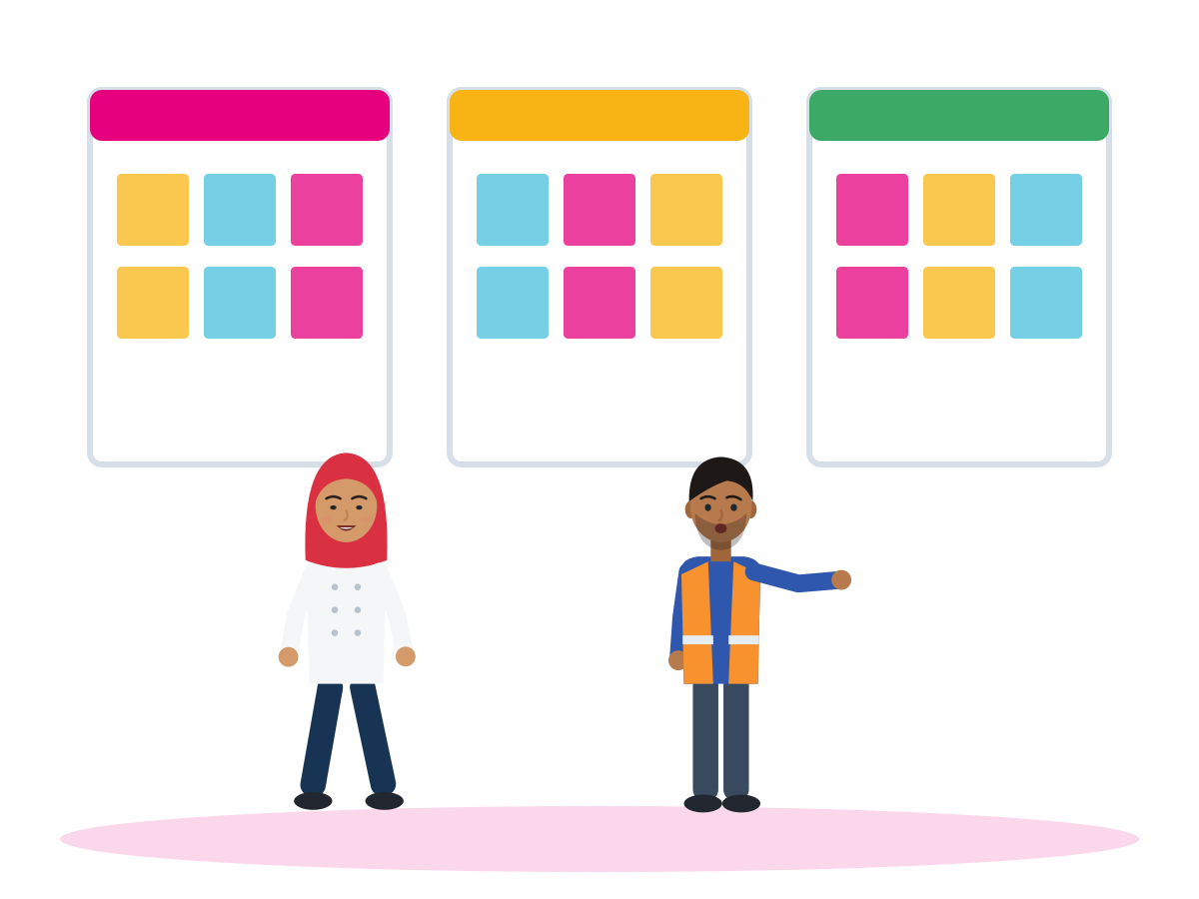
ACTIVITY · 2.2 BARRIERS TO EMPATHY
Gallery Walk: empathy blockers
TIME
14 min
STEPS
In small groups, brainstorm “empathy blockers” you have experienced or witnessed, blocked by you or by someone else.
Send them anonymously by Slido or Mentimeter, or on paper slips.
The trainer sorts them onto posters: bias, stress, miscommunication, power and history, too much empathy.
Walk around the posters. Add sticky notes: “What would empathy look like here?” “Which needs are being overlooked?”
Short input on blockers and empathy excesses (next two slides).
GROUP
Small groups, then the whole room
MATERIALS
Slido or Mentimeter (or paper slips in a box), 4-5 posters, sticky notes
DEBRIEF
GOAL
Turn blockers into ideas for empathic action
How can we move from projection to presence?
What does ethical empathy look like in unequal power dynamics?
Module 2 · Empathy
25
Notes:
Curriculum 2.2: in small groups participants brainstorm empathy blockers they have experienced or witnessed. Responses are collected anonymously via Slido or Mentimeter and displayed in a Gallery Walk; participants add sticky notes with the two prompts on the slide.
Paper slips make it possible to take part without a smartphone or data. Read every slip yourself before it goes on a poster, and remove names.
If a slip describes discrimination or violence, acknowledge it calmly ("This is serious and it is not OK"), do not ask for details in the group, and offer a private talk and the referral list after the session.
Tip: stand back during the walk. Let participants talk to each other first.

Slide 26



2.2 BIAS, STRESS, MISCOMMUNICATION AND COLONIAL LEGACIES
Four empathy blockers, and what they look like
Bias
Stress
Empathy flows easily to “us”. Same CV in Germany: 18.8% got a call-back with a German name, 4.2% with a Turkish name and a headscarf.
Under pressure we leave our “window of tolerance” and stop listening. A stressed colleague is often overloaded, not cold.
Miscommunication
Colonial legacies
“Hard to understand” is partly in the ear of the listener: candidates with a strong accent were rated less hireable, with equally good arguments.
Old hierarchies still shape who is seen as competent. Research describes a stereotype of “the generic immigrant” as incompetent and untrustworthy.
Source: Weichselbaumer (2016), IZA DP 10217, pp. 12, 17 · Siegel (1999) · Roessel et al. (2019) · Lee & Fiske (2006) · Zembylas (2018)
Module 2 · Empathy
26
Notes:
These are the four barriers named in the title of curriculum section 2.2. Use participants' own blockers from the gallery as examples first, then add the evidence.
Bias: "Empathic failure towards out-group members is a well-known phenomenon" (LifeComp, Sala et al., 2020, p. 47). When the other person is from an outgroup, "empathic responses are rare and fragile" (Cikara, Bruneau & Saxe, 2011). Weichselbaumer (2016), 1,474 applications in Germany: the applicant with a Turkish name and a headscarf had to send 4.5 times as many applications to get the same number of interview invitations. Bias also exists between and inside migrant groups: towards other migrant groups, Roma, LGBTQ+ colleagues or locals.
Stress: insecure income, employment, housing and legal status "were consistently associated with poor mental health" (WHO, 2023, p. xv). "Lack of empathy" in a stressed person is often overload, not character.
Miscommunication: three German experiments (Roessel et al., 2019). A US study found that prejudice reduced hiring recommendations through the listener's perceived difficulty in understanding, not actual comprehension (Hansen & Dovidio, 2016). Empathy must go both ways: employers and customers also need to make the effort.
Colonial legacies and cultural hierarchies (Learning Outcome 2): when people learn concrete details about a person (nationality, class), the picture becomes mixed rather than uniformly negative (Lee & Fiske, 2006). Knowing a person beats knowing a label.

Slide 27
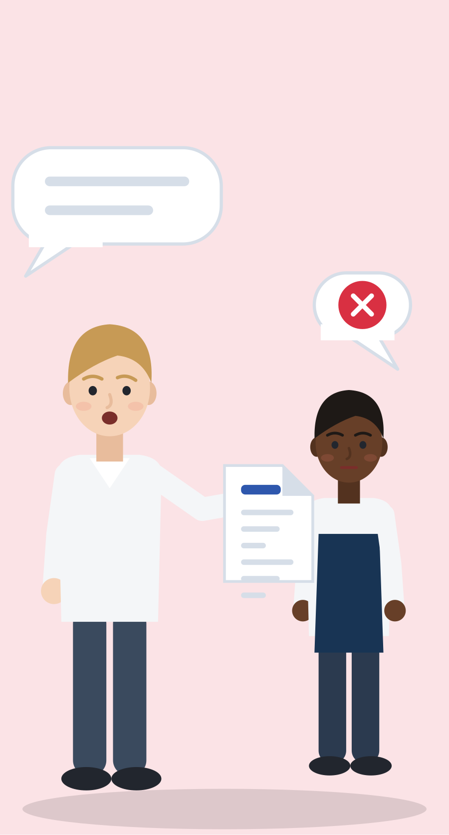

2.2 EMPATHY EXCESSES AND SAVIOUR MINDSETS
Too much, or the wrong kind: when empathy goes wrong
When empathy goes wrong
Ethical empathy
Over-identification: “I know exactly how you feel.” I stop listening.
Empathic distress: I sink into your pain and want to escape.
Strong feelings for some people, none for others.
Saviour mindset: I decide for you, speak for you and need your thanks.
“I can't fully know, but I want to understand.”
Compassion: I feel for you and stay steady.
“What would you like to happen? It's your decision.”
I share power and help you need me less.
WHO: “Don't take away the person's strength and sense of being able to care for themselves.”
Source: Khader (2018) · Singer & Klimecki (2014), Current Biology, pp. R875, R878 · WHO, War Trauma Foundation & World Vision International (2011), Psychological First Aid, p. 15
Module 2 · Empathy
27
Notes:
Curriculum 2.2: the facilitator introduces empathy excesses (e.g. over-identification), saviour mindsets, and structural bias and miscommunication. This is Learning Outcome 4: awareness of power and no "saviour" mindset. The curriculum cites Khader (2018) and Marino (2022) here.
Feel with vs feel for: "Compassion is feeling for and not feeling with the other." Empathic distress "results in negative feelings and is associated with withdrawal" (Singer & Klimecki, 2014). This is also an occupational-health message for young people going into care, interpreting and social work: compassion fatigue is reported "across all practitioner groups studied" (Cavanagh et al., 2020).
Illustrative scenario (constructed) for discussion: at an NGO in Istanbul, volunteer Elif (27) books a course for Hamid (20), calls employers for him and tells his story at a fundraising event, all without asking him. Rewind: "What would you like to do? Do you want your story told, and how?" Cole (2012): "those who are being helped ought to be consulted over the matters that concern them".
The pictures: on the left, youth worker A holds Dawit's papers and talks for him; on the right, youth worker B stands next to him while he holds the pen and speaks for himself.
It works in both directions: a young migrant who becomes a peer mentor can also slip into the saviour role ("because I have been through it"). Switch to: "What have you tried already?" Second WHO line for the flipchart: "Don't think and act as if you must solve all the person's problems for them" (p. 15).

Slide 28


ILLUSTRATIVE SCENARIO
Too slow, in front of everyone
Ahmed, 21
Packer in a logistics centre near Milan, peak season
PAUSE AND REWIND
Pause: what is said, and what is felt, by Paola and by Ahmed?
Where is the power in this scene?
Rewind: what could Ahmed say later, in private?
Rewind: how could Paola repair it?
Logistics
Italy
Team conflict
Pre-Christmas peak. Supervisor Paola is short of staff, and head office calls her every hour. In front of the team she shouts at Ahmed: “Too slow! Again!” Yesterday he was trained on a different machine. He feels humiliated and confused, and says nothing. Two colleagues look away.
Grounded in: under pressure people leave their window of tolerance (Siegel, 1999); empathic distress leads to withdrawal (Singer & Klimecki, 2014).
Module 2 · Empathy
28
Notes:
Illustrative scenario (constructed), used as the "workplace misunderstanding" card for the Pause and Rewind role-play. The curriculum names three examples for 2.3: a workplace misunderstanding, a housing dispute, community tension.
Paola is outside her window of tolerance: under pressure, afraid of missing targets. That explains her behaviour; it does not excuse humiliating a worker. Empathy for Paola and a clear request from Ahmed can exist together.
Other cards (invented): a housing dispute in a shared flat for young people in Amsterdam about late-night guests (based on Startblok Riekerhaven, where young Dutch people and refugees aged 18-27 share self-managed corridors; Czischke & Huisman, 2018); community tension about a new youth centre near Thessaloniki (Empathy Lab card).
Tip: Ahmed can prepare with an Empathy Map of Paola (observed vs guessed) before he speaks.

Slide 29
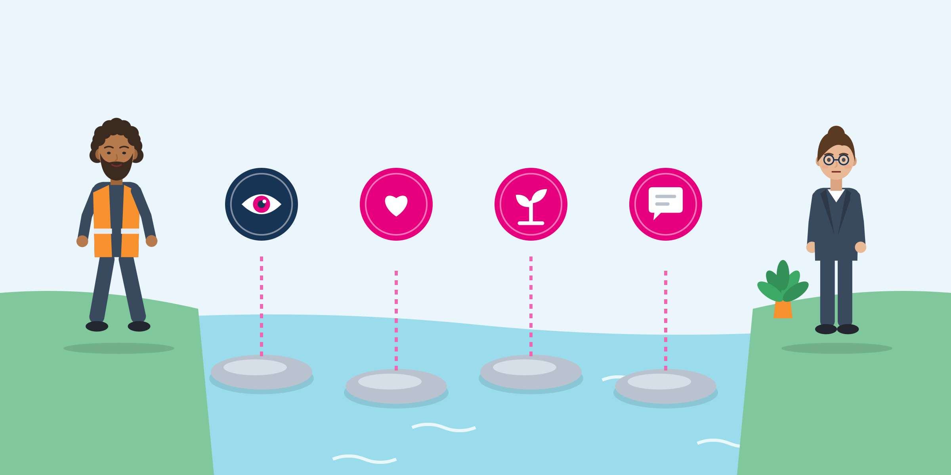
2.3 REFRAMING: A TOOL FOR THE REWIND
Four steps to turn blame into a request
Ahmed, after the rush
Observe, without judging: “This morning you said I was too slow, in front of the team.”
Feel: “I felt embarrassed and confused.”
Need: “I need to understand the new machine.”
Request: “Could someone show me the new machine for five minutes?”
Observe
Feel
Need
Request
Listening version: what did you see, feel and need? What would you like?
Source: Rosenberg (2015), Nonviolent Communication: A Language of Life (3rd ed.): observations, feelings, needs, requests
Module 2 · Empathy
29
Notes:
Nonviolent Communication has four components: observations, feelings, needs and requests. The same four parts can be used to express how you are or to receive empathically how another person is (PuddleDancer Press). This is the "reframing" the curriculum asks for in 2.3.
Listening for the need behind angry words is the core of the curriculum question "Which needs are being overlooked?" Paola's need might be: "finish the orders without mistakes".
Listening version in full: What did you see? What do you feel? What do you need? What would you like?
The picture: four stepping stones from Ahmed's side to Paola's side. Each stone is one step; skipping one makes the crossing harder.
Timing matters: Ahmed does not answer in the heat of the moment. He asks for two minutes in private, after the rush.
Tip: pairs write one four-step sentence about a small, everyday conflict of their choice and read it aloud. Correct the structure, never the grammar.

Slide 30
ACTIVITY · 2.3 EMPATHY IN CONFLICT RESOLUTION AND COLLABORATION
Pause and Rewind role-play
TIME
14 min
STEPS
Three volunteers play a 2-minute scene from a card.
Any observer can call “Pause!” and say what they noticed: a feeling, a power move, a missed need.
The observer suggests a more empathic line, using reframing and active listening.
“Rewind”: the actors replay from that moment with the new line. Maximum 2-3 rewinds.
De-roling: actors say their real name and one way they differ from their character.
GROUP
Three actors, the others observe
MATERIALS
Scenario cards (workplace, housing, community), a chair for the “hot seat”
DEBRIEF
GOAL
Practise de-escalating tension with empathy
What was said, and what was felt?
Where was empathy present, and where was it missing?
How did reframing and active listening change the outcome?
Module 2 · Empathy
30
Notes:
Curriculum 2.3: role-play scenarios simulate interpersonal or intercultural conflicts. With the Pause and Rewind Technique participants pause the scene, suggest a more empathetic response and replay it. The debrief focuses on emotional shifts, power dynamics and the role of empathy in de-escalating tension.
Trauma tip: never cast someone as a figure they may fear in real life (police, border guard, abusive employer). Observers can voice the powerful role from a chair ("hot seat"), or use cards.
Language from LaCapra (2014), cited by the curriculum: "empathic unsettlement" means being moved by another person's experience while keeping a critical distance that "precludes full identification" (as described by Fernández Santiago, 2019). In practice: feel with the character, but do not pretend to be them.
Example rewind (invented): a participant playing a landlord says "I understand you completely". Pause, rewind: "I don't know what it is like to lose a home. Can you tell me what you need from this flat?"

Slide 31
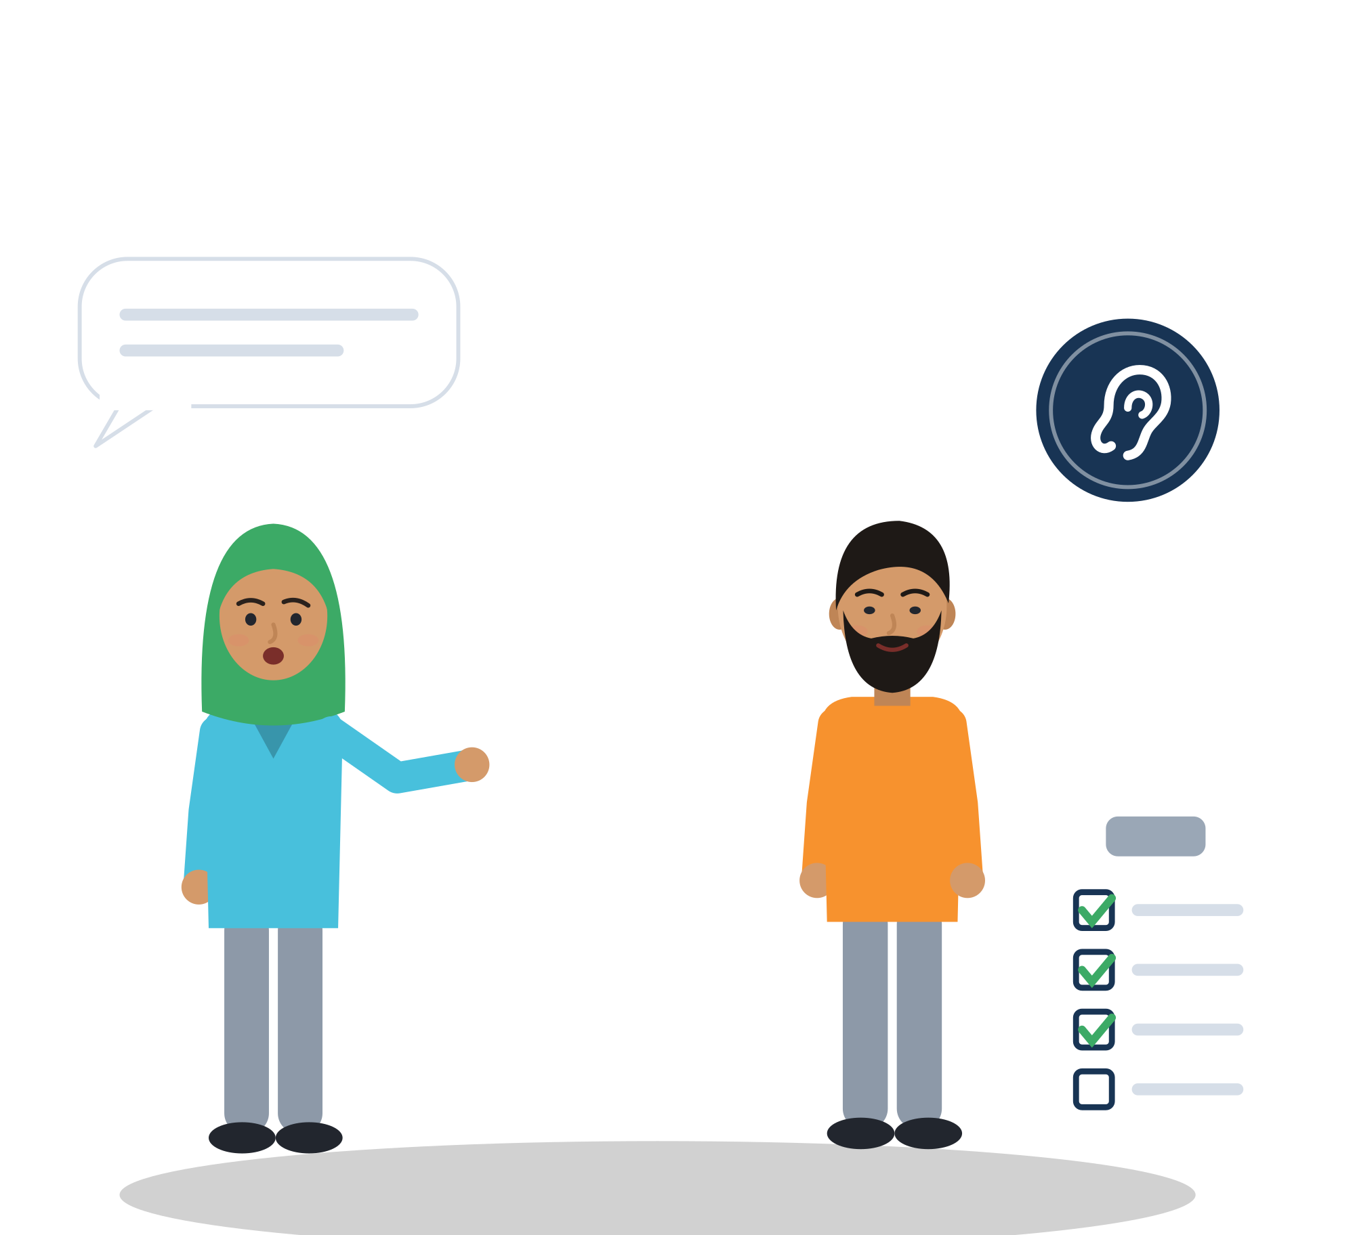
03
UNIT 3 · ≈ 55 min
Empathy in Practice
Active listening, role-play and reflection: connect empathy to your own journey and career goals.
Listen-Summarise-Reflect
Empathy Lab
Listening witness
Gratitude Circle
Module 2 · Empathy
31
Notes:
Unit 3 focuses on applied empathy through active listening, role-play and personal reflection, centred on embodied listening, creative expression and ethical sensitivity.
Suggested timing (not in the curriculum): 3.1 Listen-Summarise-Reflect and checklist 12 min, 3.2 Empathy Lab 18, 3.3 listening witness, journaling and Migration Map 15, Empathy Manifesto 5, closing ritual 5.
Curriculum note: the Closing Ritual (gratitude circle) is listed at the start of Unit 3, but the text says it happens at the end of the workshop. This deck therefore places it at the very end, after the reflection slide.

Slide 32
ACTIVITY · 3.1 ACTIVE LISTENING TECHNIQUES
Listen-Summarise-Reflect
TIME
12 min
STEPS
Warm-up: “What does it feel like to be truly heard?” One word each.
Person A talks for 2 minutes about a personal, everyday experience. B listens without interrupting.
B summarises the facts: “So, the bus was late and you missed the start.”
B reflects the emotional tone: “It sounds like you felt stressed.” A says if it fits.
Swap roles. Then fill in the Active Listening checklist (next slide).
GROUP
Pairs, then whole group
MATERIALS
Timer, Active Listening checklist
DEBRIEF
GOAL
Hear the facts and the feeling, and show it
What is the difference between hearing and listening?
When did you feel connection, and when discomfort?
Which listening habit would you like to strengthen?
Module 2 · Empathy
32
Notes:
Curriculum 3.1: in pairs, one person talks about a personal experience for two minutes while the other listens and reflects back the emotional tone; roles are swapped. The group then discusses listening habits and emotional attunement, the difference between hearing and listening, and moments of discomfort or connection.
Difference from the Empathy Relay in Unit 1: there the listener stayed silent and then paraphrased; here the focus is the emotional tone. Name feelings tentatively ("It sounds like"), never as a diagnosis.
This is language practice too: at B1 a learner "Can support communication across cultures by initiating conversation, showing interest and empathy by asking and answering simple questions, and expressing agreement and understanding" (CEFR Companion Volume, Council of Europe, 2020, p. 114).
Tip: eye contact is not polite everywhere. Ask the group what "I am listening" looks like for them.

Slide 33
SELF-CHECK
Active Listening checklist
Not yet
Sometimes
Often
I use open body language that fits the person and the situation.
I let the person finish without interrupting.
I summarise the facts in my own words.
I reflect the feeling: “It sounds like you felt worried.”
I ask at least one clarifying question.
I avoid judging. I give advice only when someone asks for it.
I stay with their story and do not change the topic to my own.
Module 2 · Empathy
33
Notes:
Curriculum tool: the Active Listening checklist, a simple handout of key listening behaviours (open body language, paraphrasing, asking clarifying questions, avoiding judgement). With the journaling prompts, it is the self-assessment tool of this module. This version adds three items from the SMILE research note; it is not a validated test, so never use it for grading.
The last item follows WHO Psychological First Aid: "Don't talk about your own troubles" (WHO et al., 2011, p. 15). Also avoid the "at least" answers from 1.2.
How to use: participants tick their level, circle 1-3 items to practise and write one intention that starts "This week I will". They look at it again at the end of the module. Add behaviours collected in the Object Stories debrief.

Slide 34


USEFUL PHRASES · 3.1
Phrases for listening, checking and naming feelings
Showing you are listening
Checking you understood
Naming feelings carefully
“Take your time. I'm listening.”
“Go on, I'm following you.”
“Mm-hm. And then what happened?”
“So, if I understand you correctly, the shift changed again?”
“Let me check: you mean the form is wrong, right?”
“In other words, the main problem is the rent.”
“It sounds like you felt ignored.”
“I imagine that was really hard. Am I right?”
“I'm not sure I understand how you feel. Can you tell me more?”
Module 2 · Empathy
34
Notes:
Phrases from the SMILE research note, written for B1-B2. They map onto the CEFR Companion Volume B1-B2 mediation descriptors: showing interest and empathy, expressing understanding of different feelings and viewpoints (Council of Europe, 2020, pp. 114-115).
Practise in trios: speaker, listener, observer. The observer notes which type of phrase the listener used.
Reflect, do not diagnose: "It sounds like you felt" leaves room for "No, I was more angry than sad".
Add the same phrases in Greek, Italian, German, Dutch, Turkish or participants' languages: multilingual prompts are part of the curriculum's methodology.

Slide 35
ACTIVITY · 3.2 ROLE-PLAY AND REAL-LIFE SCENARIOS
Empathy Lab: rotate through the stations
TIME
18 min
STEPS
Groups start at different stations. Each role card has an emotional cue and a power cue.
Play the scene for 2-3 minutes. One person observes.
Write on the station wall: “What did I feel? What did the other person need?”
At the silent station, respond only with gestures, faces or drawings.
At the repair station, write a short message to someone you misunderstood.
Rotate every 4-5 minutes when the trainer gives the signal.
GROUP
Groups of 3-4, rotating
MATERIALS
Scenario cards with emotional and power cues, sticky notes or Jamboard, paper and pens
DEBRIEF
GOAL
Practise empathic responses in different, complex situations
Which station was hardest, and why?
Where did power change the conversation?
What would you take into a real job interview?
Module 2 · Empathy
35
Notes:
Curriculum 3.2: participants rotate around an Empathy Lab with stations that simulate real-life situations (e.g. a job interview, peer conflict, a community meeting), plus a silent station and a repair (making amends) station. Scenario cards contain emotional cues and power dynamics. Participants document emotional insights on Jamboard or sticky notes.
With 18 minutes, groups visit 3-4 stations. Choose the stations that fit your group; the curriculum lists them as examples. Stay mobile and ask about ethical dilemmas, relational dynamics and emotional shifts.
Evidence note: the curriculum cites "Carnicero et al., 2022" here. The paper is Carnicero Pérez, Moreno-Rodríguez & Felgueras Custodio (2023), a survey of tabletop role-playing-game players, and it found no meaningful empathy difference between players and non-players. It does not show that role-play builds empathy, so do not use it as proof.
Better support: empathy training works on average (18 RCTs, g = 0.63; Teding van Berkhout & Malouff, 2016), and weekly perspective-taking practice changed real behaviour in Turkish-Syrian classrooms (Alan et al., 2021). Role-play is the vehicle for that practice.

Slide 36






3.2 EMPATHY LAB STATIONS (INVENTED SCENARIO CARDS)
Six stations, six situations
Job interview (NL)
Peer conflict (IT)
Community meeting (EL)
Nour is asked about a gap in her CV. Interviewer: tired, high power. Nour: ashamed, needs the job. Details on the next slide.
Malik and Chiara must cook an exam dish together. “You're always late!” Chiara does not know that Malik works night shifts.
A shop owner fears a new youth centre for local and refugee youth. Farid, a volunteer, listens first, then tells a short story.
A colleague's loss (DE)
Silent station
Repair message
In a care home, Tarek hears that his uncle has died far away. Rahel stays near, allows silence and offers practical help.
A trainee has not spoken for two sessions. Using only gestures or drawings: how could the group invite her without pressure?
Write a short text or voice message to someone you misunderstood. The person can be real or invented.
Module 2 · Empathy
36
Notes:
All cards are illustrative scenarios (constructed), each grounded in documented facts (SMILE research note §7). The first three are the curriculum's example stations; the silent and repair stations are the curriculum's additions; the care-home station adds a care-work setting.
Community meeting (near Thessaloniki): in US field experiments with 6,869 voters, arguments alone did not reduce exclusionary attitudes toward unauthorized immigrants; adding a "non-judgmental exchange of narratives" did, slightly (d about 0.08) but for at least 4 months (Kalla & Broockman, 2020). Farid listens first ("What exactly worries your customers?"), then shares a short personal story, not statistics.
Peer conflict (cooking apprenticeship, Bologna): contact reduces prejudice most when people cooperate toward a common goal with equal status (Allport, as summarised by Pettigrew, 1998), and more empathy is one of its main routes (Pettigrew & Tropp, 2008). Rewind with an observation: "Today you came 20 minutes after the start."
Care home (Dortmund): family separation and uncertain legal status are linked to more distress among refugees in Germany (Walther et al., 2020). Rahel uses WHO Psychological First Aid wording, "I'm so sorry. I can imagine this is very sad for you", does not ask for details, and asks before she talks to the shift leader. Debrief: how did Rahel protect herself?
Silent station: link to the agreement "We honour silence" and to the WHO line "Don't pressure someone to tell their story". Ask which non-verbal signals are read differently across cultures.

Slide 37


ILLUSTRATIVE SCENARIO
A gap in the CV
Nour, 24
Applying for a warehouse team-leader job, Rotterdam
DISCUSS
Play it twice: first a cold interviewer, then an empathic one. What changes?
What could the interviewer say to make it safe?
How can Nour answer briefly and turn the gap into skills?
Job interview
Netherlands
Power
The interviewer has done 12 interviews today and worries about reliability. He asks: “There is a gap of three years in your CV. What happened?” Nour freezes. Those years were the asylum procedure and life in a camp. She needs this job, but does not want to tell her whole story to a stranger.
Grounded in: with identical CVs, applicants of Turkish origin (23-25) got fewer positive call-backs in the Netherlands: 40% vs 55% (Thijssen et al., 2021).
Module 2 · Empathy
37
Notes:
Illustrative scenario (constructed): the job-interview station of the Empathy Lab. Roles: Nour (cue: shame, fear of being judged; power: low) and the interviewer (cue: tired, worried about reliability; power: high).
Empathic interviewer: "Take your time. You don't have to give details." Nour's reframe: "In those years I organised food distribution for 200 people and interpreted for families." She decides what she shares; she never owes anyone her story.
Structural fact for the debrief: among people who came for international protection and named a concrete obstacle to a suitable job, 29.9% named lack of host-language skills and 17.7% non-recognition of qualifications (Eurostat lfso_21obst03, 2021, calculated). Empathy from employers matters as much as skills from candidates.
Ground fact in full: in the GEMM field experiment (Thijssen et al., 2021), Turkish-origin applicants aged 23-25 were on average 11 points less likely to get a positive call-back; in the Netherlands 40% vs 55%; in Germany 49% vs 53%, a gap that was not statistically significant in this study.

Slide 38



USEFUL PHRASES · 3.2
Phrases for repair, accents, tension and interviews
When accent or language gets in the way
Repairing a misunderstanding
“Sorry, could you say that again a bit more slowly?”
“English is not my first language, so I may ask you to repeat. Thanks for your patience.”
“I think I misunderstood you yesterday. I'm sorry about that.”
“Can we start again? I'd like to understand your point of view.”
Calming a tense moment
Talking about empathy in an interview
“I can see this is really frustrating for you.”
“There is a lot of pressure today. What is the most urgent thing for you?”
“When there is a conflict in a team, I first try to understand what each person needs.”
“At home, I often helped people who didn't speak the language. I learned to listen carefully.”
Module 2 · Empathy
38
Notes:
From the SMILE research note (§9 E, F, H, J). The repair phrases are for the Empathy Lab repair station.
Customer-service example (invented): at a hotel reception in Munich, trainee Samuel (23) explains the check-in time and a guest shouts "I can't understand you, get me someone who speaks properly!" Samuel acknowledges the frustration without accepting the insult: "I see you've had a long journey. Let me write the times down for you." Then ask: what does employer empathy toward staff look like when the manager hears the shouting?
Interview phrases name empathy as a skill. On a CV or Europass profile, use the EU (ESCO) words: "listen actively", "demonstrate consideration", "show empathy".
Tip: let participants rewrite one phrase in their own words. A natural phrase is better than a perfect one.

Slide 39
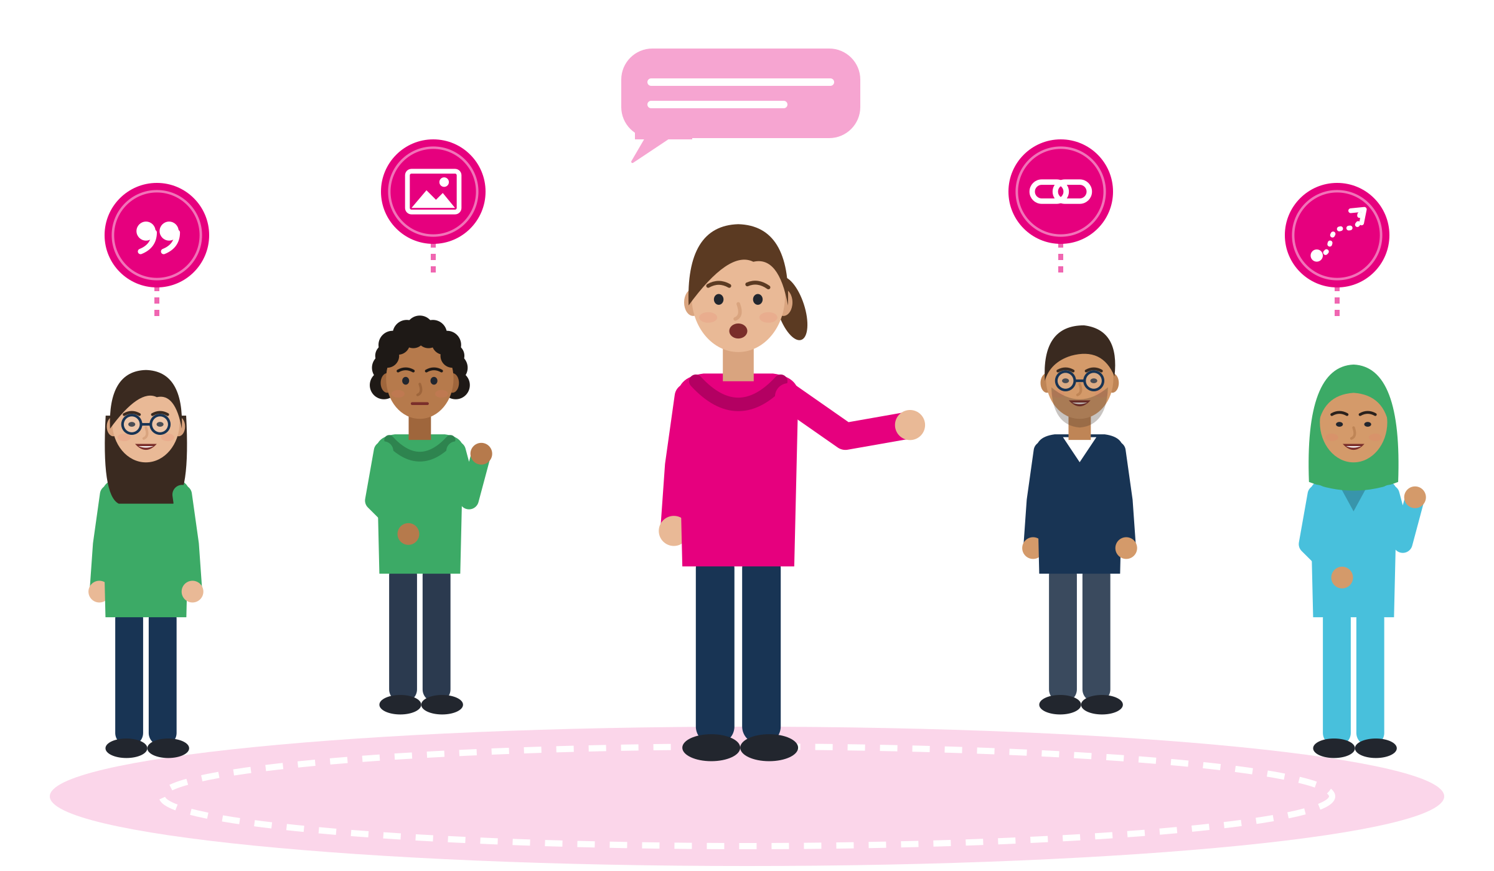
3.3 STORYTELLING CIRCLE
The listening witness: four ways to respond
Picture
Connection
Where it moves me
The witnesses ask themselves
Words
Words: which words or phrases caught my attention?
Picture: what image came to mind? What seems important to the teller?
Connection: why did it connect with something in my own life?
Where it moves me: where has this story taken me? What will I think about?
No advice, no applause, no judgement. The teller chooses a moment of feeling seen or not seen, and can always pass.
Source: Outsider-witness practice in narrative therapy: White (2007), Maps of Narrative Practice; Hayward, Dulwich Centre exercise
Module 2 · Empathy
39
Notes:
Curriculum 3.3: in a storytelling circle, participants share moments when they felt truly seen or not seen. A "listening witness" reflects back what has been heard without judgement and models deep presence.
The four questions come from outsider-witness practice (White, 2007; Hayward, Dulwich Centre exercise sheet). After the witnesses speak, the teller says what it was like to be heard this way. How to run (5 min): one or two volunteers tell, two witnesses respond.
The picture: Aylin tells, four witnesses listen. Each badge is one way to respond: words, a picture, a connection, where the story moves me.
Trauma tip: invite stories of moments of being seen or helped (strengths-based). Volunteers only; a moment from school, work or a shop is enough. If someone becomes distressed, pause, offer a quiet break and talk privately.
Related model: the Human Library (Copenhagen, 2000) uses structured, consensual conversations in which the storyteller chooses what to share. A before-after study with 105 Hungarian students found lower prejudice scores (Orosz et al., 2016; no control group).

Slide 40
ACTIVITY · 3.3 REFLECTION AND PERSONAL APPLICATION
Journaling and the Migration Map
TIME
10 min
STEPS
Journal in private: What made empathy possible? What did you need? What did you learn about yourself as a giver or receiver of empathy?
Draw a Migration Map: the imagined journey of an invented character. Map your own journey only if you choose to.
Mark moments: a heart for empathy, a circle for isolation, a question mark for misunderstanding.
Add a star where someone used a skill. Which onion layer helped or blocked?
In pairs, show one moment if you want. “Pass” is fine.
GROUP
Individual, optional pairs
MATERIALS
Journals, large paper, coloured pens
DEBRIEF
GOAL
Connect personal experience to wider social systems
Which moments of empathy came from people, and which from systems?
Which skill on the map could you name in a job interview?
Module 2 · Empathy
40
Notes:
Curriculum 3.3: guided journaling with the three prompts on the slide, then a Migration Map that traces a journey (real or imagined) and notes moments of empathy, isolation or misunderstanding. The map connects personal experience to wider social systems.
In SMILE the imagined journey is the default. Say it clearly before people start: "You can map the journey of an invented person, a character from a film or a book, or any journey, such as a move to a new city or a first job. You never have to map your own migration." Journals stay private.
The star for skills is a strengths-based addition from narrative practice: look for skills and values, not only the hardest moments. The Tree of Life approach was built around responding to people who experienced significant losses "in ways that are not re-traumatising" (Ncube, 2006, via Dulwich Centre).
Two-session format: the curriculum suggests journaling between sessions. The map can be started in class and finished at home, as an option.

Slide 41




DOCUMENTED PROGRAMMES
Lived experience plus training: empathy as a job
Refugees as peer helpers (NL)
Migration background as an asset (TR)
Syrian refugees trained for 8 days delivered 5 support sessions. Depression and anxiety fell more than in the control group (randomised trial, 206 people).
Facilitators with a migration background ran a 5-session WHO stress course for 642 Syrian refugees. After 6 months, 21.7% had a new mental disorder, against 40.7% of the control group.
Interpreters from the community (EL)
Intercultural mediators (IT)
METAdrasi trains interpreters, mainly refugees and migrants. It reports more than 1,000 certified interpreters in 61 languages since 2010.
In Emilia-Romagna, intercultural mediator is a regional qualification: 300-500 hours of training, 20-45% of it as an internship.
Source: de Graaff et al. (2023), BMJ Mental Health · Acarturk et al. (2022), World Psychiatry · METAdrasi website, self-reported · Verrept (2019), WHO Europe HEN report 64, p. 17
Module 2 · Empathy
41
Notes:
Curriculum link: Unit 3 relates empathy to participants' migration journeys and career goals. Message: the empathy and mediation many young migrants already practise informally can become a recognised skill and a job path: peer support, interpreting, intercultural mediation, care.
Honest limits: a group version of the peer-helper programme in Istanbul found no significant effect on symptoms (Acarturk et al., 2024), and the Western European trial of the WHO stress course found a benefit right after the course but no difference at 6 months (Purgato et al., 2021). The Dutch trial participants were adults (mean age 37). The method matters, and so do jobs, housing and stress.
METAdrasi figures are the organisation's own. It halted camp interpretation in July 2025 because it was owed more than 2.5 million euro (AIDA Greece 2025 Update, p. 197): empathic work must also be fairly paid, lasting work. In Berlin, the Stadtteilmütter (neighbourhood mothers) grew their clients' networks, but the mothers themselves did not move into regular jobs (Sülzle, Glock & Jörg, 2019).
Mediators in Italian hospitals describe a heavy emotional load and little recognition (Faggi & Fioretti, 2025). Boundaries are part of empathy (2.2).

Slide 42
ACTIVITY · 3.3 CLOSING THE UNIT
Our Empathy Manifesto
TIME
5 min
STEPS
Each person adds a phrase, a colour or a symbol that stands for empathy, inclusion and ethical care.
Use a starter if it helps: “At work, empathy means”, “We will not”, “When someone is new, we”.
Any language is welcome. Symbols and drawings count as much as words.
Arrange the contributions together and read the manifesto aloud.
With everyone's consent, photograph it for the SMILE learning platform.
GROUP
Whole group
MATERIALS
Large paper for a mural, or a digital collage (Miro); colours, symbols
DEBRIEF
GOAL
Turn what we learned into shared commitments
Which line will you take to work or school tomorrow?
Module 2 · Empathy
42
Notes:
Curriculum 3.3: the session closes with a shared Empathy Manifesto, co-created as a visual mural or a digital collage, with phrases, colours and symbols that represent empathy, inclusion and ethical care. It is one of the creative outputs the curriculum uses for formative assessment.
The curriculum cites Marino (2022) here, with a shortened title. Correct title: "The role of empathy in bridging Western and Indigenous knowledges: Dominick LaCapra and Ailton Krenak" (Rethinking History, 26(4)). Its abstract: "the role of empathy is to recognize other ontologies, epistemologies, and cosmologies, and to 'make time to tell new stories'". Invite proverbs, songs or images from participants' own cultures.
Tip: add your own line first, and leave enough wall space so quiet participants can add theirs while others talk.

Slide 43

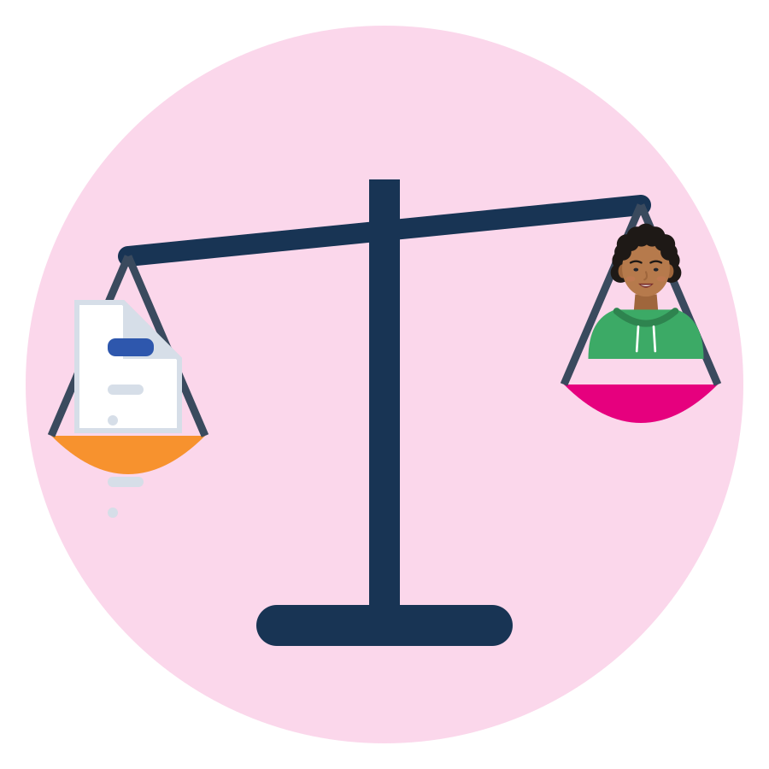
BE FAIR TO YOURSELF
Skills open doors, but they are not the whole story
What this skill can change
What it cannot fix alone
Listen so that people feel safe to speak up early.
See the person, and the system behind the problem.
Calm conflicts and repair misunderstandings.
Name empathy as a skill in interviews and on your CV.
Identical CV, different name: 55 of 100 got a positive answer with a Dutch name, 40 of 100 with a Turkish name.
Recognition of diplomas, residence permits and the right to work depend on laws and offices, not on you.
Discrimination is not your fault. It can be reported to an equality body, a union or an NGO.
Train your skills AND know your rights. Both are part of a fair start.
Source: Thijssen et al., 2021, JEMS (correspondence test, NL, applicants aged 23-25)
Module 2 · Empathy
43
Notes:
This slide protects participants from a "deficit" message: soft-skills training must not suggest that unemployment or discrimination is their fault.
Field experiments send identical CVs that differ only by name; the call-back gap therefore measures discrimination, not skills (Quillian et al., 2019, meta-analysis of 97 experiments).
Only 6% of Muslim respondents who felt discriminated against reported it (FRA, Being Muslim in the EU, 2024). Point to the help points slide.
Empathy is a two-way street: employers, offices and customers must also listen. A US report for the Tent Partnership quotes a manager: "You have to know what language they speak, and we can provide an interpreter. But you have to want to understand them, too." (Fiscal Policy Institute & Tent, 2018, p. 31; US data, an illustration only).
Understanding someone does not mean accepting discrimination. Among young people of African descent (16-24) who felt discriminated against, only 3% reported it (FRA, Being Black in the EU, 2023, p. 17). Encourage naming and reporting.

Slide 44





WHERE TO GET HELP
Official help points in the SMILE countries
 | Country | Jobs and training | Diplomas and recognition | Unfair or unsafe work
 | Türkiye | İŞKUR (iskur.gov.tr), Public Education Centres | YÖK denklik, MEB e-Denklik | Ministry of Labour (csgb.gov.tr), YİMER 157 helpline
 | Greece | DYPA (dypa.gov.gr) | DOATAP (doatap.gr) | Labour Inspectorate, phone 1555
 | Italy | Centri per l'Impiego, SIISL | CIMEA (free for protection holders) | Ispettorato Nazionale del Lavoro
 | Germany | Agentur für Arbeit, Jobcenter, Jugendmigrationsdienste (12-27) | Anerkennung in Deutschland, IQ Netzwerk | Faire Integration (free, multilingual)
 | Netherlands | UWV, werk.nl, your municipality | IDW (idw.nl) | Nederlandse Arbeidsinspectie, Juridisch Loket
Save the number or website of one help point in your phone today.
Source: Official websites, checked 1 October 2026 (SMILE research note, labour market)
Module 2 · Empathy
44
Notes:
Ask participants which country they live in and open the matching website live if internet is available.
For this module, add your local psychosocial support and legal-aid contacts (your referral list). Greece: Ministry of Migration and Asylum Help Desk for beneficiaries of international protection, 213 212 8400.

Slide 45

REFLECTION
One listening habit, one step
Which listening habit will I strengthen this week?
Who will I listen to first?
Where will I practise it: at work, in class or at home?
What will I say to show I understood?
Take the one-page Follow-up Toolkit home: active listening, the Empathy Onion, reflection questions.
Module 2 · Empathy
45
Notes:
Each participant writes the answers on a card or in their journal. Ask them to look at their Active Listening checklist again and tick the habit they chose (curriculum 3.1: "share a listening habit they would like to strengthen").
The curriculum's Follow-up Toolkit is a one-page handout that summarises empathy practices (active listening, the Empathy Onion, reflection questions) for participants to take home.
Keep it short and positive. If the group meets again, start the next session by asking how the habit went.

Slide 46
CLOSING RITUAL
Gratitude Circle
TIME
5 min
STEPS
Stand or sit in a circle.
Each person names one empathic moment they witnessed today. You do not have to name the person.
The trainer names one too. “Pass” is fine.
Check-out: one word, or a point on the safety thermometer.
Hand out the Follow-up Toolkit and the support contacts.
GROUP
Whole group, in a circle
MATERIALS
Safety thermometer poster, Follow-up Toolkit handouts, support contacts
GOAL
Close with recognition and emotional resonance
Module 2 · Empathy
46
Notes:
Curriculum closing ritual: at the end of the workshop, participants gather in a "gratitude circle"; each person names an empathetic moment they witnessed during the session. It reinforces collective learning, highlights positive behaviours and closes the training with emotional resonance.
Curriculum note: the ritual is listed at the start of Unit 3 in the curriculum text, but it describes the end of the workshop, so it is placed here.
Watch the check-out: anyone at the extremes of the thermometer gets a short private conversation before leaving, and the referral contacts.

Slide 47


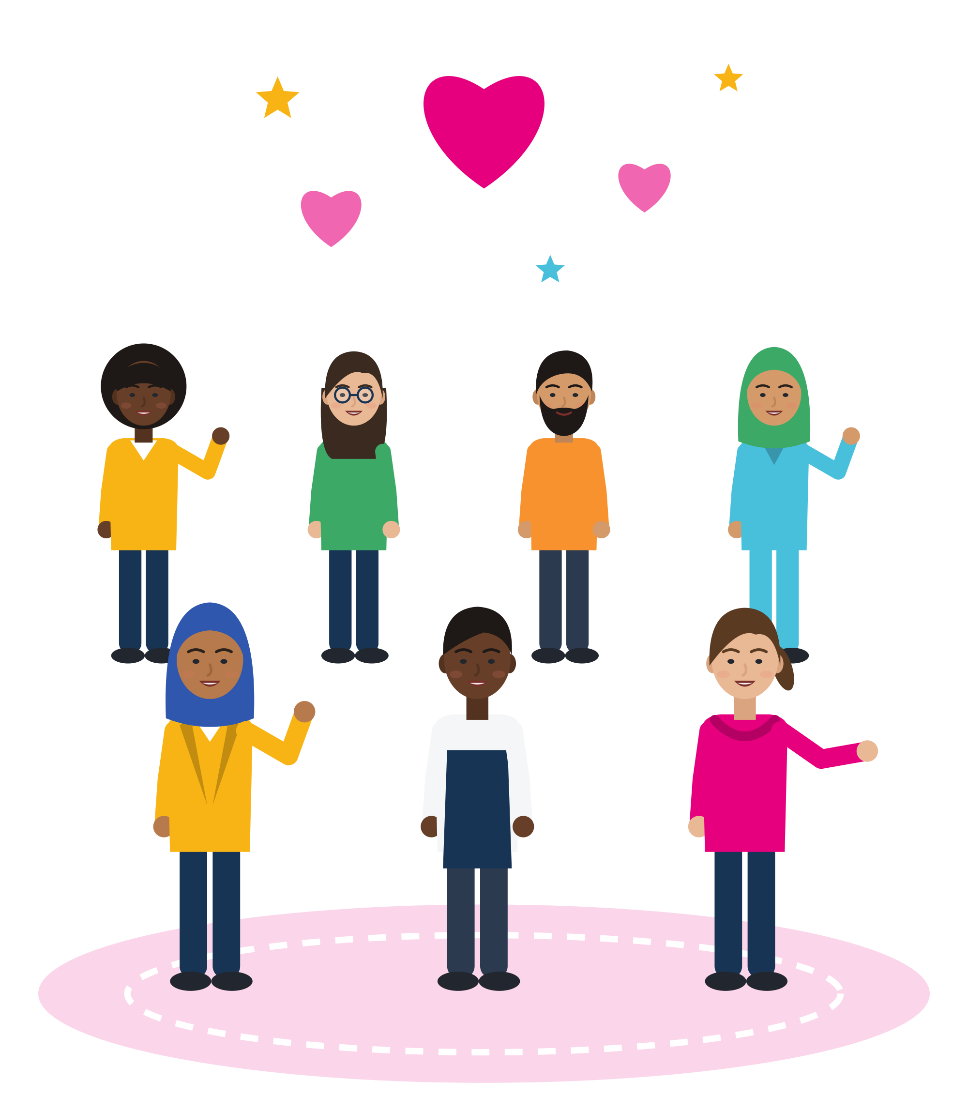

KEY MESSAGES
Listen first. Understand. Then respond with respect.
Empathy has three parts: think, feel, respond. It is not pity, not rescue and not always agreeing. It can be trained, it is a named work skill, and it goes both ways: you give it, and you have the right to receive it at work.
Module 2 · Empathy
47
Notes:
Summarise with the group: ask three volunteers to name one tool they will use (Empathy Map, Empathy Onion, the four reframing steps, Listen-Summarise-Reflect, the listening witness).

Slide 48
REFERENCES
Sources used in this presentation (1/2)
Acarturk, C., et al. (2022). Effectiveness of a WHO self-help psychological intervention for preventing mental disorders among Syrian refugees in Turkey: A randomized controlled trial. World Psychiatry, 21(1), 88-95.
Bronfenbrenner, U. (1994). Ecological models of human development. In International encyclopedia of education (2nd ed., Vol. 3). Elsevier.
Bundesagentur für Arbeit (2025). Arbeitsmarktsituation im Pflegebereich. BA Statistik.
de Graaff, A. M., et al. (2023). Peer-provided psychological intervention for Syrian refugees: Results of a randomised controlled trial on the effectiveness of Problem Management Plus. BMJ Mental Health, 26(1), e300637.
European Commission (n.d.). ESCO: European Skills, Competences, Qualifications and Occupations. Skill “listen actively”, accessed 1 October 2026.
Fasani, F., & Mazza, J. (2020). Immigrant key workers: Their contribution to Europe's COVID-19 response (IZA Policy Paper No. 155).
Gray, D. (2017, July 15). Updated empathy map canvas. The XPLANE Collection, Medium.
Greek Council for Refugees & ECRE (2026). AIDA country report: Greece, 2025 update.
Kalla, J. L., & Broockman, D. E. (2020). Reducing exclusionary attitudes through interpersonal conversation. American Political Science Review, 114(2), 410-425.
Khader, S. J. (2018). Victims' stories and the postcolonial politics of empathy. Metaphilosophy, 49(1-2), 13-26.
Lee, T. L., & Fiske, S. T. (2006). Not an outgroup, not yet an ingroup: Immigrants in the Stereotype Content Model. International Journal of Intercultural Relations, 30(6), 751-768.
Marino, T. M. (2022). The role of empathy in bridging Western and Indigenous knowledges: Dominick LaCapra and Ailton Krenak. Rethinking History, 26(4), 569-595.
METAdrasi (n.d.). Training of interpreters; Interpretation in healthcare services. metadrasi.org, accessed 2026.
Roessel, J., Schoel, C., Zimmermann, R., & Stahlberg, D. (2019). Shedding new light on the evaluation of accented speakers. Journal of Language and Social Psychology, 38(1), 3-32.
Rosenberg, M. B. (2015). Nonviolent communication: A language of life (3rd ed.). PuddleDancer Press.
Module 2 · Empathy
48
Notes:
Full verified references with URLs and page numbers: SMILE research note "Empathy" (arastirma/empathy-icerik.md, §11) and the shared labour-market note.
Corrections to the curriculum's reference list, for trainers and handbook authors: (1) "Harvard Business Review (2021). Empathy Is the Most Important Leadership Skill" is a Forbes column (Brower, 19 Sept 2021) reporting the Catalyst study (Van Bommel, 2021). (2) "Carnicero et al. (2022)" is Carnicero Pérez, Moreno-Rodríguez & Felgueras Custodio (2023), IJERI 19, 109-122, and does not show that role-play builds empathy. (3) Marino (2022): the real title is given above. (4) Zembylas (2018): full title adds ": The education of empathy". (5) Smaling (2007): Crossref dates the chapter 2006. (6) LaCapra (2014) and Carnicero are cited in the curriculum text but missing from its reference list. (7) Brown, Daring Greatly, was first published in 2012 (Gotham); 2013 is the Penguin edition.

Slide 49
REFERENCES
Sources used in this presentation (2/2)
Royal Society of Arts (2013). Brené Brown on empathy [Video]. YouTube. Animation “The Power of Empathy” by Katy Davis.
Sala, A., Punie, Y., Garkov, V., & Cabrera Giraldez, M. (2020). LifeComp: The European framework for personal, social and learning to learn key competence. Publications Office of the EU.
SAMHSA (2014). SAMHSA's concept of trauma and guidance for a trauma-informed approach (HHS Publication No. SMA 14-4884).
Siegel, D. J. (1999). The developing mind: Toward a neurobiology of interpersonal experience. Guilford Press.
Singer, T., & Klimecki, O. M. (2014). Empathy and compassion. Current Biology, 24(18), R875-R878.
Smaling, A. (2007). The meaning of empathic understanding in human inquiry. In A.-T. Tymieniecka (Ed.), Analecta Husserliana (Vol. 94, pp. 309-341). Springer.
Teding van Berkhout, E., & Malouff, J. M. (2016). The efficacy of empathy training: A meta-analysis of randomized controlled trials. Journal of Counseling Psychology, 63(1), 32-41.
Thijssen, L., Lancee, B., Veit, S., & Yemane, R. (2021). Discrimination against Turkish minorities in Germany and the Netherlands. Journal of Ethnic and Migration Studies, 47(6), 1222-1239.
Van Bommel, T. (2021). The power of empathy in times of crisis and beyond. Catalyst.
Verrept, H. (2019). What are the roles of intercultural mediators in health care? (Health Evidence Network synthesis report 64). WHO Regional Office for Europe.
Weichselbaumer, D. (2016). Discrimination against female migrants wearing headscarves (IZA Discussion Paper No. 10217).
White, M. (2007). Maps of narrative practice. W. W. Norton.
WHO, War Trauma Foundation & World Vision International (2011). Psychological first aid: Guide for field workers. WHO.
World Economic Forum (2025). The future of jobs report 2025.
Zembylas, M. (2018). Reinventing critical pedagogy as decolonizing pedagogy: The education of empathy. Review of Education, Pedagogy, and Cultural Studies, 40(5), 404-421.
Module 2 · Empathy
49

Slide 50

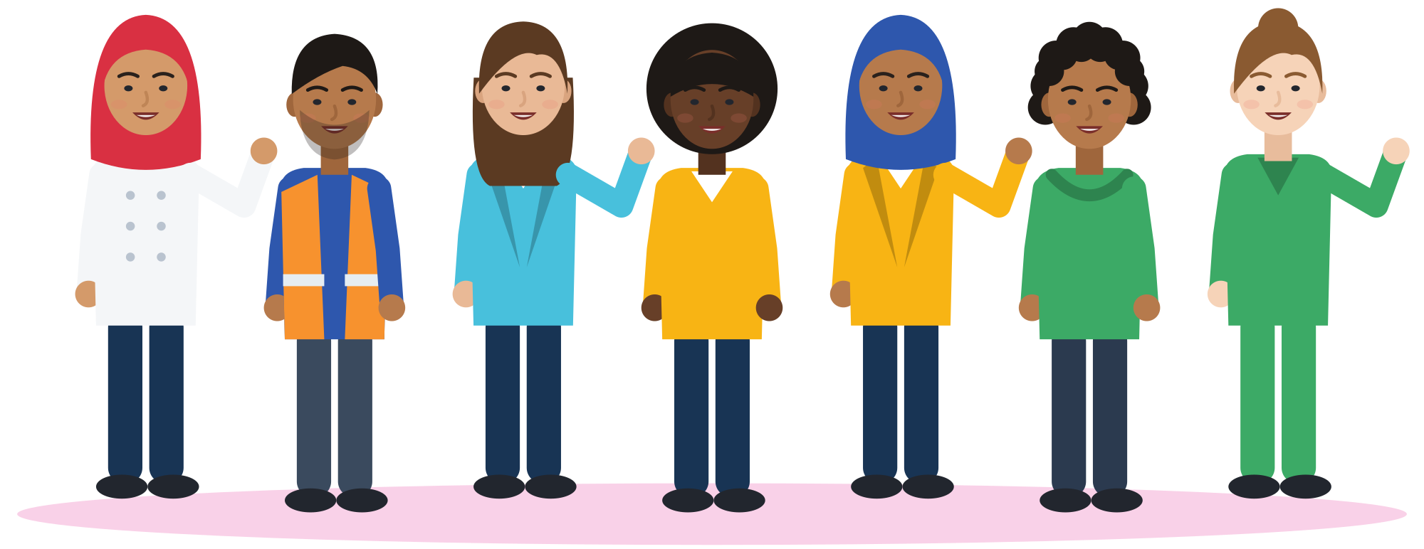
Thank you
THE SMILE PARTNERSHIP
Göç Sanat ve Spor Derneği (MIGARTS) (Türkiye, coordinator)
KYTTARO ENALLAKTIKON ANAZITISEON NEON (KEAN) (Greece)
Work in Progress APS (WiP) (Italy)
Smart Leap Education Research Consultancy GmbH (Germany)
Association of Entrepreneurship School (AES) (Türkiye)
BİR-İZ (Türkiye)
Stichting Unity Sphere Europe (SUSE) (Netherlands)
Questions, ideas, stories: the floor is yours.
KEEP LEARNING
smile-lms.smartleap.eu
MODULE
2 · Empathy
PROJECT
SMILE · Erasmus+ KA220-YOU
PROJECT NO.
2024-1-TR01-KA220-YOU-000256357
Scan to join the SMILE learning platform
Free online course: lessons, activities, quiz and certificate.
Co-funded by the European Union. Views and opinions expressed are however those of the author(s) only and do not necessarily reflect those of the European Union or the Turkish National Agency. Neither the European Union nor the granting authority can be held responsible for them.
SKILLS = Opportunity
Empowerment Through Skills · Inclusion Through Opportunity
Module 2 · Empathy
50
Notes:
Invite participants to continue on the SMILE learning platform (QR code). Collect photos of the Empathy Manifesto only with consent, and remind everyone of the support contacts.

