Slide 1




MODULE 1 · TRAINER PRESENTATION
Communication
Speak clearly, check, listen and speak up: confident communication for your first job and everyday work in a new country.
8 hours
6 sessions
Ages 18-30
B1-B2 English
SMILE
Support Young Migrants Integration in the Labour market in Europe
Erasmus+ KA220-YOU · 2024-1-TR01-KA220-YOU-000256357
Empowerment Through Skills · Inclusion Through Opportunity
Notes:
Module 1 of the SMILE soft-skills curriculum. Duration in the curriculum: 8 hours in six sessions (Session 1: 1 h, Session 2: 1.5 h, Session 3: 1.5 h, Session 4: 1 h, Session 5: 1.5 h, Session 6: 1.5 h). Suggested split: 4 hours of theoretical input and guided discussion, 4 hours of hands-on learning (case studies, role-plays, reflection). It can run as two 4-hour days or as six separate meetings.
Welcome participants, introduce yourself and the SMILE project in one sentence: an Erasmus+ project of seven partners in Türkiye, Greece, Italy, Germany and the Netherlands that helps young migrants enter the labour market.
Curriculum note for trainers: the materials list names an "employment-focused adaptability/communication checklist". The word "adaptability" seems to come from another module; this deck uses a communication checklist (Session 6) and keeps the curriculum wording here.

Slide 2




HOW WE WORK TOGETHER
Our agreement for this module
Any English is good English
Your story belongs to you
Listen to understand
“Pass” is always OK
We listen to ideas, not grammar. Nobody corrects your language here. Mix words from other languages if it helps.
You never have to share your migration story. Our examples use invented characters.
One voice at a time. Every question is a good question.
You can skip any activity or question. Take a break when you need one.
Module 1 · Communication
2
Notes:
Co-create or confirm the agreement before content starts. Write it on a flipchart and keep it visible for the whole module.
Why: many young refugees carry heavy stress. A review of 26 studies (5,143 adult refugees and asylum seekers) found PTSD and depression in about 31.5% each (Blackmore et al., 2020, PLOS Medicine). Never ask participants to tell their migration story; use the constructed characters on the slides.
Language: do not correct grammar or pronunciation during sharing. Model the phrases instead (the "useful phrases" slides).
For this module in particular: accents and mixed languages are welcome. We never correct grammar or pronunciation during activities; we praise repair moves instead ("Good question!", "Thanks for checking").
Participants may prepare role-plays in their strongest language and perform in English or the host language. Everyone can choose to be an observer instead of an actor. Use "time-out" cards in role-plays.
Agree confidentiality: "stories stay here, lessons can leave". Discrimination topics are handled only with invented characters (research note, communication, §8; SAMHSA, 2014, trauma-informed principles).

Slide 3
MODULE MAP
Six sessions, from first words to an action plan
01
Introduction and foundations
02
Understanding communication challenges
03
Verbal and non-verbal communication skills
Goals and why it matters. Icebreaker: "My communication story".
Language barriers, cultural differences, professional norms. Group discussion.
Clear speaking, repair, handovers, body language. Role-play.
1 h
1.5 h
1.5 h
04
Interpersonal skills and inclusive communication
05
Practical strategies for workplace communication
06
Reflection and action planning
Respectful interactions, active listening. Case study analysis.
Feedback, conflict, diverse teams, phone, email, chat. Simulations.
Self-assessment, personal action plan, closing discussion and feedback.
1 h
1.5 h
1.5 h
Module 1 · Communication
3
Notes:
Say: "We have six sessions. We start with what you already know, then look at what makes communication hard at work, practise, and end with your own plan."
The session durations are those of the curriculum (total 8 hours). The minute splits inside each session given in these notes are suggestions from the SMILE research note, not curriculum rules.
Two-day option: Day 1 = Sessions 1-3 (4 h), Day 2 = Sessions 4-6 (4 h). Start Day 2 with a 5-minute recap of the strategy bank from Session 1.

Slide 4
LEARNING OUTCOMES
By the end of this module, participants will be able to
1
Explain the role of communication skills in employment and workplace integration.
4
Apply practical strategies for clear and confident communication in work-related settings.
2
Identify common communication challenges related to language, culture and professional norms (expectations).
5
Demonstrate verbal, non-verbal and interpersonal communication skills (in practice) through role-play and real-life scenarios.
3
Understand the impact of effective communication on building inclusive and respectful work environments.
6
Reflect on their own communication strengths and areas for development in the workplace context (carry out a self-assessment).
Module 1 · Communication
4
Notes:
These are the six learning outcomes of the SMILE curriculum (English edition, unchanged).
Assessment is formative: no grades, only observation in role-plays, reflection and the self-assessment in Session 6. Read the outcomes aloud and ask: "Which one is most important for you right now?" A show of hands is enough.

Slide 5
WHY THIS MATTERS
Why communication matters for your start at work
65 in 100
+10 points
20 years
non-EU citizens aged 20-64 in the EU have a job. For nationals it is 77 in 100.
If refugees spoke the host language as well as natives, their employment rate would be about 10 percentage points higher.
Refugees in the EU needed up to 20 years to reach the employment rate of people born in the country. A slow start is normal, not a personal failure.
Language and communication grow with time and practice. This module is the practice part.
Source: Eurostat lfsa_ergan, 2025 · European Commission & OECD, Working Paper 1/2016, 2014 data · European Commission & OECD, 2016, 2014 data
Module 1 · Communication
5
Notes:
Say: "The gap in jobs is real. Language is one reason, and it is a reason that changes with practice. A slow start is normal."
Evidence: the +10 points is an estimate from the European Commission and OECD analysis of the 2014 EU Labour Force Survey module on refugees in 25 EU countries (Working Paper 1/2016, p. 6). Employment rates: Eurostat lfsa_ergan, 2025.
Tip: avoid a "deficit" message. Language is one factor; recognition, permits and discrimination are others. We come back to this on the slide "Skills open doors, but they are not the whole story" in Session 6.

Slide 6


01
SESSION 1 · 1 h
Introduction and foundations
Who we are, what we want to learn, and why communication is a key to work in a new country.
Welcome and goals
Why it matters
My communication story
Module 1 · Communication
6
Notes:
Session 1 sets the tone: safe, practical, multilingual. Suggested timing (research note): 10 min welcome and goals, 15 min input on why communication matters, 30 min icebreaker, 5 min close.

Slide 7

WELCOME AND SETTING OBJECTIVES
Welcome: what do you want to say better at work?
Call an employer about a job
Our goal wall
Ask when I do not understand
Talk about my payslip calmly
In 8 hours we practise real work situations: instructions, calls, feedback, handovers, group chats.
Your languages are a resource. They help you learn, translate and connect.
Set one goal: "At the end of this module, I want to be able to [my goal]."
We come back to it in Session 6, in your action plan.
Give and take feedback
Introduce myself in 60 seconds
Module 1 · Communication
7
Notes:
The goal wall shows example goals (Ask when I do not understand an instruction. Call an employer about a job. Talk about my payslip calmly. Give and take feedback. Introduce myself in 60 seconds.). The empty card is the participant's own goal.
Say: "This module is about real situations at work, not about perfect grammar. Everybody here already communicates in more than one language."
Run (10 min): welcome round with name and the word for "hello" in a language of your choice. Then everyone writes one goal on a card and sticks it on a "goal wall". Keep the wall for Session 6.
Evidence: the Council of Europe describes plurilingual competence as "an uneven and changing competence" with "a single, interrelated, repertoire" (CEFR Companion Volume, 2020, p. 30). Translation apps, peers and mother-tongue resources are legitimate tools.
Tip: model it first. Write your own goal on a card and read it aloud.

Slide 8



THE IMPORTANCE OF COMMUNICATION IN WORKPLACE INTEGRATION
Communication is part of every job
8 in 10
50%
49%
workers in Europe work in a team, and 74% deal with clients or customers at least sometimes.
of employers call "empathy and active listening" a core skill. 47% say the same of customer service.
of workers say they themselves need to develop their social skills further. Everybody is still learning.
Warehouse, café, care home or office: talking, listening and checking are in every job description.
Source: Cedefop (2022), Second European Skills and Jobs Survey (2021 data), pp. 55, 82 · World Economic Forum (2025), Future of Jobs Report, Fig. 3.3
Module 1 · Communication
8
Notes:
Say: "Communication is not a soft extra. It is part of the daily work in almost every job you can think of."
Evidence: Cedefop surveyed 46,213 adult employees aged 25-64 in the EU-27, Iceland and Norway. 49% said they need to develop social skills further, more than technical skills (40%). WEF: more than 1,000 employers in 55 economies. In ESCO, the EU skills classification, "use body language", "interact with others" and "use online conventions of netiquette" are transversal skills, relevant for all jobs.
Run (5 min): ask "Which jobs have you done or want to do? Where do you talk, listen or write in them?" Collect 3-4 answers.
Tip: the 49% is useful against shame. Say: "Half of all workers in Europe feel they need to improve too."

Slide 9

AGER AND STRANG: INTEGRATION FRAMEWORK
Language is a bridge to work, people and services
Four layers
Bonds
Bridges
Markers: work, housing, education, health
Foundation: rights and citizenship, the base for everything else.
Facilitators: language and cultural knowledge, safety and stability. Language does not stand alone.
Social connection: bonds (your own community), bridges (other groups), links (institutions such as the job centre).
Markers and means: employment, housing, education, health: integration in daily life.
Links
Facilitators: language, culture, safety
Foundation: rights and citizenship
Source: Ager & Strang (2008), Understanding integration: A conceptual framework, Journal of Refugee Studies 21(2), Figure 1
Module 1 · Communication
9
Notes:
Say: "In this model, language is a facilitator: it does not give you a job alone, but it makes bridges to people and services, and bridges lead to jobs."
Evidence (author's version, pp. 15-17): "Being able to speak the main language of the host community is, for example, consistently identified as central to the integration process." And: "'bridging' capital may significantly facilitate employment opportunities". The authors stress that integration is two-way: services should reduce language barriers too, for example with interpreting.
Example: "My cousin found me my first job (bond). My colleague who helps me with the rota is a bridge. The municipality's job coach is a link." Settling In 2023 (OECD/EC, p. 82): "Long spells of unemployment rob immigrants of the opportunity to speak the host-country language and socialise in the workplace".
Tip (optional, 5 min): participants write one bond, one bridge and one link on sticky notes, without names. In Session 6 they plan "one new bridge".

Slide 10





ACTIVITY
Icebreaker: "My communication story"
TIME
30 min
STEPS
Pick 2 of 4 prompt cards: a moment when communication worked well; a misunderstanding (any place); a word from my language I love; a person who helped me understand something.
Draw a simple timeline or make notes. Any language is fine. (5 min)
In pairs, share for 4 minutes each. Then introduce your partner to the group in one sentence. (15 min)
Together, collect "what helped" (asking again, gestures, a translation app) on a flipchart: our strategy bank. (10 min)
GROUP
Individual, then pairs, then whole group
MATERIALS
Four prompt cards, paper, pens, flipchart
DEBRIEF
GOAL
Collect what already helps you to be understood
What helped you to be understood?
What did the other person do that helped?
Which of these strategies can you use at work?
Module 1 · Communication
10
Notes:
Curriculum activity (Session 1): Icebreaker "My Communication Story".
Trauma-informed: the misunderstanding can come from school, a shop or family life. Never ask for the migration journey. Participants choose how deep they go; "pass" is OK.
Tip: share a short story of your own first, to model openness and the right depth. Keep the strategy bank visible for all six sessions and add to it.
Link: the Council of Europe's Autobiography of Intercultural Encounters (mentioned in the CEFR Companion Volume, p. 13) uses a similar reflective approach.

Slide 11

02
SESSION 2 · 1.5 h
Understanding communication challenges
Language, culture and unwritten rules at work: what makes communication harder, and what helps.
Language barriers
Cultural differences
Professional norms
Group discussion
Module 1 · Communication
11
Notes:
Session 2 names the challenges without blaming the person. Suggested timing (research note): 25 min input with a data quiz, 40 min group work, 20 min plenary, 5 min close.

Slide 12
LANGUAGE BARRIERS
The obstacle people name most often: language
What the bars show: non-EU-born people (15-74) who named an obstacle to a suitable job, and chose language.
Other obstacles in the EU: recognition of qualifications 15.1%, no suitable job 14.6%, discrimination because of foreign origin 7.9%.
Italy: 67% answered "other", so the Italian figure is hard to compare.
Source: Eurostat lfso_21obst01, EU Labour Force Survey 2021 ad hoc module; shares of people reporting an obstacle, own calculation in the SMILE research note
Module 1 · Communication
12
Notes:
Run as a data quiz (5 min): "Which obstacle do people born outside the EU name most often when they look for a suitable job?" Collect guesses, then show the chart.
Say: "Language is named most often, but not alone. Recognition and discrimination are also there. So part of the problem is in the system, not in you."
Evidence: EU-wide, 1.45 million people named language (22.9% of those who named any obstacle; 4.8% of all non-EU-born). Language grows with time: 40% of recent arrivals report advanced host-language skills, compared with about 70% of settled immigrants (OECD/EC, Settling In 2023, p. 74).
Tip: ask participants in the Netherlands and Germany if the high figure matches what they see. Do not ask about their personal level.

Slide 13
DOCUMENTED PROGRAMMES: LANGUAGE COURSES AND WORK
Language courses work best together with work
775,000
+2 points
+8-9%
participations in Germany's job-related German courses, 2016-2022. Participants speak much better German than similar non-participants.
more people in insured employment four years after the course start. In the first years, course time slowed job entry.
better Danish fluency for refugees with 100 extra hours of language class (Denmark).
Learn while you work, and work while you learn. Language plus job practice is the strongest path.
Source: Baderschneider et al. (2024; 2025), evaluation of the Berufssprachkurse, IZA Research Reports 142 and 149 · Foged & van der Werf (2023), Labour Economics 84
Module 1 · Communication
13
Notes:
Say: "Courses clearly improve language. But jobs come faster when language learning and work practice go together."
Evidence: the German federal evaluation (f-bb, IZA, IAW, Kantar; 3,711 participant interviews plus a comparison group) found clear language gains, more transitions into vocational training, a "lock-in" during courses and +2 percentage points of insured employment after four years. Women, younger and more educated participants benefited more (RR 149, p. 11). The evaluators recommend more courses for people already in work and practice-oriented formats (RR 142, p. 21).
Balance: a Danish "work first" policy sped up job entry for men, but "into precarious jobs with few hours", and crowded out language learning (Arendt, 2022). The middle way is both.
Tip: ask "Who learns a language and works or studies at the same time? What helps you?" Add answers to the strategy bank. Sessions 3 and 5 practise workplace language: instructions, handovers, emails, calls.

Slide 14


MYTH OR FACT?
Language and culture: common misunderstandings
"If my language is perfect, I will get the job."
Language is named most often, but recognition, discrimination and a lack of suitable jobs also block people. Language works best with work and qualification.
"Employers just can't understand my accent."
In a meta-analysis of hiring studies, accent bias (d = 0.47) was not explained by how easy candidates were to understand. It is about the listener.
"Asking someone to repeat makes me look weak."
Asking for clarification is a competence at every language level. Handover tools exist because misunderstandings are normal for everyone.
"Learn the rules of 'the Germans' or 'the Dutch' and you avoid all problems."
A study of 67 countries found "more consensus than disagreement on value priorities across countries". People differ: observe and ask.
"Work first: the language will come by itself."
In Denmark, work-first led many men into precarious jobs with few hours and less language learning. Language plus work is better.
Source: Eurostat lfso_21obst01 (2021) · Spence et al. (2024), PSPB 50(3) · Council of Europe (2020), CEFR Companion Volume, p. 89 · Fischer & Schwartz (2011) · Arendt (2022)
Module 1 · Communication
14
Notes:
Run (8 min) as a quick vote: read each myth; participants stand up if they think it is true. Then reveal the fact and ask one person to say it in their own words.
Accent: the meta-analysis covered 139 effect sizes (N = 4,576); bias was stronger for jobs with a lot of communication and for foreign accents, and candidates' actual comprehensibility was not a significant moderator (Spence et al., 2024). A short intervention reduced accent bias among German raters (Roessel et al., 2019). Participants who want to work on pronunciation can: instruction has large effects (Lee, Jang & Plonsky, 2015). Never present accent as a defect.
Tip: when someone generalises about a nationality, ask: "Is that true for everyone you know there?"

Slide 15

CULTURAL DIFFERENCES: HALL'S HIGH AND LOW CONTEXT
The words are only the tip of the message
"Maybe you could check the fridge temperatures?"
A suggestion or an order?
Above the water: the words.
Below the water: the context.
Make it visible. Ask: "Do you want me to do it now, before my break?"
Who says it, and your relationship
Tone of voice
The situation and the time
What is not said
Source: Hall (1976), Beyond Culture · SMILE research note, communication, §4.2
Module 1 · Communication
15
Notes:
Say: "In low-context communication most of the meaning is in the words: 'Please send the report by Friday at 12:00.' In high-context communication much of the meaning is in the situation, the relationship and what is not said: 'It would be nice to see the report soon.' Both are normal."
Misunderstandings happen when people expect different levels of directness. The safe strategy at work: make the hidden meaning visible with a polite question.
Important: use the model for situations and people, not to rank nations. Country rankings of "directness" in popular business books were not verified for this module and are deliberately not used.
Tip (5 min): ask for one sentence they heard at work or school that was really an order. Practise the polite check question together.

Slide 16
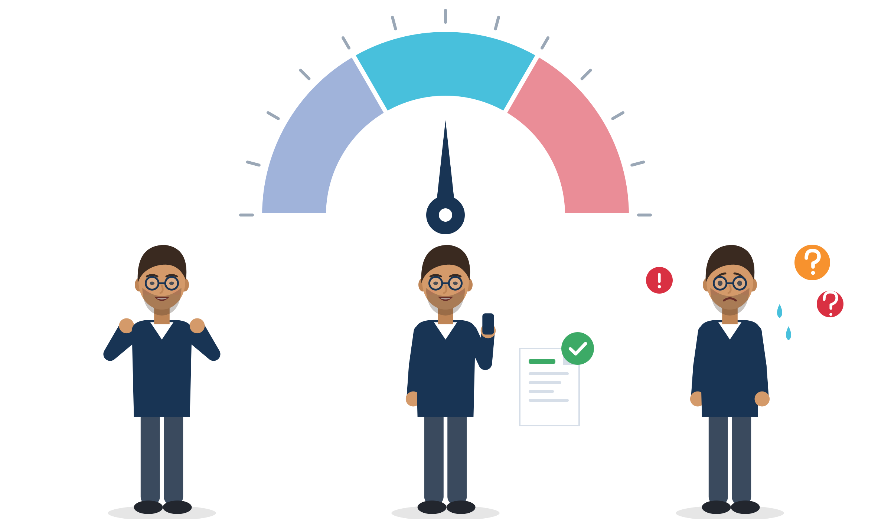
GUDYKUNST: ANXIETY AND UNCERTAINTY MANAGEMENT
Nervous before a call? Aim for "just right"
Anxiety and uncertainty
Mindful
Too little: careless. "No problem, I know everything." You do not prepare or check, and you miss details.
Just right: mindful. A bit nervous, but curious. You prepare, listen and check: "Just to confirm, Monday at 6 a.m.?"
Too much: frozen. "Will I make a fool of myself?" Your head goes empty, and you only nod.
Careless
Frozen
Source: Gudykunst (2004), Bridging Differences, 4th ed. · Gudykunst (1998), International Journal of Intercultural Relations 22(2) · core constructs only
Module 1 · Communication
16
Notes:
Say: "When we talk with people from other groups, we feel anxiety (a feeling: will I look stupid?) and uncertainty (a thought: what does she expect?). Too much blocks us. Too little makes us careless. Being mindful keeps both at a good level."
Mindful means: notice what is happening, check your interpretation, ask a question. Example: before a first call to an employer, prepare three key sentences, one clarification phrase and the job reference. That lowers uncertainty.
Context: uncertainty about legal status, money or family can raise anxiety in conversations with supervisors, interviewers and officials. That is normal, not a weakness (research note, §3.9).
Tip (3 min): "thermometer" with the hand: how nervous do you feel before calling an employer? Then ask: "What brings it down?" Add answers to the strategy bank. Pass is OK.

Slide 17





PROFESSIONAL NORMS AND EXPECTATIONS
Unwritten rules at work: observe, mirror, ask
Formal or informal "you"
Greetings and small talk
Short, fast instructions
Sie/du, u/jij, Lei/tu, siz/sen, Greek eseís/esý. Start formal, mirror the other person, accept an offer to switch.
Being greeted matters a lot to people. A short "How was your weekend?" builds bridges.
Jargon, noise and speed are normal in warehouses and kitchens. Checking is expected, not a weakness.
Group chats and email
Talking about pay and contracts
When unsure, ask
Many teams plan shifts in chats. Short replies can be misread: write clearly what you will do.
Asking about pay, hours and contracts politely, in writing and with dates is a normal work conversation.
"Is there anything I should know about how things work here?" Rules differ between workplaces.
Source: Ager & Strang (2008), p. 15 · FRA (2019), p. 16 · SAI (2026), p. 117 · SMILE research note, communication, §3.5, §3.7-3.8
Module 1 · Communication
17
Notes:
Say: "Every workplace has unwritten rules. You cannot know them all on day one. Watch, copy what fits, and ask."
Forms of address: all five partner languages have a formal and an informal "you" (the T/V distinction, Brown & Gilman, 1960). Safe rule: start formal, mirror, accept an offer to switch. Small talk: Ager & Strang found that "Being recognized and greeted by others in the neighbourhood was greatly valued. Small acts of friendship appeared to have a disproportionately positive impact on perceptions" (author's version, p. 15). No verified comparison of small-talk rules by country exists, so we teach observation, not national rules.
Jargon: in Italy's SAI network a mediator simplifies technical language "dall'italiano all'italiano" (from Italian to Italian) in vocational courses (SAI, 2026, p. 117). Contracts: FRA recommends that "all workers should be given a written contract in a language they can understand, at least as regards the basic terms of their employment" (FRA, 2019, p. 16).
Tip: ask participants to add one unwritten rule they noticed at a workplace, school or office. Keep it about places, not nationalities.

Slide 18

ACTIVITY
Group discussion: common challenges for young migrants
TIME
60 min
STEPS
Build a "challenge wall" with three columns: Language, Culture and norms, System (contracts, recognition, bias).
Write challenges young migrants meet at work on sticky notes, one per note. Use examples of "people I know" if you prefer.
Mark each note: can I influence it? Yes, partly or no.
Choose one challenge. Write one first-step strategy and one person or service who could help.
Gallery walk: visit the other walls and add one idea to each.
GROUP
Groups of 4, then gallery walk
MATERIALS
Flipchart paper, sticky notes in three colours, markers
DEBRIEF
GOAL
Name challenges, see what you can influence, find a first step
Which challenges can I influence? Which need employers or institutions?
Which strategy from our strategy bank fits?
Who can help?
Module 1 · Communication
18
Notes:
Curriculum activity (Session 2): group discussion on common challenges faced by young migrants. Suggested split: 40 min group work, 20 min plenary.
In the plenary, link strategies to the models: repair (Session 3), mindful checking (Gudykunst), bonds, bridges and links (Ager & Strang).
The "System" column protects against self-blame: many challenges need employers and institutions to change.
Tip: keep a "parking lot" flipchart for personal or legal questions, and refer them to advisers after the session. Do not try to give legal advice in the group.

Slide 19

03
SESSION 3 · 1.5 h
Verbal and non-verbal communication skills
Say it clearly, check it, and let your body language support your words.
Clear speaking
Repair moves
Handovers
Body language
Module 1 · Communication
19
Notes:
Session 3 is the main practice session for speaking. Suggested timing (research note): 30 min input (six slides, about 5 min each), 45 min role-play, 15 min debrief.

Slide 20






ELEMENTS OF EFFECTIVE VERBAL COMMUNICATION
Six elements of clear speaking at work
Structure
Key words and facts
Pace and volume
Main point first, then the details. One message at a time.
Names, numbers, times and places: "Room 12, at 14:00".
Slow down a little. Pause after key words. Keep a calm volume.
Match the other person
Check understanding
Close the loop
Adjust formality and speed to them. If someone talks down to you: "Thanks, you can speak normally."
Repeat back the key point, or ask the other person to do it.
End with the next step: who does what, and by when.
Source: International Plain Language Federation, definition of plain language · Giles, Coupland & Coupland (1991), Communication Accommodation Theory
Module 1 · Communication
20
Notes:
Say: "Clear speaking is not about difficult words. It is about order, facts, pace and checking."
Plain language (IPLF): "A communication is in plain language if its wording, structure, and design are so clear that the intended readers can easily find what they need, understand what they find, and use that information."
Communication Accommodation Theory, plainly: people adjust their speech to each other. Becoming more similar in speed and formality (convergence) signals respect. Speaking very slowly, loudly or in "simplified" language to someone who does not need it (over-accommodation) can feel patronising. Mirror formality: first name only after an invitation.
Run (5 min): in pairs, one gives a three-sentence instruction using the six elements ("Please clean tables 1 to 6 first. Then the windows. Tell me when you finish."). The partner repeats back. Tip: give each pair a real object or task card to make it concrete.

Slide 21

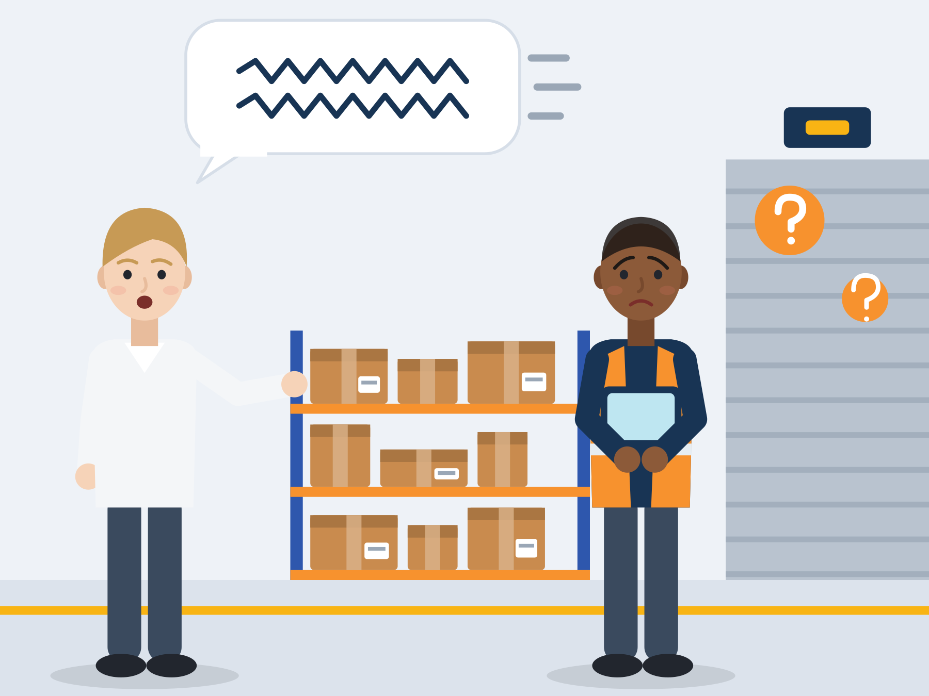
ILLUSTRATIVE SCENARIO
Aisle 4 or dock 2?
Bilal, 19
First day in a warehouse near Rotterdam
DISCUSS
Why did Bilal nod?
What could he say in the first ten seconds?
What could the team leader do differently?
Logistics
First day
Fast instruction
The team leader says quickly: "Grab the scanner, pick the B-list, drop the totes at dock two, and don't block the fire lane." Bilal nods and starts. Ten minutes later he is at the wrong place, and the team leader is annoyed.
Grounded in: 19% of immigrant workers vs 7% of native-born workers hold elementary jobs, with short spoken instructions (OECD/EC, Settling In 2023, p. 92).
Module 1 · Communication
21
Notes:
Say: "Nodding when we do not understand is very human, especially when we are nervous. The question is what we can do in the next ten seconds."
Run (5 min): two volunteers replay the scene twice: once with silent nodding, once using the four repair moves on the next slide.
Evidence: immigrants hold about 30% of all elementary jobs in the EU (Settling In 2023, p. 92). Lack of host-language skills is the most-named specific obstacle to a suitable job (Eurostat lfso_21obst01). "Fire lane" shows why checking is also a safety issue.
Tip: ask the third question seriously. Clear instructions are also the team leader's job, not only Bilal's.

Slide 22
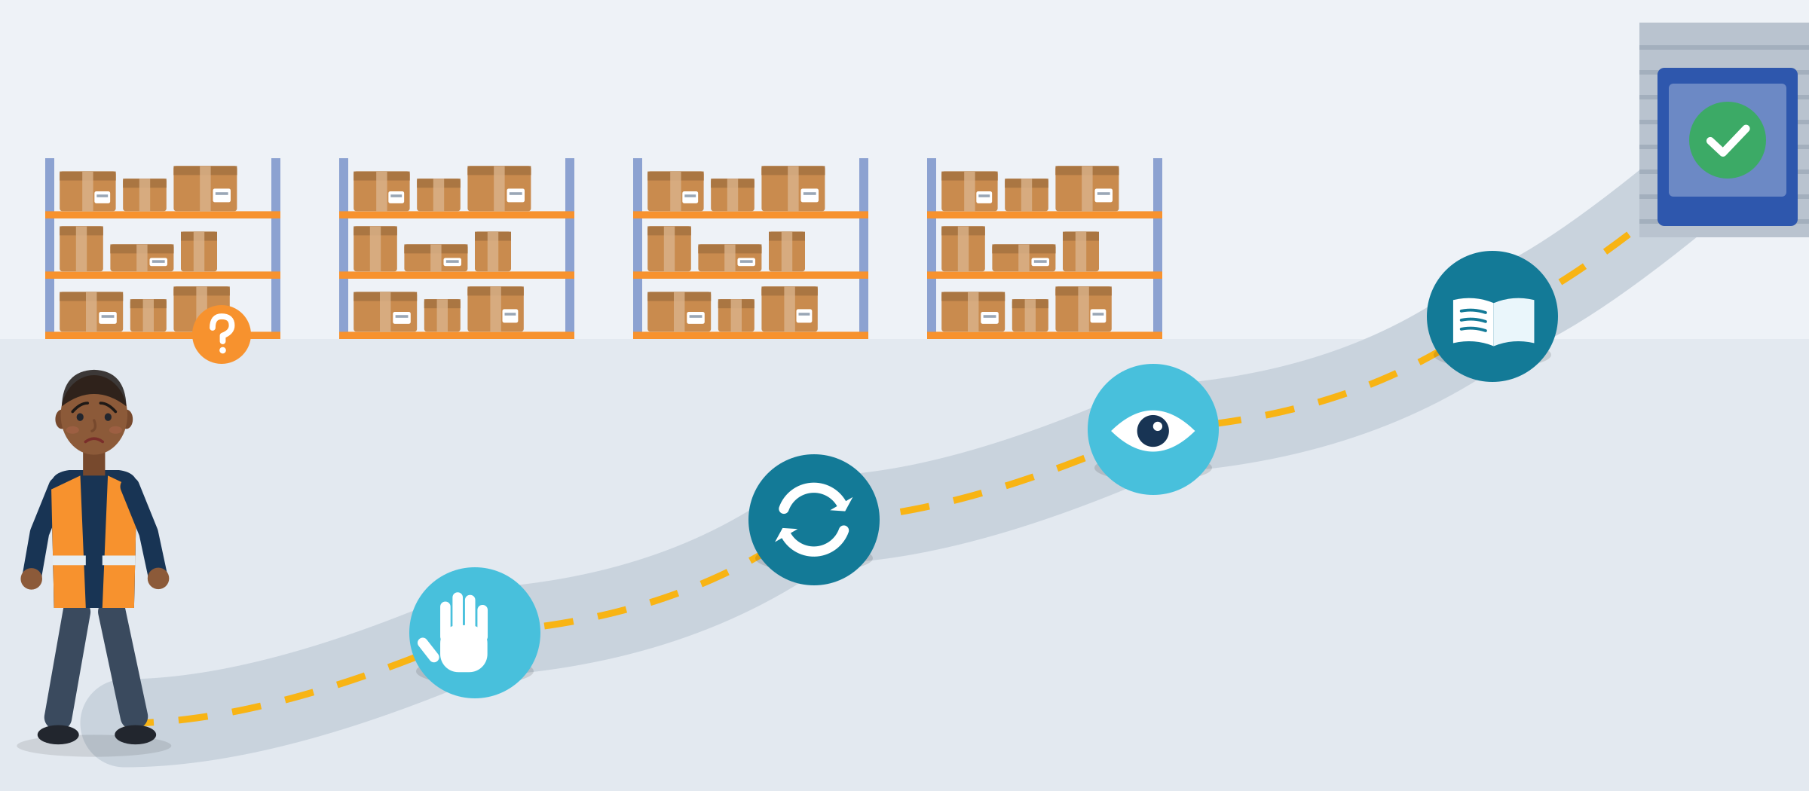
WHEN YOU DO NOT UNDERSTAND
Four repair moves for the first day
Say it like this
1 · Signal: "Sorry, I didn't catch that. Could you say it again, a bit more slowly?"
2 · Repeat back: "So: pallets from aisle 4 to dock 2, right?"
3 · Ask to see it: "Could you show me once? Then I'll do the rest."
4 · Ask for the word: "What does 'tote' mean here?" "What do you call this?"
4 · Ask for the word
3 · Ask to see it
2 · Repeat back
1 · Signal
Everybody repairs, also native speakers. Asking is a skill, not a failure.
Source: Schegloff, Jefferson & Sacks (1977) on repair · Council of Europe (2020), CEFR Companion Volume, p. 89 · Council of Europe (2018), RFCDC Vol. 1, p. 51
Module 1 · Communication
22
Notes:
Slide message: repair happens in every conversation, also between native speakers. Asking is a skill, not a failure.
Say: "Conversation researchers call fixing misunderstandings 'repair'. Everybody does it all the time. These four moves work in any language."
Evidence: the CEFR treats asking for clarification as a competence: "Can ask very simply for repetition when they do not understand" and "Can ask someone to clarify or elaborate what they have just said" (A2-B1 descriptors, p. 89). The Council of Europe's democratic competences include "The ability to manage breakdowns in communication, for example by requesting repetitions or reformulations from others" (RFCDC, Vol. 1, p. 51).
Mediation: helping a new colleague who speaks your language is also a valued skill (CEFR Companion Volume, p. 90).
Tip: praise every repair move you hear in the room ("Good question!"). As a trainer, check with "Show me" or "Tell me in your words", not "Do you understand?"

Slide 23

USEFUL PHRASES
Phrases for checking, phoning and first days
Checking and repair
On the phone
First days
“Sorry, I didn't catch that. Could you say it again, a bit more slowly?”
“Just to check I understood: you want me to clean the cold room first, right?”
“Could you show me once? Then I'll do the rest.”
“Good morning, my name is Amir Haddad. I'm calling about the job advert for a forklift assistant.”
“Could you spell that for me, please?”
“Let me repeat the details: Monday, 6 a.m., at the main gate. Is that correct?”
“Should I say Sie or du to you?”
“How was your weekend?”
“Is there anything I should know about how things work here?”
Module 1 · Communication
23
Notes:
Run (5 min): pairs read the phrases aloud, then each person chooses the two phrases they will use this week and writes them on a card.
Phone: at B1, a person "Can use telecommunications for everyday personal or professional purposes, provided they can ask for clarification from time to time" (CEFR Companion Volume, p. 81). Asking for spelling and repeating details is part of competent phone use.
Context: in an experiment with telephone-based interviews, managers rated accented applicants lower, especially for customer-facing jobs (Timming, 2017). Preparation helps, but the bias is not the applicant's fault.
Tip: adapt "Sie or du" to the local language (u/jij, Lei/tu, siz/sen). Translate the phrase cards into participants' strongest languages if you can.

Slide 24

STRUCTURED SPEAKING: THE SHIFT HANDOVER
Shift handover in four boxes: SBAR
Room 12: Mrs K. refused lunch and seems confused.
Four boxes
S
S · Situation: what is happening now.
B · Background: what is relevant.
A · Assessment: what I think.
R · Recommendation: what next.
In a warehouse: "Dock 2: the truck is late. The driver called at 6:10. We will miss the 10:00 slot. Start loading order 5 first."
B
It started after her morning medication.
A
I think she may be dehydrated.
R
Please check her again at 4 p.m. and call the nurse if it continues.
On the board: a care-home handover. A fixed order lowers the language load.
Source: Leonard, Graham & Bonacum (2004), Quality & Safety in Health Care · Müller et al. (2018), BMJ Open 8(8), systematic review of 11 studies
Module 1 · Communication
24
Notes:
Slide message: a fixed order lowers the language load. You know what comes next, so you can focus on how to say it. The board shows the care-home example (Grace); the panel shows the same order in a warehouse.
Say: "SBAR comes from hospitals and aviation. It works anywhere a shift ends and another begins."
Evidence: a systematic review found "moderate evidence for improved patient safety through SBAR implementation, especially when used to structure communication over the phone", but also "a lack of high-quality research" (Müller et al., 2018).
Invented scenario for practice: Grace, 24, care assistant from Ghana in the Netherlands, worries her Dutch is "not good enough" and only says "Mrs K. is not good." Task: rewrite it as SBAR and say it in under one minute; the listener reads back the key point. Refugee health professionals in Germany named language and team communication among their challenges (Khan-Gökkaya & Mösko, 2021).
Tip: let pairs write their own SBAR for a job they know (kitchen, shop, building site).

Slide 25
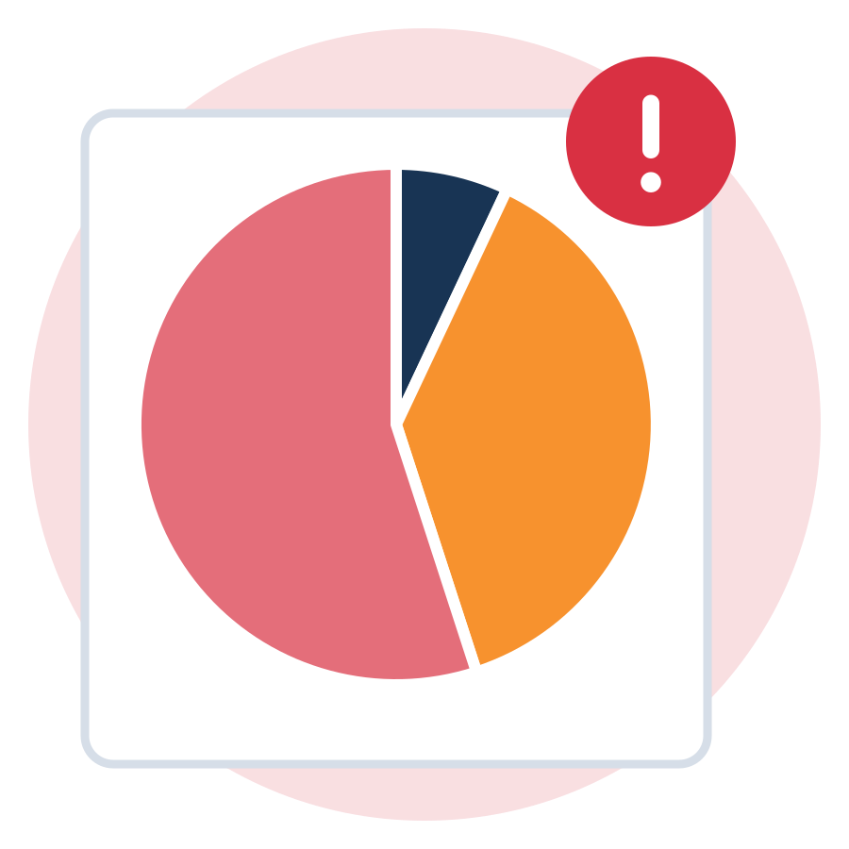

NON-VERBAL CUES: A FAMOUS MYTH
"93% is body language"? What the study really said
The popular claim
What Mehrabian studied
"Only 7% of communication is words, 38% is voice and 55% is the face."
Seen on posters and in many trainings.
It suggests that words hardly matter.
Two small experiments in 1967: judging liking from single words.
Words, voice and face sent mixed signals on purpose.
Mehrabian: "Unless a communicator is talking about their feelings or attitudes, these equations are not applicable."
At work, words matter. Let your face, voice and posture tell the same story as your words.
Source: Mehrabian & Wiener (1967) · Mehrabian & Ferris (1967) · Mehrabian, kaaj.com/psych/smorder.html · Council of Europe (2018), RFCDC Vol. 1, p. 48
Module 1 · Communication
25
Notes:
Run (3 min): before showing the slide, ask "How much of communication is body language? Write a number." Then show the slide.
Say: "The 7-38-55 numbers come from small experiments where people judged if a speaker liked them, from one word and a tone or face that did not match. Mehrabian himself says the numbers do not apply to normal conversations. At work, your words carry the instruction, the time, the number."
Evidence: Mehrabian & Wiener (1967), Mehrabian & Ferris (1967). The Council of Europe lists noticing "possible inconsistencies between verbal and non-verbal messages" as a listening skill (RFCDC, Vol. 1, p. 48): body language matters most when it does not fit the words.
Tip: do not laugh at anyone who believed the number. Many trainers still teach it.

Slide 26
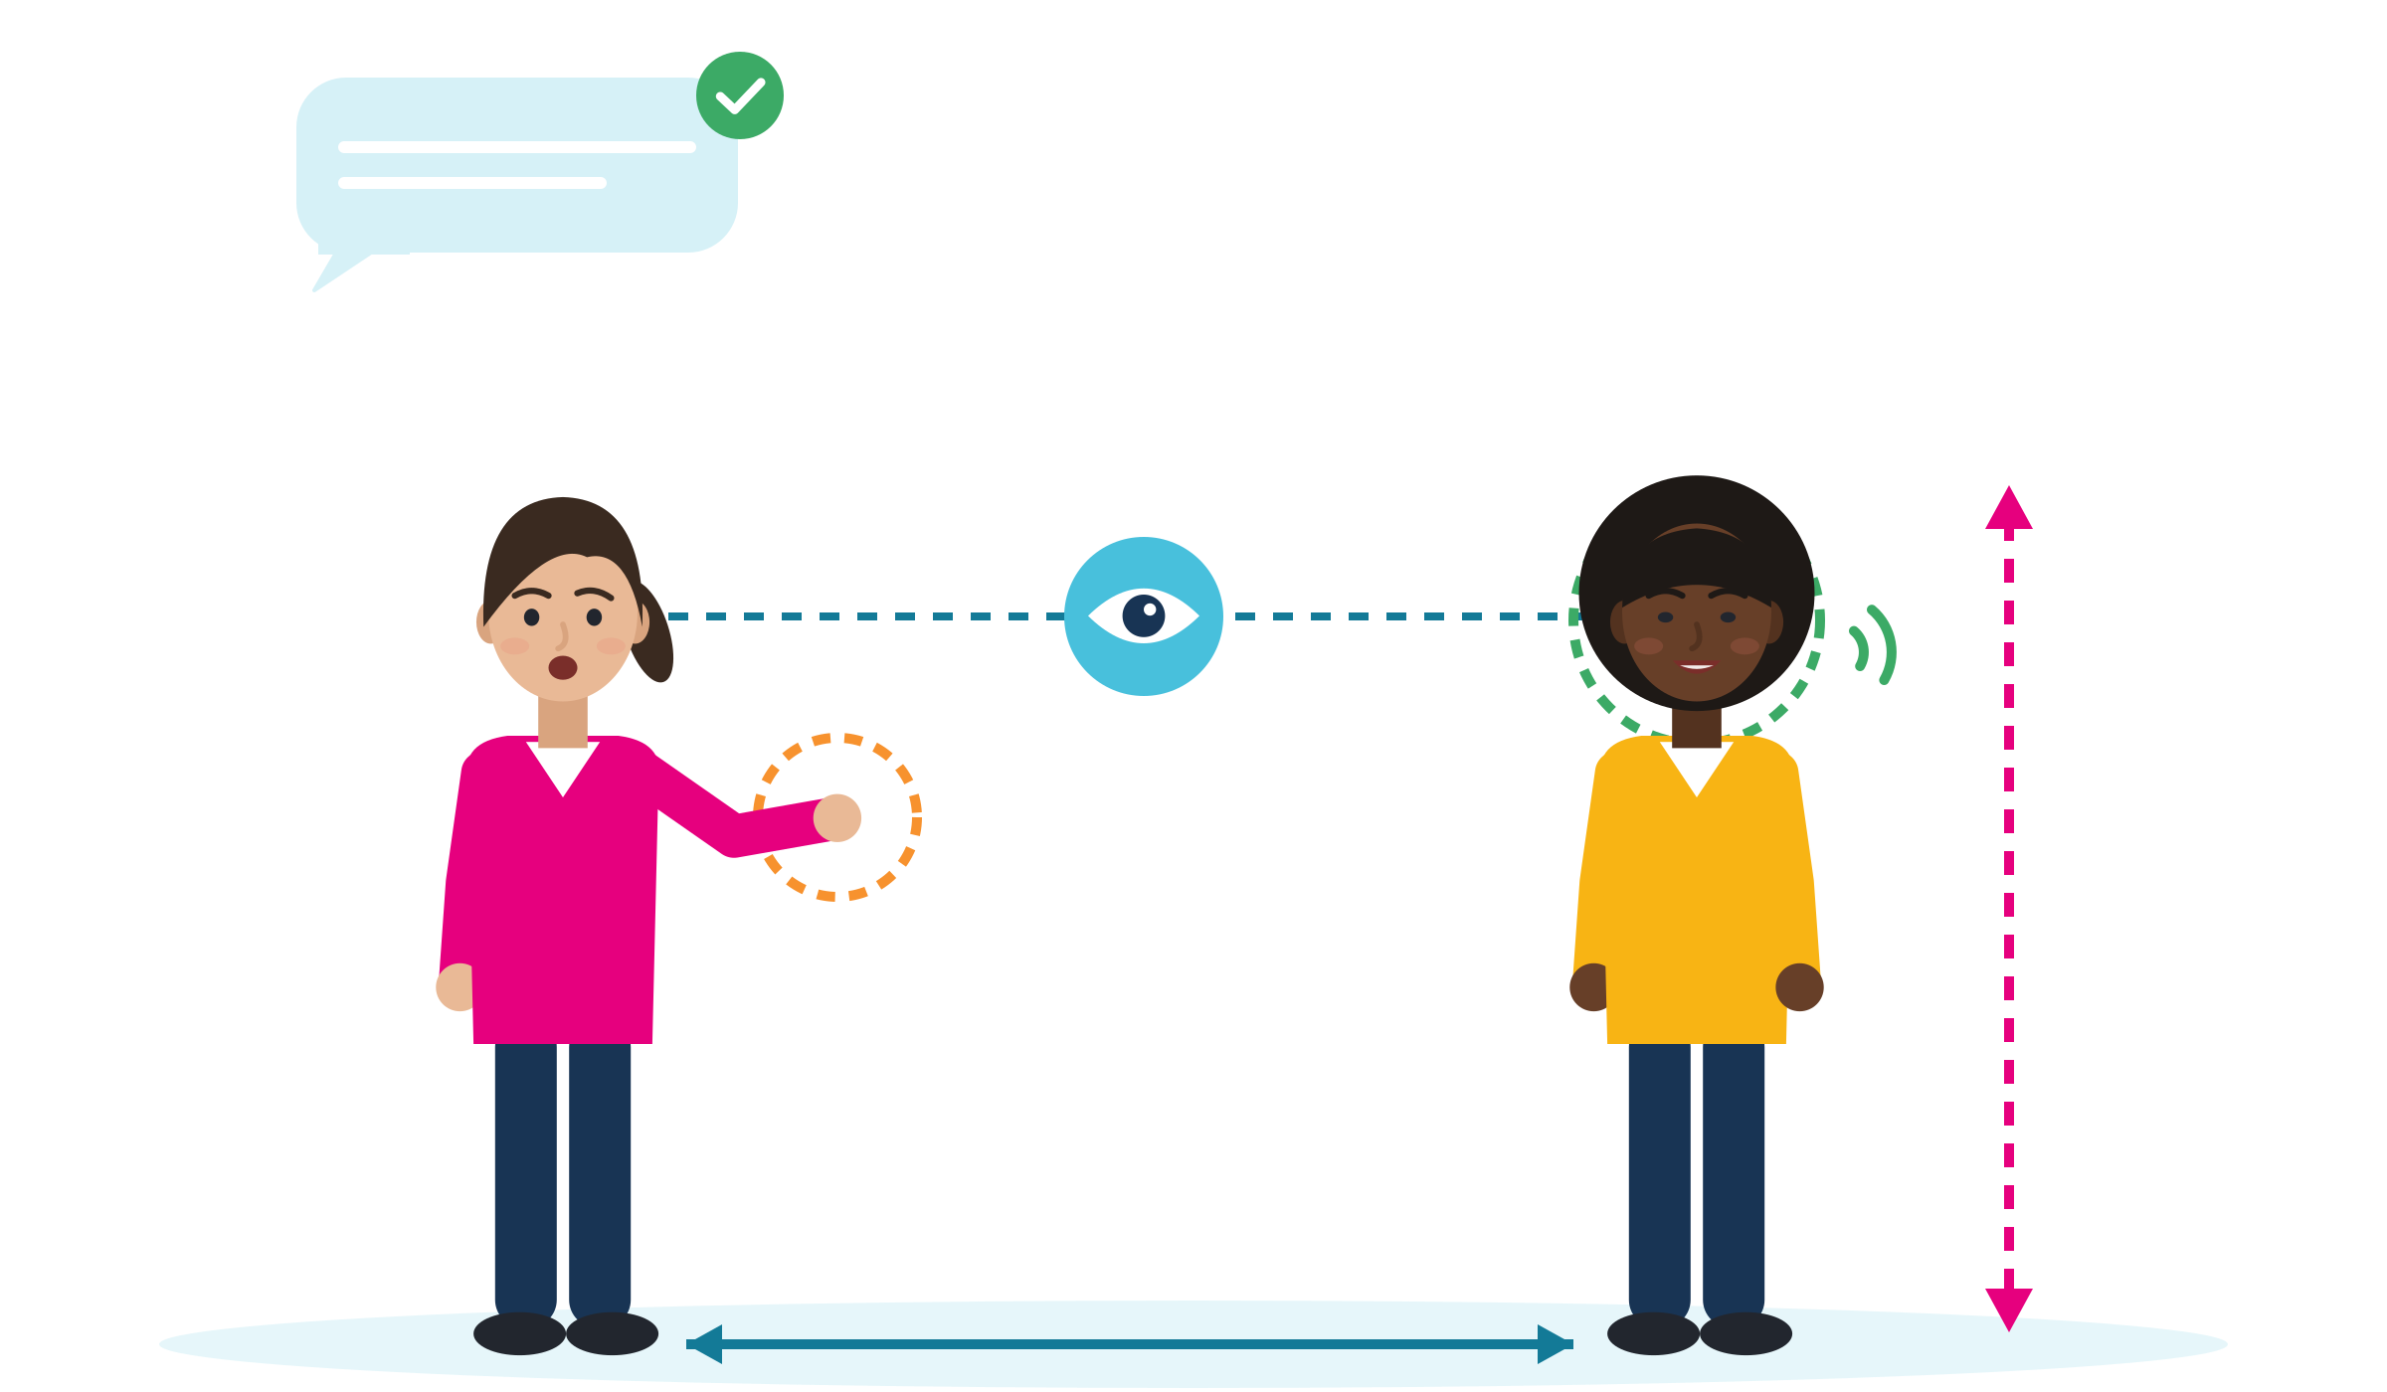
NON-VERBAL CUES AND BODY LANGUAGE
Body language: observe, do not assume
Words and body agree
Observe, then adjust
Eye contact: what feels polite differs. Observe before you judge.
Distance: differs with age and gender, not only country.
Gestures: the same gesture can mean different things. Not sure? Ask.
Face and voice: calm and friendly, also when your language is not perfect.
Posture: open and calm: feet on the ground, hands visible, breathe.
Words and body agree: people notice mixed signals. Make them say the same thing.
Face and voice
Eye contact
Posture
Gestures
Personal distance
Source: Akechi et al. (2013), PLoS ONE · Sorokowska et al. (2017), JCCP 48(4) · Council of Europe (2018), RFCDC Vol. 1, p. 61 · ESCO skill "use body language"
Module 1 · Communication
26
Notes:
Say: "Body language is real, but it is not a dictionary. The same signal can mean different things to different people. So we observe, and when it matters, we ask."
Evidence: preferred personal distance varies with age and gender as well as country (Sorokowska et al., 2017, global comparison). Responses to eye contact differ between groups studied in the West and East (Akechi et al., 2013). The CEFR describes a pluricultural skill: "Can generally act according to conventions regarding posture, eye contact and distance from others" (pp. 124-125). We make no claims about specific gestures, because those could not be verified.
ESCO lists "use body language" ("Use and understand body language, gestures and other paralinguistic cues") as a transversal skill: participants can name it on a CV.
Run (5 min), "same sentence, three bodies": a volunteer says "I can do that" with a closed, an aggressive and an open posture. The group guesses what each one means. Tip: let volunteers choose; nobody has to act.

Slide 27

ACTIVITY
Role-play: practising workplace conversations
TIME
60 min
STEPS
Pick a scenario card: the first phone call (Amir), Aisle 4 or dock 2 (Bilal), the handover (Grace), "Tell me about yourself" (Hevin) or the café complaint (Mariam).
Prepare for 3 minutes. You may prepare in your strongest language.
Play for 4-5 minutes. The partner speaks fast once, so the speaker can use a repair move.
The observer ticks: greeting and formality, one repair move, a repeat-back, calm open body language, a clear closing.
Rotate roles so everyone plays the speaker once (about 12 minutes per round).
GROUP
Trios: speaker, partner, observer
MATERIALS
Scenario cards, phrase cards, observer checklist, time-out cards
DEBRIEF
GOAL
Practise greeting, checking, repeating back and closing in real work situations
What did you do when you did not understand?
How did your body language change when you were nervous?
What will you say differently next time?
Module 1 · Communication
27
Notes:
Curriculum activity (Session 3): Role-play, practising workplace conversations. Suggested split: 45 min role-play, 15 min debrief.
Card "The first phone call" (invented): Amir, 21, calls a logistics company about a forklift-assistant job. The recruiter asks fast: "Can you start on the early shift on Monday, and do you have your own safety shoes?" Amir understands "Monday" but not "early shift". Task: greet, give the job reference, use one repair phrase, repeat back the details, end politely.
Debrief with "two stars and a wish": two things that worked, one thing to try next time.
Tip: allow time-out cards and let shy participants start as observers. No filming.

Slide 28

04
SESSION 4 · 1 h
Interpersonal skills and inclusive communication
Respect, support and real listening: how good colleagues talk with each other.
Respectful interactions
Active listening
Case study
Module 1 · Communication
28
Notes:
Session 4 is short and practical. Suggested timing: 5 min respectful interactions, 10 min active-listening demo and pair practice, 30 min case work, 15 min plenary (research note).

Slide 29




BUILDING RESPECTFUL AND SUPPORTIVE INTERACTIONS
Effective for you, appropriate for them
Use names well
Choose a shared language
Give credit
Learn names and how to say them. Ask: "How do you pronounce your name?"
If someone does not understand, switch language or summarise for them.
Say who did the work: "Sara prepared the new shelf plan. Thanks, Sara."
Ask before you judge
Speak up as a bystander
Both sides adapt
"What did you mean by that?" before you decide it was rude.
If a "joke" hurts someone, a short "Not funny. Let's get back to work" helps.
Respect is not only the newcomer's job. Colleagues learn and adapt too.
Source: Deardorff (2015), Tuning Journal for Higher Education 3(1), p. 142 · Council of Europe (2018), RFCDC Vol. 1, p. 50
Module 1 · Communication
29
Notes:
Say: "Intercultural competence means communication that is effective, so you reach your goal, and appropriate, so the other person feels respected. Both count."
Evidence: Deardorff defines intercultural competence as "the effective and appropriate behavior and communication in intercultural situations, with effectiveness being determined by the individual and the appropriateness being determined by the other person(s) in the interaction" (2015, p. 142). Her process model runs from attitudes (respect, openness, curiosity) to knowledge and skills (listen, observe, interpret), to inner change (flexibility, empathy) and to effective and appropriate communication. It applies to host colleagues too.
The Council of Europe includes the ability "to express a fundamental disagreement with another person in a manner that is nevertheless respectful of that person's dignity and rights" (RFCDC, Vol. 1, p. 50).
Run (5 min): example: "Effective: my day off was approved. Appropriate: my supervisor felt I asked respectfully." Tip: ask which card participants see least often at work, and why.

Slide 30

ACTIVE LISTENING TECHNIQUES
Listen for the facts and the feeling
Active listening
1 · Listen: full attention. Notice words, voice, face and pauses.
2 · Reflect the feeling: "I can see this is frustrating."
3 · Summarise the facts: "So the order was wrong twice."
4 · Ask or offer: "What would help now?" "Would you prefer a new coffee or a refund?"
2 · Feeling
3 · Facts
1 · Listen
4 · Offer
Source: Rogers & Farson (1957; reprinted 1987), Active Listening · Council of Europe (2018), RFCDC Vol. 1, p. 48
Module 1 · Communication
30
Notes:
Say: "Every message has two parts: the facts and the feeling. Good listeners answer both."
Evidence: Rogers and Farson: "Any message a person tries to get across usually has two components: the content of the message and the feeling or attitude underlying this content." Their workplace example: a machinist says "Well, I'm finally finished with that damned lathe setup", and a good foreman first answers the feeling: "Had a pretty rough time of it?"
Bonus in a second language: summarising is also a way to check that you understood. WEF 2025: 50% of employers call "empathy and active listening" a core skill.
Run (10 min): demonstrate the lathe example with a volunteer, then pairs practise. A tells a small annoying event (invented is fine), B reflects the feeling and summarises the facts; swap. Tip: forbid advice in the first round; only reflect and summarise.

Slide 31





ACTIVE LISTENING WITH A CUSTOMER
The second wrong order
Customer This is the second time my order is wrong! I asked for oat milk.
Mariam I'm sorry about that. So the order was wrong twice. I understand why you're upset.
Customer Yes. And I'm in a hurry.
Mariam Let me see what I can do. Would you prefer a new coffee right now, or a refund?
Customer A new one, quickly please.
Invented scenario: Mariam, 19, works in a café in Amsterdam; her Dutch is A2-B1. Listen, name the feeling, summarise, offer two options.
Module 1 · Communication
31
Notes:
Say: "Mariam's Dutch is not perfect, but she does not need perfect Dutch here. She needs four steps: listen, feeling, facts, offer."
Evidence: 74% of workers in Europe deal with clients or customers at least sometimes (Cedefop, 2022, p. 55); "service orientation and customer service" is a core skill for 47% of employers (WEF, 2025).
Run (5 min): trios with customer, Mariam and observer. Version 2: Mariam freezes first, then asks "Is English OK for you?" and switches language politely if the customer agrees.
Tip: the customer actor can be loud but never insulting.

Slide 32


ILLUSTRATIVE SCENARIO
"Say it again, with your accent!"
Sara, 23
Supermarket team in Greece
DISCUSS
What is said, and what is not said?
What could Sara say, and to whom?
What could a colleague who sees it do?
Where can Sara get support if it continues?
Retail
Greece
A "joke" that hurts
In team meetings, a colleague often repeats Sara's words with an exaggerated accent, "as a joke". Others laugh. Sara laughs too, but now she avoids speaking in meetings. Her ideas for the new shelf plan stay in her head.
Grounded in: 27% of Muslim respondents in 13 EU countries experienced racist harassment in five years; only 21% in Greece knew the national equality body (FRA, Being Muslim in the EU, 2024).
Module 1 · Communication
32
Notes:
Case study for Session 4 (constructed character). Never ask participants for their own discrimination stories.
Options to map with risks: avoid; talk directly with a calm script; ask a supervisor; contact the equality body (in Greece: the Greek Ombudsman). Calm script (DESC, Bower & Bower, 1976): "When you repeat my words with my accent (Describe), I feel embarrassed in front of the team (Express). Please stop doing it (Specify). Then I can keep working with you without tension (Consequence)."
Phrases: "I know you mean it as a joke, but it doesn't feel good. Please stop." "My accent is part of who I am. Let's focus on the work." "Can we talk about this privately for a moment?" Accent bias is linked to status and prejudice, not to how well people are understood (Spence et al., 2024). Only 6% of Muslim respondents who felt discriminated against reported it (FRA, 2024, p. 18).
Tip: this topic can trigger memories. Keep the focus on Sara and offer a quiet exit or a break.

Slide 33



DOCUMENTED PRACTICE: ITALY'S SAI RECEPTION NETWORK
Real practice: communication that opens work
Acireale
Rome
2025
"From Italian to Italian"
Three-way talk in an internship
The network in numbers
In Acireale, a mediator simplifies technical words in vocational courses, so trainees are not stopped by jargon.
D., mother of a one-year-old, did a three-month internship as a hotel chambermaid in Rome. It led to a job.
55,779 people supported in 2025. Of adults: 18.6% vocational training, 10.6% internship, 33.8% job placement.
Source: Servizio Centrale SAI, ANCI & Cittalia (2026), XXIV Rapporto annuale SAI, pp. 103, 105, 117 (programme statistics, no comparison group)
Module 1 · Communication
33
Notes:
Say: "These are real examples from Italy's public reception and integration network. Communication between the young person, the company and the support team made the difference."
Evidence: in the Rome case, the report stresses that communication between the three parties (intern, company and SAI team) is "fondamentale" (essential) for the job placement (p. 103). The programme reports that 33.8% of adult beneficiaries were in job placement in 2025 (p. 105); these are programme statistics without a comparison group, not proven impact.
Case card (invented, based on this practice): Fatou, 21, three-month internship in a hotel in Rome. After two weeks the supervisor says she is "too quiet"; Fatou thinks she is being respectful. Her tutor proposes a three-way meeting.
Tip: ask "Who could be your 'third person' in a difficult talk at work: a tutor, a mentor, a union representative?"

Slide 34
ACTIVITY
Case study analysis: what would respect look like?
TIME
45 min
STEPS
Each group gets one case: Sara and the accent "jokes" (invented), Fatou is "too quiet" (invented) or the SAI Rome internship (real).
Answer: Who is affected? What is said, and what is not said?
Write what respectful, supportive communication would sound like for each person, including bystanders.
Use active listening: how would you reflect the feeling and summarise the facts?
Present in 2 minutes. Add your best sentences to a "team charter" on the flipchart.
GROUP
Groups of 3-4
MATERIALS
Case study texts (Sara, Fatou, the SAI Rome case), flipchart
DEBRIEF
GOAL
Find respectful, supportive words for every person in the case
What does a supportive colleague do in this case?
What can a bystander say?
Which listening technique helped?
Module 1 · Communication
34
Notes:
Curriculum activity (Session 4): Case study analysis. Suggested split: 30 min case work, 15 min plenary.
Fatou's case can be played as a three-way meeting (intern, supervisor, tutor): each prepares one observation and one request.
Tip: discrimination cases can bring back personal memories. Keep the focus on the constructed characters, remind the group that "pass" is OK, and offer a quiet exit.

Slide 35
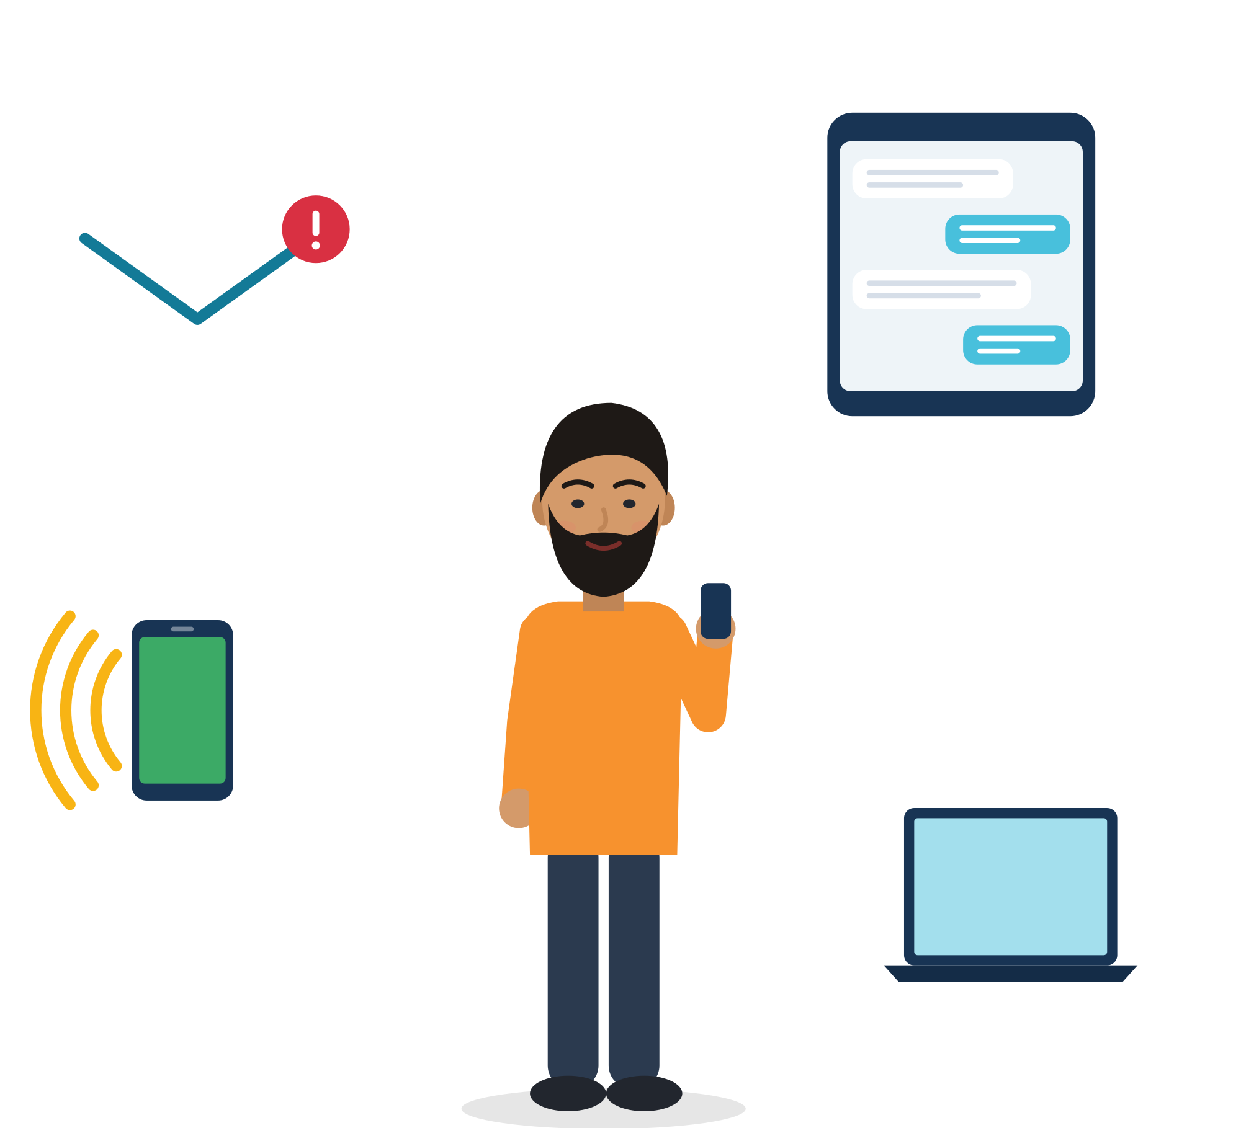
05
SESSION 5 · 1.5 h
Practical strategies for workplace communication
Feedback, conflict, diverse teams and the channels we use every day: phone, email and group chats.
Feedback
Conflict
Diverse teams
Simulation
Module 1 · Communication
35
Notes:
Session 5 gives structures that make hard conversations easier. Suggested timing (research note): 20 min input (SBI, Thomas-Kilmann, channels), 55 min simulation stations, 15 min debrief.

Slide 36
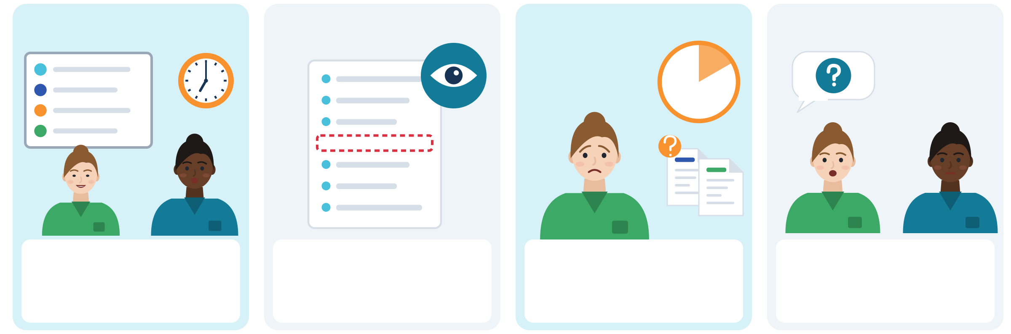
FEEDBACK: CRITICISM AND APPRECIATION
Feedback with SBI: situation, behaviour, impact
S · Situation
B · Behaviour
I · Impact
I · Intent
When and where: "This morning at the handover."
What you saw or heard, no "lazy" or "rude": "The list was missing room 12."
What it caused or how you felt: "I lost ten minutes looking for the information."
Ask what the person wanted: "Was there a reason it was left out?"
Appreciation works the same way: "Yesterday, when the truck came late, you stayed to help me unload. We finished on time. Thank you."
Source: Center for Creative Leadership, Situation-Behaviour-Impact (SBI) and SBII (Intent) feedback model, web article checked 1 October 2026
Module 1 · Communication
36
Notes:
Say: "Good feedback describes what happened, not what kind of person someone is. That makes it easier to hear, and easier to change."
When receiving feedback, use the same structure: if the supervisor is vague, ask for the situation and the behaviour. The Intent step (CCL's extension) turns feedback into a dialogue.
Evidence: 49% of workers in Europe say they need to develop their social skills further (Cedefop, 2022, p. 82). Feedback is a skill everybody is still learning, not only newcomers.
Tip: practise appreciation first. Pairs give each other one SBI compliment about something from this module. It builds safety before criticism.

Slide 37
GIVING AND RECEIVING FEEDBACK
From judgement to clear, fair feedback
INSTEAD OF
TRY
"You are lazy."
"The lunch dishes were still in the sink at 3 p.m. Can we agree who does them?"
"That was not professional."
"Could you tell me which situation you mean, so I can do it better?"
"Your handover is always bad."
"At today's handover, room 12 was missing. I lost ten minutes."
Silence, and then quitting.
"I'd like to talk about something that's important for me."
"Good job."
"You showed me the new machine slowly, once. Now I can do it alone. Thanks."
Module 1 · Communication
37
Notes:
Say: "On the left are judgements. On the right are facts, requests and questions. The right side is easier to accept, and it is fairer."
Line 2 is the receiving side. Invented scenario: Yusuf, 20, kitchen assistant in Italy, is told in front of others: "That was not professional today." He does not know what he did wrong. Practise: stay calm, ask for situation and behaviour, agree a next step. Phrases: "Thank you for telling me. Could you give me an example, so I can improve?" "I understand. Next time I will [action]. Is that what you expect?"
Run (5 min): pairs write one more judgement they have heard (anywhere) and rewrite it.
Tip: criticism in front of the whole team is itself a problem. "Can we talk about this privately for a moment?" is always a valid answer.

Slide 38
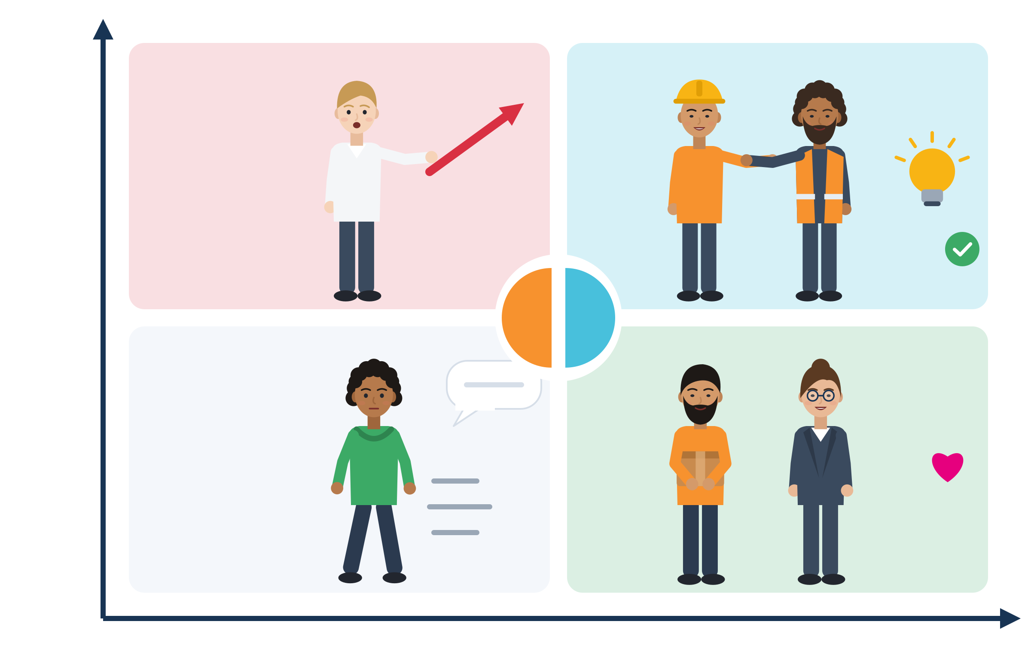
CONFLICT MANAGEMENT: THOMAS-KILMANN
Five ways to handle conflict: choose, do not default
Assertive: my needs
Competing
Collaborating
Choose the mode
Competing: "We do it my way." Needed when safety is at risk. Costly in everyday team life.
Collaborating: "Let's find a solution that works for both." Worth it when a problem repeats.
Compromising: "Let's meet halfway." Fast, and both give something.
Avoiding: "Let's leave it." Wise for a short, unimportant disagreement. Harmful if problems grow.
Accommodating: "OK, as you wish." Builds goodwill. Harmful if it means unpaid hours or harassment.
Newcomers often avoid or accommodate. Choose, do not default: what do I risk?
Compromising
Avoiding
Accommodating
Cooperative: the other person's needs
Source: Kilmann & Thomas (1977), Educational and Psychological Measurement 37(2) · assertiveness × cooperativeness diagram after Thomas
Module 1 · Communication
38
Notes:
Say: "There is no always-right way to handle conflict. Each mode is a tool. Problems start when we use one tool for everything."
Evidence: the five modes (competing, collaborating, compromising, avoiding, accommodating) were verified in Kilmann & Thomas (1977). Many newcomers default to avoiding or accommodating because of insecurity about contract, status or language (research note, §4.10).
Run (5 min): read short conflicts (a rota swap, a colleague takes credit for your work, music in the break room, unpaid overtime). Participants point to the mode they would choose and say why.
Tip: make clear that accommodating to unpaid hours or harassment is never the "nice" option. Link to the help points in Session 6.

Slide 39

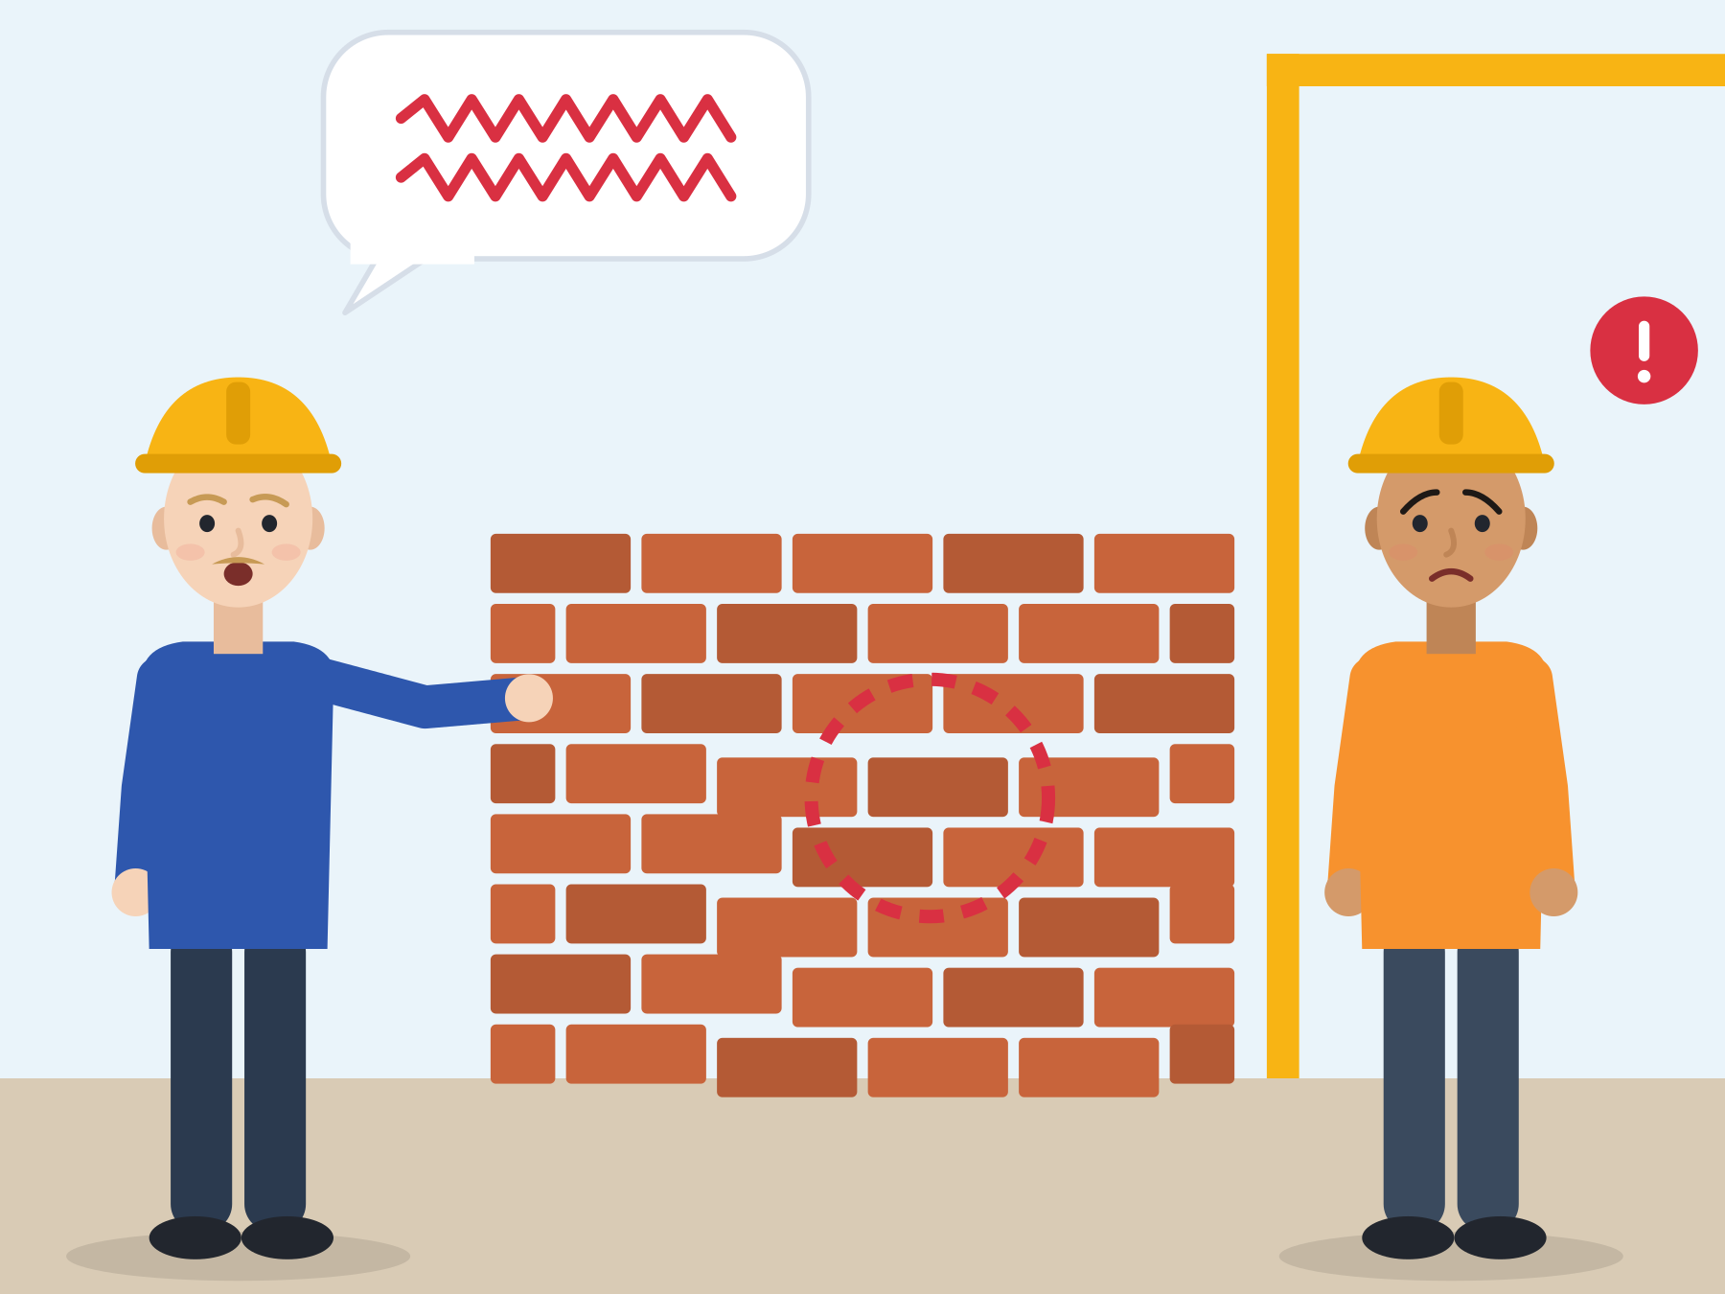
ILLUSTRATIVE SCENARIO
Direct or rude?
Kemal, 22
New in a construction team in the Netherlands
DISCUSS
What did Pieter mean? What did Kemal hear?
How could Kemal raise it, using SBI?
Which conflict mode fits here?
What team rule could help both of them?
Construction
Diverse team
Feedback style
Pieter, an experienced bricklayer, says: "This wall is wrong, do it again." Kemal hears an insult in front of everyone. Pieter thinks he was only being clear and fast. After that day, Kemal stops asking questions, and small mistakes become bigger.
Grounded in: across 67 countries there is "more consensus than disagreement on value priorities across countries" (Fischer & Schwartz, 2011). This is about two people's styles, not two nations.
Module 1 · Communication
39
Notes:
Communication in diverse teams. Say: "Pieter's style is fast and direct. Kemal's expectation is different. Neither is a bad person, and the team loses when Kemal stops asking."
Possible solution: both explain their intention; Pieter adds a reason ("The joints are too wide, so it is not stable"), Kemal asks "What exactly should I change?" (convergence, Communication Accommodation Theory). The team agrees how to give fast feedback that is clear and respectful.
Evidence: the Council of Europe lists "Adapting to different communication styles and behaviours" under flexibility and adaptability skills (RFCDC, Vol. 1, p. 50).
Tip: if the discussion turns to "the Dutch are" or "Turks are", ask "Is that true for everyone you know there?"

Slide 40
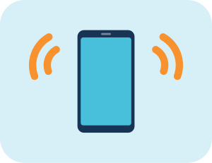



PHONE, EMAIL AND GROUP CHATS
Phone, email or group chat: which one, and how?
 | Channel | Good for | How to do it well
 | Phone call | Urgent things, being late or sick, first contact with an employer | Prepare 3 sentences and the job reference. Repeat details back. Ask people to spell names.
 | Email | Pay, hours, contracts, anything you may need to show later | Clear subject, one request, dates and numbers, polite start and end. Keep a copy.
 | Team group chat | Shift swaps and quick updates for everyone | Write the full answer, not only an emoji: "I can cover Saturday, 8 to 16."
 | Private talk or message | Feedback, conflict, personal topics | Move sensitive topics out of the group: "Can we talk privately for a moment?"
Omar answered "Who can cover Saturday?" with a thumbs-up. He meant "I saw it". He was put on the rota.
Source: Cedefop (2022), ESJS 2021, p. 23 · ESCO skill "use online conventions of netiquette" · Council of Europe (2020), CEFR Companion Volume, p. 81
Module 1 · Communication
40
Notes:
Say: "Choosing the right channel is part of the message. Pay questions in writing, urgent things by phone, sensitive things in private."
Evidence: 46% of workers in Europe used digital communication tools more often for work meetings after COVID-19 (Cedefop, 2022, p. 23). ESCO's netiquette skill: "Adapt communication strategies to the specific audience and be aware of cultural and generational diversity in digital environments."
Invented scenario: Omar, 25, replied with a thumbs-up meaning "I saw it"; the shift leader read it as "yes"; Omar did not come; conflict followed. In chats, tone and context are thin, so check before you react. Model answers: "To confirm: I can cover Saturday 8-16." / "I saw the message, but I can't work on Saturday, sorry."
Tip: let the group agree three "group-chat rules" for an imaginary team.

Slide 41

TALKING ABOUT PAY: A NORMAL WORK CONVERSATION
Six hours missing on the payslip: write it clearly
Lina, 22, bakery in Germany
1 · Subject: "Question about my payslip, March 2026".
2 · Facts: "My payslip shows 74 hours, but I worked 80 hours (see the dates below)."
3 · One request: "Could you please check it?"
4 · Polite close: "Thank you. Kind regards, Lina." Keep a copy and your own record of hours.
Not an attack: a question with dates. In Germany, employers must give a pay statement in text form with every payment.
1
2
Payslip: 74 hours
3
4
My record: 80 hours
Source: Gewerbeordnung § 108 (Germany) · FRA (2019), Protecting migrant workers from exploitation: workers' perspectives, pp. 16, 20 · invented scenario
Module 1 · Communication
41
Notes:
Say: "Asking about your pay is not rude and not dangerous. It is a normal question. Facts, dates and a polite request make it easy for the employer to check."
Scenario (invented): Lina, 22, works in a bakery in Germany. She is afraid of losing her job if she complains. A short, factual email is not an attack: it is a question with dates. The picture: the payslip shows 74 hours, her own record shows 80.
Evidence: FRA interviewed 237 exploited migrant workers in eight EU countries: "Lack of language skills emerged as strongly interconnected with migrant status and as an obstacle to knowing workers' rights" (FRA, 2019, p. 20); language skills deterred them from challenging employers, and access to language courses increased willingness to report. The ILO Guiding Principles call for information on rights "in a language they understand". In Germany, § 108 GewO requires a pay statement "in Textform" with each payment.
Run (10 min): participants write the four-sentence email for Lina, then role-play the follow-up talk with the manager. Rules differ by country; for Türkiye, ILO Information Centres give free information on registration and social security (30,100 workers counselled by May 2026; ILO, 2026, p. 4).
Tip: stress "keep your own record": hours, breaks, photos of rotas, copies of messages.

Slide 42
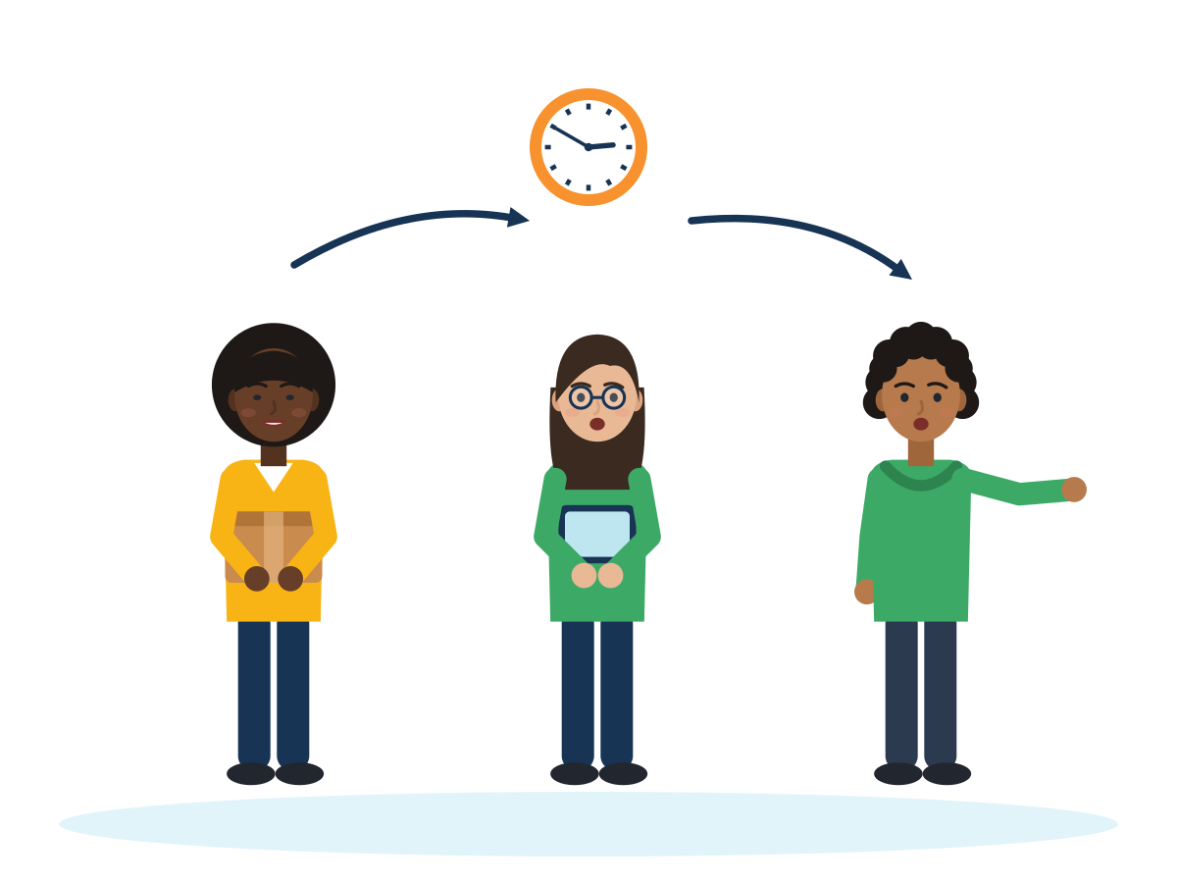
ACTIVITY
Simulation exercises: four stations
TIME
70 min
STEPS
Station A, feedback: Yusuf hears "That was not professional." He asks for the situation and behaviour; the supervisor repeats it with SBI.
Station B, conflict in a diverse team: Pieter and Kemal. Choose a conflict mode and explain why.
Station C, handover: Grace gives an SBAR handover in under one minute. The listener reads back the key point.
Station D, chat and email: rewrite Omar's thumbs-up and Lina's payslip email in plain language.
Each station has a role card, a phrase card and a one-line success criterion. Everyone plays the supervisor once.
GROUP
Four groups rotate, about 12 min per station
MATERIALS
Role cards, phrase cards, timer, sample chat and payslip printouts
DEBRIEF
GOAL
Use a structure (SBI, conflict modes, SBAR, plain language) under light pressure
Which tool felt most useful?
When is avoiding OK, and when not?
What changed when you used a structure?
Module 1 · Communication
42
Notes:
Curriculum activity (Session 5): Simulation exercises. Suggested split: 55 min stations (4 × 12 min plus changes), 15 min debrief.
Success criteria to print on the cards: A = situation and behaviour named; B = mode named and explained; C = handover under one minute, read back correctly; D = subject, facts, one request, polite close.
Tip: rotating the "supervisor" role builds confidence and empathy. Participants often notice how hard it is to give clear feedback.

Slide 43

06
SESSION 6 · 1.5 h
Reflection and action planning
Look at your strengths, choose one goal, and plan the next four weeks.
Self-assessment
Action plan
Closing discussion
Module 1 · Communication
43
Notes:
Session 6 turns practice into a plan. Suggested timing (research note): 25 min self-assessment, 35 min personal action plan, 30 min closing discussion and feedback.

Slide 44
SELF-CHECK
Self-assessment: my communication at work
Not yet
Sometimes
Usually
I ask someone to clarify or repeat when I do not understand.
I can use the phone for work, asking for clarification when needed.
I can explain a task or a problem in a clear order.
My body language is calm and fits my words, also when I am nervous.
I listen for the feeling and the facts, and I summarise.
I can ask for feedback, and give it with situation, behaviour and impact.
I can express disagreement respectfully.
Module 1 · Communication
44
Notes:
Curriculum tool (Session 6): Self-assessment, strengths and areas for development in communication. The statements are adapted from the CEFR Companion Volume (pp. 81, 89), the Council of Europe RFCDC (pp. 48-51) and LifeComp S2 Communication (Sala et al., 2020, p. 48).
This is not a validated test: never use it for grading or selection. Participants mark one strength (a "Usually") and one area for development (a "Not yet"), and keep both for the action plan.
Run (15 min): individual, then 5 minutes in pairs: "Tell your partner one strength and one example where you used it." Tip: start with the strengths.

Slide 45
SELF-CHECK
Employment-focused communication checklist
Not yet
Almost
Yes
I can introduce myself in 60 seconds.
I have three repair phrases ready.
I know how to confirm instructions.
I can write a short, clear work email.
I know my rights documents (contract, payslip) and whom to ask.
I know my local equality body or advice centre.
I have one mentor or "bridge" person.
Module 1 · Communication
45
Notes:
The curriculum names an "employment-focused adaptability/communication checklist" among its materials. This 7-item version is proposed in the SMILE research note (§8) for the communication module; it is a practical list, not a validated instrument.
Run (10 min): every "Not yet" or "Almost" is a possible step for the action plan. Ask: "Which one could become a 'Yes' in four weeks?"
Tip: for "equality body or advice centre", point to the table "Where to go when it is not OK" later in this session.

Slide 46


BE FAIR TO YOURSELF
Skills open doors, but they are not the whole story
What this skill can change
What it cannot fix alone
Ask, check and repeat back, so fewer mistakes happen.
Explain your experience clearly in interviews and at work.
Give and take feedback, and handle conflict calmly.
Build bridges: colleagues, mentors, advisers.
Identical CV, different name: 55 of 100 got a positive answer with a Dutch name, 40 of 100 with a Turkish name.
Recognition of diplomas, residence permits and the right to work depend on laws and offices, not on you.
Discrimination is not your fault. It can be reported to an equality body, a union or an NGO.
Train your skills AND know your rights. Both are part of a fair start.
Source: Thijssen et al., 2021, JEMS (correspondence test, NL, applicants aged 23-25)
Module 1 · Communication
46
Notes:
This slide protects participants from a "deficit" message: soft-skills training must not suggest that unemployment or discrimination is their fault.
Field experiments send identical CVs that differ only by name; the call-back gap therefore measures discrimination, not skills (Quillian et al., 2019, meta-analysis of 97 experiments).
Only 6% of Muslim respondents who felt discriminated against reported it (FRA, Being Muslim in the EU, 2024). Point to the help points slide.
Communication-specific evidence: accent bias in hiring (d = 0.47) is not explained by how well candidates are understood (Spence et al., 2024). In a German field experiment, a Turkish name plus headscarf got 4.2% call-backs, compared with 18.8% for a German name and the same CV: she needed 4.5 times as many applications (Weichselbaumer, 2016/2020).
Clear information can help: in a German test, the name gap disappeared when applications included reference letters with positive information about the person (Kaas & Manger, 2012). But this never removes the employer's duty not to discriminate.

Slide 47



FREE EUROPEAN TOOLS
Name your communication skills in EU words
EU Skills Profile Tool
Europass
ESCO skill names
ENIC-NARIC
Describe your skills and experience in your language and English side by side. Arabic, Farsi, Pashto, Turkish, Ukrainian and more.
Free CV editor and profile in 31 languages. Use it to turn your skills profile into a CV.
Use the EU's own words for soft skills, e.g. “collaborating in teams and networks”, on your CV.
National centres that compare and recognise foreign diplomas. Refugees can be assessed even with missing papers.
Source: ec.europa.eu/migrantskills · europass.europa.eu · esco.ec.europa.eu · enic-naric.net (Lisbon Recognition Convention, Art. VII)
Module 1 · Communication
47
Notes:
The EU Skills Profile Tool is "not intended as a recognition or authentication tool": it helps you describe skills, not certify them.
ESCO names for this module: "use body language", "interact with others", "use online conventions of netiquette", "use communication techniques", "establish communication with foreign cultures". Put them on Europass with one concrete example each, for example "handed over shifts with SBAR in a care home".
Optional activity (15 min, if there is internet): fill in part of the EU Skills Profile Tool in two languages side by side, then practise saying two lines aloud for an interview.
Netherlands: most people in civic integration can get a free credential evaluation by IDW (inburgeren.nl).

Slide 48


INTERVIEWS: TELLING YOUR STORY
"Tell me about yourself": a 60-second answer
Interviewer Tell me about yourself.
Hevin I'm a trained nursing assistant, and I'm improving my German to B2. Before, I worked two years in a textile workshop.
Interviewer I see a gap in your CV. What did you do in the last year?
Hevin I focused on German and finished B1. I volunteer at a care home twice a week. Now I'm ready to start in care.
Invented scenario: Hevin, 26, Germany. Present, past, future. Show what you are doing now: courses, volunteering, certificates.
Module 1 · Communication
48
Notes:
Say: "A gap is easier to explain when you show what you are doing now. Present, past, future: who I am now, what I did before, what I want next."
Evidence: in a Swedish field experiment, past long unemployment did not matter to employers once it was followed by work, but current spells of nine months or more were penalised (Eriksson & Rooth, 2014). So name your current activity. 41.4% of tertiary-educated non-EU citizens work below their qualification level (Eurostat lfsa_eoqgan, 2025): translate foreign experience into tasks and results.
Useful phrases: "In my last job I was responsible for [task]; for example, I [result]." "In the last year I focused on [X]; now I'm ready to [Y]." End with a question: "Could you tell me more about the team and a typical day?"
Run (10 min): pairs with a timer, 60 seconds each. Tip: participants choose what to share; they may use an invented character.

Slide 49

CREATING A PERSONAL ACTION PLAN
My communication plan for the next four weeks
Five steps up
1 · One goal: "I ask my team leader for feedback every Friday."
2 · One situation: when and where will I practise it?
3 · One bridge person: a colleague, mentor or adviser who can help me.
4 · One resource: a course, an app, a phrase card, a help point.
5 · How I will know: what will be different in four weeks?
5
4
3
2
1
In pairs, read your plan to a partner. The partner asks one question to make it clearer.
Source: SMILE research note, communication, §8 · Ager & Strang (2008), social bridges
Module 1 · Communication
49
Notes:
Say: "Take your goal card from Session 1 and your self-assessment. Choose one goal only, small enough for four weeks."
LifeComp, the EU framework for personal and social competences, describes communication as "Use of relevant communication strategies, domain-specific codes and tools, depending on the context and content" (Sala et al., 2020, p. 48). Ask: "Which channel and which formality does your goal need?"
Run (35 min): 15 min writing (any language), 15 min in pairs, 5 min: three volunteers read their goal aloud.
Tip: a good goal names a person and a day. "Speak better" is too big; "Ask one repair question every shift" is a plan.

Slide 50





WHERE TO GET HELP
Where to go when it is not OK
 | Country | Equality body (discrimination) | Know it | Unfair pay or work
 | Türkiye | TİHEK, Human Rights and Equality Institution (tihek.gov.tr) | no data | Ministry of Labour (csgb.gov.tr), YİMER 157 helpline
 | Greece | Greek Ombudsman | 21% | Labour Inspectorate, phone 1555
 | Italy | UNAR, National Office against Racial Discrimination | 17% | Ispettorato Nazionale del Lavoro
 | Germany | Antidiskriminierungsstelle des Bundes | 20% | Faire Integration (free, multilingual)
 | Netherlands | College voor de Rechten van de Mens | 39% | Nederlandse Arbeidsinspectie, Juridisch Loket
Only 6% of people who felt discriminated against reported it. Knowing where to go is part of speaking up.
Source: FRA (2024), Being Muslim in the EU, pp. 18, 126-127 ("Know it" = awareness among Muslim respondents, 2022) · official websites (SMILE research notes)
Module 1 · Communication
50
Notes:
Say: "If something is not OK, you do not have to solve it alone. Every EU country has an equality body for discrimination, and labour inspectorates for unfair work."
Evidence: "Under EU equality legislation, all Member States are required to designate 'equality bodies' to combat discrimination based on racial or ethnic origin, to provide assistance to victims of discrimination" (FRA, Being Black in the EU, 2023/2024, p. 24). In Türkiye, TİHEK accepts e-applications.
For jobs, training and diploma recognition: İŞKUR (TR), DYPA (EL), Centri per l'Impiego (IT), Agentur für Arbeit and Jugendmigrationsdienste for ages 12-27 (DE), UWV and the municipality (NL); recognition: YÖK/MEB, DOATAP, CIMEA, Anerkennung in Deutschland, IDW.
Tip: ask everyone to save one number or website in their phone now, as the "resource" in their action plan.

Slide 51

REFLECTION
Closing discussion: what do I take with me?
What will I do differently at work from tomorrow?
Who is my bridge person?
Which strategy from our strategy bank will I use first?
What feedback do I have for this module?
One word or one sentence each. "Pass" is always OK.
Module 1 · Communication
51
Notes:
Curriculum (Session 6): closing discussion and feedback. Run a closing circle (15 min): each person answers one question of their choice in one sentence.
Then hand out the anonymous module feedback form (10 min). Ask also which activity helped most and which was hardest. Use it to adapt the next round.
Tip: end with the strategy bank from Session 1: read three strategies aloud and thank the group for building it.

Slide 52




KEY MESSAGES
Ask. Check.
Listen. Speak up.
Clear communication is a skill you can practise. Asking is part of competence, not a weakness. Your accent and your languages are part of who you are. When something is not OK, you have words, rights and people who can help.
Module 1 · Communication
52
Notes:
Summarise with the group: ask three volunteers to name one tool they will use (repair moves, SBAR, active listening, SBI, a conflict mode, a clear email, the 60-second answer).

Slide 53
REFERENCES
Sources used in this presentation (1/2)
Ager, A., & Strang, A. (2008). Understanding integration: A conceptual framework. Journal of Refugee Studies, 21(2), 166-191.
Akechi, H., et al. (2013). Attention to eye contact in the West and East: Autonomic responses and evaluative ratings. PLoS ONE, 8(3), e59312.
Arendt, J. N. (2022). Labor market effects of a work-first policy for refugees. Journal of Population Economics, 35(1), 169-196.
Baderschneider, A., et al. (2024; 2025). Evaluation der berufsbezogenen Deutschsprachförderung nach § 45a AufenthG (IZA Research Reports 142 and 149).
Cedefop (2022). Setting Europe on course for a human digital transition: Second European skills and jobs survey. Publications Office.
Center for Creative Leadership (n.d.). Closing the gap between intent vs. impact (SBI/SBII). Retrieved 1 October 2026.
Council of Europe (2018). Reference framework of competences for democratic culture, Vol. 1. Council of Europe Publishing.
Council of Europe (2020). CEFR: Learning, teaching, assessment. Companion volume. Council of Europe Publishing.
Deardorff, D. K. (2015). A 21st century imperative: Integrating intercultural competence in Tuning. Tuning Journal for Higher Education, 3(1), 137-147.
European Commission & OECD (2016). How are refugees faring on the labour market in Europe? (Working Paper 1/2016).
Eurostat (2026). lfso_21obst01, lfsa_ergan, lfsa_eoqgan [Data sets]. Retrieved 1 October 2026.
Fischer, R., & Schwartz, S. (2011). Whence differences in value priorities? Journal of Cross-Cultural Psychology, 42(7), 1127-1144.
Foged, M., & van der Werf, C. (2023). Access to language training and the local integration of refugees. Labour Economics, 84, 102366.
FRA (2019). Protecting migrant workers from exploitation in the EU: Workers' perspectives. Publications Office.
FRA (2024). Being Muslim in the EU: Experiences of Muslims. Publications Office.
Module 1 · Communication
53
Notes:
Full verified references with URLs and page numbers, including laws, tools and sources cited only in the speaker notes (GewO § 108, ESCO, LifeComp, IPLF, Bower & Bower, Kaas & Manger, Eriksson & Rooth, Weichselbaumer, Timming, Roessel et al., Lee et al., Khan-Gökkaya & Mösko, ILO 2026): SMILE research note "Communication" (arastirma/communication-icerik.md) and the shared labour-market note.

Slide 54
REFERENCES
Sources used in this presentation (2/2)
Giles, H., Coupland, N., & Coupland, J. (1991). Accommodation theory. In Contexts of accommodation (pp. 1-68). Cambridge University Press.
Gudykunst, W. B. (2004). Bridging differences: Effective intergroup communication (4th ed.). Sage.
Hall, E. T. (1976). Beyond culture. Anchor Press/Doubleday.
Kilmann, R. H., & Thomas, K. W. (1977). Developing a forced-choice measure of conflict-handling behavior: The "MODE" instrument. Educational and Psychological Measurement, 37(2), 309-325.
Leonard, M., Graham, S., & Bonacum, D. (2004). The human factor. Quality & Safety in Health Care, 13(Suppl 1), i85-i90.
Mehrabian, A., & Wiener, M. (1967). Decoding of inconsistent communications. JPSP, 6(1), 109-114; Mehrabian, A., & Ferris, S. R. (1967). Journal of Consulting Psychology, 31(3), 248-252.
Müller, M., et al. (2018). Impact of the communication and patient hand-off tool SBAR on patient safety: A systematic review. BMJ Open, 8(8), e022202.
OECD & European Commission (2023). Indicators of immigrant integration 2023: Settling in. OECD Publishing.
Rogers, C. R., & Farson, R. E. (1987). Active listening. In Communicating in business today. D.C. Heath. (Original work published 1957)
Schegloff, E. A., Jefferson, G., & Sacks, H. (1977). The preference for self-correction in the organization of repair in conversation. Language, 53(2), 361-382.
Servizio Centrale SAI, ANCI & Fondazione Cittalia (2026). XXIV Rapporto annuale del Sistema di Accoglienza e Integrazione.
Sorokowska, A., et al. (2017). Preferred interpersonal distances: A global comparison. Journal of Cross-Cultural Psychology, 48(4), 577-592.
Spence, J. L., et al. (2024). Is your accent right for the job? A meta-analysis on accent bias in hiring decisions. PSPB, 50(3), 371-386.
Thijssen, L., Lancee, B., Veit, S., & Yemane, R. (2021). Discrimination against Turkish minorities in Germany and the Netherlands. JEMS, 47(6), 1222-1239.
World Economic Forum (2025). The future of jobs report 2025.
Module 1 · Communication
54

Slide 55


Thank you
THE SMILE PARTNERSHIP
Göç Sanat ve Spor Derneği (MIGARTS) (Türkiye, coordinator)
KYTTARO ENALLAKTIKON ANAZITISEON NEON (KEAN) (Greece)
Work in Progress APS (WiP) (Italy)
Smart Leap Education Research Consultancy GmbH (Germany)
Association of Entrepreneurship School (AES) (Türkiye)
BİR-İZ (Türkiye)
Stichting Unity Sphere Europe (SUSE) (Netherlands)
Questions, ideas, stories: the floor is yours.
KEEP LEARNING
smile-lms.smartleap.eu
MODULE
1 · Communication
PROJECT
SMILE · Erasmus+ KA220-YOU
PROJECT NO.
2024-1-TR01-KA220-YOU-000256357
Scan to join the SMILE learning platform
Free online course: lessons, activities, quiz and certificate.
Co-funded by the European Union. Views and opinions expressed are however those of the author(s) only and do not necessarily reflect those of the European Union or the Turkish National Agency. Neither the European Union nor the granting authority can be held responsible for them.
SKILLS = Opportunity
Empowerment Through Skills · Inclusion Through Opportunity
Module 1 · Communication
55
Notes:
Invite participants to continue on the SMILE learning platform (QR code). Remind them to keep their action-plan card and to check it in four weeks.

